Slide 1
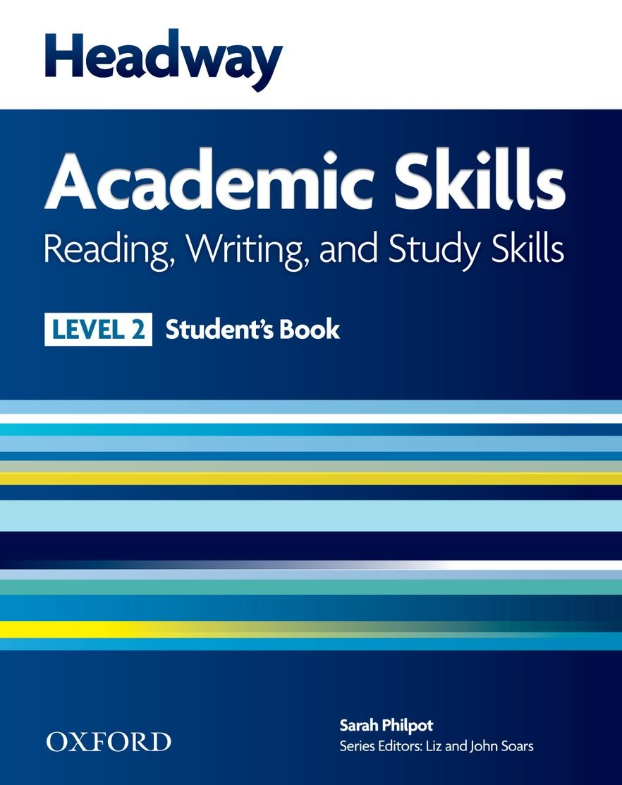
College of Law, Mustansiriyah U. English course for M. A. 2017-2018
Textbook: Headway Academic Skills, Level 2
Author: Sarah Philpot
Instructor:
Asst. Lect. Rania Adnan Aziz

Slide 2
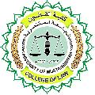
College of Law, Mustansiriyah U. Second Year Course in legal English
2017-2018
Instructor: Asst. Lect. Rania Adnan Aziz
College of Law, Mustansiriyah U. English course for M. A.
2017-2018
Instructor: Asst. Lect. Rania Adnan Aziz
Lecture 06
Unit 1
International Student
REVIEW
As a review, and to get students to talk about themselves or use their personal information for a more realistic exercise, they are required to complete a visa application form using that information (Review Exercise 1).
Review Exercise 2, on the other hand, requires them to use the dictionary to correct the spelling of certain underlined words:
Payed
Bougth
Studing
Advise
Applied
shelfs

Slide 3
College of Law, Mustansiriyah U. Second Year Course in legal English
2017-2018
Instructor: Asst. Lect. Rania Adnan Aziz
College of Law, Mustansiriyah U. English course for M. A.
2017-2018
Instructor: Asst. Lect. Rania Adnan Aziz
Lecture 06
Unit 1
International Student
Continue VOCABULARY DEVELOPMENT Dictionary work
Review Exercise 3 requires students to review the texts and vocabulary in Unit 1 and choose at least five words that are new for them. Then they make word cards for them as a way of practicing dictionary entries.
Some example words include:
Speech,
Technology
Birth
Accommodation
Extensive.

