Slide 1
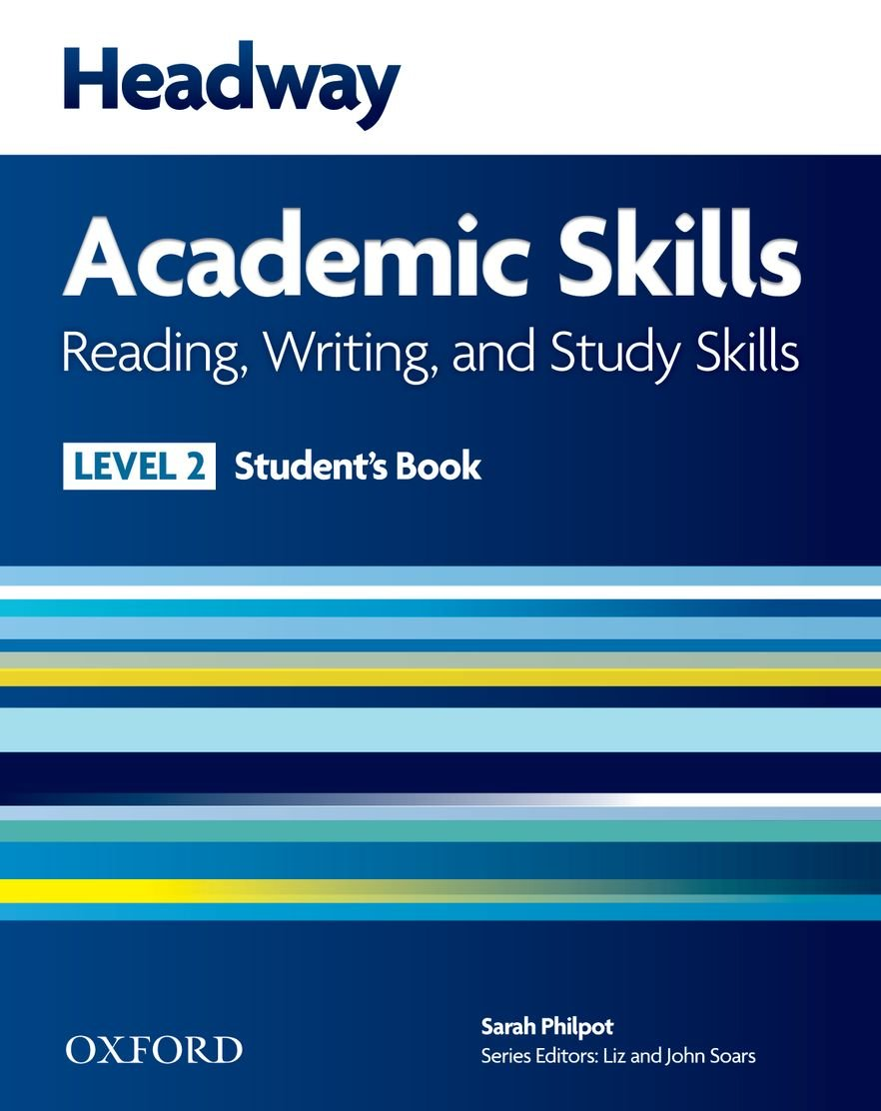
College of Law, Mustansiriyah U. English course for M. A. 2017-2018
Textbook: Headway Academic Skills, Level 2
Author: Sarah Philpot
Instructor:
Asst. Lect. Rania Adnan Aziz

Slide 2
College of Law, Mustansiriyah U. Second Year Course in legal English
2017-2018
Instructor: Asst. Lect. Rania Adnan Aziz
College of Law, Mustansiriyah U. English course for M. A.
2017-2018
Instructor: Asst. Lect. Rania Adnan Aziz
Lecture 05
Unit 1
International Student
VOCABULARY DEVELOPMENT Dictionary work
A dictionary entry: understanding information about a word
Recording vocabulary (1): word cards
Students arrange a number of words in alphabetical order, quickly, and compare to other students’. This works as a warm-up for the next task.

Slide 3
College of Law, Mustansiriyah U. Second Year Course in legal English
2017-2018
Instructor: Asst. Lect. Rania Adnan Aziz
College of Law, Mustansiriyah U. English course for M. A.
2017-2018
Instructor: Asst. Lect. Rania Adnan Aziz
Lecture 05
Unit 1
International Student
Continue VOCABULARY DEVELOPMENT Dictionary work
The instructor provides students with copies of dictionary entries as examples and exercises to get to know the dictionary and how to use it.
The kind of information found in a dictionary entry includes
The part of speech of the word in question (noun, verb, adjective, adverb, preposition)
Stress (which syllable is stressed in a word and how that affects meaning when listening rather than reading)
Pronunciation (how to read phonetic symbols)
Definitions (what the word means)
Example sentences

Slide 4
College of Law, Mustansiriyah U. Second Year Course in legal English
2017-2018
Instructor: Asst. Lect. Rania Adnan Aziz
College of Law, Mustansiriyah U. English course for M. A.
2017-2018
Instructor: Asst. Lect. Rania Adnan Aziz
Lecture 05
Unit 1
International Student
Continue VOCABULARY DEVELOPMENT Dictionary work
It is important at this point to point out that some words have more than one meaning and use. The word match is an example. It may refer to match sticks, marriage, sports event or to find somebody/something that goes together with another person/thing. The same word can be either a noun or a verb. Student are advised to be careful and make sure to use the correct part of the definition.

Slide 5
College of Law, Mustansiriyah U. Second Year Course in legal English
2017-2018
Instructor: Asst. Lect. Rania Adnan Aziz
College of Law, Mustansiriyah U. English course for M. A.
2017-2018
Instructor: Asst. Lect. Rania Adnan Aziz
Lecture 05
Unit 1
International Student
Continue VOCABULARY DEVELOPMENT Dictionary work
To apply what students have learned, Exercise 4 provides them with sentences where certain words are underlines. They must make dictionary entries for these words and identify the different parts of that entry.
The words are:
Chemical
Scan
Punctuation
Dictionary
Biography
literature

