Slide 1
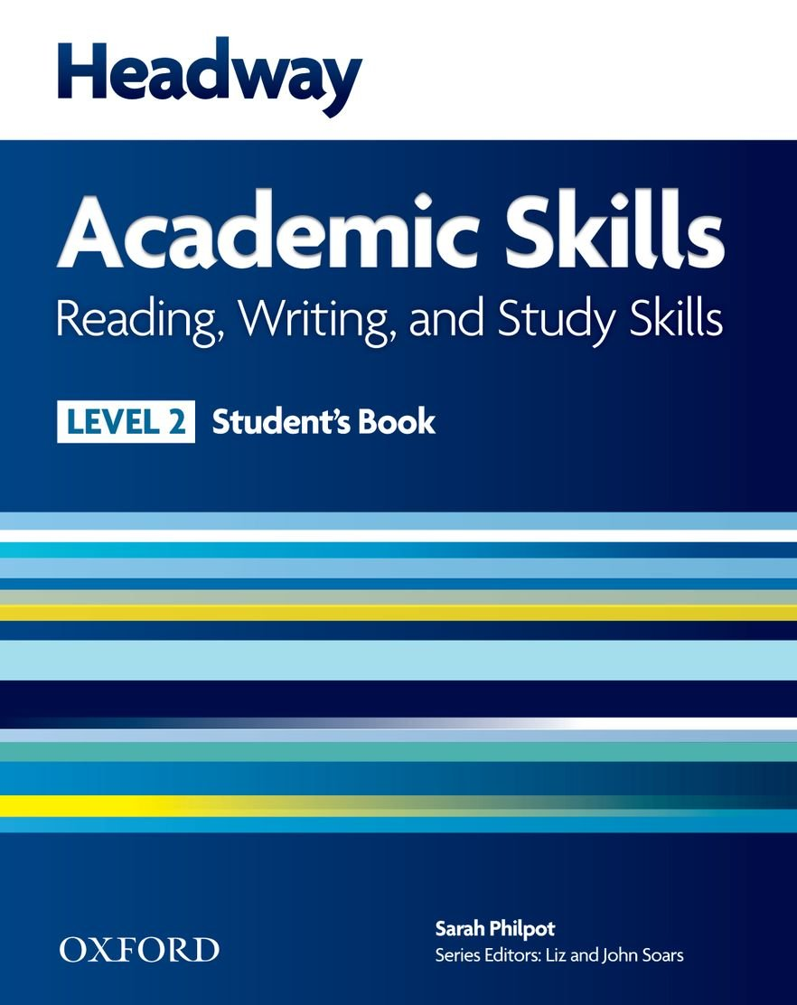
College of Law, Mustansiriyah U. English course for M. A. 2017-2018
Textbook: Headway Academic Skills, Level 2
Author: Sarah Philpot
Instructor:
Asst. Lect. Rania Adnan Aziz

Slide 2
College of Law, Mustansiriyah U. English course for M. A.
2017-2018
Instructor: Asst. Lect. Rania Adnan Aziz
Lecture 04
Unit 1
International Student
WRITING A host family
This section prepares students for life abroad. It includes the information a students might use when writing to a host family and writing (informal) emails.
Exercise 1 contains pieces of information a student is likely to use while living with a host family abroad.
Exercise 2 focuses on spelling and punctuation mistakes by providing an email that contains such mistakes and asking students to identify them and correct them. Through identification and correction, the rules are presented to students and are brought closer to their understanding.

Slide 3
College of Law, Mustansiriyah U. English course for M. A.
2017-2018
Instructor: Asst. Lect. Rania Adnan Aziz
Lecture 04
Unit 1
International Student
Continue WRITING A host family
For example:
Capital letters are used at the beginning of sentences and for proper nouns (names of people, buildings, cities and countries). {Jack, The Empire State, Baghdad, Iraq, }
Full stops are placed at the end of sentences. {Notice the earlier sentence.}
Question marks are placed at the end of questions. {When are we leaving?}
To avoid spelling mistakes, use a dictionary or computer spellchecker to check your spelling. Keep a record of any words that you misspell. Learn the correct spelling.

Slide 4
College of Law, Mustansiriyah U. English course for M. A.
2017-2018
Instructor: Asst. Lect. Rania Adnan Aziz
Lecture 04
Unit 1
International Student
Continue WRITING A host family
In Exercise 4 students write an imaginary informal email to a host family. The email includes the following pieces of information:
Say you accept their offer of a room
Tell them about your studies and hobbies
Give them information about your arrival
Ask for information you would like.
Students check their work and give it to other students to check again.

