Slide 1
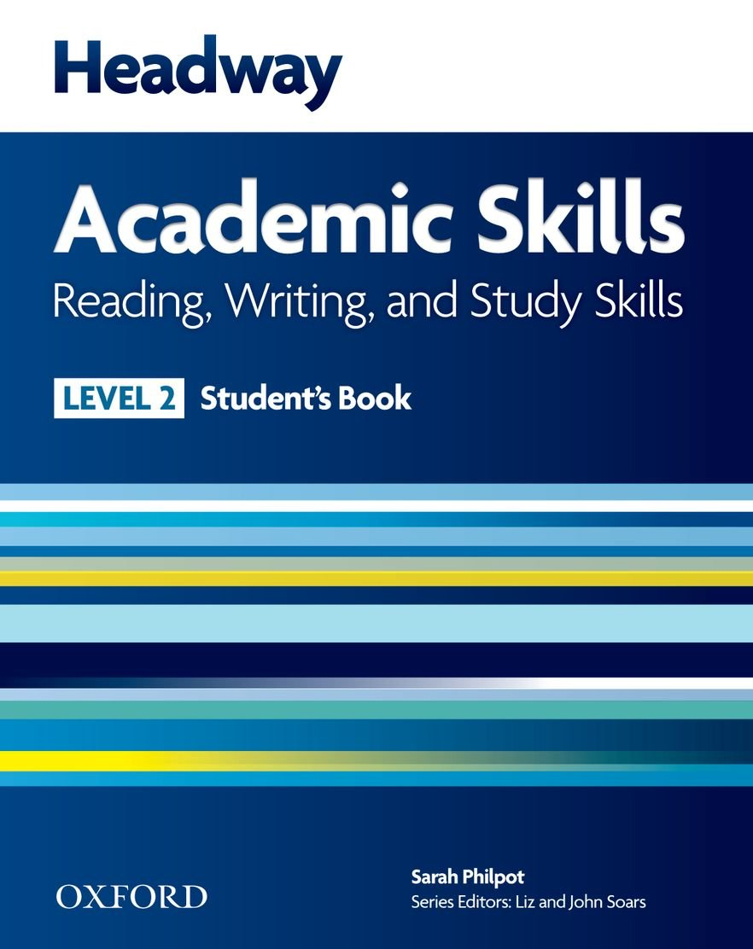

College of Law, Mustansiriyah U.
English course for M. A.
2017-2018
Textbook: Headway Academic Skills, Level 2
Author: Sarah Philpot
Instructor:
Asst. Lect. Rania Adnan Aziz

Slide 2

College of Law, Mustansiriyah U.
English course for M. A.
2017-2018
Instructor: Asst. Lect. Rania Adnan Aziz
Lecture 03
Unit 1
International Student
Continue READING Going abroad to study
As mentioned in the introductory part, the material provided makes use of the students’ personal experiences and attitudes which are reflected in the exercises. Exercise 4, which is a Study Skill, presents students with a form which they fill in using their own personal information.
Exercise 5 requires students to pick the materials they read based on their own experience and reasons. Then, in Exercise 6 they divide the materials into groups: pleasure, work and studies.

Slide 3
College of Law, Mustansiriyah U.
English course for M. A.
2017-2018
Instructor: Asst. Lect. Rania Adnan Aziz
Lecture 03
Unit 1
International Student
Effective Reading
This passage, which may reflect the kind of reading higher studies requires, provides four kinds of reading and describes them and the instances in which they are used. The passage also encourages students to practice these methods and enhance their reading strategies in order to be ore efficient readers. After reading the passage, students answer questions on it. Effective reading includes:

Slide 4
College of Law, Mustansiriyah U.
English course for M. A.
2017-2018
Instructor: Asst. Lect. Rania Adnan Aziz
Lecture 03
Unit 1
International Student
Skimming
Sometimes you will read just to get a general idea of a text. This is skim reading. And it is done as follows: first, identify your reason for reading, for example, to decide whether an article meets your needs or perhaps to understand a writer’s attitude.
Read the text very quickly. Don’t worry about understanding everything. Instead, look at the first and last paragraphs, and the first and last sentences of paragraphs. These often summarize the main points.

Slide 5
College of Law, Mustansiriyah U.
English course for M. A.
2017-2018
Instructor: Asst. Lect. Rania Adnan Aziz
Lecture 03
Unit 1
International Student
Scanning
Sometimes you will read quickly to find certain pieces of information, for example, a statistic a date, a person’s name (as when checking for your admission acceptance), or the name of a place. Again, you do not need to read every word ; scan the text using a finger or a pencil to move quickly through the words.

Slide 6
College of Law, Mustansiriyah U.
English course for M. A.
2017-2018
Instructor: Asst. Lect. Rania Adnan Aziz
Lecture 03
Unit 1
International Student
Intensive reading
In this strategy you red for every detail, for example, a description of a process, the results of a scientific study, or a set literature text. To do this, take your time. Stop and think about what you are reading. You may also need to read the text more than one in order to better understand it, make notes or highlight important points. This method is also called study reading.

Slide 7
College of Law, Mustansiriyah U.
English course for M. A.
2017-2018
Instructor: Asst. Lect. Rania Adnan Aziz
Lecture 03
Unit 1
International Student
Extensive reading
Sometimes you will read for pleasure; perhaps as extra research or purely for interest. You may concentrate, but you don’t have to worry about detail

