Slide 1
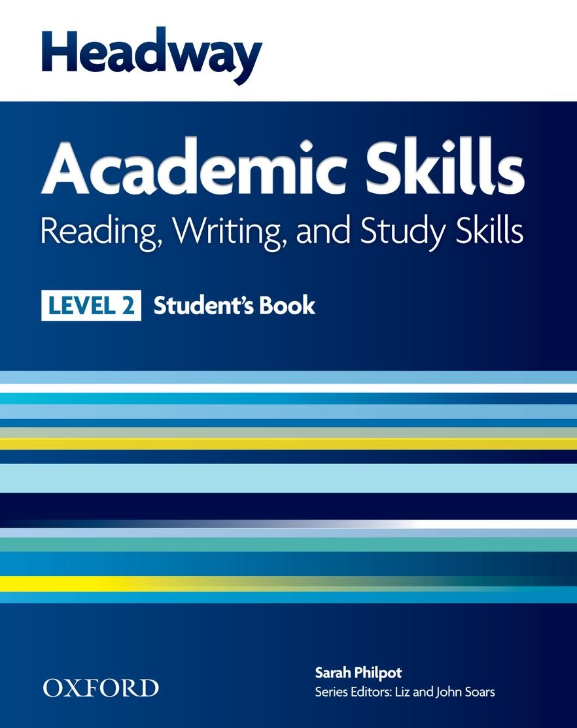
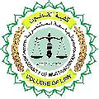
College of Law, Mustansiriyah U. English course for M. A. 2017-2018
Textbook: Headway Academic Skills, Level 2
Author: Sarah Philpot
Instructor:
Asst. Lect. Rania Adnan Aziz

Slide 2
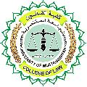
College of Law, Mustansiriyah U. English course for M. A.
2017-2018
Instructor: Asst. Lect. Rania Adnan Aziz
Lecture 02
Unit 1
International Student
In this unit, students will see the world from an international student’s standpoint and will learn and practice language based on that. The skills targeted in this unit are READING, WRITING and VOCABULARY DEVELOPMENT.

Slide 3
College of Law, Mustansiriyah U. English course for M. A.
2017-2018
Instructor: Asst. Lect. Rania Adnan Aziz
Lecture 02
Unit 1
International Student
READING Going abroad to study
Following instructions: Filling in forms
Reading methods: skim, scan, intensive reading, extensive reading
This section presents personal information, such as name, address and grades, that appears on documents. Exercise 1 requires students to relate different pieces of information to the appropriate document, which might be a birth certificate or a driving licence.

Slide 4
College of Law, Mustansiriyah U. English course for M. A.
2017-2018
Instructor: Asst. Lect. Rania Adnan Aziz
Lecture 02
Unit 1
International Student
Exercise 2 provides different examples of documents: a passport, a formal letter, an informal letter and an exam certificate. Students take a look at them and try to label them based on the information they find in them. More importantly, they are confronted with formal and informal letters which they are required to distinguish by identifying the nature of the language used by the addresser to the addressee.
After finishing that part, students answer different question based on what they understand from the documents.

