Slide 1
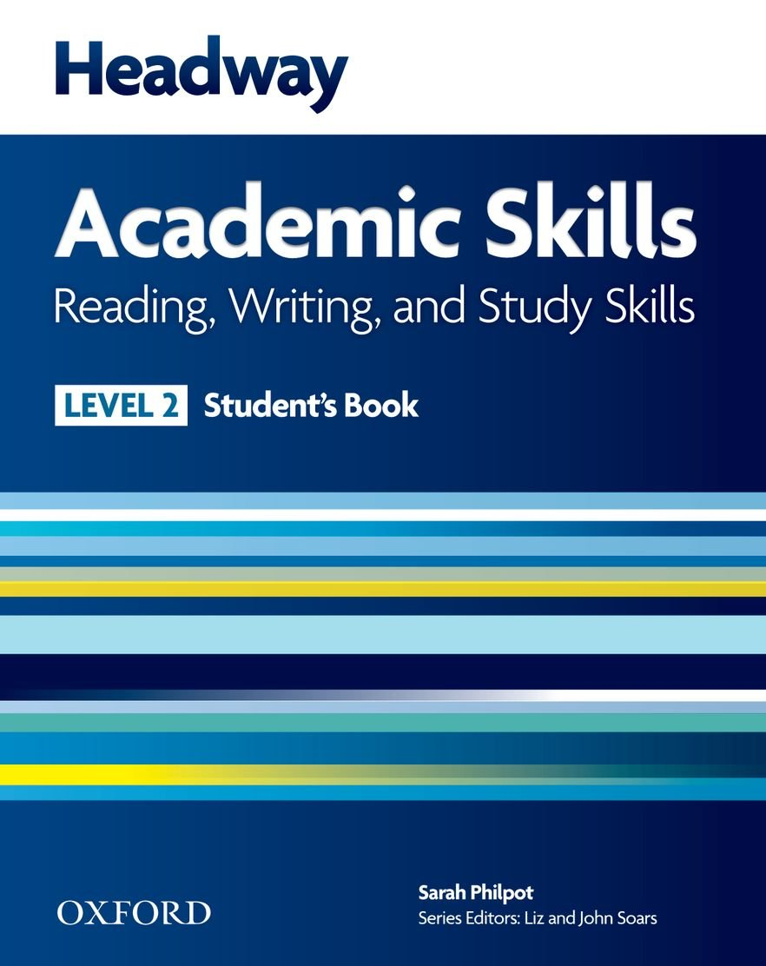
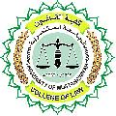
College of Law, Mustansiriyah U.
English course for M. A.
2017-2018
Textbook: Headway Academic Skills, Level 2
Author: Sarah Philpot
Instructor:
Asst. Lect. Rania Adnan Aziz

Slide 2
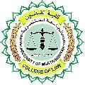
College of Law, Mustansiriyah U.
English course for M. A.
2017-2018
Instructor: Asst. Lect. Rania Adnan Aziz
Lecture 01 Introduction
This is an orientation. The lecture introduces the textbook to students and explains the nature of the material in this book and how students will deal with them. It is important at this point to explicate to students the differences between the book of this level and books of other levels in this series, or even books other than of this series.

Slide 3
College of Law, Mustansiriyah U.
English course for M. A.
2017-2018
Instructor: Asst. Lect. Rania Adnan Aziz
Lecture 01 Introduction
Nature of the book
This book, Headway Academic Skills Level 2, is a course that teaches students at higher education the necessary skills for better academic performance. It aims at improving primary linguistic skills: reading, writing. The course gives guidance in key study areas and provides a lot of practice so as to encourage learner independence. In addition to these primary skills, the course is also designed to develop students’ study skills.
One of the features of this book is that it some of its exercises are designed to incorporate students’ opinions, tastes and habits in order to give the contents a more interesting and realistic flavor.

Slide 4
College of Law, Mustansiriyah U.
English course for M. A.
2017-2018
Instructor: Asst. Lect. Rania Adnan Aziz
Lecture 01 Introduction
Contents of the book
The book contains 10 units, each includes parts on reading, writing, vocabulary development and research. The material is designed to involve students through the topics that appear in each unit and the exercises that reinforce the information learned.

