Slide 1
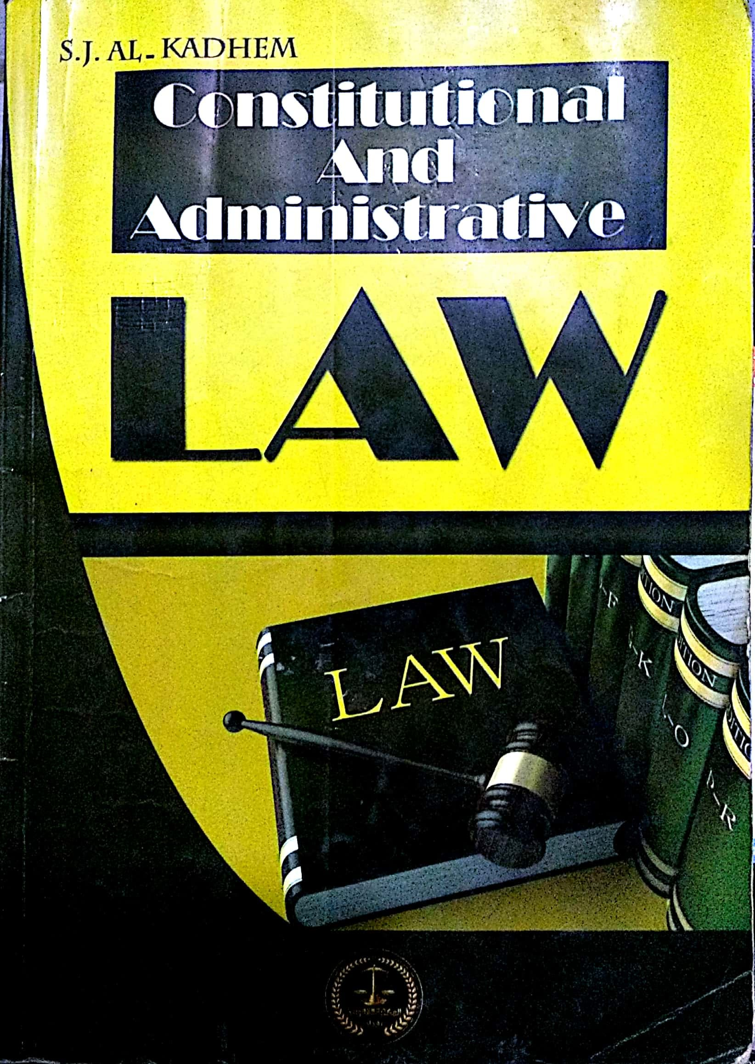
College of Law, Mustansiriyah U. Second Year Course in legal English 2017-2018
Textbook: Constitutional and Administrative Law
Author: S. J. Al-Kadhem
Instructor:
Asst. Lect. Rania Adnan Aziz

Slide 2
College of Law, Mustansiriyah U. Second Year Course in legal English
2017-2018
Instructor: Asst. Lect. Rania Adnan Aziz
Lecture 10 Part One: Constitutional Law
Chapter Four
Contents of Constitution
Preamble
A preamble, which is found in most constitutions, narrates the steps by which the constitution has come to be passed. It also enumerates the general principles and aims which have inspired the makers concerned to draw up the constitution.

Slide 3
College of Law, Mustansiriyah U. Second Year Course in legal English
2017-2018
Instructor: Asst. Lect. Rania Adnan Aziz
Lecture 10 Part One: Constitutional Law
Chapter Four
Contents of Constitution
There are differences of opinion on the legal value of the preamble.
Some constitutional writers say that a preamble to a constitution is not itself part of the constitution. It is, therefore, part of the law. It has just a moral value.
Others maintain that the preamble is an integral part of the constitution. It acts as a restraint on those who exercise legislative or executive power. It also binds the authorities concerned to pursue certain economic and social policies.

Slide 4
College of Law, Mustansiriyah U. Second Year Course in legal English
2017-2018
Instructor: Asst. Lect. Rania Adnan Aziz
Lecture 10 Part One: Constitutional Law
Chapter Four
Contents of Constitution
Some of the important/new words and terms that appear in this section
preamble
narrate
steps
Be passed
enumerate
aims
moral
Draw up
restraint
exercise
value
policies
pursue

