Slide 1
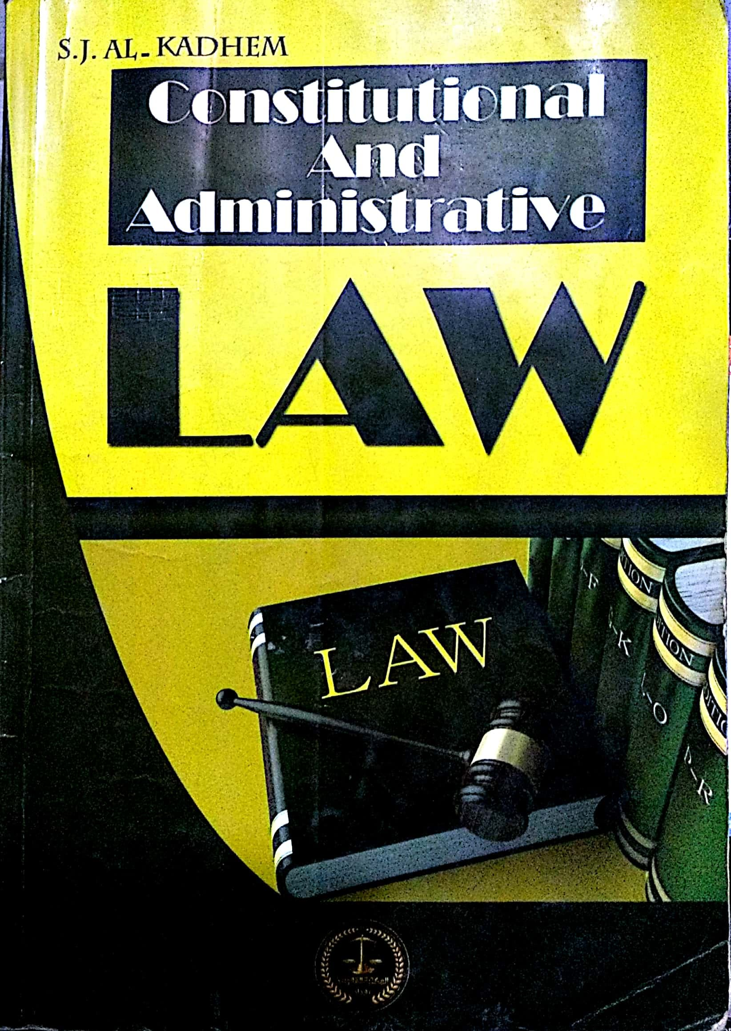
College of Law, Mustansiriyah U. Second Year Course in legal English 2017-2018
Textbook: Constitutional and Administrative Law
Author: S. J. Al-Kadhem
Instructor:
Asst. Lect. Rania Adnan Aziz

Slide 2
College of Law, Mustansiriyah U. Second Year Course in legal English
2017-2018
Instructor: Asst. Lect. Rania Adnan Aziz
Lecture 09 Part One: Constitutional Law
Chapter Four
Contents of Constitution
Directive principles of state policy
A considerable number of constitutions contain directive principles of state policy. These principles set out the economic, social and political goals of the constitutional system concerned.
They also impose certain obligations on the state to take positive action in certain directions. They aim to promote the welfare of the people and achieve social democracy.

Slide 3
College of Law, Mustansiriyah U. Second Year Course in legal English
2017-2018
Instructor: Asst. Lect. Rania Adnan Aziz
Lecture 09 Part One: Constitutional Law
Chapter Four
Contents of Constitution
Examples of directive principles
1- all citizens, irrespective of sex, equally have the right to an adequate means of livelihood
2- equality of opportunity is guaranteed to all citizens
3- equal pay for equal work for both men and women
4- the right to work, education and public assistance in cases of unemployment, old age, sickness and disablement is secured.

Slide 4
College of Law, Mustansiriyah U. Second Year Course in legal English
2017-2018
Instructor: Asst. Lect. Rania Adnan Aziz
Lecture 09 Part One: Constitutional Law
Chapter Four
Contents of Constitution
Some of the important/new words and terms that appear in this section
directive
considerable
Set out
unemployment
irrespective
adequate
secured
equally
means
pay
disablement
opportunity
livelihood
assistance
guaranteed
citizens

