Slide 1
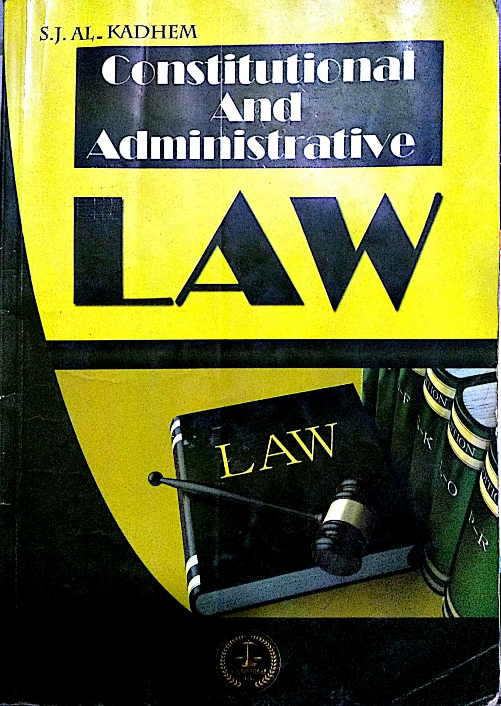

College of Law, Mustansiriyah U.
Second Year Course in legal English
2017-2018
Textbook: Constitutional and Administrative Law
Author: S. J. Al-Kadhem
Instructor:
Asst. Lect. Rania Adnan Aziz

Slide 2

College of Law, Mustansiriyah U.
Second Year Course in legal English
2017-2018
Instructor: Asst. Lect. Rania Adnan Aziz
Lecture 08 Part One: Constitutional Law
Chapter Four
Contents of Constitution
Different attitudes
A- There are those who regard the constitution as primarily and exclusively legal document that should be confined to rules of law.
B- Others think of the constitution as consecration of political ideas held by a political leadership. These ideas should be the main, if not only, content of constitution.
Legal document
Political ideas
Contents of constitution

Slide 3
College of Law, Mustansiriyah U.
Second Year Course in legal English
2017-2018
Instructor: Asst. Lect. Rania Adnan Aziz
Lecture 08 Part One: Constitutional Law
Chapter Four
Contents of Constitution
Classical and modern constitutions
In practice, most of the classical constitutions contain mainly rules of law. Modern constitutions, on the other hand, contain statements of political ends.
These statements, it is said, are either not strictly constitutional by nature or, if they are, not really law; i.e. they are non-justiciable.

Slide 4
College of Law, Mustansiriyah U.
Second Year Course in legal English
2017-2018
Instructor: Asst. Lect. Rania Adnan Aziz
Lecture 08 Part One: Constitutional Law
Chapter Four
Contents of Constitution
Some of the important/new words and terms that appear in this section
ends
statements
classical
inserted
consecration
confined
exclusively
attitudes
contents
non-justiciable

