Slide 1
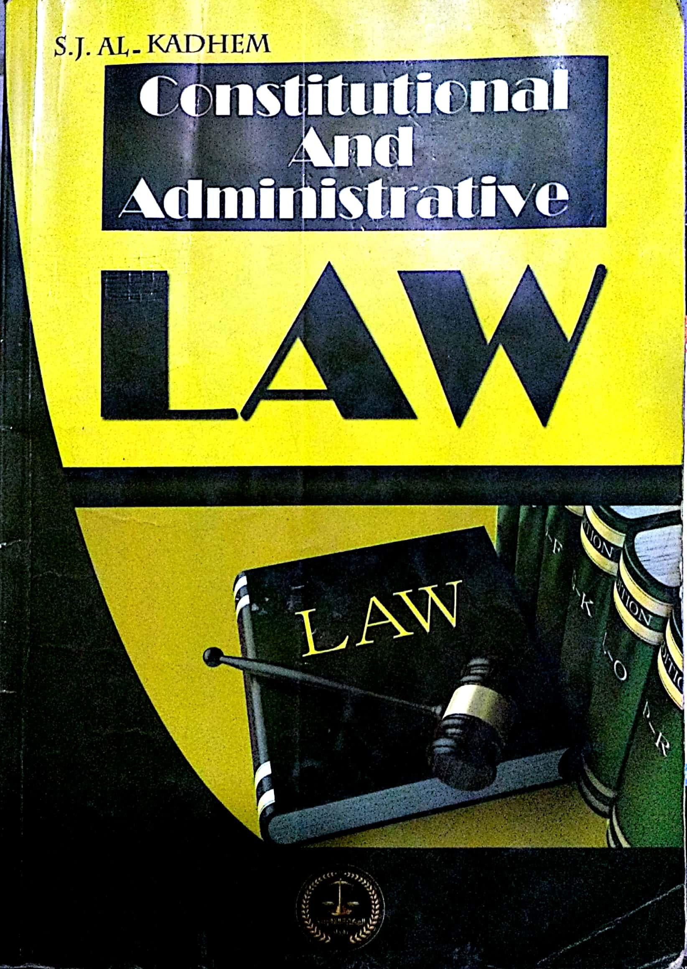
College of Law, Mustansiriyah U. Second Year Course in legal English 2017-2018
Textbook: Constitutional and Administrative Law
Author: S. J. Al-Kadhem
Instructor:
Asst. Lect. Rania Adnan Aziz

Slide 2
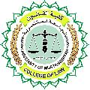
College of Law, Mustansiriyah U. Second Year Course in legal English
2017-2018
Instructor: Asst. Lect. Rania Adnan Aziz
Lecture 07 Part One: Constitutional Law
Chapter Three
The Making of Constitution
3- Constituent power
A constitution is usually framed by a constituent power which may be embodied in a person, committee or assembly.
Person
Assembly
Committee
Constituent power

Slide 3
College of Law, Mustansiriyah U. Second Year Course in legal English
2017-2018
Instructor: Asst. Lect. Rania Adnan Aziz
Lecture 07 Part One: Constitutional Law
Chapter Three
The Making of Constitution
A- A person holding political power may make the constitution which defines the procedure under which the various organs of the state discharge their functions.
B- A committee composed of a number of persons ruling the country may also draw up a constitution.
C- An assembly of empowered representatives elected by the people may be assigned the task of framing and adopting the constitution.

Slide 4
College of Law, Mustansiriyah U. Second Year Course in legal English
2017-2018
Instructor: Asst. Lect. Rania Adnan Aziz
Lecture 07 Part One: Constitutional Law
Chapter Three
The Making of Constitution
4- Constitution by grant
In certain circumstances, constitutions appear as though they’ve been given or granted to subjects by kings, emperors or princes.
The years 1818-1931 witnessed the declaration of similar constitutions in various places such as Italy, Japan, Monaco, Bavaria and Ethiopia.

Slide 5
College of Law, Mustansiriyah U. Second Year Course in legal English
2017-2018
Instructor: Asst. Lect. Rania Adnan Aziz
Lecture 07 Part One: Constitutional Law
Chapter Three
The Making of Constitution
5- Contract theory
According o this theory, a compact is made between the subjects and the monarch to restrict the latter‘s unlimited powers.

Slide 6
College of Law, Mustansiriyah U. Second Year Course in legal English
2017-2018
Instructor: Asst. Lect. Rania Adnan Aziz
Lecture 07 Part One: Constitutional Law
Chapter Three
The Making of Constitution
Some of the important/new words and terms that appear in this section
monarch
Constituent power
embodied
Committee
assembly
procedures
provisional
restrict
composed
representative
assigned
subjects
grant
witnessed
unlimited
Contract theory

