Slide 1
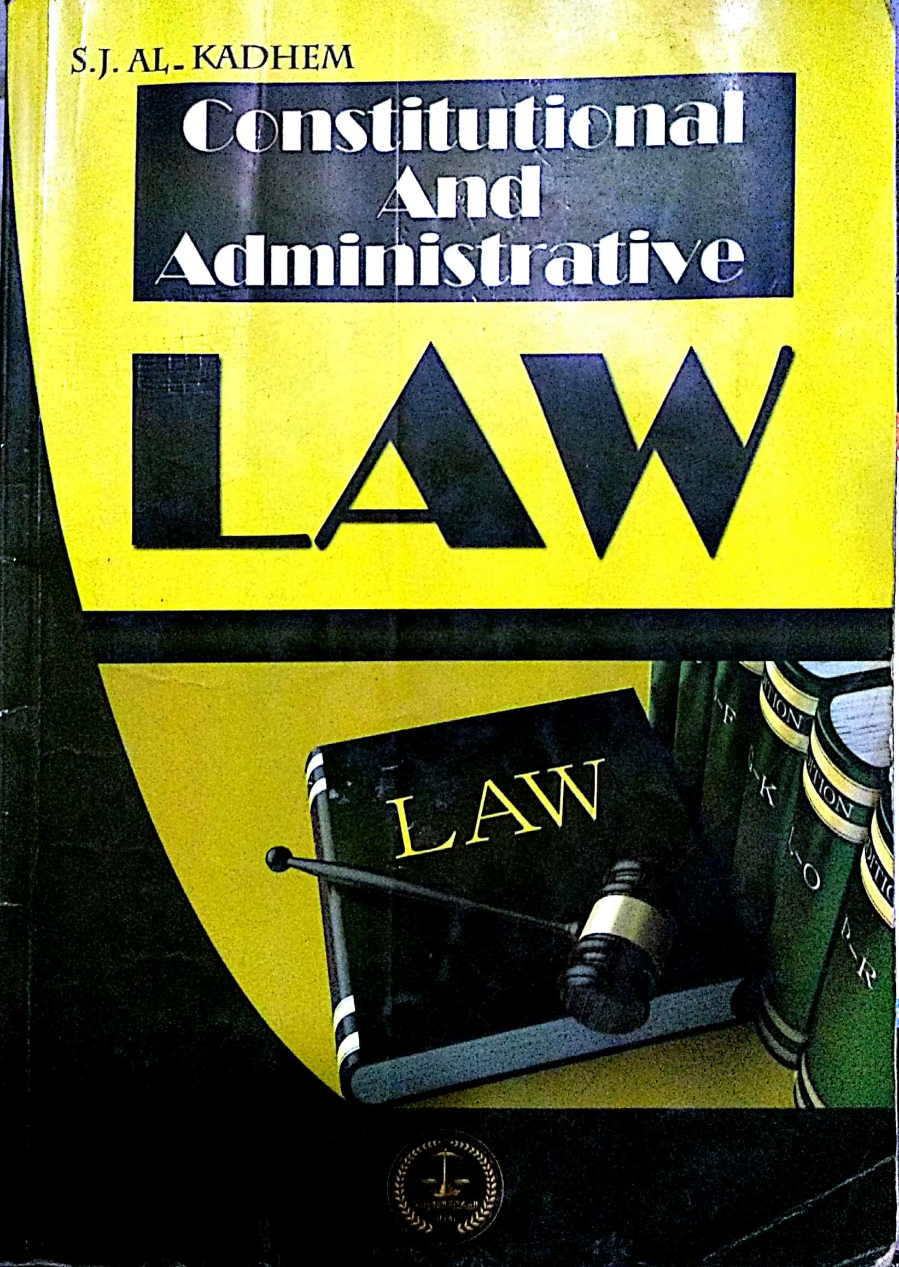

College of Law, Mustansiriyah U.
Second Year Course in legal English
2017-2018
Textbook: Constitutional and Administrative Law
Author: S. J. Al-Kadhem
Instructor:
Asst. Lect. Rania Adnan Aziz

Slide 2

College of Law, Mustansiriyah U.
Second Year Course in legal English
2017-2018
Instructor: Asst. Lect. Rania Adnan Aziz
Lecture 06 Part One: Constitutional Law
Chapter Three
The Making of Constitution
There are different ways by which a constitution comes into being. They are summarized in the diagram below.
Emergence of new state
Constitution by grant
Contract theory
Constituent power
Change of political regime
Making of Constitution

Slide 3
College of Law, Mustansiriyah U.
Second Year Course in legal English
2017-2018
Instructor: Asst. Lect. Rania Adnan Aziz
Lecture 06 Part One: Constitutional Law
Chapter Three
The Making of Constitution
1- Emergence of new state
A newly emergent state requires a constitution that defines its nature, goals and structure. Though the very emergence of a new state does not depend on the existence of a prior constitution, such state cannot carry on indefinitely without a constitution. In this case, the constitution may take the form of declarations or decrees, also known as de facts constitution.

Slide 4
College of Law, Mustansiriyah U.
Second Year Course in legal English
2017-2018
Instructor: Asst. Lect. Rania Adnan Aziz
Lecture 06 Part One: Constitutional Law
Chapter Three
The Making of Constitution
2- Change of political regime
A change of a political regime by a revolution or a coup d'état is usually followed by a change of constitution. This change may not immediate. The authority may retain, fully or partly, the prior constitution.

Slide 5
College of Law, Mustansiriyah U.
Second Year Course in legal English
2017-2018
Instructor: Asst. Lect. Rania Adnan Aziz
Lecture 06 Part One: Constitutional Law
Chapter Three
The Making of Constitution
Some of the important/new words and terms that appear in this section
de facts constitution
replaced
emergence
coup d'état
require
prior
define
depend
carry on
authority
indefinitely
revolution
declarations

