Slide 1
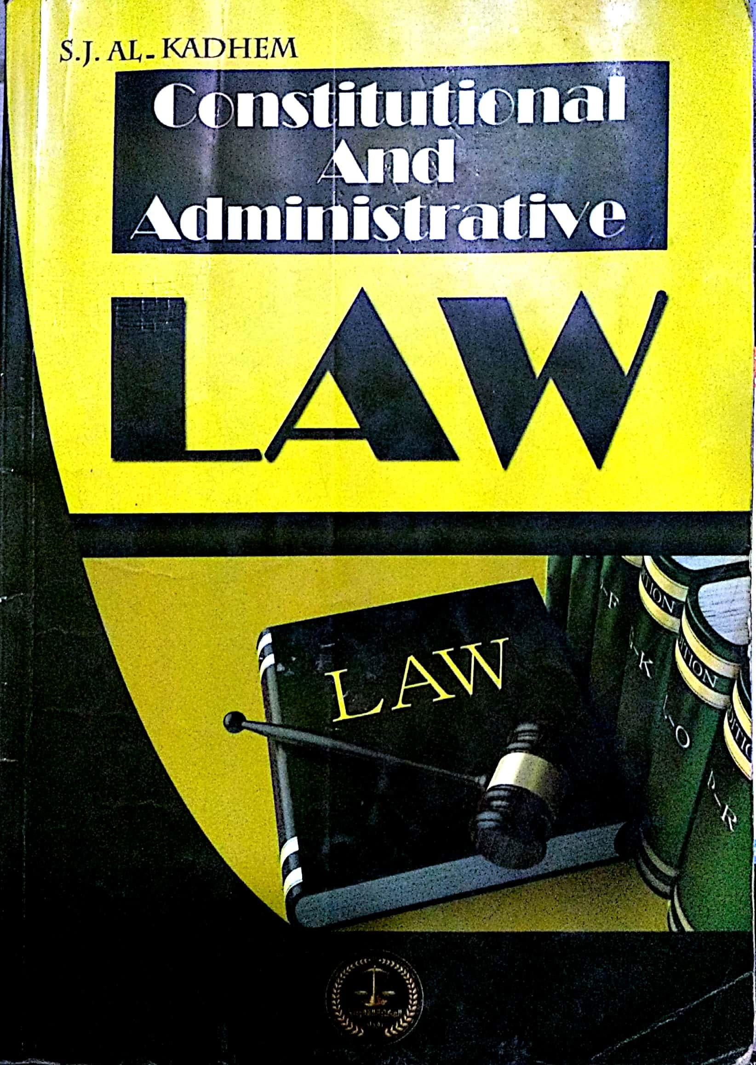
College of Law, Mustansiriyah U. Second Year Course in legal English 2017-2018
Textbook: Constitutional and Administrative Law
Author: S. J. Al-Kadhem
Instructor:
Asst. Lect. Rania Adnan Aziz

Slide 2
College of Law, Mustansiriyah U. Second Year Course in legal English
2017-2018
Instructor: Asst. Lect. Rania Adnan Aziz
Lecture 05 Part One: Constitutional Law
Chapter Two
Sources of Constitutional Law
Sources of Constitutional Law
Legislation
Conventions
Judicial Interpretation

Slide 3
College of Law, Mustansiriyah U. Second Year Course in legal English
2017-2018
Instructor: Asst. Lect. Rania Adnan Aziz
Lecture 05 Part One: Constitutional Law
Chapter Two
Sources of Constitutional Law
3- Convention
Conventions are defined as a mixture of rules based on custom and expediency. They are implemented to supplement the framework of the constitution.
Constitutional conventions arise from two main sources:
A- a course of conduct may continue over a long period of time ultimately becoming obligatory; i.e. a convention
B- people may agree among themselves to adopt a particular rule of conduct. Such rule is a convention.
The first kind stems from custom while the second from agreement.

Slide 4
College of Law, Mustansiriyah U. Second Year Course in legal English
2017-2018
Instructor: Asst. Lect. Rania Adnan Aziz
Lecture 05 Part One: Constitutional Law
Chapter Two
Sources of Constitutional Law
3- Convention
Constitutional conventions have been described as non-legal rules. They are non-legal because rules do not apply them and rules because they are binding and are observed in practice.
There are three main ways in which these rules operate:
1- they may nullify a provision of the constitution without formally abolishing it
2- transforming powers granted in the constitution from one person to another
3- supplementing a constitutional provision.

Slide 5
College of Law, Mustansiriyah U. Second Year Course in legal English
2017-2018
Instructor: Asst. Lect. Rania Adnan Aziz
Lecture 05 Part One: Constitutional Law
Chapter Two
Sources of Constitutional Law
Some of the important/new words and terms that appear in this section
conventions
custom
expediency
practice
mixture
ultimately
Course of conduct
obligatory
nullify
binding
adopt
transform

