Slide 1
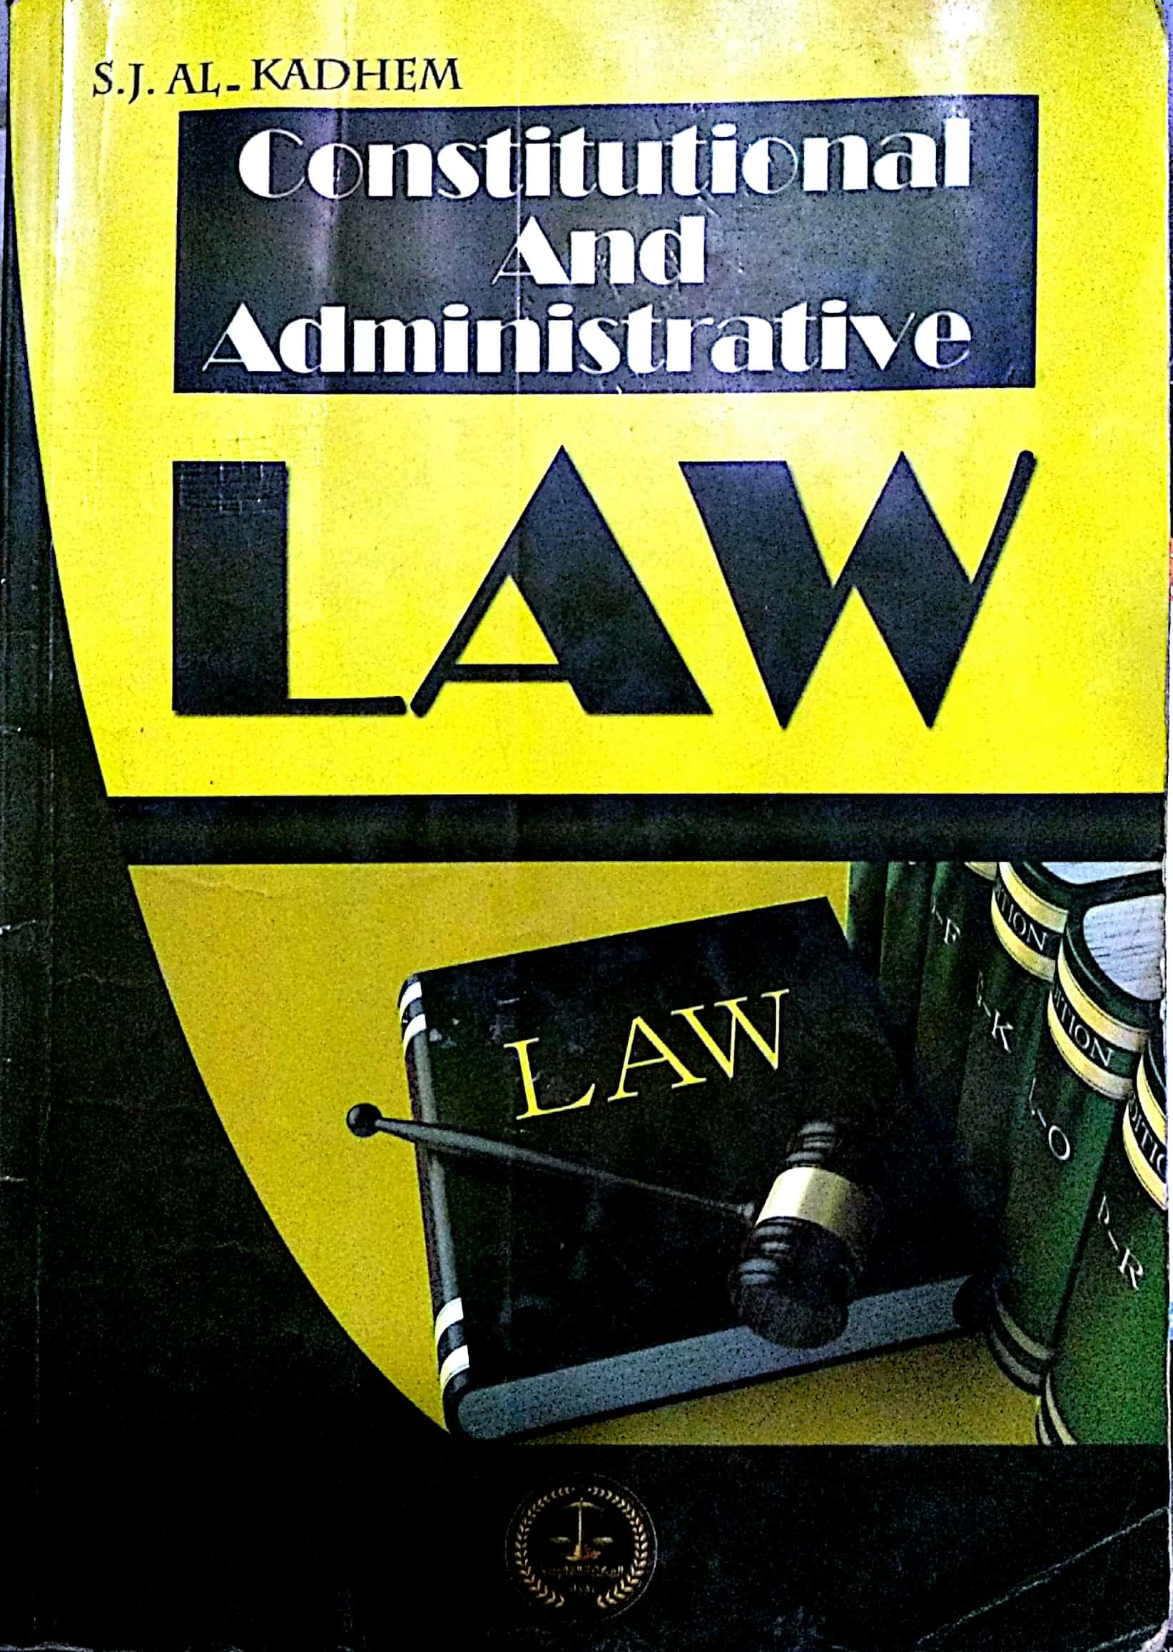

College of Law, Mustansiriyah U.
Second Year Course in legal English
2017-2018
Textbook: Constitutional and Administrative Law
Author: S. J. Al-Kadhem
Instructor:
Asst. Lect. Rania Adnan Aziz

Slide 2

College of Law, Mustansiriyah U.
Second Year Course in legal English
2017-2018
Instructor: Asst. Lect. Rania Adnan Aziz
Lecture 03 Part One: Constitutional Law
Chapter One
Nature of Constitutional Law
Changing law
The constitution cannot remain unchanged due to the changing nature of society. Changes in constitution are brought about by amendment of abrogation.
Either way, the change is simply an echo of social and political change.
Amendment
Or
Abrogation
Reasons
Either political
Or
Social
Methods
Constitutional Change

Slide 3
College of Law, Mustansiriyah U.
Second Year Course in legal English
2017-2018
Instructor: Asst. Lect. Rania Adnan Aziz
Lecture 03 Part One: Constitutional Law
Chapter One
Nature of Constitutional Law
Programmatic law
The constitution usually confirms existing rules enshrined in it. In so doing, it deals with the present.
It may, however, declare certain aims or stipulate standards that are for the time being unrealizable. In this case, it deals with the future.

Slide 4
College of Law, Mustansiriyah U.
Second Year Course in legal English
2017-2018
Instructor: Asst. Lect. Rania Adnan Aziz
Lecture 03 Part One: Constitutional Law
Chapter One
Nature of Constitutional Law
Fundamental law
The constitution of a state is its fundamental and supreme law. This supremacy has several important effects.
No act, whether executive, judicial, or legislative, contrary to the constitution can stand.
It is under this fundamental law that all laws are made and executed.
The constitution conditions the whole governmental process.
It cannot be overridden by any governmental organ.
A written constitution cannot be changed by ordinary process. It can be amended only by following a special procedure.

Slide 5
College of Law, Mustansiriyah U.
Second Year Course in legal English
2017-2018
Instructor: Asst. Lect. Rania Adnan Aziz
Lecture 03 Part One: Constitutional Law
Chapter One
Nature of Constitutional Law
Some of the important/new words and terms that appear in this section
essence
dominant
operate
vacuum
executive
affect
isolation
interests
programmatic
abrogation
amendment
supreme

