Slide 1
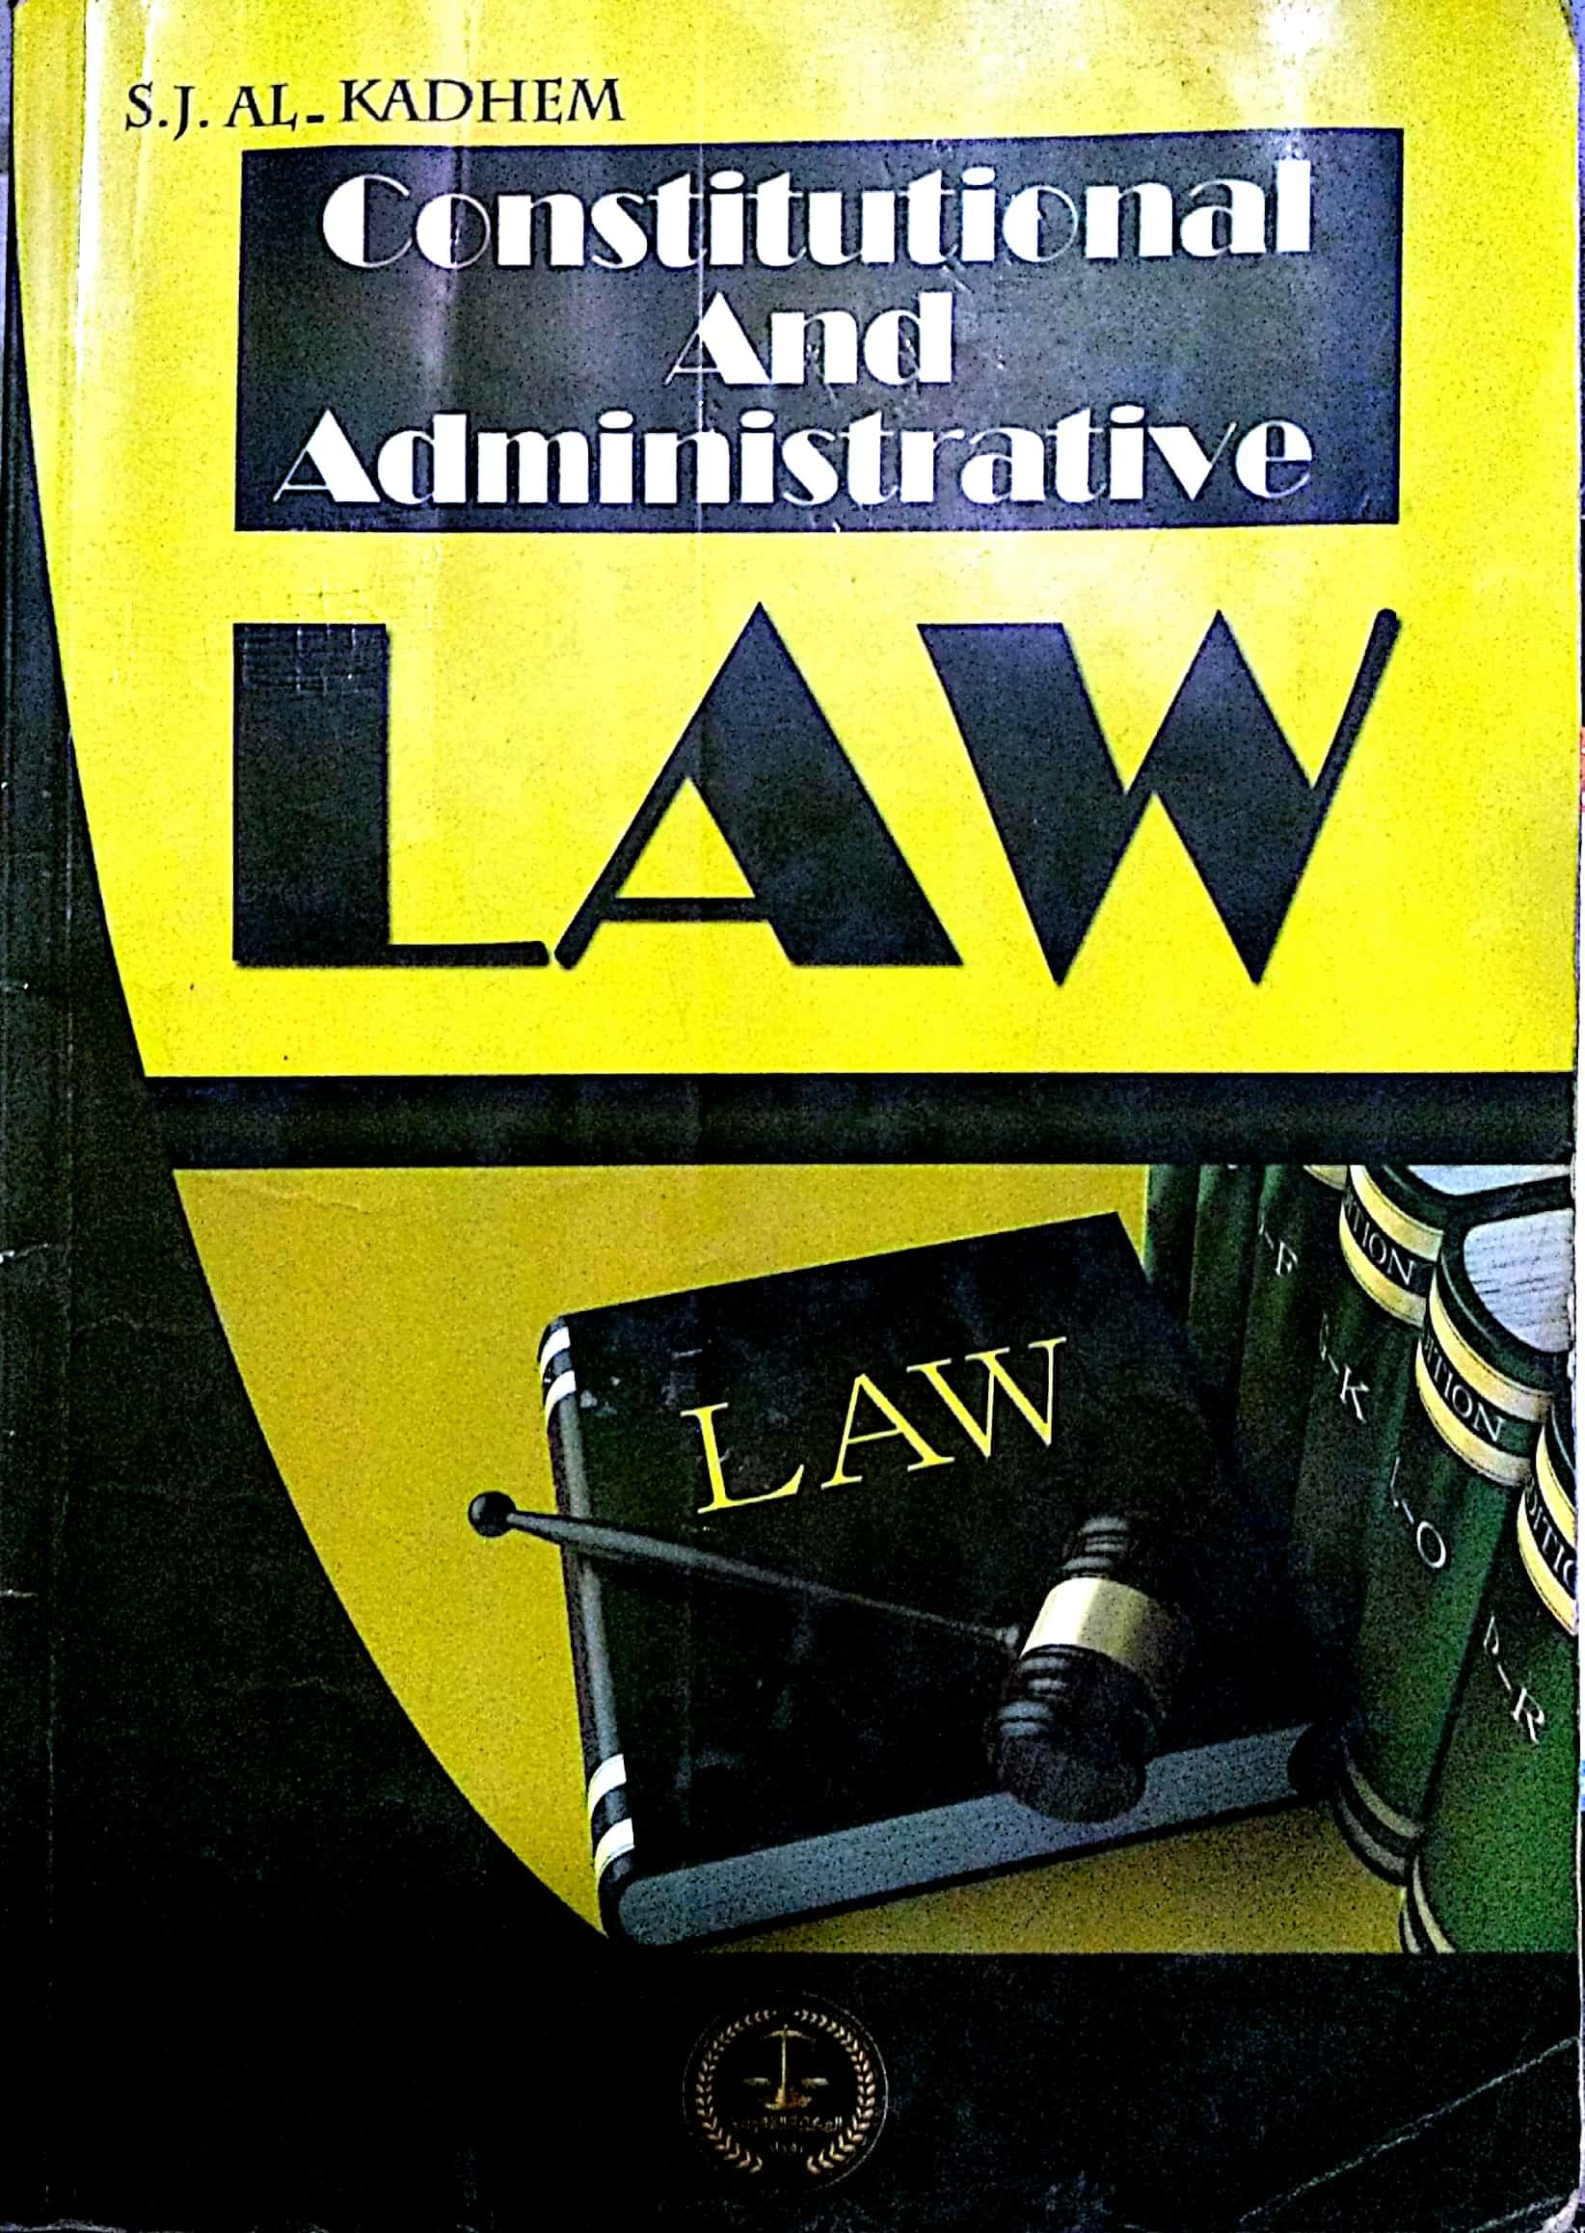

College of Law, Mustansiriyah U.
Second Year Course in legal English
2017-2018
Textbook: Constitutional and Administrative Law
Author: S. J. Al-Kadhem
Instructor:
Asst. Lect. Rania Adnan Aziz

Slide 2

College of Law, Mustansiriyah U.
Second Year Course in legal English
2017-2018
Instructor: Asst. Lect. Rania Adnan Aziz
Lecture 02 Part One: Constitutional Law
Chapter One
Nature of Constitutional Law
In this chapter students are introduced to the concept of constitutional law and the main characteristics of this law. The chapter includes:
Definition
Universal phenomenon
Essence of constitutional rules
Changing law
Programmatic law
Fundamental law

Slide 3
College of Law, Mustansiriyah U.
Second Year Course in legal English
2017-2018
Instructor: Asst. Lect. Rania Adnan Aziz
Lecture 02 Part One: Constitutional Law
Chapter One
Nature of Constitutional Law
Definition
The term constitution is defined in three different ways. It can be said that the term is used in three different senses (click to activate diagram).
It is used to denote a collection of rules which establish and regulate the government of a country.
It may be used to mean a document having a special legal sanctity.
It can also indicate the fundamental law of state.
LAW
Collection of rules
Fundamental law
Document having legal sanctity

Slide 4
College of Law, Mustansiriyah U.
Second Year Course in legal English
2017-2018
Instructor: Asst. Lect. Rania Adnan Aziz
Lecture 02 Part One: Constitutional Law
Chapter One
Nature of Constitutional Law
One of the main characteristics of constitution is its being universal. Nearly every state has its constitution; which maybe of one kind or another. Even though a state may not have a constitution as a single coherent document, there is an aggregate of rules establishing the principles of social and state systems. These rules form a constitution.
A SINGLE DOCUMENT
CONSTITUTION HAS TWO FORMS
AN AGGREGATE OF RULES

Slide 5
College of Law, Mustansiriyah U.
Second Year Course in legal English
2017-2018
Instructor: Asst. Lect. Rania Adnan Aziz
Lecture 02 Part One: Constitutional Law
Chapter One
Nature of Constitutional Law
Essence of constitutional rules
Constitutional rules may be written or unwritten. They are no merely formal legal rules. They reflect the will, interests and aspirations of the dominant social and political forces. Constitutional rules do not operate in vacuum. They are part of the whole socio-political system of a country.
In other words, they should be considered within the context of the political system I which they are set and the politics in which they operate.

Slide 6
College of Law, Mustansiriyah U.
Second Year Course in legal English
2017-2018
Instructor: Asst. Lect. Rania Adnan Aziz
Lecture 02 Part One: Constitutional Law
Chapter One
Nature of Constitutional Law
Some of the important/new words and terms that appear in this section
document
denote
fundamental
regulate
phenomenon
constitution
Sanctity
collection
aggregate
framework

