Slide 1
College of Law, Al-Mustansiriyah U.
Fourth Year Course in Mercantile Contracts
2016-2017
Lecture #0: Orientation
General Description of the Course

Slide 2
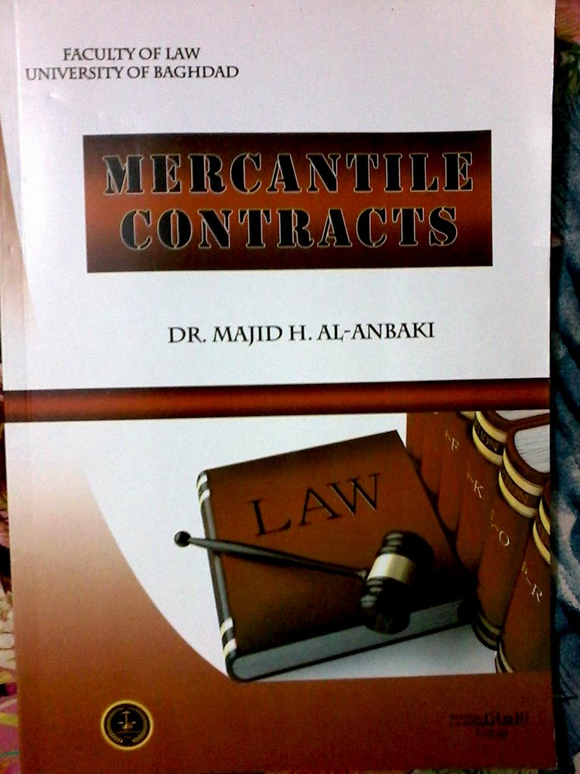
Textbook Info
Title: Mercantile Contracts
Author:
Dr. Majid H. Al-Anbaki,
Faculty of Law, U of Baghdad.
Publisher: Al-Aatic

Slide 3
General Description of the Course
The book is divided into five chapters each discussing a different topic within the domain of mercantile contracts.
The course includes legal material presented to students in English whereby they learn legal concepts related to what they study in college.

Slide 4
The activities include reading material by instructor and students, discussing the legal concepts found in each lecture and explaining the meaning of words that appear throughout the book.
The course also includes oral exams, reading exams and pop quizzes, given by instructor, for which students are awarded participation and extra points.

