Slide 1
Microbial genetics
Three grade lec. 7

Slide 2
Conjugation
High-frequency recombination cell
A high-frequency recombination cell (also called an Hfr strain) is a bacterium with a conjugative plasmid (often the F-factor) integrated into its genomic DNA. The Hfr strain was first characterized by Luca Cavalli-Sforza. Unlike a normal F+ cell, Hfr strains will, upon conjugation with a F− cell, attempt to transfer their entire DNA through the mating bridge, not to be confused with the pilus. This occurs because the F factor has integrated itself via an insertion point in the bacterial chromosome. Due to the F factor's inherent tendency to transfer itself during conjugation, the rest of the bacterial genome is dragged along with it, thus making such cells very useful and interesting in terms of studying gene linkage and recombination. Because the genome's rate of transfer through the mating bridge is constant, molecular biologists and geneticists can use Hfr strain of bacteria (often E. coli) to study genetic linkage and map the chromosome. The procedure commonly used for this is called interrupted mating.

Slide 3
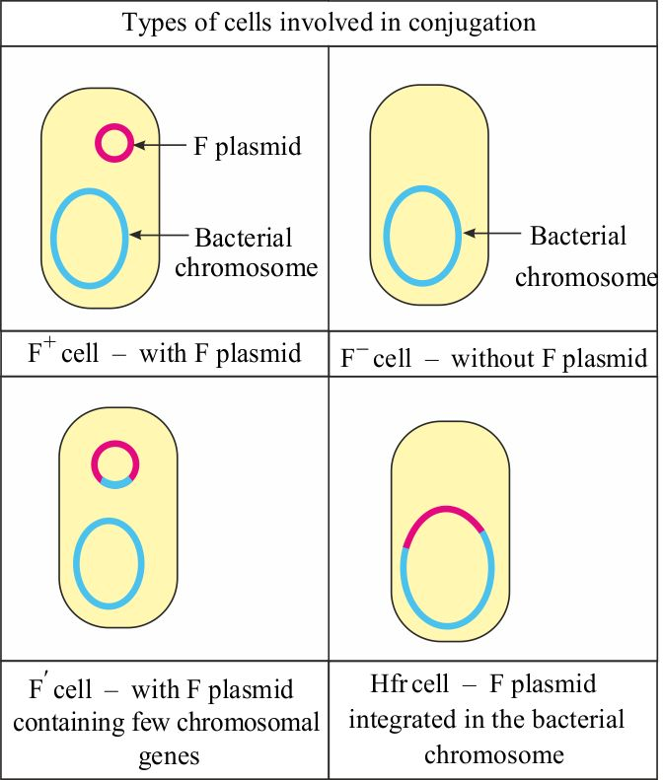

Slide 4
An important breakthrough came when Luca Cavalli-Sforza discovered a derivative of an F+ strain. On crossing with F− strains this new strain produced 1000 times as many recombinants for genetic markers as did a normal F+ strain. Cavalli-Sforza designated this derivative an Hfr strain to indicate a high frequency of recombination. In Hfr × F− crosses, virtually none of the F− parents were converted into F+ or into Hfr. This result is in contrast with F+ × F− crosses, where infectious transfer of F results in a large proportion of the F− parents being converted into F+. It became apparent that an Hfr strain results from the integration of the F factor into the chromosome. Now, during conjugation between an Hfr cell and a F− cell a part of the chromosome is transferred with F. Random breakage interrupts the transfer before the entire chromosome is transferred. The chromosomal fragment can then recombine with the recipient chromosome.

Slide 5
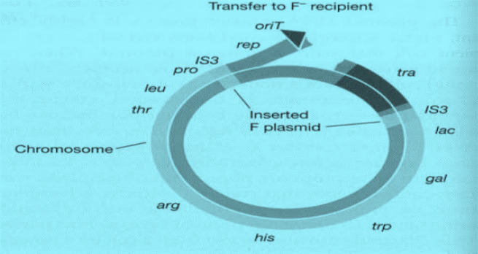
Breakage of the Hfr chromosome at the origin of transfer and the beginning of DNA transfer to the recipient.
F sexduction :F mobilizes small excised region of donor chromosome.

Slide 6
Details of the replication and transfer process

Slide 7
F plasmids containing chromosomal genes are called F' (Fprime) plasmids.
F' plasmids differ from normal F plasmids in that they contain identifiable chromosomal genes, and they transfer these genes at high frequency to recipients. F' -mediated transfer resembles specialized transduction in that only a restricted group of chromosomal genes can be transferred. Transferring a known F' into a recipient allows one to establish diploids (two copies of each gene) for a limited region of the chromosome. Such partial diploids are called merodiploids.

Slide 8
Conjugation in other bacteria
Many Gram-positive species, ranging from Streptomyces to Enterococcus, also possess plasmids that are transmissible by conjugation and in many cases the mechanism of DNA transfer is quite similar to that described above.
In general, the number of genes required for conjugative transfer, in some cases as few as five genes, is very much less than in Gram-negative bacteria where 20 or more genes are needed. Conjugative plasmids in Gram-positive bacteria can therefore be considerably smaller. One reason for a smaller number of genes being required is that there seems to be no need for production of a pilus. This is probably, at least in part, a reflection of the different cell-wall architecture in Gram-positive bacteria which lack the outer membrane characteristic of the Gram-negatives. One group of Gram-positive bacteria where conjugation systems have been studied in detail are the enterococci, principally Enterococcus faecalis. Some
strains of E. faecalis secrete diffusible peptides that have a pheromone-like action that can stimulate the expression of the transfer (tra) genes of a specific plasmid in a neighbouring cell. Note that, rather surprisingly, it is the recipient cell that produces the pheromones.

Slide 9
The donor cell, carrying the plasmid, has a plasmid encoded receptor on the cell surface to which the pheromone binds. Different types of plasmid code for different receptors and are therefore stimulated by different pheromones. However the recipient produces a range of pheromones and is therefore capable of mating with cells carrying different plasmids.
After the pheromone has bound to the cell-surface receptor it is transported
into the cytoplasm, by a specific transport protein, where it interacts with a
protein called TraA. This protein is a repressor of the tra genes on the plasmid and the binding of the peptide to it relieves that repression, thus stimulating expression of the tra genes. One result is the formation of aggregation products which cause the formation of a mating aggregate containing donor and recipient cells bound together. A further consequence of expression of the tra genes is stimulation of the events needed for transfer of the plasmid which occurs by a mechanism similar to that described previously.

Slide 10
One advantage of this system is that the cells containing the plasmid do not
express the genes needed for plasmid transfer unless there is a suitable recipient in the vicinity. Not only does this reduce the metabolic load on the cell but it also means that they are not expressing surface antigens (such as conjugative pili) that could be recognized by the host immune system.
Conjugative transposons E. faecalis also provides an example of an exception to the general rule that conjugation is plasmid-mediated. Some strains of E. faecalis contain a transposon known as Tn916. Transposons are able to move from one DNA site to another. What sets Tn916 apart from other transposons is its ability to transfer from one cell to another by conjugation. Conjugative transposons such as Tn916 differ from plasmids in that they are
replicated and inherited as part of the chromosome. There is no stable independently replicating form as there is with a plasmid. However, closer inspection of the method of transfer
In particular, Tn916 contains a origin of transfer (oriT) which is quite similar to that found in many plasmids. The first step in transfer is the excision of the transposon from the chromosome, using transposon-encoded enzymes (Int and Xis) which are related to those responsible for the integration and excision of bacteriophage lambda .

Slide 11
This produces a circular molecule that resembles a plasmid in all but one vital feature – it does not have an origin of replication so is unable to be copied in the normal way. However since it does have an oriT site and carries the tra genes needed for conjugal transfer, it can be transferred to a recipient cell. transfer of Tn916 involves single-stranded DNA synthesis initiated at oriT and transfer of the displaced strand to the recipient. The transferred single strand is then circularized and converted to a double-stranded circular form which is inserted randomly into the recipient chromosome by the action of the integrase.
Transfer would start from oriT and would have to work right round the chromosome before reaching the rest of the transposon. This does not seem to happen. The reason is that the promoter for expression of the tra genes is found towards the left-hand end of the transposon and faces away from the tra genes.
In the integrated linear form the tra genes will not be expressed. However, when the transposon is excised from the chromosome and circularized, this brings the promoter into the correct position and orientation for transcription of the tra genes. They will therefore be expressed from the circular intermediate, but not from the integrated form. This ensures that the transfer system will only be activated after excision has occurred.

Slide 12
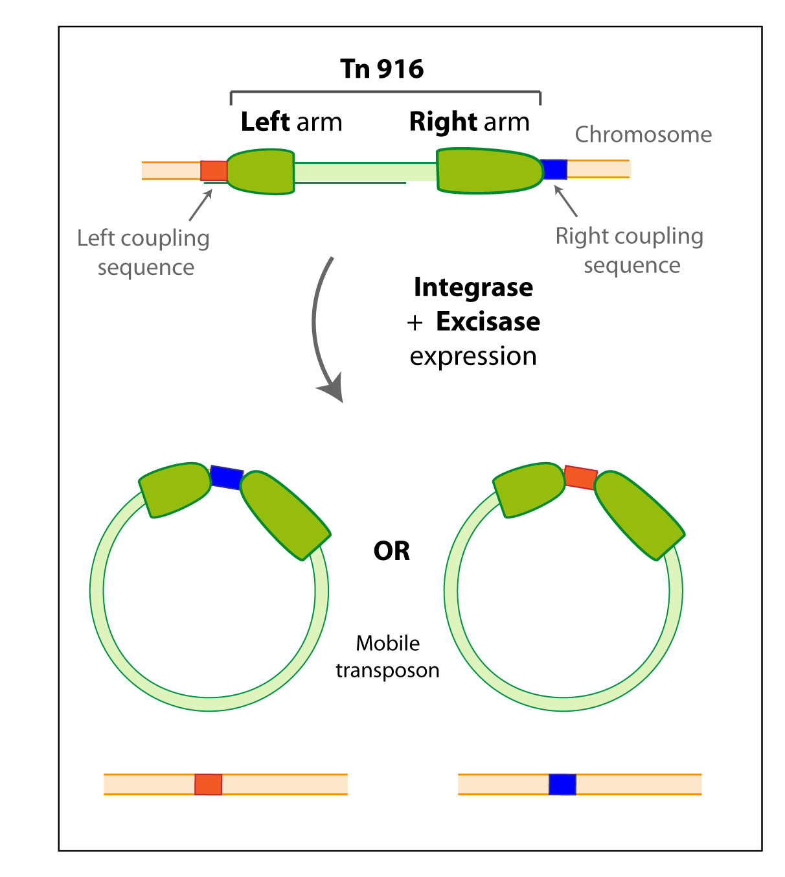

Slide 13
Tn916 is the prototype of a family of related conjugative transposons that are especially widespread in Gram-positive cocci, although related elements also occur in Gram-negative bacteria (e.g. Bacteroides). For many of these elements, including Tn916, conjugative transmission is promiscuous in that they can transfer to other species or genera. It can be assumed therefore that conjugative transposons have played a significant role in the dissemination of genetic material, including antibiotic resistance genes, throughout the bacterial kingdom. In particular. many of these transposons, including Tn916, carry a tetracycline resistance gene (tetM) which is found in a wide range of bacterial species, suggesting that they have played a role in the dispersal of this particular gene.

Slide 14
Conjugation in Mycobacteria smegmatis, like conjugation in E. coli, requires stable and extended contact between a donor and a recipient strain, is DNase resistant, and the transferred DNA is incorporated into the recipient chromosome by homologous recombination. However, unlike E. coli Hfr conjugation, mycobacterial conjugation is chromosome rather than plasmid based. Furthermore, in contrast to E. coli Hfr conjugation, in M. smegmatis all regions of the chromosome are transferred with comparable efficiencies. The lengths of the donor segments vary widely, but have an average length of 44.2kb. Since a mean of 13 tracts are transferred, the average total of transferred DNA per genome is 575kb. This process is referred to as Distributive conjugal transfer. Gray et al. found substantial blending of the parental genomes as a result of conjugation and regarded this blending as reminiscent of that seen in the meiotic products of sexual reproduction.

Slide 15
Bacteria related to the nitrogen fixing Rhizobia are an interesting case of inter-kingdom conjugation. For example, the tumor-inducing (Ti) plasmid of Agrobacterium and the root-tumor inducing (Ri) of A. rhizogenes contain genes that are capable of transferring to plant cells. The expression of these genes effectively transforms the plant cells into opine-producing factories. Opines are used by the bacteria as sources of nitrogen and energy. Infected cells form crown gall or root tumors, respectively. The Ti and Ri plasmids are thus endosymbionts of the bacteria, which are in turn endosymbionts (or parasites) of the infected plant.
The Ti and Ri plasmids can also be transferred between bacteria using a system (the tra, or transfer, operon) that is different and independent of the system used for inter-kingdom transfer (the vir, or virulence, operon). Such transfers create virulent strains from previously a virulent strains.

Slide 16
Several conjugative plasmids have also been found in Sulfolobus, a genus of Archaea. Little is known about conjugation in Sulfolobus,although it is known that cell pairing occurs before plasmid transfer and that transfer is unidirectional. However, with one exception, the genes involved seem to have little similarity to those in gram-negative Bacteria. The exception is a gene similar to traG, whose protein product in F plasmid-mediated conjugation seems to be involved in stabilizing mating pairs. It thus seems likely that the mechanism of conjugation in Archaea is quite different from that in Bacteria.

