Slide 1
Microbial genetics
Three grade fourth lecture

Slide 2
Extra chromosomal Agents
Plasmids are nonessential extrachromosomal elements that control their own replication. They are found mainly in bacteria and in some eukaryotic microbes such as yeast and algae. Plasmids are normally circular double stranded DNA molecules that range in size from as little as 1 kb to over 100 kb although linear plasmids have been observed in Borrelia burgdorferi, the causative agent of Lyme disease. Relative to the size of the bacterial chromosome plasmids are very small.
The number of copies of a plasmid in each cell is tightly controlled with a general rule that small plasmids tend to have a high copy number, sometimes over 100 copies per cell, whereas larger plasmids may be present in one or a few copies per cell.
Certain classes of plasmids are capable of horizontal transmission from one bacterium to another. In most cases the recipient bacterium does not have to be the same species as the donor bacterium and can, in fact, be distantly related. By definition, the coding potential of a plasmid is nonessential for the bacterial life cycle but plasmids frequently encode functions that give the bacteria a selective advantage in certain environments, the most infamous example being the class of genes which encode antibiotic resistance.
The fact that plasmids can confer resistance to antibiotics and that horizontal transmission can occur between distantly related bacteria has major implications for medicine, since it has allowed rapid spread of antibiotic resistance throughout the microbial world. plasmids have been absolutely key to the development of gene cloning.

Slide 3
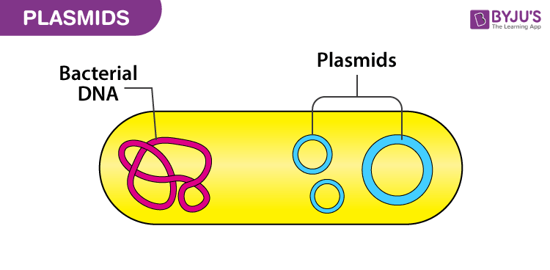
In order for the plasmids to replicate independently within a cell, they must possess a stretch of DNA that can act as an origin of replication. The self-replicating unit, in this case the plasmid, is called a replicon. A few types of plasmids are also capable of inserting into the host chromosome, and these integrative plasmids are sometimes referred to as episomes in prokaryotes.
Plasmids almost always carry at least one gene. Many of the genes carried by the plasmid are beneficial for the host cells, for example enabling the host cell to survive in an environment that would otherwise be lethal or restrictive for growth. Some of these genes encode traits for antibiotic resistance or resistance to heavy metal, while others may produce virulence factors that enable a bacterium to colonize a host and overcome its defenses, or have specific metabolic functions that allow the bacterium to utilize a particular nutrient, including the ability or to degrade recalcitrant or toxic organic compounds. Plasmids can also provide bacteria with the ability to fix nitrogen. Some plasmids, however, have no observable effect on the phenotype of the host cell or its benefit to the host cells cannot be determined, and these plasmids
are called cryptic plasmids.

Slide 4
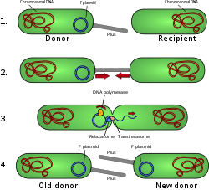
Classifications and types
Plasmids may be classified in a number of ways. Plasmids can be broadly classified into conjugative plasmids and non-conjugative plasmids. Conjugative plasmids contain a set of transfer or tra genes which promote sexual conjugation between different cells. In the complex process of conjugation, plasmid may be transferred from one bacterium to another via sex pili encoded by some of the tra genes . Non-conjugative plasmids are incapable of initiating conjugation, hence they can be transferred only with the assistance of conjugative plasmids. An intermediate class of plasmids are mobilizable, and carry only a subset of the genes required for transfer. They can parasitize a conjugative plasmid, transferring at high frequency only in its presence.
Plasmids can also be classified into incompatibility group. A microbe can harbour different types of plasmids, however, different plasmids can only exist in a single bacterial cell if they are compatible. If two plasmids are not compatible, one or the other will be rapidly lost from the cell. Different plasmids may therefore be assigned to different incompatibility group depending
on whether they can coexist together.
Incompatible plasmids normally
share the same replication or
partition mechanisms.

Slide 5
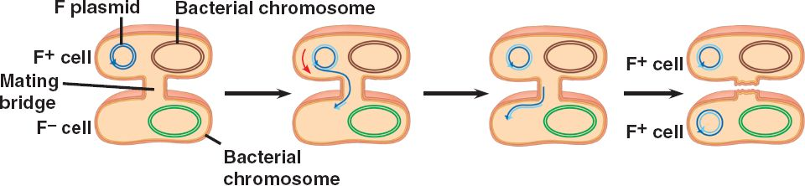
Another way to classify plasmids is by function. There are five main classes:
Fertility F-plasmids, which contain tra genes. They are capable of conjugation and result in the expression of sex pilli.
Resistance (R) plasmids, which contain genes that provide resistance against antibiotics or poisons. Historically known as R-factors, before the nature of plasmids was understood.
Col plasmids, which contain genes that code for bacteriocins, proteins that can kill other bacteria.
Degradative plasmids, which enable the digestion of unusual substances, e.g. toluene and salicylic acid.
Virulence plasmids, which turn the bacterium into a pathogen.

Slide 6
Plasmids can belong to more than one of these functional groups:
R Plasmid:
The most widely studied plasmid-borne characteristic is that of drug resistance.
R plasmids were first discovered in Japan in strains of enteric bacteria that had acquired resistance to a number of antibiotics (multiple resistance) and have since been found throughout the world. The emergence of bacteria resistant to several antibiotics is of considerable medical significance and was correlated with the increasing use of antibiotics for the treatment of infectious diseases.
Many bacteria can become resistant to antibiotics by acquisition of a plasmid, although plasmid-borne resistance to some drugs such as nalidixic acid and rifampicin does not seem to occur. (In those cases, resistance usually occurs by mutation of the gene that codes for the target protein).
The antibiotic resistance genes themselves are many and varied, ranging from plasmid-encoded beta lactamases which destroy penicillins to membrane proteins which reduce the intracellular accumulation of tetracycline. The ability of plasmids to be transferred from one bacterium to another, even sometimes between very different species , has contributed greatly to the widespread dissemination of antibiotic resistance genes. Bacteria can become resistant to a number of separate antibiotics, either by the acquisition of several independent plasmids or through acquiring a single plasmid with many resistance determinants on it.
Transposons are thought to have played a major role in the development of drug resistance plasmids, by promoting the movement of the genes responsible between different plasmids or from the chromosome of a naturally resistant organism onto a plasmid.

Slide 7
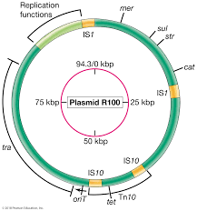
It should be appreciated that other mechanisms of antibiotic resistance also occur and that such resistance is not always due to plasmids: indeed many of the bacteria that are currently causing problems of hospital cross-infection are either inherently resistant or owe their antibiotic resistance to chromosomal genes.
Plasmid RI00 can be transferred between enteric bacteria of the genera Escherichia, Klebsiella, Proteus, Salmonella, and Shigella, but does not transfer to the non enteric gram-negative bacterium Pseudomonas.
Different R plasmids with genes for resistance to most antibiotics are known. Many drug-resistant elements on R plasmids, such as those on RI00,
are also transposable elements and this, plus the fact that many of these plasmids are conjugative, have made them a serious threat to traditional antibiotic therapies.

Slide 8
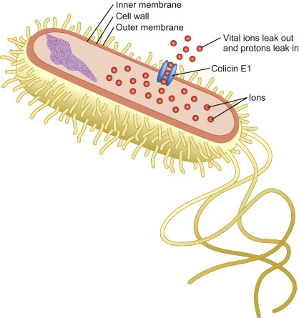
Colicins and bacteriocins
Another property conferred by some plasmids that has been widely studied is the ability to produce a protein which has an antimicrobial action, usually against only closely-related organisms. One group of such proteins, produced by strains of E. coli, are capable of killing other E. coli strains, and are hence referred to as colicins, and the strains that produce them are colicinogenic. The colicin gene is carried on a col plasmid , together with a second gene that confers immunity to the action of the colicin, thus protecting the cell against the lethal effects of its own product. However, colicin E2 is a DNA endonuclease that can cleave DNA, and colicin E3 is a nuclease that cuts at a specific site in 16S rRNA and inactivates ribosomes. Col plasmids can be either conjugative or nonconjugative. The bacteriocins or bacteriocin-like agents
of gram positive bacteria are quite different from
the colicins but are also often encoded by plasmids;
some even have commercial value. For instance,
lactic acid bacteria produce
the bacteriocin Nisin A, which strongly inhibits
the growth of a wide range of gram-positive
bacteria and is used as a preservative in the food industry.

Slide 9
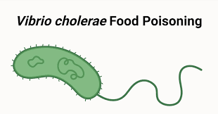
Virulence determinants
In some bacterial species toxin genes are carried on plasmids rather than phages. For example, some strains of E. coli are capable of causing a disease that resembles cholera (although milder). These strains produce a toxin known as LT (labile toxin – to distinguish it from a different, heat-stable, toxin known as ST). The LT toxin is closely related to the cholera toxin, but whereas the gene in Vibrio cholerae is carried by a prophage, the LT gene in E. coli is found on a plasmid.
Plasmids can also carry other types of genes that are necessary for (or enhance) virulence. One of the most dramatic examples of this is the 70-kb virulence plasmid of Yersinia species. This plasmid which is found in species of Yersinia (including Yersinia pestis, the causative organism of plague) .

Slide 10
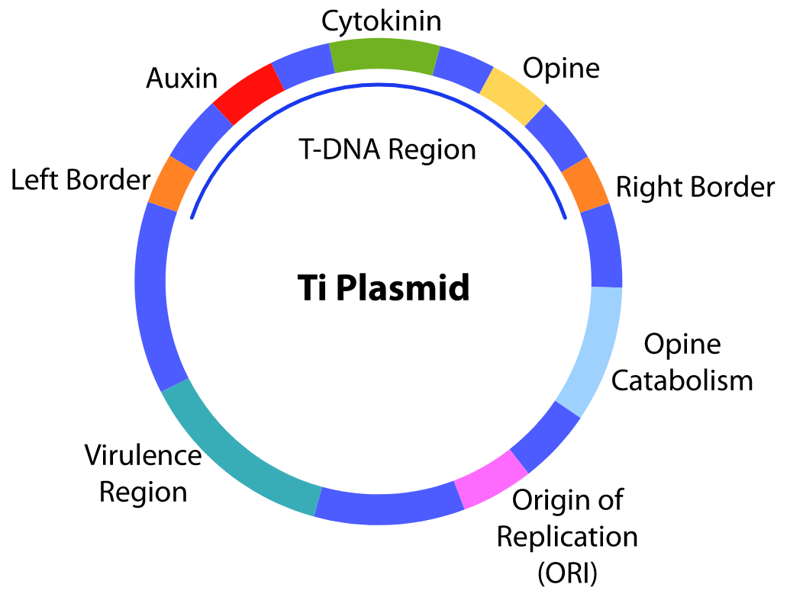
Plasmids in plant-associated bacteria
A different type of pathogenicity is seen with the plant pathogen Agrobacterium tumefaciens, which causes a tumour-like growth known as a crown gall in some plants. Again, it is only strains that carry a particular type of plasmid (known as a Ti plasmid, for Tumour Inducing) that are pathogenic; in this case however, pathogenicity is associated with the transfer of a specific part of the plasmid DNA itself into the plant cells. This phenomenon has additional importance because of its application to the genetic manipulation of plant cells .
Members of the genus Rhizobium also ‘infect’ plants, although in this case the relationship is symbiotic rather than pathogenic. These bacteria form nodules on the roots of leguminous plants. Under these conditions the bacteria are able to fix nitrogen and supply the plant with a usable source of reduced nitrogen, a process of considerable ecological and agricultural importance. The genes necessary for both nodulation and nitrogen fixation are carried by plasmids.

Slide 11
Metabolic activities
Plasmids are capable of expanding the host cell’s range of metabolic activities in a variety of other ways. For example, a plasmid that carries genes for the fermentation of lactose, if introduced into a lactose non-fermenting strain, will convert it to one that is able to utilize lactose. Such plasmids can cause problems in diagnostic laboratories where organisms are often identified on the basis of a limited set of biochemical characteristics. Commonly the potentially pathogenic Salmonella genus is differentiated from the (usually) non-pathogenic E. coli species primarily

Slide 12
Plasmid replication and control
Many plasmids are replicated as double stranded circular molecules. The overall picture with such plasmids is basically similar to that of the chromosome, in that replication starts at a fixed point known as oriV (the vegetative origin, to distinguish it from the point at which conjugative transfer is initiated, oriT), and proceeds from this point, either in one direction or in both directions simultaneously until the whole circle is copied.
However there are some aspects of replication that differ from that of the chromosome, especially for the multicopy plasmids. Two examples that have been studied intensively are ColE1 and R100.

