Slide 1
Microbial genetics grade three
Lecture 2&3

Slide 2
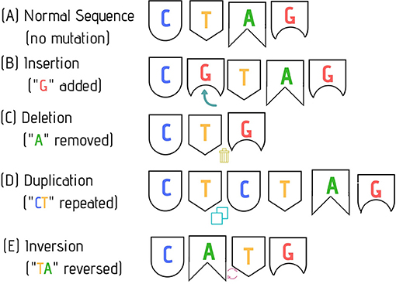

Slide 3
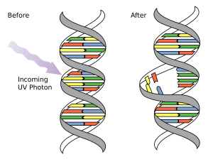
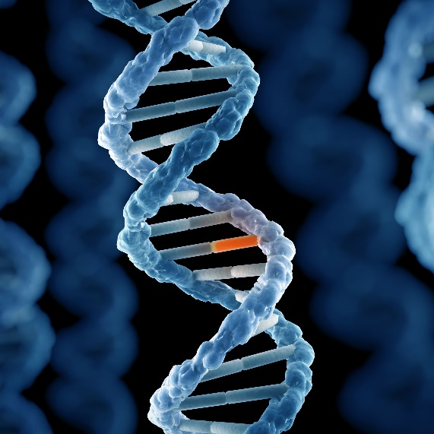
Mutation
A mutation is a heritable change in the base sequence of the nucleic acid in the genome of an organism. strain carrying such a change is called a mutant. A mutant by definition differs from its parental strain in genotype, the nucleotide sequence of the genome.
Mutations can be either spontaneous or induced. Spontaneous mutations can occur as a result of exposure to natural radiation (cosmic rays, and so on) that alters the structure of bases in the DNA , Also, oxygen radicals can affect DNA structure by chemically modifying DNA.

Slide 4
Mutagens
Mutagen is a physical or chemical agent that changes the genetic material, usually DNA, of an organism and thus increases the frequency of mutations above the natural background level. As many mutations can cause cancer, mutagens are therefore also likely to be carcinogens. Not all mutations are caused by mutagens: so-called "spontaneous mutations" occur due to spontaneous hydrolysis, errors in DNA replication, repair and recombination.
Mutagens cause changes to the DNA that can affect the transcription and replication of the DNA, which in severe cases can lead to cell death. The mutagen produces mutations in the DNA, and deleterious mutation can result in aberrant, impaired or loss of function for a particular gene, and accumulation of mutations may lead to cancer.
Mutagens may also modify the DNA sequence; the changes in nucleic acid sequences by mutations include substitution of nucleotide base-pairs and insertions and deletions of one or more nucleotides in DNA sequences. Although some of these mutations are lethal or cause serious disease, many have minor effects as they do not result in residue changes that have significant effect on the structure and function of the proteins. Many mutations are silent mutations, causing no visible effects at all, either because they occur in non-coding or non-functional sequences, or they do not change the amino-acid sequence due to the redundancy of codons.

Slide 5
Types of mutagens
Mutagens may be of physical, chemical or biological origin. They may act directly on the DNA, causing direct damage to the DNA, and most often result in replication error. Some however may act on the replication mechanism and chromosomal partition. Many mutagens are not mutagenic by themselves, but can form mutagenic metabolites through cellular processes. Such mutagens are called promutagens.
Physical mutagens
Ionizing radiations such as X-rays, gamma rays and alpha particles may cause DNA breakage and other damages. The most common sources include cobalt-60 and cesium-137.
Ultraviolet radiations with wavelength above 260 nm are absorbed strongly by bases, producing pyrimidine dimers, which can cause error in replication if left uncorrected.
Radioactive decay, such as ¹⁴C in DNA which decays into nitrogen.

Slide 6
Chemical mutagens
A large number of chemicals may interact directly with DNA.
Reactive oxygen species (ROS) – These may be superoxide, hydroxyl radicals and hydrogen peroxide,
Deaminating agents, for example nitrous acid which can cause transition mutations by converting cytosine to uracil.
Polycyclic aromatic hydrocarbon (PAH), when activated to diol-epoxides can bind to DNA and form adducts.
Alkylating agents such as ethylnitrosourea. The compounds transfer methyl or ethyl group to bases or the backbone phosphate groups. Guanine when alkylated may be mispaired with thymine. Some may cause DNA crosslinking and breakages. Nitrosamines are an important group of mutagens found in tobacco, and may also be formed in smoked meats and fish via the interaction of amines in food with nitrites added as preservatives. Other alkylating agents include mustard gas and vinyl chloride.
Aromatic amines and amides have been associated with carcinogenesis since 1895 .

Slide 7
Alkaloid from plants, such as those from Vinca species may be converted by metabolic processes into the active mutagen or carcinogen.
Bromine and some compounds that contain bromine in their chemical structure.
Sodium azide, an azide salt that is a common reagent in organic synthesis and a component in many car airbag systems
Psoralen combined with ultraviolet radiation causes DNA cross-linking and hence chromosome breakage.
Benzene, an industrial solvent and precursor in the production of drugs, plastics, synthetic rubber and dyes.

Slide 8
Base analogs
Base analog, which can substitute for DNA bases during replication and cause transition mutations.
Intercalating agents
Intercalating agents, such as ethidium bromide and proflavine, are molecules that may insert between bases in DNA, causing frameshift mutation during replication. Some such as daunorubicin may block transcription and replication, making them highly toxic to proliferating cells.
Metals
Many metals, such as arsenic, cadmium, chromium, nickel and their compounds may be mutagenic, they may however act via a number of different mechanisms..

Slide 9
Biological agents
Transposon, a section of DNA that undergoes autonomous fragment relocation/multiplication. Its insertion into chromosomal DNA disrupt functional elements of the genes. Transposons have the ability to move (transpose) from one site to another.
Elements known as Insertion Sequences (IS) have a specific ability to insert into other DNA sequences, thus generating insertion mutations. A substantial proportion of spontaneous mutations may be due to inactivation of genes by insertion of a copy of an IS element rather than by replication errors.
Virus , Virus DNA may be inserted into the genome and disrupts genetic function. Infectious agents have been suggested to cause cancer as early as 1908 by Vilhelm Ellermann and Oluf Bang.

Slide 10
In summary mutagens can be divided into Three classes based on the ways they cause mutation:
* Base analogs. Examples: ( 2-aminopurine, ) (5-bromouracil.) These base analogs are incorporated into DNA where they mispair with other bases. 5BU can pair with adenine and guanine. These result in transition mutations.
* Base modifications causing mispairs Examples: ethyl methane sulfonate (EMS). These mutagens modify bases on DNA such that they mispair. EMS alkylate the O6 of guanine, which is highly mutagenic and causes mispairing with thymine ,and show preference for GC to AT transitions. However, they also alkylate bases at many positions with other effects. Nitrous acid and hydroxylamine deaminate cytosine to yield uracil (see deamination above) resulting in transition mutations.
* Base modifications which destroy pairing; SOS-dependent mutagens. Examples: UV light, benzo(a)pyrene, aflatoxin B1 (i.e. most carcinogens) These mutagens or their metabolites modify DNA so that no specific pairing is possible; replication cannot proceed past the lesion. Unrepaired AP sites also elicit this response.

Slide 11
Types of mutations
Point mutations
There are many ways in which the structure of the genetic material may change. In point mutations the sequence of the DNA has been altered at a single position. Where this change consists of replacing one nucleotide by another, it is known as a base substitution. The consequence of such a change depends both on the nature of the change and its location. If the change is within the coding region of a gene (i.e. the region which ultimately is translated into protein), it may cause an alteration of the amino acid sequence which may affect the function of the protein. The alteration may of course have little or no effect, either because the changed triplet still codes for the same amino acid or because the new amino acid is sufficiently similar to the original one for the function of the protein to remain unaffected.
For example, the triplet UUA codes for leucine; a single base change in the DNA can give rise to one of nine other codons. Two of the possible changes (CUA , UUG) are completely silent, as the resulting codons still code for leucine. These are known as synonymous codons. Two further changes (AUA and GUA) may well have little effect on the protein since the substituted amino acids (isoleucine and valine respectively) are similar to the
original leucine (they are all hydrophobic amino acids). Phenylalanine (UUC or UUU codons) is also hydrophobic but is more likely to cause a significant change in the structure of the protein at that point. The significance of the change to UCA, resulting in the substitution of serine (which is considerably different) for leucine will depend on the role played by that amino acid (and its neighbours) in the overall function or conformation of the protein.
The final two changes (UGA , UAA) are referred to as stop or termination codons (as is a third codon, UAG), since they result in termination of translation; there is normally no tRNA molecule with the corresponding anticodon.

Slide 12
Types of point mutations
• A nucleotide-pair substitution: replaces one nucleotide and its partner with another pair of nucleotides
• Silent mutations have no effect on the amino acid produced by a codon because of redundancy in the genetic code
• Missense mutations still code for an amino acid, but not the correct amino acid
• Nonsense mutations change an amino acid codon into a stop codon, nearly always leading to a nonfunctional protein
A different kind of mutation still involving a change at a single position,
consists of the deletion or addition of a single nucleotide (or of any number
other than a multiple of three). This is known as a frameshift mutation, since it results in the reading frame being altered for the remainder of the gene. Since the message is read in triplets, with no punctuation marks (the reading frame being determined solely by the translation start codon), an alteration in the reading frame will result in the synthesis of a totally different protein from that point on.

Slide 13
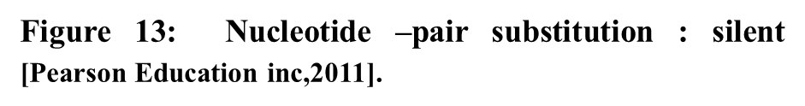

Slide 15
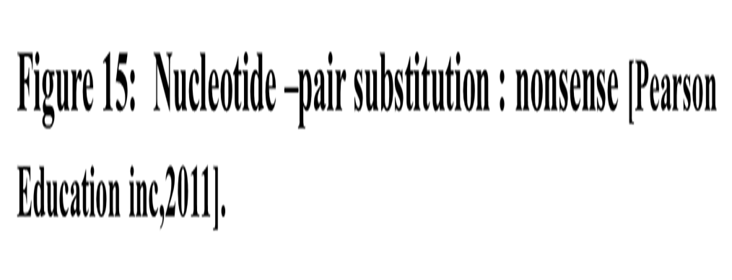

Slide 16
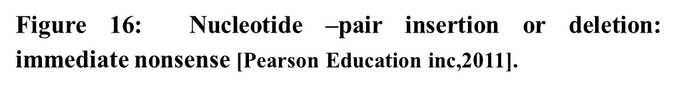

Slide 17
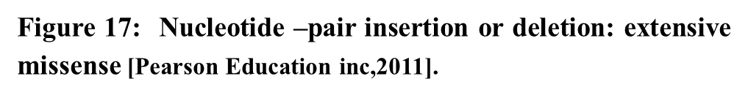

Slide 18
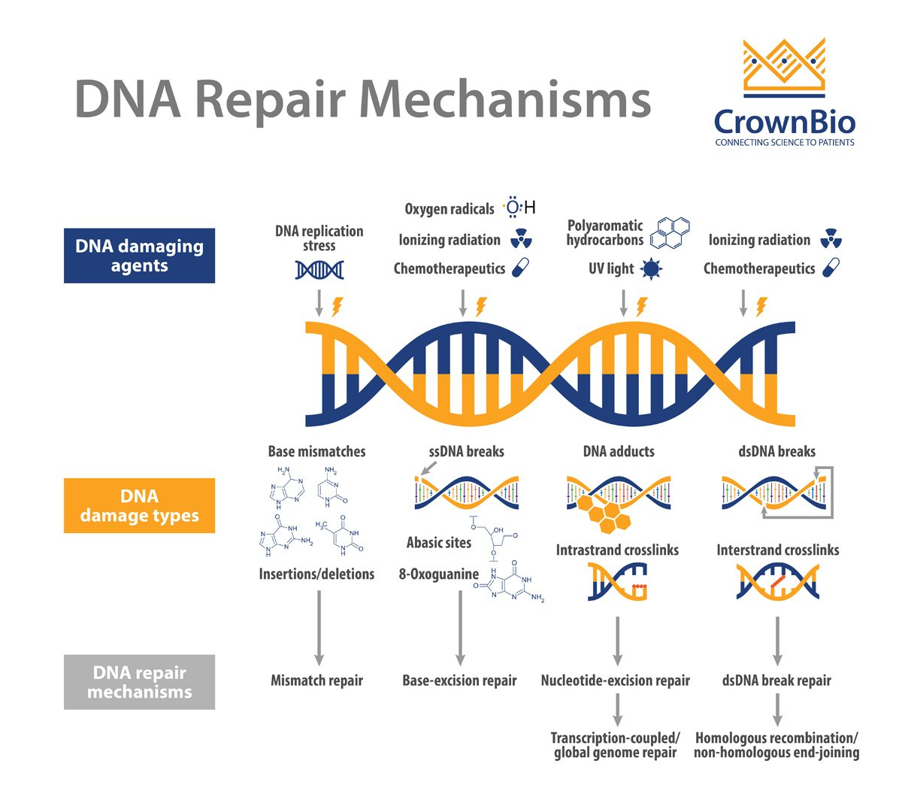
Conditional mutants:
There are many genes that do not affect resistance to antibiotics or bacteriophages, biosynthesis of essential metabolites or utilization of carbon sources. Some of these genes are indispensable and any mutants defective in those activities would die (or fail to grow).
DNA modification repair pathways
Repair pathways that remove DNA modifications have Three basic mechanisms: direct repair, base-excision repair and nucleotide-excision repair.

Slide 19
A. Direct chemical reversal.
1. Photolyase, AKA photo-reactivation. UV light induces the formation of pyrimidine dimers between adjacent C or T bases in DNA. The photolyase enzyme break the cyclobutane dipyrimidine bond. To do so, the enzyme must absorb visible light, hence the name photo-reactivation. E. coli and the yeast Saccharomyces cerevisiae have such an enzyme.
2. Methyltransferase. The methyl groups from mutagenic O6-methylguanine (O6-MeG is particularly mutagenic) and O4-methylthymine can be removed directly by this enzyme.
B. base-excision:
Glycosylase + AP endonuclease. Many modified bases are recognized by specific N-glycosylases that cleave the modified base. The resulting AP site is repaired by AP endonucleases. Examples in E. coli: hypoxanthine-DNA glycosylase, 3-methyladenine glycosylase . formamidopyrimidine glycosylase, hydroxymethyl glycosylase.
c. Nucleotide excision repair.
In this form of DNA repair, the damaged bases are removed from DNA as an oligonucleotide and the resulting gap is repaired by resynthesis. This pathway is used to remove many bulky adducts in DNA, including cross-links and UV-induced pyrimidine dimers.

Slide 21
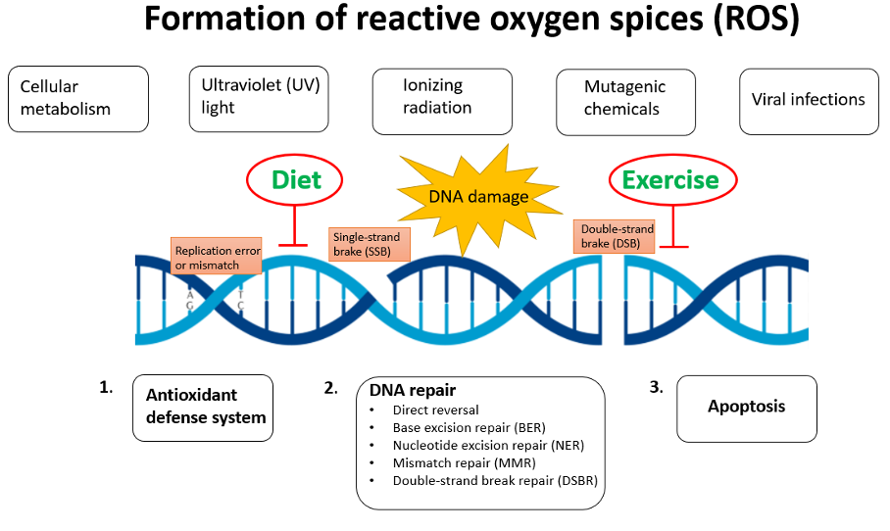
In both E. coli , yeast and human cells, there seems to be a mechanism that targets excision repair to lesions on transcribed strand (i. e. the template strand for transcription) of the damaged gene.
SOS response : a number of genes involved with DNA repair and related functions are induced by the presence of unrepaired DNA. An alternative strategy, when faced with overwhelming levels of DNA damage preventing normal replication, is to temporarily modify or abolish the specificity of the DNA polymerase.
Mutation Rate
Mutation rate is a probability that gene will mutate when cell divides . A mutation rate has evolved in cells that is very low yet detectable. This allows organisms to balance the need for genetic stability with that for evolutionary improvement.

Slide 22
The fact that organisms as phylogenetically disparate as hyper thermophilic Archaea and Escherichia coli have about the same mutation rate might make one believe that evolutionary pressure has selected for organisms with the lowest possible mutation rates. However, this is not so. The mutation rate in an organismis subject to change. For example, mutants of some organisms have been selected in the laboratory that are hyperaccurate in DNA replication and repair.
However, in these strains, the improved proofreading repair mechanisms has a significant metabolic cost; thus, a hyperaccurate mutant might actually be at a disadvantage in its natural environment. On the other hand, some organisms seem to benefit from a hyperaccurate phenotype that enables them to occupy particular niches in nature. A good example is the bacterium
Deinococcus radiodurans . This organism is 20 times more resistant to UV radiation and 200 times more resistant to ionizing radiation than E. coli.

