Slide 1
Computer Organization
Arithmetic and logic Instructions
Second Group Instructions
أعداد: م. د. سمر أميل يوسف
2026-2025

Slide 2
Second Group Instructions
MUL, DIV REG
Memory
MUL instructions affect these flags only: CF, OF
When result is over operand size these flags are set to 1, when result fits in operand size these flags are set to 0.
For DIV flags are undefined.

Slide 3
MUL instruction
when operand is a byte:
AX = AL * operand.
when operand is a word:
(DX AX) = AX * operand.

Slide 4
MUL instruction
Q:Write a program in assembly language to compute Z= 5*3 put the result in cx?
MOV AL, 5
MOV Bl, 3
MUL Bl
mov cx,ax
RET

Slide 5
MUL instruction
Q:Write a program in assembly language to compute Z= 4444H *2222H
MOV AX, 4444H
MOV CX, 2222H
MUL CX
RET

Slide 6
MUL instruction
Q:Write a program in assembly language to compute Z= x*y , save the value in memory location [0000]
MOV AL, X
MOV BL, Y
MUL BL
MOV [0000] ,X
RET
X DB 8
Y DB 2

Slide 7
Second Group Instructions
MUL, DIV REG
Memory
DIV flags are undefined.

Slide 8
DIV instruction
when operand is a byte:
AL = AX / operand
AH = remainder.
when operand is a word:
AX = (DX AX) / operand
DX = remainder.

Slide 9
DIV instruction
Q: Write a program in assembly language to compute Z=200 /4
MOV AX, 200
MOV BL, 4
DIV BL
RET

Slide 10
Q: Write a program in assembly language to compute C=(FD/9)*(FA-32)
MOV AX,0FDH
MOV Bl,09
DIV Bl
MOV Bl,0FAH
MOV Cl, 32H
SUB Bl,Cl
MUL Bl
RET

Slide 11
Q: Write a program in assembly language to compute [2518]=(8+5)/(FA*32)

Slide 12
Q: Write a program in assembly language to compute the average of 5 degrees 80,88,90,80,88 ?
ADD AX,80
ADD AX,88
ADD AX,90
ADD AX,80
ADD AX,88
MOV BX,05
DIV BX
RET
Notes:
mov cx, 5
sum:
add al,a1[si]
inc si
loop sum
mov bl,5
div bl
ret
a1 db 80H, 90H, 85H, 90H, 80H

Slide 13
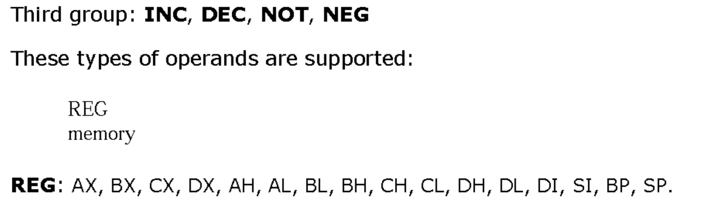
Third Group Instructions

Slide 14
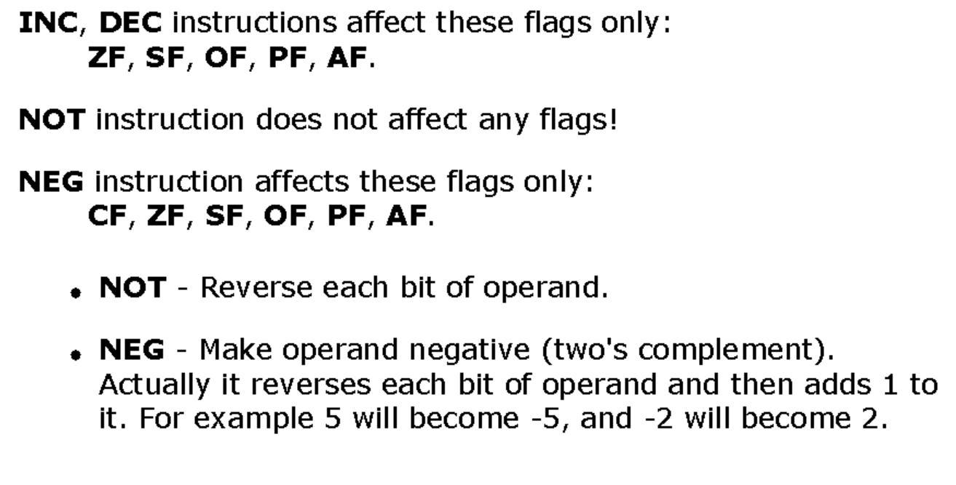
Third Group Instructions

Slide 15
mov ax, 0FFFFH
neg ax
ret

Slide 16
mov ax, 0FFFFH
NOT ax
ret

