Slide 1
Immunoglobulines (Ig.) or Antibodies (Abs)
By
Dr. Rajaa Hendi Salih

Slide 2
Immunoglobulins
Immunoglobulins are glycoprotein molecules that are produce by B-cells in response to an immunogen. B-lymphocytes are differentiate into plasma cells that secretes Abs ,They work by specifically binding to antigens
The basic antibody structure discovered by Edelman and porter which are awarded Nobel Prize (1959)

Slide 3
Structure of Immunoglobulin
Although different immunoglobulins can differ structurally, but all Igs built from the same basic units
-The Ig monomer is a "Y"-shaped molecule that consists of
A -four polypeptide chains .
the four chain structure as their basic unit linked covalently by bisulfate bonds:
2 identical light (L) chains (22kDa)
2 identical heavy (H) chains (55kDa)
- Each heavy chain is consist of 440 amino acid, while the light chain included 220 amino acid

Slide 4
B-. Variable (V) and Constant (C) Regions
1- Variable region (V)
- In the light chain (VL) and (Vh) in the heavy chain
The site of binding to specific Ag. finished with amine group (NH3+)
2- Constant region (C)
- In the light chain (CL) and (Ch) in the heavy chain
- The light chain contain (1) constant region while the heavy chain contain (3-4) regions.
Finished with carboxyl group (COO-)
C-Disulfide bonds
1. Inter-chain disulfide bonds -
The heavy and light chains and the two heavy chains are held together by inter-chain disulfide bonds. The number of inter-chain disulfide bonds varies among different immunoglobulin molecules.
2.Intra-chain disulfide bonds –
Within each of the polypeptide chains there are intra-chain disulfide bonds.

Slide 5
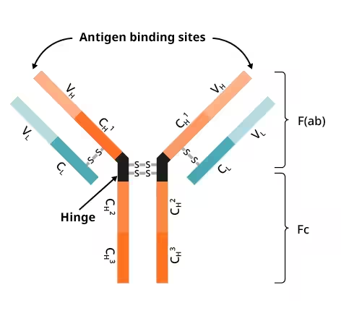
D. Hinge Region
• Antibody molecule in heavy chain include hinge region with Y form. It is called the hinge region because there is some flexibility in the molecule at this point

Slide 6
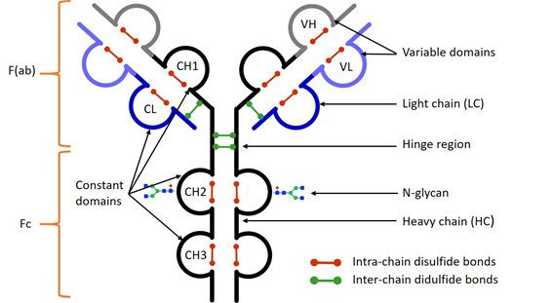
E. Domains
The amino acid sequence in both light and heavy chain is not a linear sequence but there are domes and loops due to the presence of intra chain disulfide bonds these globular areas called domains.

Slide 7
main domain in antibody molecule
1- Fragment antigen binding (Fab): This region of the antibody is composed of one constant and one variable domain from each heavy and light chain. This domain including the site of antigen binding.
2- Fragment crystallizable (Fc): it is composed of two heavy chains that contribute two or three constant domains depending on the class of the antibody.
This region plays a role in modulating immune cell activity by binding to a specific class of Fc receptors and other immune molecules, such as complement system and immune cells including phagocytic cells, eosinophil and basophil

Slide 8
IMMUNOGLOBULIN CLASSES, SUBCLASSES AND TYPES
A. Immunoglobulin classes
• The immunoglobulins can be divided into five different classes, based on differences in the amino acid sequences in the constant region of the heavy chains.
•1. IgG - Gamma heavy chains
•2.IgM - Mu heavy chains
•3.IgA - Alpha heavy chains
•4.IgD - Delta heavy chains
•5.IgE - Epsilon heavy chains

Slide 9
B. Immunoglobulin Subclasses
•The classes of immunoglobulins can be divided into subclasses based on small differences in the amino acid sequences in the constant region of the heavy chains.
1. IgG Subclasses
a) IgG1 - Gamma 1 heavy chains
b) IgG2 - Gamma 2 heavy chains
c) IgG3 - Gamma 3 heavy chains
d) IgG4 - Gamma 4 heavy chains
2. IgA Subclasses
•a) IgA1 - Alpha 1 heavy chains
•b) IgA2 - Alpha 2 heavy chains

Slide 10
C. Immunoglobulin Types
Immunoglobulins can also be classified by the type of light chain that they have. Light chain types are based on differences in the amino acid sequence in the constant region of the light chain.
•**Kappa light chains
• **Lambda light chains

Slide 11
GENERAL FUNCTIONS Of IMMUNOGLOBULINS
A. Primary function: Antigen binding
• Immunoglobulins bind specifically to one antigens.
•B. Secondary function: Effector Functions
• The binding of an antibody to an antigen has no direct biological effect. Rather, the significant biological effects are secondary "effector functions" of antibodies.

Slide 12
Antibody function
A. Opsonization: coating of bacteria with antibody's Fab region (IgG). This facilitates phagocytosis by cells possessing Fc receptor, e.g. neutrophil, polymorphonuclear leucocytes
B. Agglutination: Agglutination of particulate antigen, including bacteria and viruses. IgM is suitable for this function.
C. Neutralization: Neutralization of toxins released by bacteria e.g. tetanus toxin is neutralized when specific IgG antibody binds, thus preventing the toxin binding to it’s receptor. In the case of viruses, antibodies can hinder their ability to attach to receptors on host cells

Slide 13
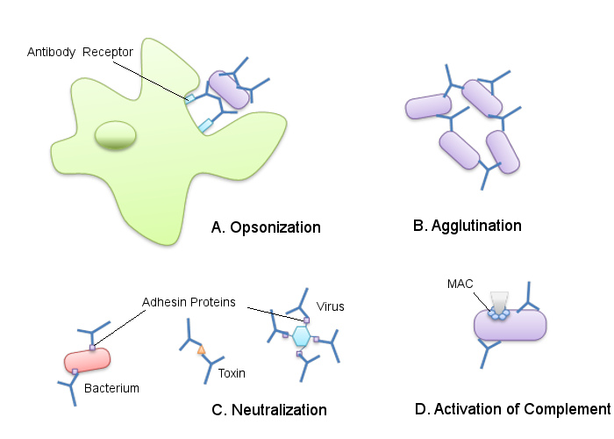

Slide 14
D. Complement activation (classical pathway): by IgM and IgG, leads eventually to death of bacteria by the terminal complement components which make holes in the cell wall, leading to an osmotic death.
E. Precipitation: Precipitation of soluble antigens by immune complex formation. They can be removed by phagocytic cells, and can fix complement.

Slide 15
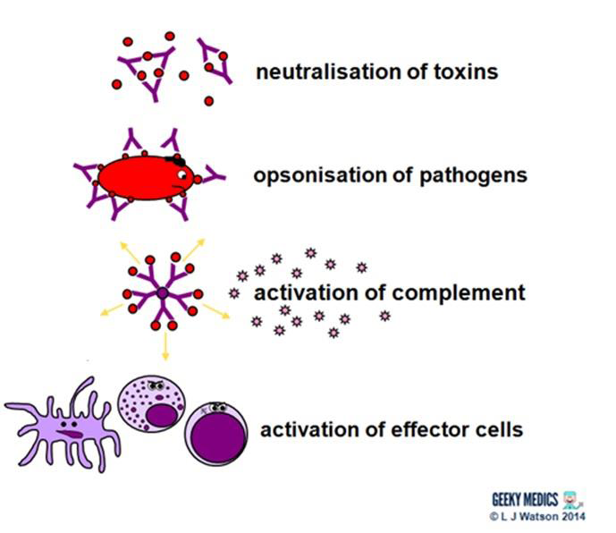

Slide 16
6. Antibody dependent cell mediated cytotoxicity (ADCC): Antibodies bind to organisms via their Fab region. Large granular lymphocytes NK cells, attach via Fc receptors, and kill these organisms not by phagocytosis but by release of toxic substances called perforins. Antibody dependent cell mediated cytolysis (ADCC) - Antibodies serve as bridge 7. Mucosal protection: mediated by IgA, it acts chiefly by inhibiting pathogens from gaining attachment to mucosal surfaces.

Slide 17
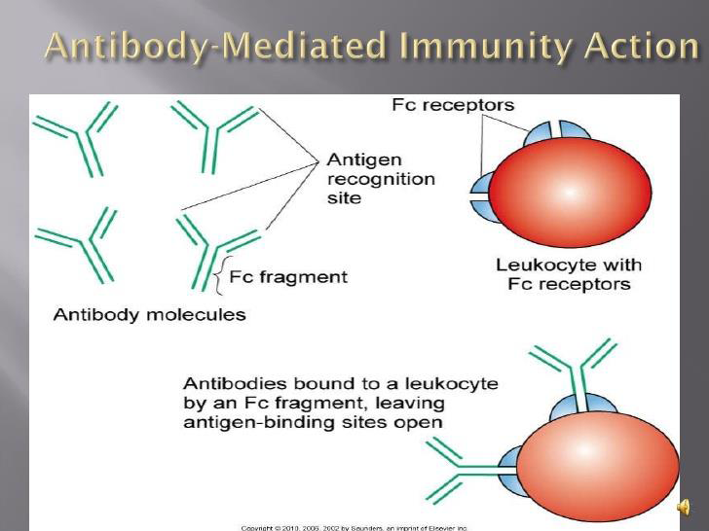

Slide 18
Properties of Igs
IgG
•Monomer, 70-75% of total immuniglobulin
•Secreted in high quantities in secondary exposures
•Cross the placenta
•Most protective because it is capable of carrying out all effector functions of immunoglobulins.
•Major functions / applications
–neutralize microbes and toxins
–opsonize antigens for phagocytosis
–activate the complement
–protect the newbornl
IgG is monomere and the heavy chain is with Gamma (γ) type.-
- IgG molecular weight is with 160 kDa
- It is has four isotypes: IgG1, IgG2, IgG3, IgG4

Slide 19
IgM
Normally pentamer linked by J chain, but it can also exist as a monomer on the surface of B cells
Major functions / applications
–secreted first during primary exposure
–activates the complement
–functions as Ag receptor on B cell
–the first Ig made by the fetus and the first Ig to be made by a virgin B cells when it is stimulated by antigen.
–used as a marker of recent infection
-Cannot cross the placenta

Slide 20
IgA
Monomeric in serum
•Dimeric with secretory component (J chain) in secretion.
•Major function
–neutralizes microbes and toxins
IgA is exist in two forms:
1. Serum IgA
2. Secretary IgA (SIgA): found in fluids (Milk, saliva, mucous, tears).
- The function of IgA is neutralize bacteria and viruses and constitute (5-10%) of immunoglobulins. The concentration in the serum is 2.8 μg/ml
- Half-life of IgA is 6 days; molecular weight with 160kDa.
- There are two types of IgA: IgA1, IgA2.
- It is exist as monomeric or dimeric (J chain is associated with it)

Slide 21
IgD
Monomeric
•Major functions
–present on the surface of B lymphocytes as Ag receptor

Slide 22
IgE
•Mediates type I hypersensitivity
•Monomeric
•Major functions
- Mediates type I hypersensitivity
- Plays a role in immunity to helminthic parasitesEosinophils have Fc receptors for IgE and binding of eosinophils to IgE-coated helminths results in killing of the parasite

Slide 23
Immune Response
I-First exposure (primary humoral immune response)
a- Lag phase: in the first few days, Ab level in serum is zero and no Ab production.
Lag phase duration depend on, nature of Ag, dose, route of entry and immune status.
b-Log phase: Ab produce and increasing.
c-Plateau phase or stationary phase: Ab production stop at certain level.
d-Decline phase: Ab titer decrease because of combination with Ag.
II-Second exposure (secondary humoral immune response)
a-There is memory cells (no need for lag phase).
b-There is high level of Ab.
c- Only those cells with identical receptors will be stimulated (high affinity).

Slide 24
