Slide 1
Blood Analysis
Lec. 5&6

Slide 2
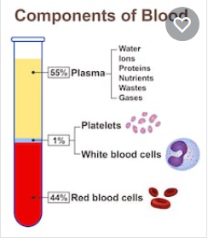
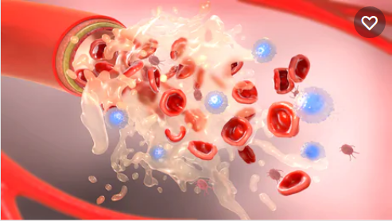
Blood Analysis
Blood: consist about 7%-8% of human body weight ,an essential fluid with critical functions
-Transposing oxygen and nutrients to body cells
-Getting rid of carbon dioxide, ammonia and other waste products

Slide 3
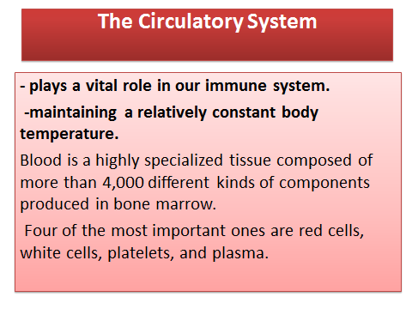

Slide 4
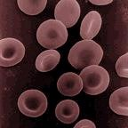
The Circulatory System
1-Red Cells or erythrocytes large microscopic cells without nuclei.
normally make up 40-50% of the total blood volume.
They transport oxygen from the lungs to all of the living tissues of the body and carry away carbon dioxide.
The red cells are produced continuously in our bone marrow from stem cells at a rate of about 2-3 million cells per second.

Slide 5
The Circulatory System
2-White Cells(WBCs), or leukocytes
exist in variable numbers and types but make up a very small part of blood's volume--normally only about 1% in healthy people.
Leukocytes are not limited to blood. They, most notably in the spleen, liver, and lymph glands.
Most are produced in our bone marrow from the same kind of stem cells that produce red blood cells. Others are produced in the thymus gland, which is at the base of the neck.
Some white cells are involved in defending the body against both infectious disease and foreign materials.
There are several different types of white blood cells. They all have many things in common but are all distinct in form and function.
A major distinguishing feature is the presence of granules; white blood cells are often characterized as granulocytes or a granulocytes

Slide 6
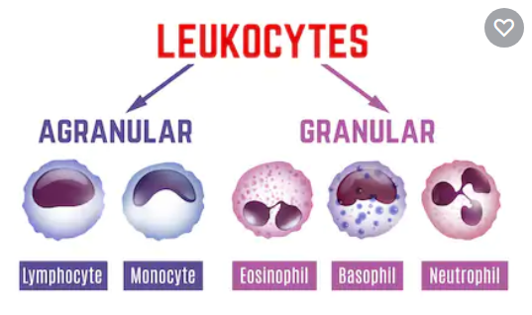
or leukocytes(White Cells(WBCs

Slide 7
A-Granulocytes
Granulocytes, also known as polymorphonuclear leukocytes (PMNs)
are characterized by differently stained granules as viewed in their cytoplasm under light microscopy.
These granules are membrane-bound enzymes that act primarily in the digestion of endocytosed particles.
There are three types of granulocytes :

Slide 8
A-Granulocytes
Neutrophils defend against bacterial or fungal infection and other very small inflammatory processes.
They are usually the first responders to microbial infection; their activity and death in large numbers forms pus.
Eosinophils primarily deal with parasitic infections. They are also the predominant inflammatory cells in allergic reactions.
-Basophils are chiefly responsible for allergic and antigen response by releasing the histamine, which causes dilation of the blood vessels.

Slide 9
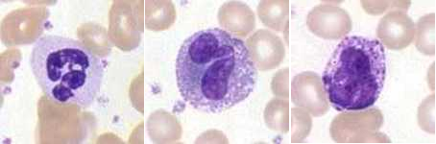
A-Granulocytes

Slide 10
B-Agranulocytes
Agranulocytes, or mononuclear leukocytes(MNs), are leukocytes characterized by absence of granules in their cytoplasm.
Agranulocytes contain lysosomes which are small vesicles containing digestive enzymes that break down any foreign matter that is endocytosis by the cell.
A granulocytes cells include:

Slide 11
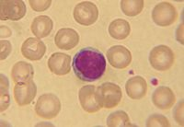
B-Agranulocytes
Lymphocytes: there are three types :
B-lymphocytes, which produce antibodies in the humeral immune response.
T-lymphocytes which participate in the cell-mediated immune response.
The null group which contains natural killer cells; cytotoxic cells that participate in the innate immune response.

Slide 12
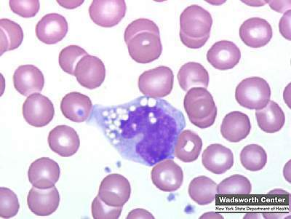
B-Agranulocytes
Monocytes
differentiate to macrophages) present pieces of pathogens to T cells so that the pathogens may be recognized again and killed,
or so that an antibody response may be mounted.

Slide 13
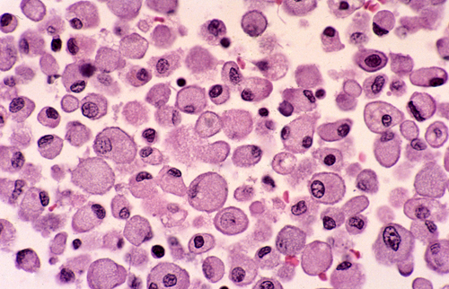
B-Agranulocytes
Macrophages
monocytes that have migrated out of the blood stream and enter the body tissues.
They take up and destroy necrotic cell debris and foreign material including viruses, bacteria, and tattoo ink.

Slide 14
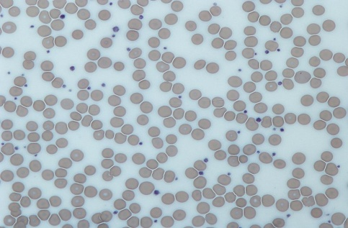
The Circulatory System
3-Platelets Platelets , or thrombocytes , are cell fragments without nuclei that work with blood clotting chemicals at the site of wounds. They do this by adhering to the walls of blood vessels, thereby plugging the rupture in the vascular wall.
They also can release coagulating chemicals which cause clots to form in the blood that can plug up narrowed blood vessels.

Slide 15
The Circulatory System
4-Plasma the clear, yellow, liquid part of blood contain (92%) water, sugar, fat, protein and salt solution .
Plasma carries the red cells, white cells, and platelets. Normally, 55% of our blood's volume is made up of plasma.
Plasma helps maintain blood pressure and regulates body temperature. plasma brings nourishment to them and removes the waste products of metabolism.
It contains a complex mix of substances used by the body to perform important functions. These substances include minerals, salts, hormones and proteins

Slide 16
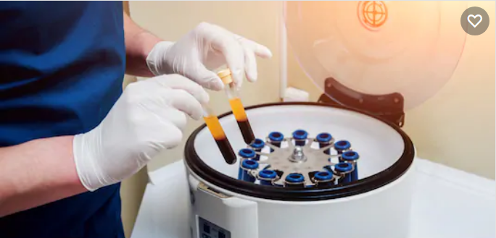
Three important proteins found in plasma
a- albumin
b- Globulin
c- Fibrinogen

Slide 17
plasma salts
salts present in plasma include sodium, potassium, calcium, magnesium, chloride, and bicarbonate.
These salts are also called electrolytes. An imbalance of electrolytes, which can be caused by dehydration, can be a serious medical condition.
Many gastrointestinal illnesses, such as cholera, cause a loss of electrolytes through severe diarrhea.

Slide 18
plasma nutrients
include amino acids, glucose, or sugars; and fatty acids and glycerol, the components of lipids (fats).
In addition to nutrients, plasma also contains enzymes, or small proteins that function in chemical reactions, and hormones, which are transported from glands to body tissues.

Slide 19
Blood tests
A blood test is a a laboratory analysis performed on a blood sample that is usually extracted from a vein in the arm using a needle, or via finger-prick.

Slide 20
Phlebotomists
a laboratory practitioners and nurses are those charged with patient blood extraction.
However, in special circumstances, and emergency situations,
paramedics and physicians sometimes extract blood.
Also, respiratory therapists are trained to extract arterial blood to examine arterial blood gases.

Slide 21
1-Complete Blood Count
The complete blood count, or CBC, lists a number of many important values. Typically, it includes the following:

Slide 22
a-White Blood Count (WBC).
White blood cells are larger than red blood cells, but there are fewer of them in numbers.
In infection, an increased number of white blood cells are sent from the bone marrow to attack the bacteria or virus that is causing the infection.
An increased number of white blood cells may occur with mild infections, appendicitis, pregnancy, leukemia, hemmorrhage and hemolysis.

Slide 23
b-Red Blood Count (RBC)
Red blood cells are the most common type of cell in the blood ,body contains millions upon millions of these disc-shaped cells.
The RBC determines if the number of red blood cells in the body is low (called anemia) or high (called polycythemia).

Slide 24
c-Hemoglobin Concentration (HGB)
(للاطلاع)
The purpose of this test is to determine the ratio of plasma (clear liquid part of the blood)to red cells in the blood .

Slide 25
d-Hematocrit measurement
The hematocrit (Ht or HCT), British English spelling (haematocrit), also known as packed cell volume (PCV) or erythrocyte volume fraction (EVF),
is the volume percentage (%) of red blood cells in blood.
It is normally 45% for men and 40% for women. It is considered an integral part of a person's complete blood count results.

Slide 26
e- MCV (Mean Cell Volume)
(للاطلاع)
Measures the average size of red blood cells.
In patients with anemia, it is the MCV measurement that allows classification as either a microcytic anemia (MCV below normal range), normocytic anemia (MCV within normal range) or macrocytic anemia (MCV above normal range).
Normocytic anemia is usually deemed so because the bone marrow has not yet responded with a change in cell volume. It occurs occasionally in acute conditions, namely blood loss and hemolysis.

Slide 27
f- MCH (Mean Cell Hemoglobin)
(للاطلاع)
Reflects the average weight of hemoglobin found in the red blood cell.
("normochromic") in macrocytic anemias (due to larger cell size, though the hemoglobin amount or MCH is high, the concentration remains normal).

Slide 28
g- MCHC (Mean Cell Hemoglobin (للاطلاع)Concentration
macrocytic anemias (due to larger cell size, though the hemoglobin amount or MCH is high, the concentration remains normal).
MCHC is elevated ("hyperchromic").
h-RDW (Red Cell Distribution Width):
RCD is a histogram (visual), which is a measure of the range of variation of red blood cell (RBC) volume.

Slide 29
i- MPV (Mean Platelet Volume)
(للاطلاع)
Reflect the average volume of platelet.
Platelets are the smallest type of cell found in the blood.
Platelets help stop bleeding after an injury by gathering around the injury site, plugging the hole in the bleeding vessel and helping the blood to clot more quickly.

Slide 30
j- Platelet count
platelet counts are often done in bruising or in surgery.
The platelet count may change with bleeding disorders, heart disease, diabetes, inflammatory disorders, and anemia.

Slide 31
k- Erythrocyte Sedimentation Rate (ESR)
Also called sedimentation rate test, measures the speed at which red blood cells settle to the bottom of an upright glass test tube.
This measurement is important because when abnormal proteins are present in the blood, typically due to inflammation or infection, they cause red blood cells to clump together and sink more quickly, which results in a high ESR value.
The ESR is useful in detecting inflammation in the body that may be caused by infection and some cancers. and certain autoimmune diseases such as juvenile idiopathic arthritis, lupus, and Kawasaki disease.

Slide 32
2- Blood typing
Is a test that determines a person’s blood type. The test is essential in blood transfusion or in donate blood.
Not all blood types are compatible, so it is important to blood group to ensure that in transfusion the body doesn’t make antibodies to attack the donor blood.

Slide 33
The Blood Types
The ABO blood typing system groups blood is one of four categories:
O: type O individuals can donate blood to anyone, but can receive blood only from other type O individuals.
A: type A individuals can donate to other type A individuals and type AB individuals. Type A individuals can receive blood only from other type A individuals and type O individuals.
B: type B individuals can donate blood to other B individuals and AB individuals. Type B individuals can receive blood only from type B individuals and type O individuals.
AB: type AB individuals can give blood only to other AB individuals, but can receive blood of any type.

Slide 34
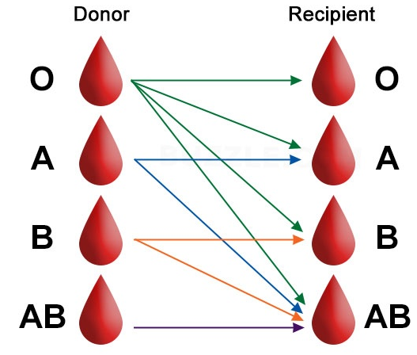
ABO System for Blood Typing

Slide 35
The Rh factor blood grouping system:
Rh+: People with Rh-positive blood have Rh antigens on the surface of their red blood cells. People with Rh+ blood can receive Rh+ or Rh- blood.
Rh-: People with Rh-negative blood do not have Rh antigens they can receive only blood that is also Rh-.
Together,
the ABO and Rh grouping systems yield your complete blood type. There are eight possible types: O+, O-, A+, A-, B+, B-, AB+, and AB-.

Slide 36

Thank you

