Slide 1

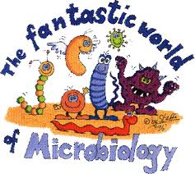
Lecture-1/Microbiology/ Introduction, Methods used in microbiology and the study of microbes

Slide 2
Lecture-1/Microbiology
Microbiology: Is the study of organisms too small to be seen without magnification
Microorganisms include:
  Bacteria,Viruses,Fungi,Protozoa ,Helminths (worms) ,Algae
Microorganisms are too small to see with the naked eye unicellular structures.They have ability to reproduce themselves with simple cell division. The single cell of the microorganisms contains the complete genetic material and can be transferred to the next generation of cells.
2
Notes:
2

Slide 3
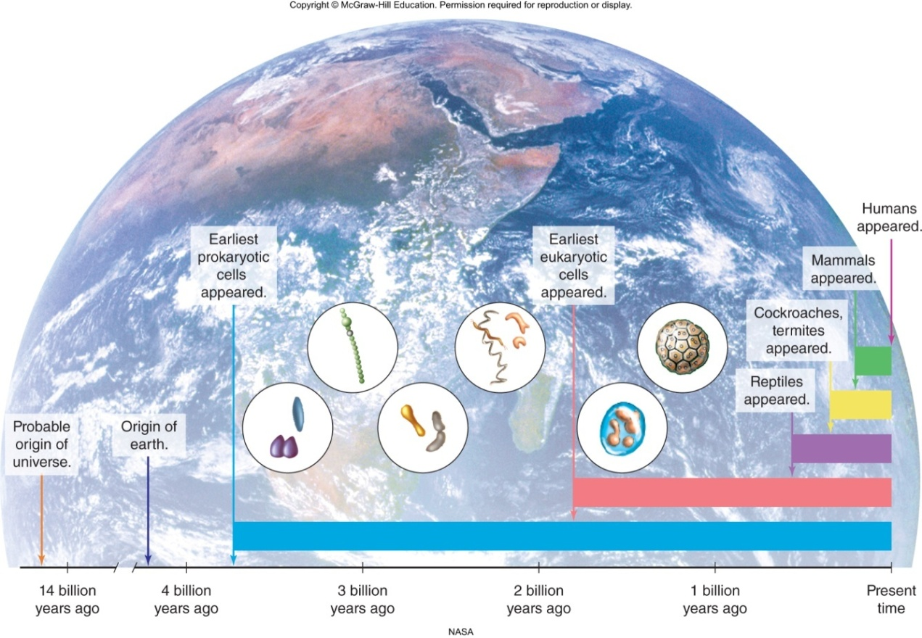
Origins of Microorganisms
Bacteria-like organisms have existed on earth for about 3.5 billion years
  Prokaryotes (pre-nucleus): Simple cells
  Eukaryotes (true nucleus): Complex cells
3
Notes:
3

Slide 4
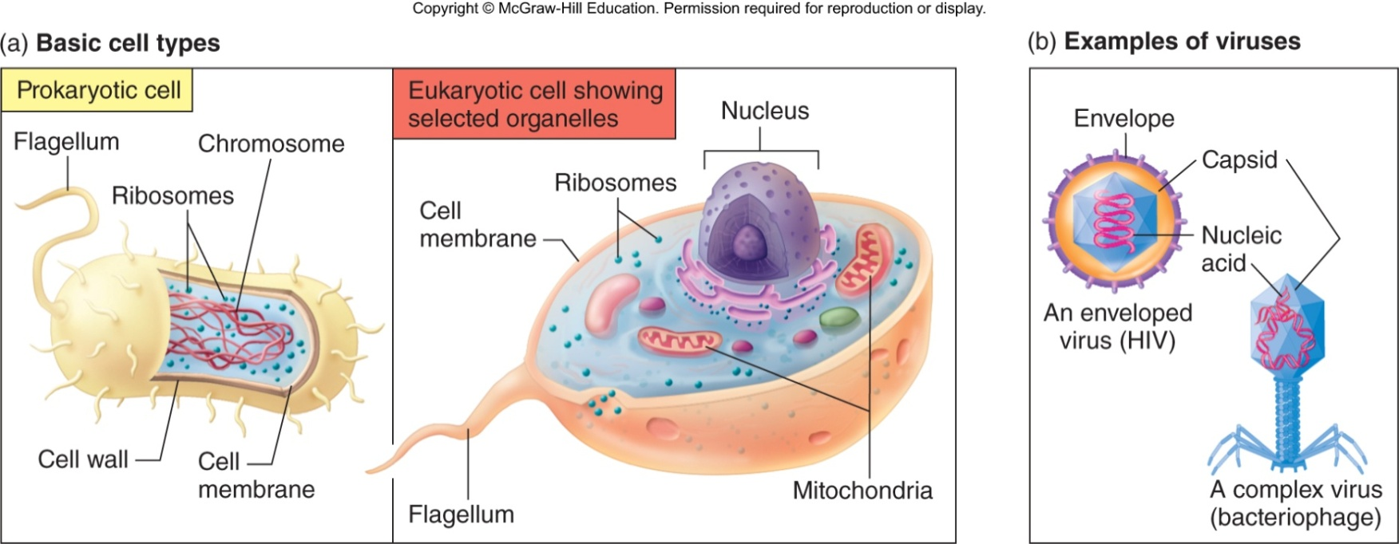
Microbial Structure
Two cell lines
  Prokaryote – microscopic, unicellular organisms, lack nuclei and membrane-bound organelles
  Eukaryote – unicellular (microscopic) and multicellular, nucleus and membrane-bound organelles
Viruses - Acellular, parasitic particles composed of a nucleic acid and protein
4

Slide 5
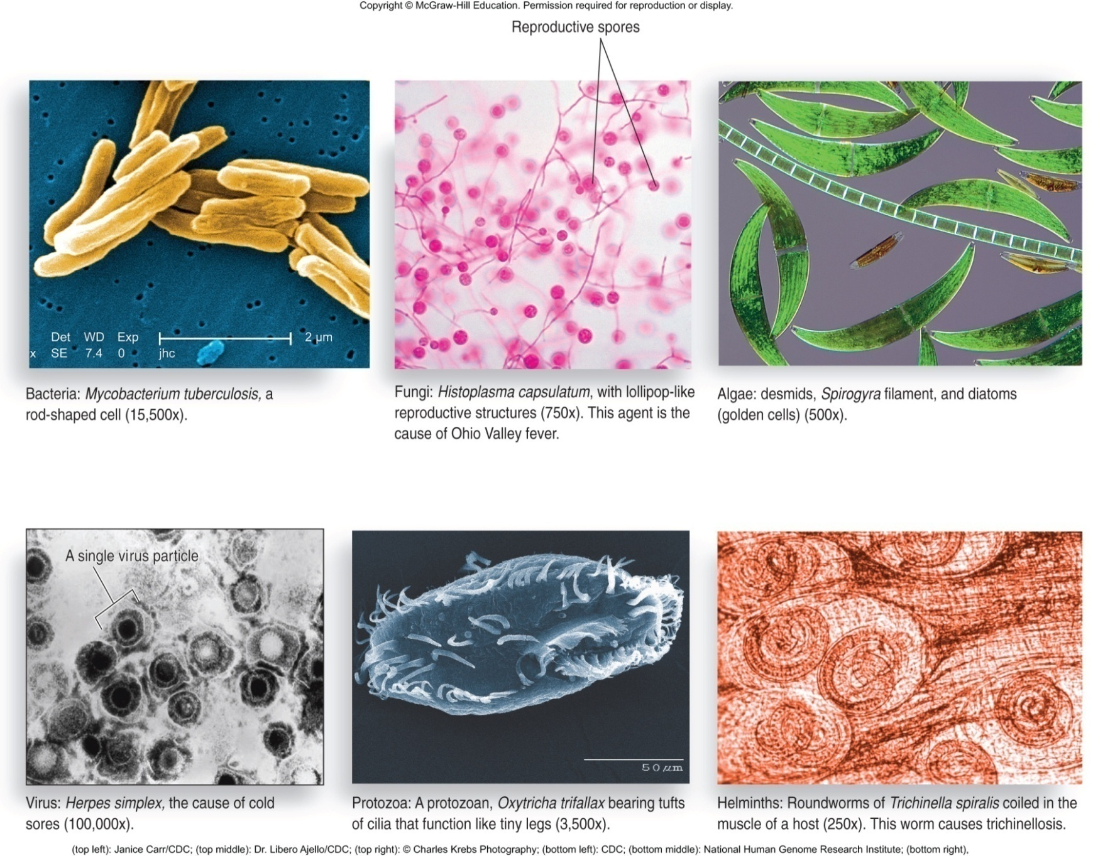
Microbial Diversity: 6 Types of Microbes
5

Slide 6
microbiology topics divided into speciﬁc ﬁelds:
Bacteriology : study of bacteria
Mycology : study of fungi
Phycology: study of algae
Parasitology: study of protozoa
and parasitic worms
Virology: study of viruses
Immunology: host immunity & vaccines
Recombinant DNA Technology: insertion of genes into microbes to produce therapeutics
6

Slide 7
Microbiologists study these organisms using tools
Like microscopes, genetics, and culturing.
Microscopes allow scientists to magnify microbial cells that are otherwise too small to see.
Genetics and molecular biology help scientists understand the evolutionary relationships between microbes and their habitats.
Culturing is the term used to describe growing microbes, usually combined with tests to see what the microbes like to utilize or what conditions they can live in.
7

Slide 8
Organism Nomenclature
Organism Nomenclature
-Established by Carolus Linnaeus (1735)
-latinized
-each organism has unique two part genus & species name:
e.g. Escherichia coli
-written in italics or underlined
-genus with capital ﬁrst letter
-species/speciﬁc epithet all lowercase
-after ﬁrst use in documents can abbreviate genus: E. coli
-name often describes organism: shape, habitat, name of discoverer, etc.
8

Slide 9
The Importance of Microorganisms
They have great impact on human lives and are used for different purposes as listed below:
1-Food:
Nature uses microorganisms to carry out fermentation processes, and for thousands of years mankind has used yeasts, moulds and bacteria to make food products such as bread, beer, wine, vinegar, yoghurt and cheese, as well as fermented fish, meat and vegetables.
2-Medicine:
Microbes play a major role in the development, production, and future of medicine. Vaccines and antibiotics are only two of the hundreds of uses for microbes in the medical field. Microbes have played a significant role in the development of medical treatments.
9

Slide 10
3-Human health
1-Human digestion:Microorganisms can form an endosymbiotic relationship with other, larger organisms. For example, the bacteria that live within the human digestive system contribute to gut immunity, synthesise vitamins such as folic acid and biotin, and ferment complex indigestible carbohydrates.
2-Disease: Microorganisms are the cause of many infectious diseases.
The organisms involved include pathogenic bacteria, causing diseases such as tuberculosis and anthrax. Protozoa, causing diseases such as malaria and dysentery. Fungi causing diseases such as candidiasis. However, other diseases such as influenza, yellow fever or AIDS are caused by pathogenic viruses
10

Slide 11
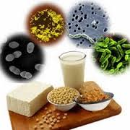
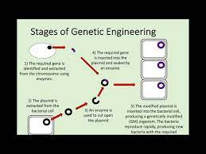
Human Use of Microorganisms
4-Biotechnology: Production of foods, drugs, and vaccines using living organisms
5-Genetic engineering: Manipulating the genes of organisms to make new products
6-Bioremediation: Using living organisms to remedy an environmental problem
11
Notes:
11

Slide 12
Microbes and Human Disease
Normal Microbiota = microbes that live in or on you always
sometimes good, sometimes bad
*prevent pathogen colonization
*produce vitamins in gut
*can cause disease in new location or immuno-compromised host
-Resistance = ability to ward off disease
-Infectious Disease
Pathogens = microbes that have part of life cycle in human host causing illness
*reemerging and increasing
*increasing drug resistance Emerging Infectious
*Of all known bacteria, less than 10% cause any illness in humans
12

Slide 13
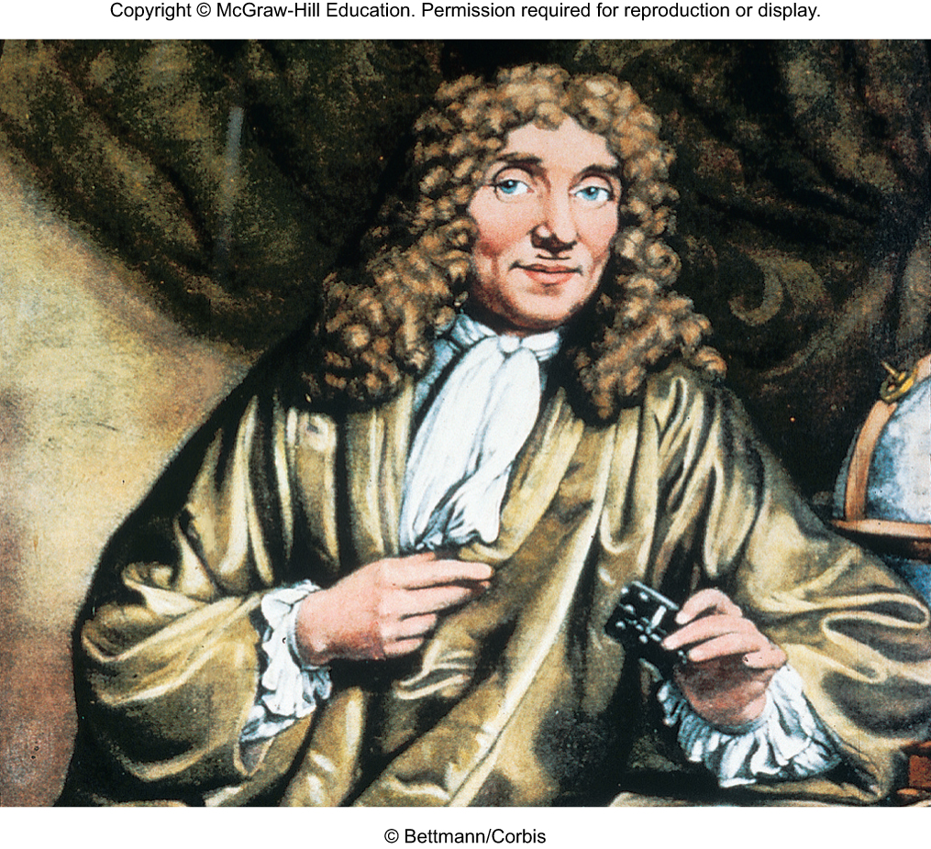
Antonie van Leeuwenhoek (1632-1723)
Dutch linen merchant
First to observe living microbes
Single-lens magnified up to 300X
13
Notes:
13

Slide 14
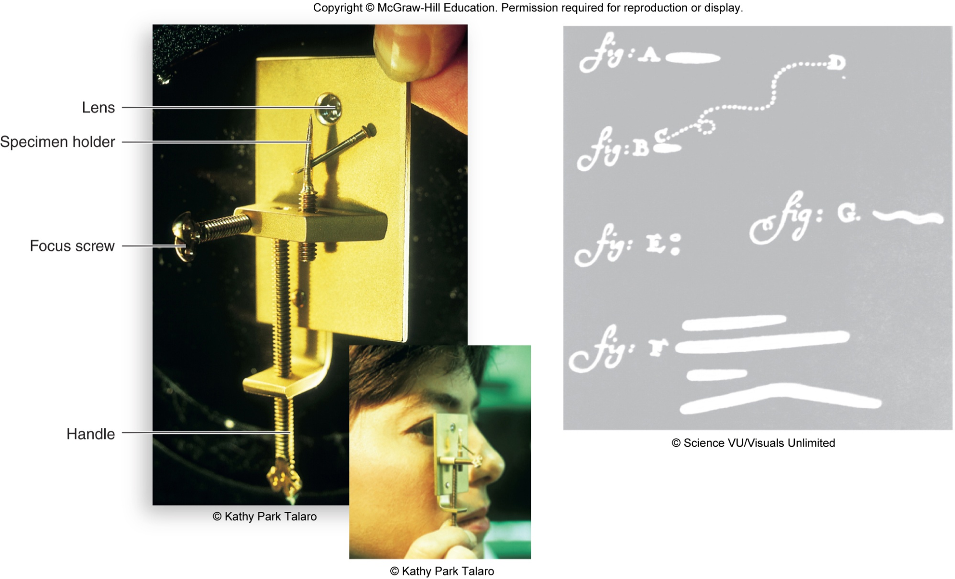
Leeuwenhoek’s Work
14
Notes:
14

Slide 15
Tools of the Laboratory :The methods for studying microorganisms
The Microscope :is the Key characteristics of a reliable microscope are:
Magnification – ability to enlarge objects
Resolving power – ability to show detail.
Magnification in most microscopes results from an interaction between visible light waves and the curvature of a lens. The extent of enlargement is the magnification
15
Notes:
15

Slide 16
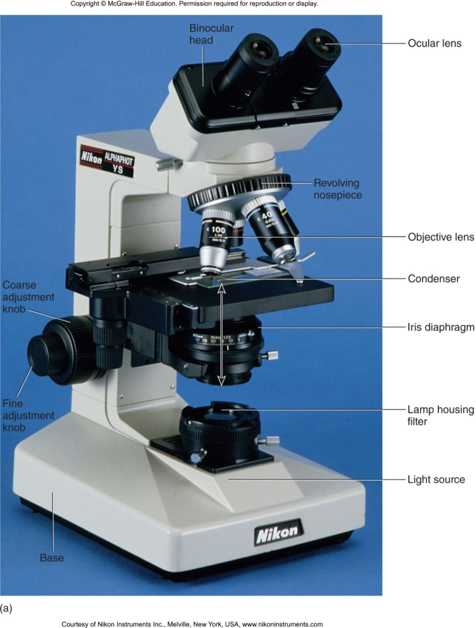
Parts of the Microscope
16
Notes:
16

Slide 17
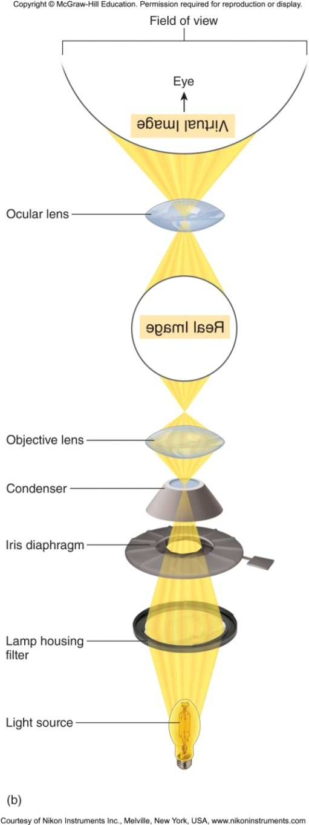
Magnification in Two Phases
  The objective lens forms the magnified real image
  The real image is projected to the ocular where it is magnified again to form the virtual image
17
Notes:
شكل العدسة الموضوعية الصورة الحقيقية المكبرة
يتم عرض الصورة الحقيقية على العين حيث يتم تكبيرها مرة أخرى لتكوين الصورة الافتراضية
17

Slide 18
Total Magnification
Total magnification of the final image is a product of the separate magnifying powers of the two lenses
objective power
ocular power
total magnification
x
=
18
Notes:
18

Slide 19
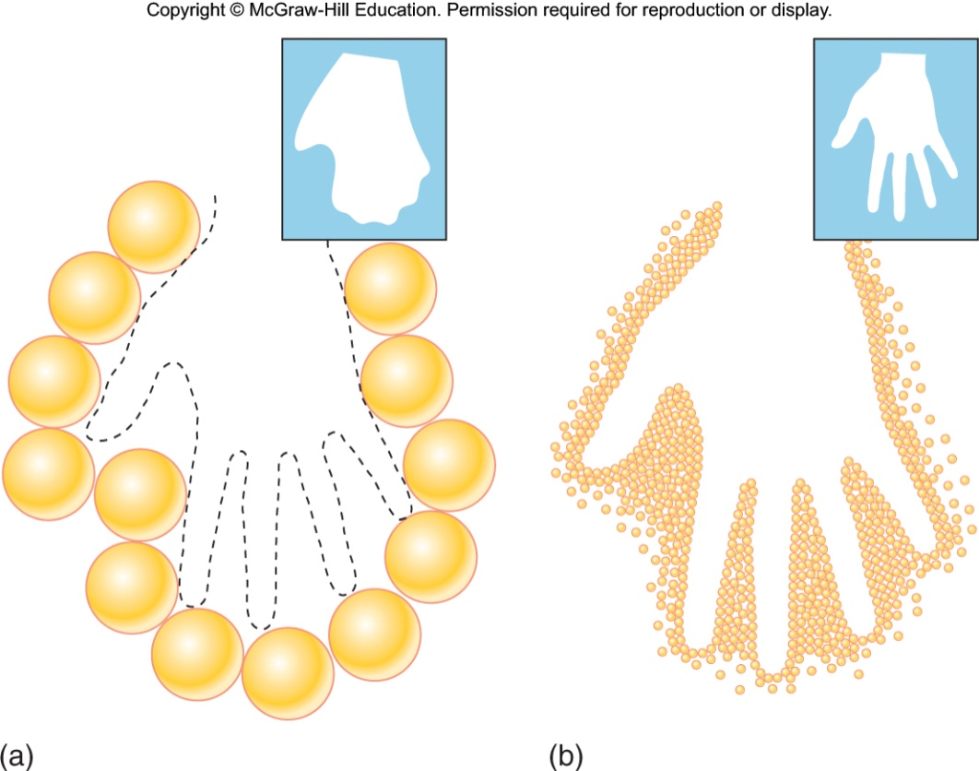
Resolution
The capacity to distinguish or separate two adjacent objects and depends on
  The wavelength of light that forms the image along with characteristics of the objectives
19
Notes:
الدقه
19

Slide 20
Quantifying Resolution
Wavelength of light in nm
Resolving Power (RP)
=
2 X Numerical aperture of objective lens
    Visible light wavelength is 400 nm–750 nm
    Numerical aperture of lens ranges from 0.1 to 1.25 μm
    Shorter wavelength and larger numerical aperture will provide better resolution
    Oil immersion objectives resolution is 0.2 μm
    Magnification between 40X and 2000X
20
Notes:
كميه الدقه//Numerical aperture الفتحه العدديه
20

Slide 21
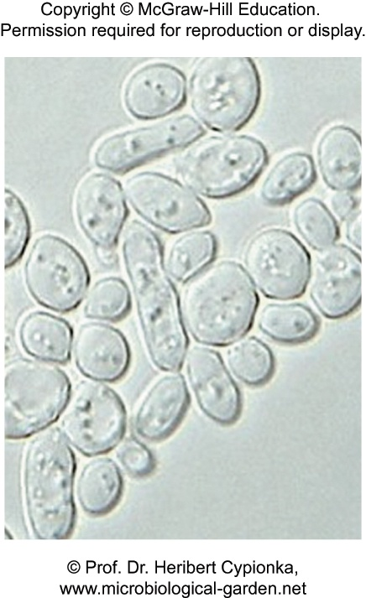
Variations on the Optical Microscope
Bright-field – most widely used; specimen is darker than surrounding field; used for live and preserved stained specimens
21
Notes:
21

Slide 22
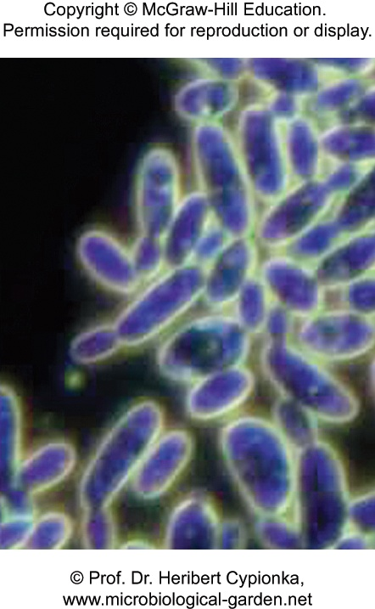
Variations on the Optical Microscope
Dark-field – brightly illuminated specimens surrounded by dark field; used for live and unstained specimens
22
Notes:
22

Slide 23
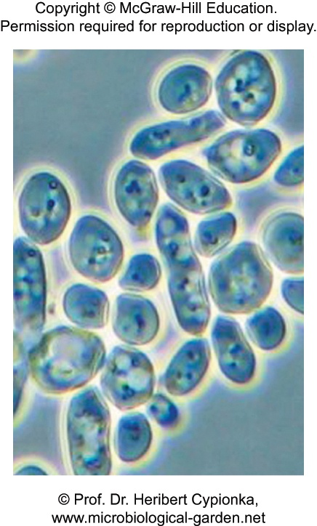
Variations on the Optical Microscope
Phase-contrast – transforms subtle changes in light waves passing through the specimen into differences in light intensity, best for observing intracellular structures
23
Notes:
تباين مرحلي//يحول التغييرات الطفيفة في موجات الضوء التي تمر عبر العينة إلى اختلافات في شدة الضوء ، وهو الأفضل لمراقبة الهياكل داخل الخلايا
23

Slide 24
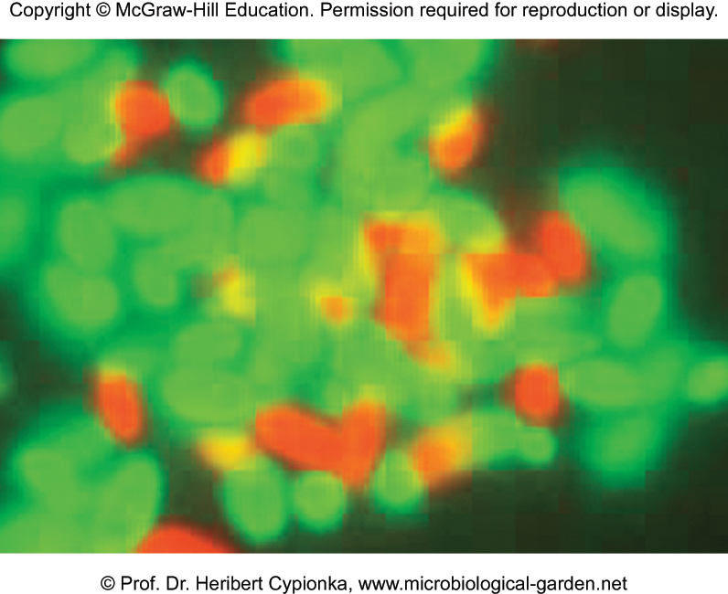
Fluorescence Microscope
Modified microscope with an ultraviolet radiation source and filter.
Uses dyes that emit visible light when bombarded with shorter UV rays - fluorescence
Useful in diagnosing infections
24
Notes:
24

Slide 25
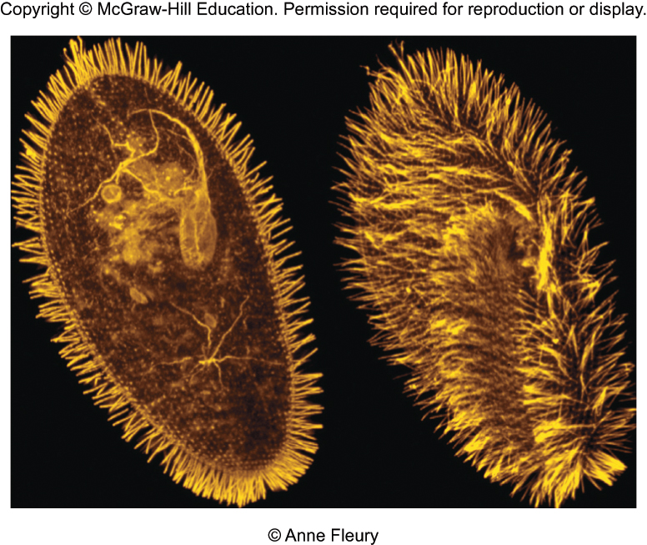
Scanning Confocal Microscope
Uses a laser beam of light to scan the specimen.
Integrates images to allow focus on multiple depths or planes.
25
Notes:
مجهر متحد البؤر
25

Slide 26
Electron Microscopy
Forms an image with a beam of electrons that can be made to travel in wavelike patterns when accelerated to high speeds
Electron waves are 100,000 times shorter than the waves of visible light
Electrons have tremendous power to resolve minute structures because resolving power is a function of wavelength
Magnification between 5,000X and 1,000,000X
26
Notes:
26

Slide 27
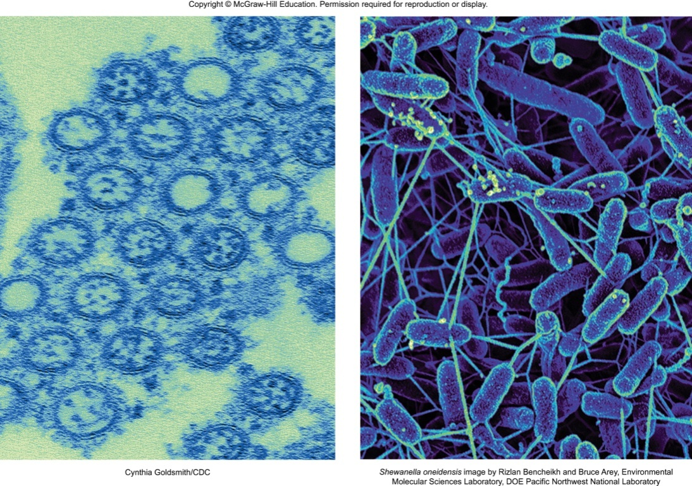
2 Types of Electron Microscopes
Transmission electron microscopes (TEM) – transmit electrons through the specimen. Darker areas represent thicker, denser parts and lighter areas indicate more transparent, less dense parts.
27
Notes:
المجاهر الإلكترونية الناقلة (TEM) - تنقل الإلكترونات من خلال العينة. تمثل المناطق الداكنة أجزاء أكثر سمكًا وكثافة ، وتشير المناطق الأفتح إلى الأجزاء الأكثر شفافية والأقل كثافة.
27

Slide 28
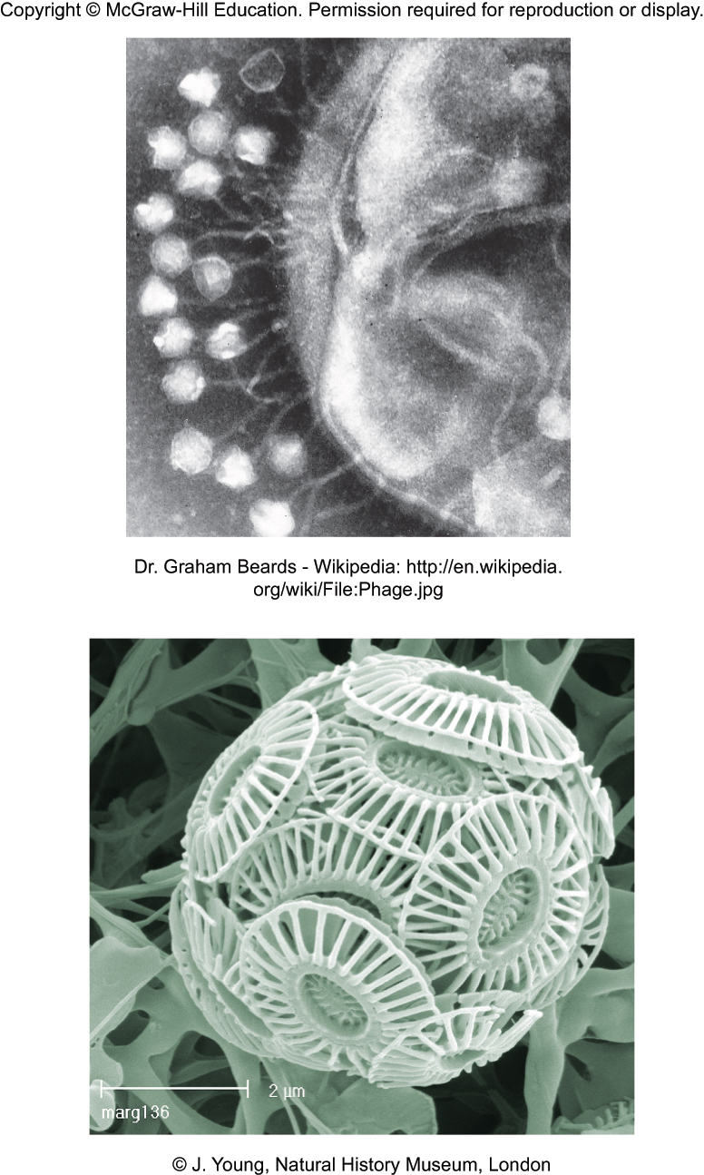
2 Types of Electron Microscopes
Scanning electron microscopes (SEM) – provide detailed three-dimensional view. SEM bombards surface of a whole, metal-coated specimen with electrons while scanning back and forth over it.
28
Notes:
المجاهر الإلكترونية (SEM) - توفير عرض مفصل ثلاثي الأبعاد. تقصف SEM عينة كاملة مغلفة بالمعدن بإلكترونات أثناء المسح ذهابًا وإيابًا فوقها
28

