Slide 1
Microbial genetics
Grade three lec. 6 & 7

Slide 2
Horizontal gene transfer , the transmission of DNA between different genomes, occur between different species.
The horizontal gene transfer is distinguished from the transmission of genetic material from parents during reproduction, which is known as vertical gene transfer.
Horizontal gene transfer is made possible in large part by the existence of mobile genetic elements, such as plasmids (extrachromosomal genetic material), transposons (“jumping genes”), and bacteriophages (bacteria-infecting viruses).
These elements are transferred between organisms through (in prokaryotes) transformation, conjugation, and transduction. In transformation, prokaryotes take up free fragments of DNA, often in the form of plasmids, found in their environment

Slide 3
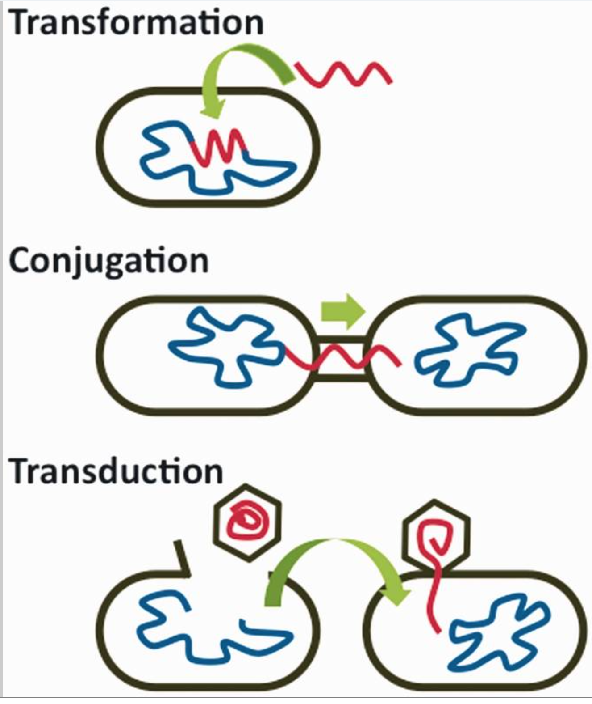
In conjugation, genetic material is exchanged during a temporary union between two cells, which may entail the transfer of a plasmid or transposon.
In transduction, DNA is transmitted from one cell to another via a bacteriophage.
In horizontal gene transfer, newly acquired DNA is incorporated into the genome of the recipient through either recombination or insertion.
Recombination essentially is the regrouping of genes, such that native and foreign (new) DNA segments that are homologous are edited and combined.
Insertion occurs when the foreign DNA introduced into a cell shares no homology with existing DNA.
In this case, the new genetic material is embedded between existing genes in the recipient’s genome

Slide 4
1. Conjugation
Bacterial conjugation is the transfer of genetic material between bacterial cells by direct cell-to-cell contact or by a bridge-like connection between two cells. Discovered in 1946 by Joshua Lederberg and Edward Tatum.
In most cases, this involves the transfer of plasmid DNA, although with some organisms chromosomal transfer can also occur. As with other modes of gene transfer in bacteria.
In the simplest of cases, conjugation is achieved in the laboratory by mixing the two strains together and after a period of incubation to allow conjugation to occur, plating the mixture onto a medium that does not allow either parent to grow, but on which a transconjugant that contains genes from both parents will grow.

Slide 5
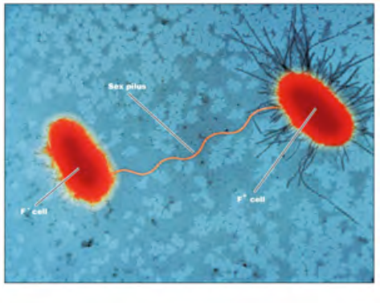
Conjugation is demonstrated amongst members of the Enterobacteriaceae and other Gram-negative bacteria (such as Vibrios and Pseudomonads). As well as
Gram-positive including Streptomyces species, which are involved antibiotics production, the lactic streptococci, which are applied to the dairy products industry.
One practical consequence is that plasmids that are present in the normal gut flora can be transmitted to infecting pathogens, which then become resistant to a range of different antibiotics.

Slide 6
F plasmid
The F plasmid was originally discovered in E. coli by mixed culture of two auxotrophic strains, so that plating onto minimal medium would only permit recombinants to grow.
The information was transferred from the donor (‘male’) to the recipient (‘female’). The donor strains carry the F plasmid (F‏) while the recipients are F^{-­­­­­­­­­­­­­} .
The co-cultivation of an F‏ and an F ⁻ strain resulted in the ‘females’ being converted into ‘males’ due to the transmission of the F plasmid itself which occurs at a high frequency.
in contrast to the transfer of chromosomal markers which is very inefficient with an F‏ donor since transfer does not start from a defined point on the chromosome.
The combination of the partial transfer of chromosomal DNA with the ordered transfer of genes made conjugation an important tool in the mapping of bacterial chromosomes, Integration and excision of F: formation of F plasmids Integration of the F plasmid occurs by recombination between a sequence on the plasmid and a chromosomal site.

Slide 7
Mechanism of conjugation
Formation of mating pairs
In E. coli and other Gram-negative bacteria, the donor cell carries appendages on the cell surface known as pili. These vary in structure – for example the pilus specified by the F plasmid is long, thin and flexible, while the RP4 pilus is short, thicker and rigid. The pili make contact with receptors on the surface of the recipient cell.
a channel or pore is made through which the DNA passes from the donor to the recipient.

Slide 8
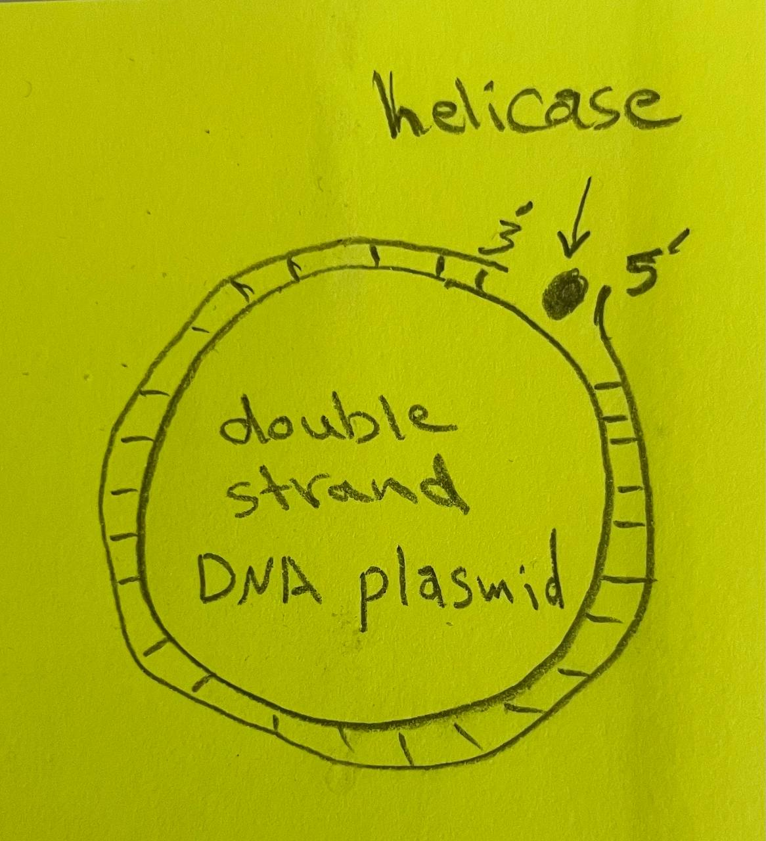
Transfer of DNA
The transfer of plasmid DNA is initiated by a protein which makes a single-strand break (nick) at a specific site in the DNA, known as the origin of transfer (oriT).
A plasmid-encoded helicase unwinds the plasmid DNA and the single nicked strand is transferred to the recipient starting with the 5- end generated by the nick.
Concurrently, the free 3- end of the nicked strand is extended to replace the DNA transferred, by a process known as rolling circle replication.
The nicking protein remains attached to the 5- end of the transferred DNA. DNA synthesis in the recipient converts the transferred single strand into a double stranded molecule.
The consequence can be spread of the plasmid through the mixed population.

Slide 9
Mobilization and chromosomal transfer
Not all plasmids are capable of achieving this transfer to another cell unaided; those that can are known as conjugative plasmids.
In some cases a conjugative plasmid is able to promote the transfer of a second otherwise nonconjugative plasmid from the same donor cell. This does not happen by chance and not all non-conjugative plasmids can be mobilized.
In plasmid ColEI Mobilization involves the mob gene, which encodes a specific nuclease, and the bom site (¼ oriT, the origin of transfer), where the Mob nuclease makes a nick in the DNA.
ColE1 plasmid has the genes needed for DNA transfer but it does not carry the genes required for mating-pair formation.
The presence of another (conjugative) plasmid enables the donor to form mating pairs with the recipient cell and ColE1 can then use its own machinery to carry out the DNA transfer.

Slide 10
Some plasmids which can be mobilized do not carry a mob gene. Mobilization then depends on the ability of the Mob nuclease of the conjugative plasmid to recognize the bom site on the plasmid to be mobilized. This only works if the two plasmids are closely related.
some types of plasmids can also promote transfer of chromosomal DNA.
As in the F (fertility) plasmid of E. coli, and in Pseudomonas aeruginosa.
chromosomal transfer does not involve a complete intact copy of the chromosome. One reason for this is the time required for transfer. the whole chromosome would take about 100 min (in E. coli). The mating pair very rarely remains together this long. the transfer of the plasmid would be expected to be completed in 1 min.
an F-containing cell, which is designated F+, can mate with a cell lacking the plasmid, designated F-, to yield two F+ cells. The F plasmid is an episome, a plasmid that can integrate into the host chromosome .
When the F plasmid is integrated into the chromosome, the chromosome becomes mobilized and can lead to transfer of chromosomal genes. Cells possessing an integrated F plasmid are called F+. Those that have a chromosome-integrated F plasmid are called Hfr (for high frequency of recombination).

Slide 11
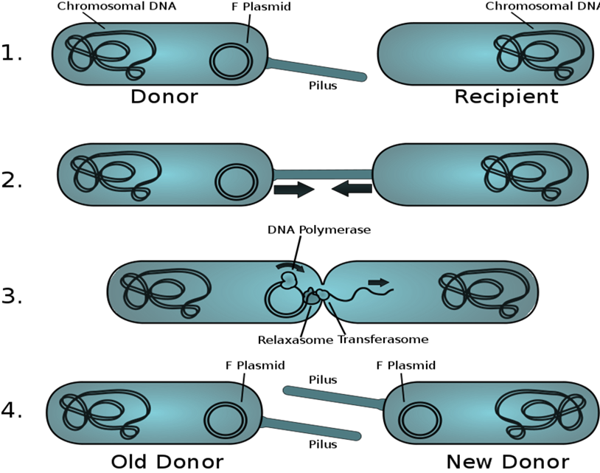

Slide 12
High-frequency recombination cell
A high-frequency recombination cell (also called an Hfr strain) is a bacterium with a conjugative plasmid (often the F-factor) integrated into its genomic DNA.
Hfr strains will, upon conjugation with a F− cell, attempt to transfer their entire DNA through the mating bridge, not to be confused with the pilus.
This occurs because the F factor has integrated itself in the bacterial chromosome. during conjugation, the rest of the bacterial genome is dragged along with it, thus making such cells very useful in studying gene linkage and recombination.
In Hfr × F− crosses, virtually none of the F− parents were converted into F+ or into Hfr. This result is in contrast with F+ × F− crosses, where transfer of F results in a large proportion of the F− parents being converted into F+. It became apparent that an Hfr strain results from the integration of the F factor into the chromosome.
during conjugation between an Hfr cell and a F− cell a part of the chromosome is transferred with F.
Random breakage interrupts the transfer before the entire chromosome is transferred.
The chromosomal fragment can then recombine with the recipient chromosome.

Slide 13
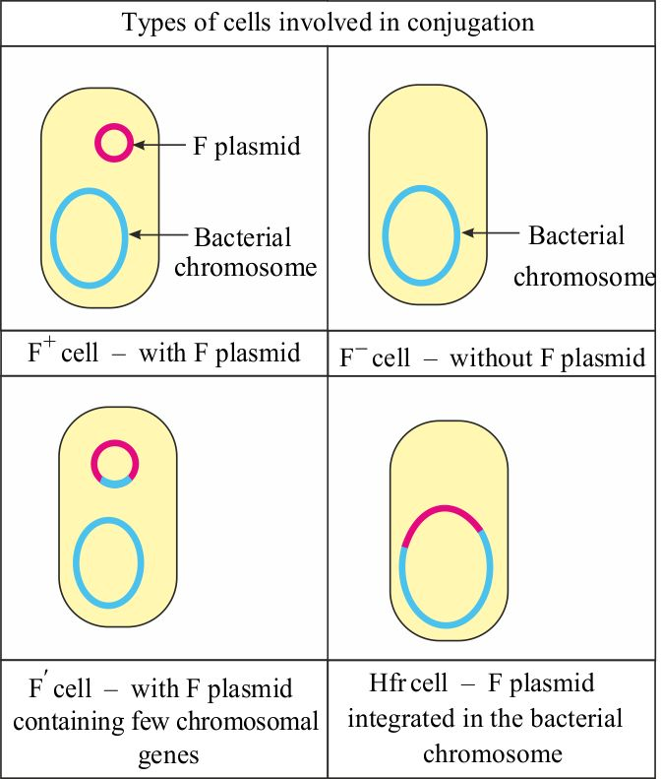

Slide 14
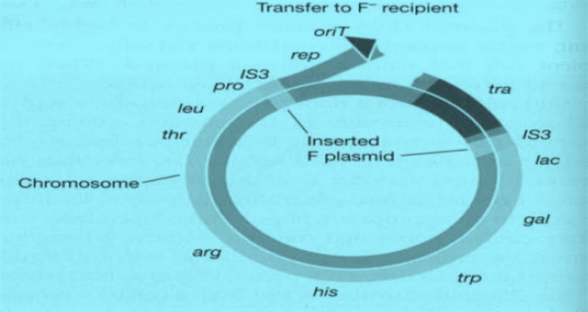
Breakage of the Hfr chromosome at the origin of transfer and the beginning of DNA transfer to the recipient.
F sexduction :F mobilizes small excised region of donor chromosome.

Slide 15
Details of the replication and transfer process

Slide 16
F plasmids containing chromosomal genes are called F' (F prime) plasmids.
F' plasmids differ from normal F plasmids in that they contain identifiable chromosomal genes, and they transfer these genes at high frequency to recipients. F' -mediated transfer resembles specialized transduction in that only a restricted group of chromosomal genes can be transferred.
Conjugation in other bacteria
Many Gram-positive species, ranging from Streptomyces to Enterococcus, also possess plasmids that are transmissible by conjugation
In general, the number of genes required for conjugative transfer, is very much less than in Gram-negative bacteria.
Conjugative plasmids in Gram-positive bacteria can therefore be considerably smaller. One reason for a smaller number of genes being required is that there seems to be no need for production of a pilus. This is probably, a reflection of the different cell-wall architecture in Gram-positive bacteria which lack the outer membrane characteristic of the Gram-negatives.
One group of Gram-positive bacteria where conjugation systems have been studied in detail are the enterococci, principally Enterococcus faecalis.

Slide 17
studied in detail are the enterococci, principally Enterococcus faecalis. Some
strains of E. faecalis secrete diffusible peptides that have a pheromone-like action that can stimulate the expression of the transfer (tra) genes of a specific plasmid in a neighbouring cell. Note that, it is the recipient cell that produces the pheromones. The donor cell, carrying the plasmid, has a plasmid encoded receptor on the cell surface to which the pheromone binds. Different types of plasmid code for different receptors and are therefore stimulated by different pheromones. However the recipient produces a range of pheromones and is therefore capable of mating with cells carrying different plasmids.
After the pheromone has bound to the cell-surface receptor it is transported into the cytoplasm, by a specific transport protein, where it interacts with a protein called TraA. This protein is a repressor of the tra genes on the plasmid and the binding of the peptide to it relieves that repression, thus stimulating expression of the tra genes. One result is the formation of aggregation products which cause the formation of a mating aggregate containing donor and recipient cells bound together. A further consequence of expression of the tra genes is stimulation of the events needed for transfer of the plasmid which occurs by a mechanism similar to that described previously.
One advantage of this system is that the cells containing the plasmid do not
express the genes needed for plasmid transfer unless there is a suitable recipient in the vicinity. Not only does this reduce the metabolic load on the cell but it also means that they are not expressing surface antigens (such as conjugative pili) that could be recognized by the host immune system.

