Slide 1
Practical Network Computer Science IT&CS&CY Third Class part 3 A.P Mohanad Ali 2025

Slide 2
A: Twisted-Pair Cable
B: Coaxial Cable
C: Optical Fiber Cable

Slide 3
Twisted-Pair Cable
Twisted-pair cable is a type of cabling that is used for telephone communications and most modern Ethernet networks. A pair of wires forms a circuit that can transmit data. The pairs are twisted to provide protection against crosstalk, the noise generated by adjacent pairs. When electrical current flows through a wire, it creates a small, circular magnetic field around the wire. Two basic types of twisted-pair cable
exist:
Unshielded Twisted Pair (UTP).
Shielded Twisted Pair (STP).

Slide 4
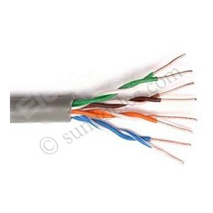
UTP Cable
UTP cable is a medium that is composed of pairs of wires. UTP cable is used in a variety of networks. Each of the eight individual copper wires in UTP cable is covered by an insulating material. In addition, the wires in each pair are twisted around each other.
Speed and throughput—10 to 1000 Mbps
Maximum cable length—100 m (short)

Slide 5
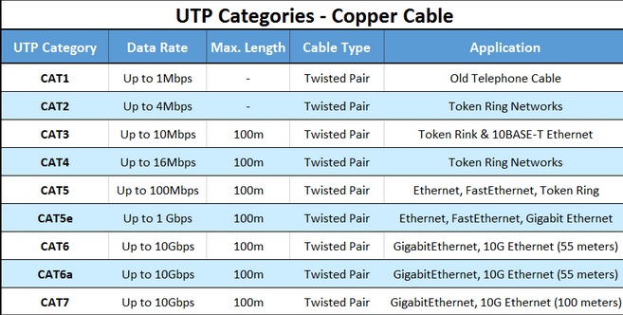

Slide 6
Advantages & Disadvantages of UTP
Advantages
Small size can be advantageous during installation.
A small external diameter, UTP does not fill up wiring ducts as rapidly as other types of cable.
UTP cable is easy to install.
UTP is less expensive than other types of networking media. In fact, UTP costs less per meter than any other type of LAN cabling.
UTP can be used with most of the major networking architectures, it continues to grow in popularity.
Disadvantages
UTP cable is more prone to electrical noise and interference than other types of networking media.
The distance between signal boosts is shorter for UTP than it is for coaxial and fiber-optic cables. slower at transmitting data than other types of cable.

Slide 7
STP Cabling
It is contain with four pairs wires then are wrapped in an overall metallic braid or foil.
Use in Ethernet network
It is more expensive
Difficult to install. Speed and throughput 10 to 100 Mbps
Average cost is expensive
Maximum cable length 100 m (short)
NOT
Because most buildings are already wired with UTP, many transmission standards are adapted to use it, to avoid costly rewiring with an alternative cable type.

Slide 8
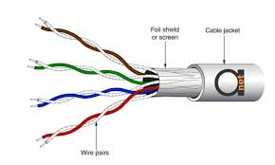
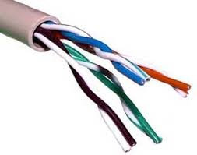

Slide 13
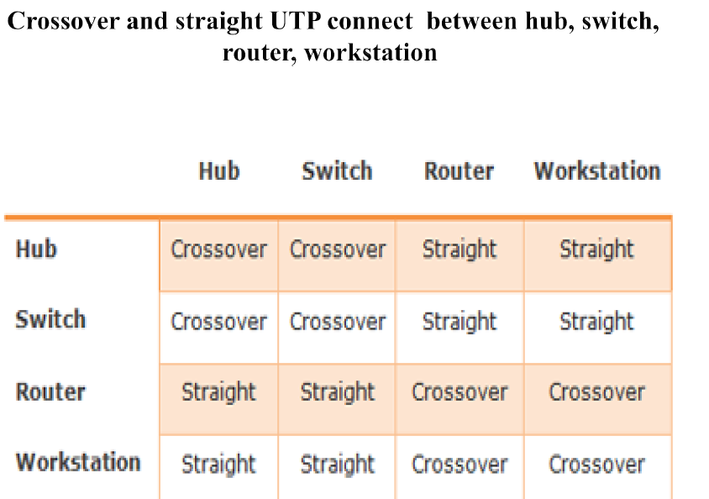

Slide 14
Coaxial Cable
Coaxial cable supports 10 to 100 Mbps and is relatively inexpensive, although it is more costly than UTP on a per-unit length. However, coaxial cable can be cheaper for a physical bus topology because less cable will be needed. . Using coaxial cable increases this distance to 500 m (1640.4 feet).

Slide 15
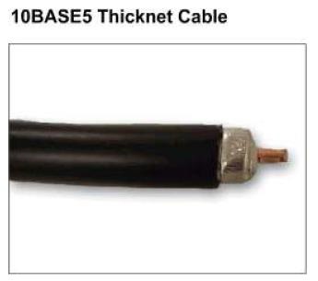
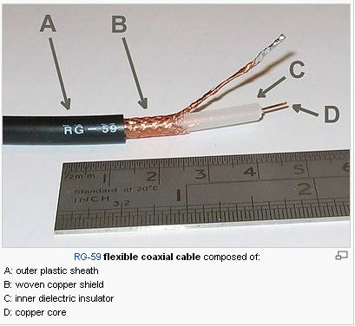
Thin Coaxial Cable

Slide 16
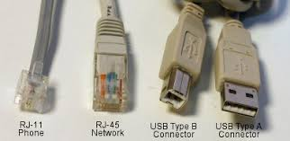
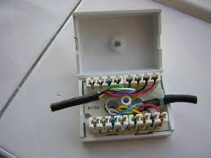
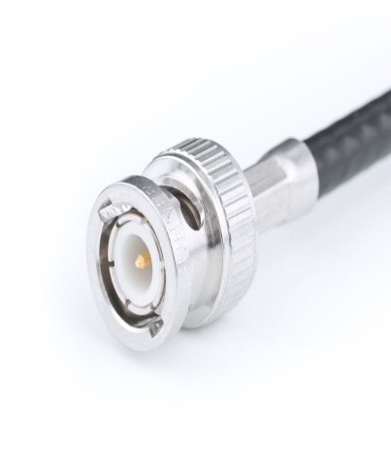
Connectors Type

Slide 17
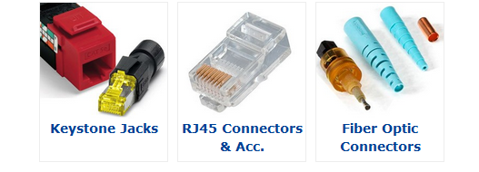
CONNECTERS TYPE

Slide 19
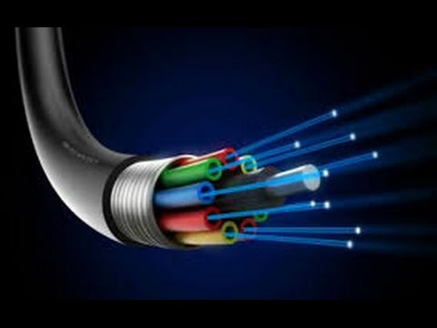

Slide 21
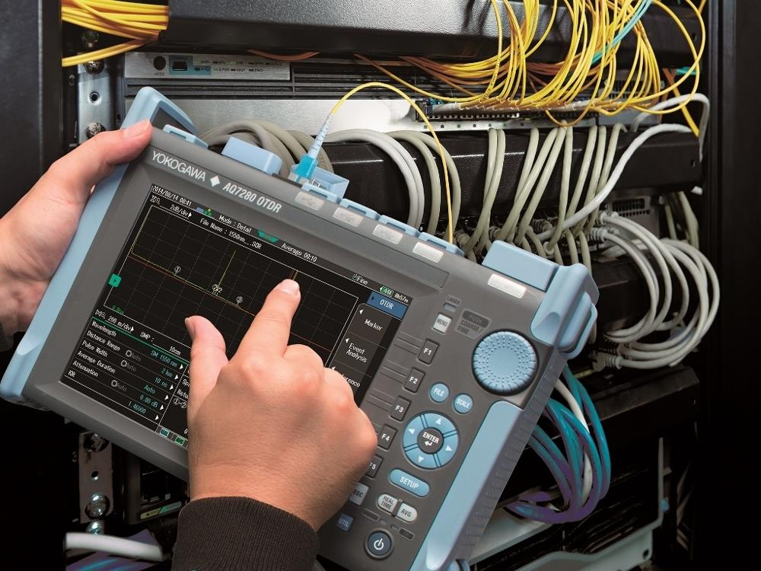

Slide 22
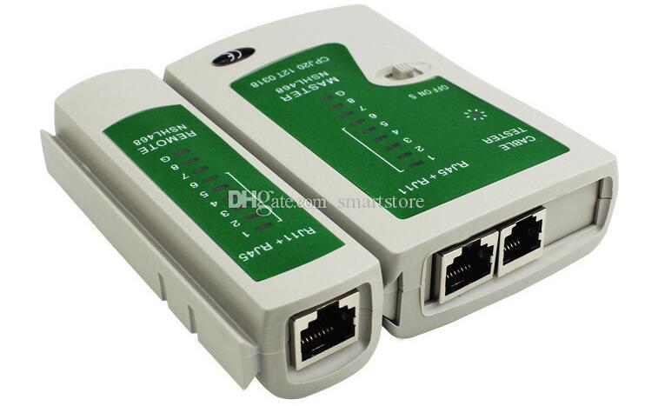
Tester for cable utp &stp

Slide 23
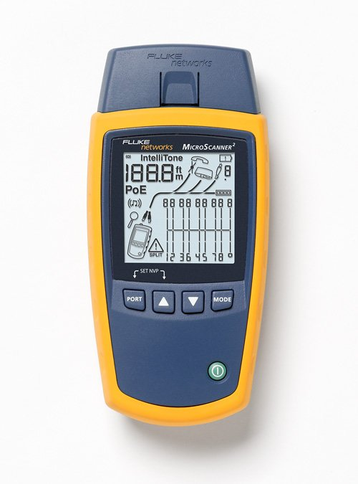
Other type foe tester

Slide 24
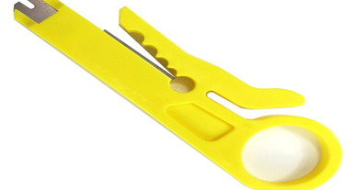
Pee wheel

Slide 25
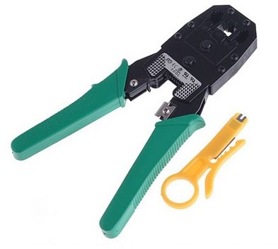
Crimping tool

