Slide 1
Practical Network
Third Class CY/IT/SC
L.2,2024-2025
A.P. Mohanad Ali

Slide 2
Hubs, Switches, and Routers
Hubs, switches, bridge, and routers are all devices that let you connect one or more computers to other computers, networked devices, or to other networks. Each has two or more connectors called ports into which you plug in the cables to make the connection.

Slide 3
Hub
A hub is typically:
Its job is very simple: anything that comes in one port is sent out to the others.
Least expensive.
Least intelligent.
Least complicated of the other three.
Every computer connected to the hub "sees" everything that every other computer on the hub sees.

Slide 4
Hubs
Hub is device that pass on anything received on one connection to all other connections, anything that comes in one port is sent out to the others(broadcast by IP address).
There are two types of hubs:
Passive hubs simply connect all ports together and usually not powered.
Active hubs use electronics to amplify and clean up the signal before it is broadcast to the other ports.
.

Slide 5
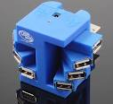
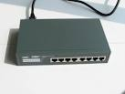
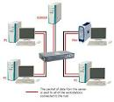
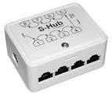
Shape of Hub

Slide 6
Switch
A switch is a device used on a computer network to physically connect devices together. (also called switching hub, bridging hub, officially MAC bridge)
Switches manage the flow of data across a network by only transmitting a received message to the device for which the message was intended. Each networked device connected to a switch can be identified using a MAC address, allowing the switch to regulate the flow of traffic. This maximizes security and efficiency of the network.

Slide 7
Switch

Slide 8
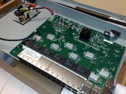

Slide 9
Router
A router is a computer and networking device that forwards data packets between computer networks, including internetworks such as the global Internet.
A router is connected to two or more data lines from different IP networks. When a data packet comes in on a line, the router reads the network address information in the packet header to determine the ultimate destination. Then, using information in its routing table or routing policy, it directs the packet to the next network on its journey. Data packets are forwarded from one router to another through an internetwork until it reaches its destination node.

Slide 10
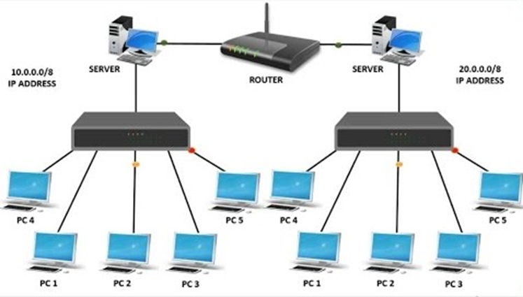
The most familiar type of IP routers are home and small office routers that forward IP packets between the home computers and the Internet. More sophisticated routers, such as enterprise routers, connect large business or ISP networks to powerful core routers that forward data at high speed

Slide 11
Bridge Network

Slide 12
Different design for network types

Slide 13
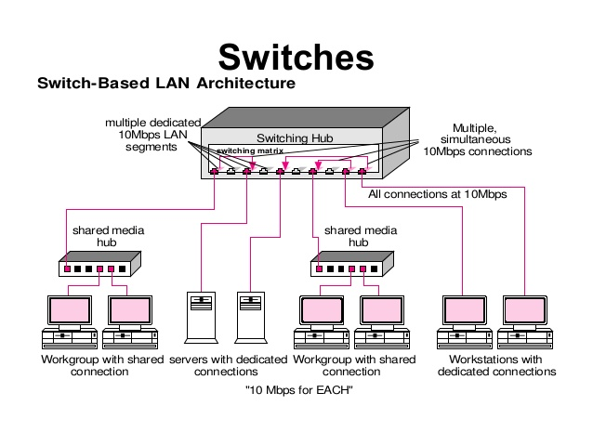

Slide 14
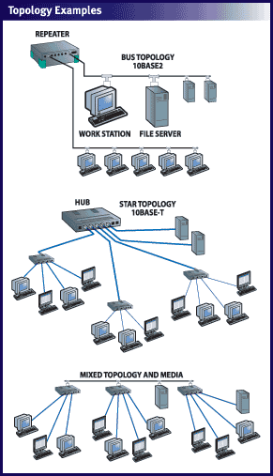

Slide 15
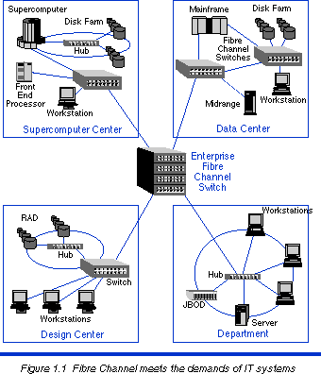

Slide 16
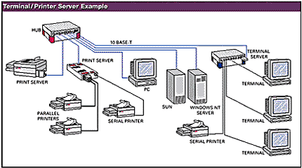

Slide 17
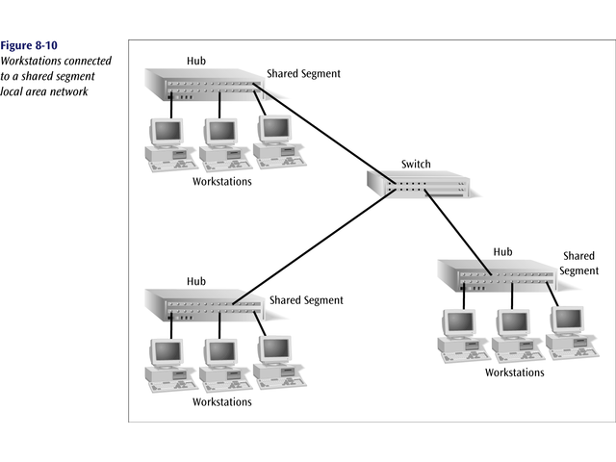
Workstations connected to a shared segment of a LAN

Slide 18
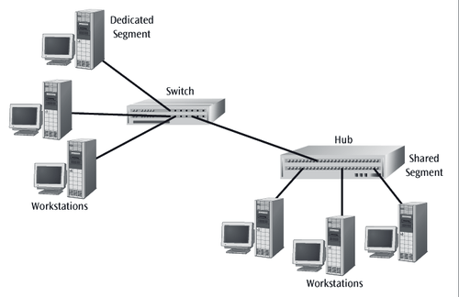
Workstations connected to a dedicated segment of a LAN

Slide 19
A Switch with Two Servers Allowing Simultaneous Access to
Each Server

Slide 20
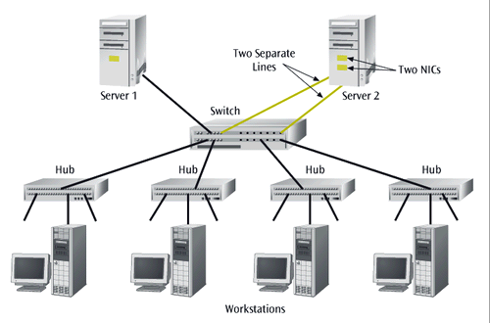
A server with two NICs and two connections to a switch

Slide 21
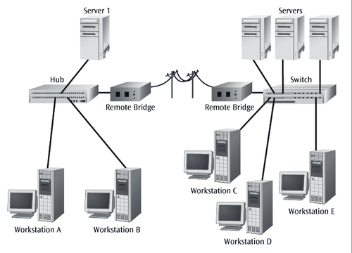
A pair of remote bridges and switch combination
designed to isolate network traffic

Slide 22
Switch providing multiple access to an e-mail server

Slide 23
Connections (in general)
Bridges for LANs and hubs.
Switches for LANs and workstations.
Routers for LANs and WANs (the Internet).

Slide 24
Exercise
buildings 3 with a distance of less than 50m between each building.
Each floor is occupied by the Finance Department, Administration Department and Computing Department.
Your report should have the following items. Anything extra is encouraged.
Network Diagrams
Devices that will be used.
What is the require to draw the Network Diagrams all cables and the devise uses

