Slide 1
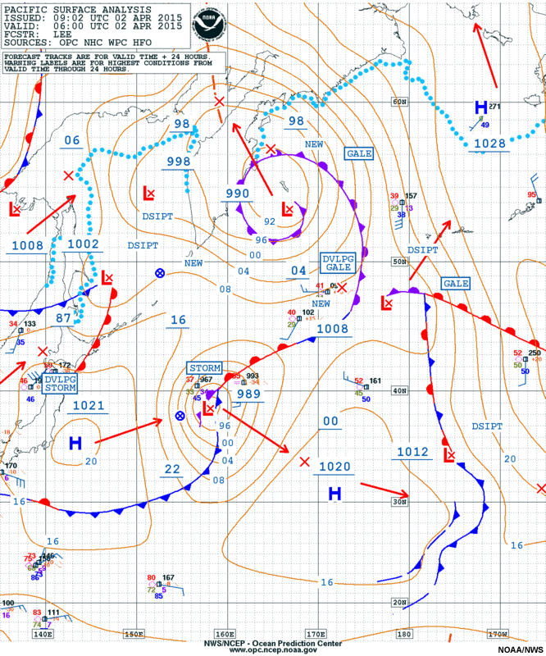
The Course of Synoptic Meteorology
Lecture 6
AL-MUSTANSIRIYAH UNIVERSITY
COLLEGE OF SCIENCES
ATMOSPHERIC SCIENCES DEPARTMENT
2024-2025
Dr. hussain abodi
SECOND STAGE

Slide 2

Welcome Students In The Seventh Lecture ☺

Slide 3
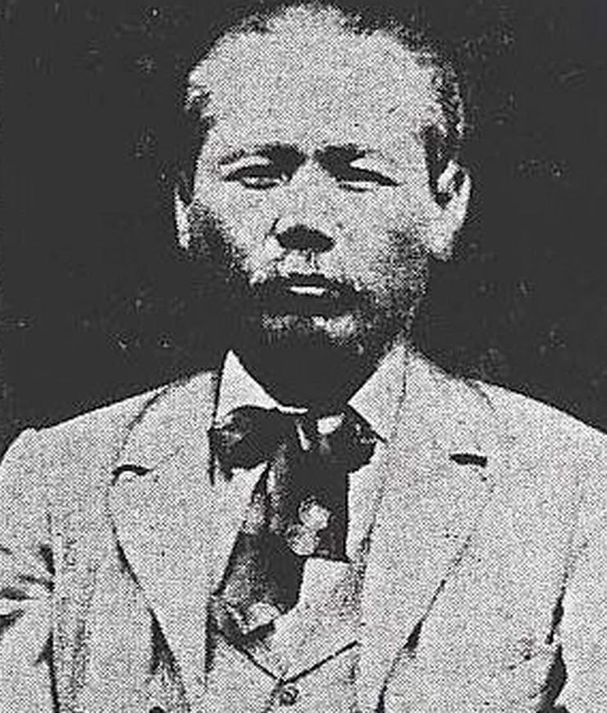
Wasaburo Oishi, Japanese Discoverer of the Jet Stream
(1920s)

Slide 4
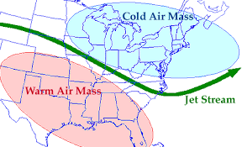
Jet Stream
A jet stream is a narrow band of thousands of kilometers long, and hundreds of kilometers wide and more than a kilometer thick, and a relatively strong winds which move weather systems around the globe
Found 9-16 km above the surface of the Earth, just below the tropopause.
On upper-tropospheric synoptic charts, jet streams are identified where the wind speed equals or exceeds 50 knots (25 m/s).
Jet streams follow the boundaries between hot and cold air. Since these hot and cold air boundaries are most pronounced in winter, jet streams are the strongest for both the northern and southern hemisphere winters.

Slide 5
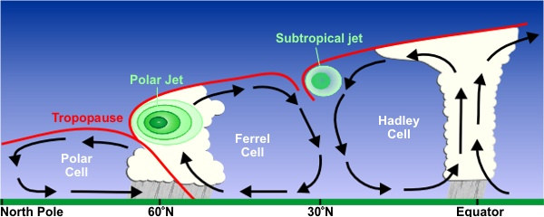
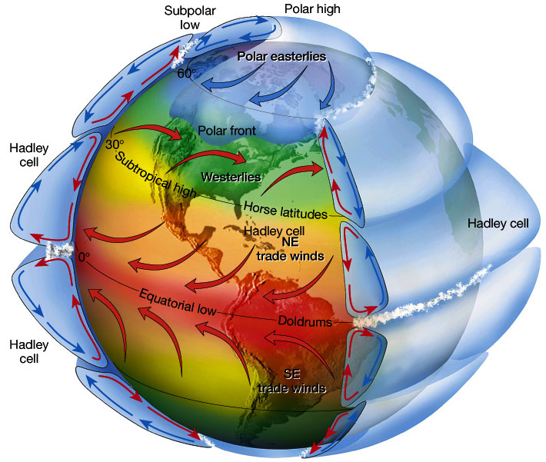
The earth's rotation divided this circulation into three cells.
the regions around 30° N/S and 50°-60° N/S are areas where temperature changes are the greatest.
As the difference in temperature between the two locations increase, the strength of the wind increases. Therefore, the regions around 30° N/S and 50°-60° N/S are also regions where the wind, in the upper atmosphere, is the strongest.

Slide 6
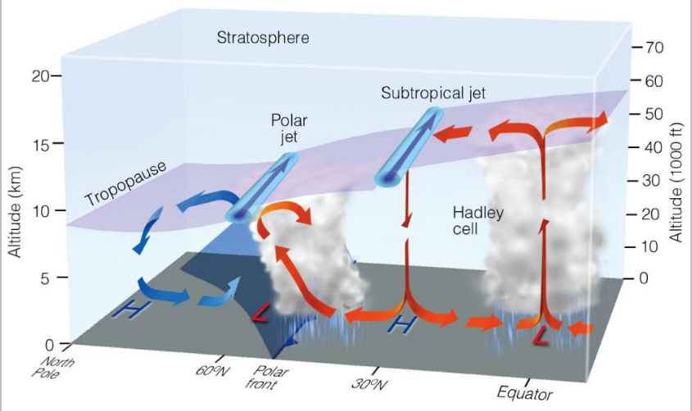
Two main types of jet stream:
  Polar Front Jet (Polar Jet)
  Located in (50°-60° N/S), and situated at about 10 km AGL over the polar front
  Subtropical Jet (STJ)
  Located around 30° N/S and situated above the subtropical highs at about 13 km AGL, and it is often visible as a plume of moisture extending from the tropics to the sub-tropical regions

Slide 7
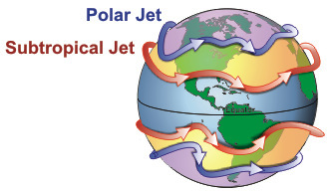
Jet Stream Waves
Often have troughs and ridges
generally have a jet maximum (jet streak) in the base of the trough, transport heat pole ward (cold air south and warm air north).
The actual appearance of jet streams result from the complex interaction between many variables - such as
    the location of high and low pressure systems,
    warm and cold air,
    and seasonal changes.
They meander around the globe, dipping and rising in altitude/latitude, splitting at times and forming eddies, and even disappearing altogether to appear somewhere else.

Slide 8
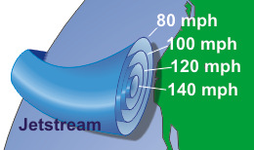
The jet stream is often indicated by a line on maps. The line generally points to the location of the strongest wind. Jet streams are typically wider and not as distinct but a region where the wind increase toward a core of strongest wind.
One way of visualizing this is to consider a river, which is generally the strongest in the center with decreasing strength as one approaches the river's bank. It can be said that jet streams are "rivers of air".

Slide 9
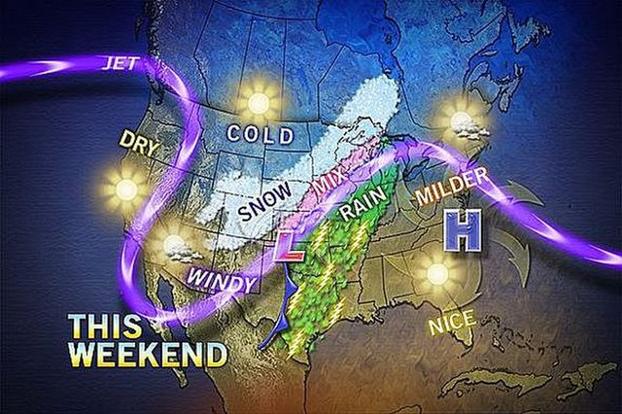
Why Jet Stream is important?
The polar jet stream is important for synoptic scale weather systems due to its ability to control the synoptic storm path. The storms propagate downstream the jet axes flow
Variability in polar jet stream location, intensity, or altitude can cause variations in frequency and intensity of the weather system. These include the extreme weather events such hurricanes, tornadoes, and severe thunder storms

Slide 10
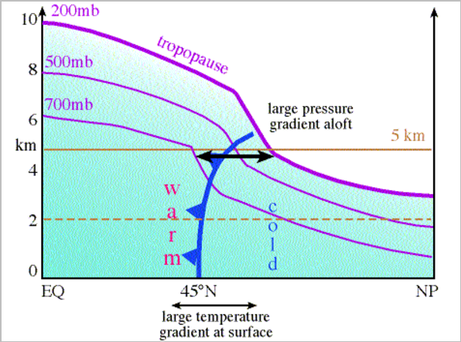
Formation of Polar Front Jet (Polar Jet)
boundary between warm air to the south and cold air to the north
location of a large temperature gradient near the surface
recall that tropopause height is proportional to the mean tropospheric temperature
Hence, the large temperature gradient at the surface across the polar front creates a large pressure gradient aloft
recall that the strength of the geostrophic wind is proportional to the magnitude of the pressure gradient force
Hence, the large pressure gradient aloft over the polar front generates a band of strong winds
http://apollo.lsc.vsc.edu/classes/met130/notes/chapter10/graphics/57_Polar_Jet_Stream/57.html

Slide 11
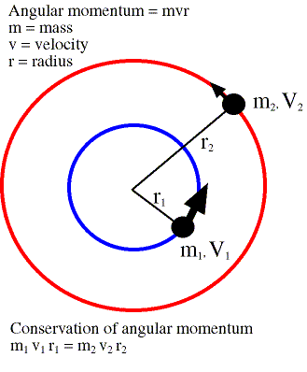
Formation of Sub Tropical Jet
The STJ results from the air flowing upward and poleward in the Hadley cell.
As air parcels move to a smaller latitude circle, their velocity must increase in order to conserve angular momentum.
Note that typical speeds in the STJ are less than calculated using the angular momentum equation because large-scale eddies (e.g., cyclones) transport some of the momentum from the Hadley cell to the midlatitudes and air parcels are slowed by small scale turbulence.
The transfer of zonal kinetic energy by the eddies helps to maintain the STJ. The jet is located near the region of maximum transport.

Slide 12
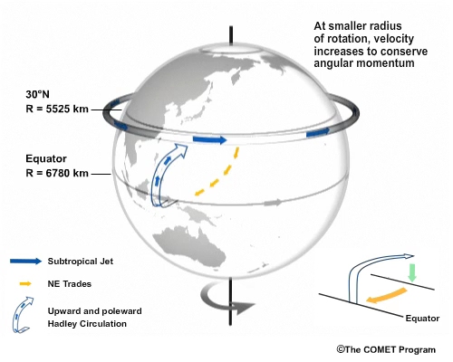

Slide 13
Jet Streams and Developing Mid-latitude Cyclones
Jet streams play an additional part in the formation of surface mid-latitude cyclones and anticyclones.
When the polar jet stream flows in a wavy west to east pattern, deep troughs and ridges exist in the flow aloft.
Jet maxima or jet streaks produce regions of strong convergence and divergence along the flanks of the jet.

Slide 14
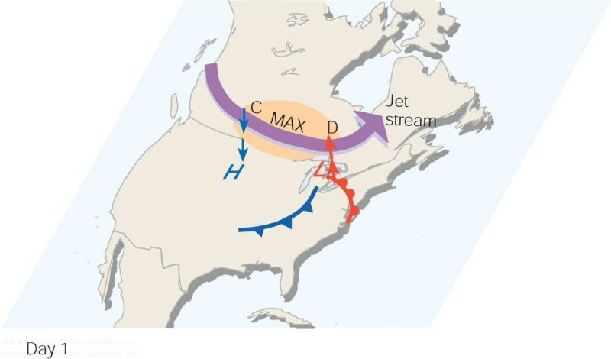
As the polar jet stream and its area of maximum winds (the jet streak, or MAX). Swings over a developing mid-latitude cyclone, an area of divergence (D) draws warm surface air upward, and an area of convergence (C) allows cold air to sink. The jet stream removes air above the surface storm, which causes surface pressures to drop and the storm to intensify.

Slide 15
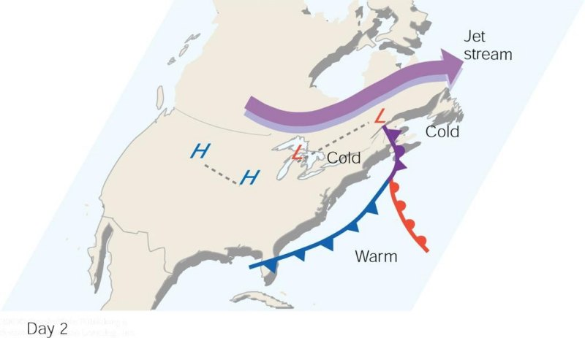
When the surface storm moves northeastward and occludes, it no longer has the upper-level support of diverging air, and the surface storm gradually dies out.

