Slide 1
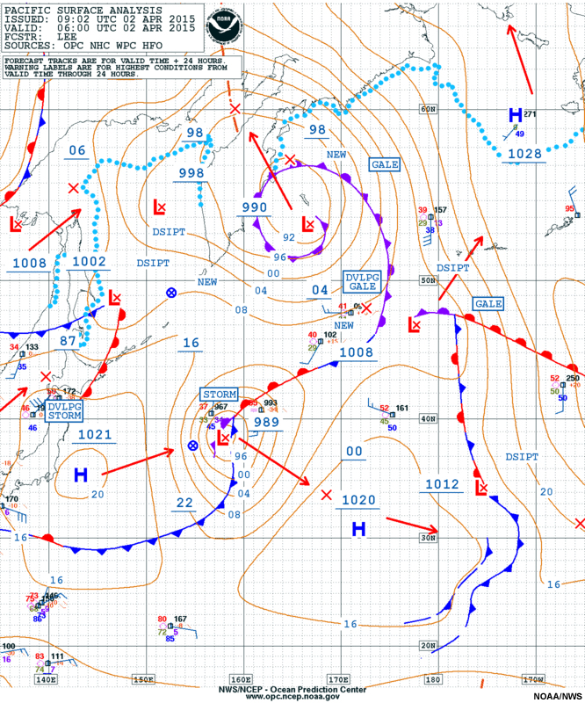
The Course of Synoptic Meteorology
Lecture 2
AL-MUSTANSIRIYAH UNIVERSITY
COLLEGE OF SCIENCES
ATMOSPHERIC SCIENCES DEPARTMENT
2024-2025
Dr. Hussain A. Nema
SECOND STAGE

Slide 2
Welcome Students In The Third Lecture ☺

Slide 3
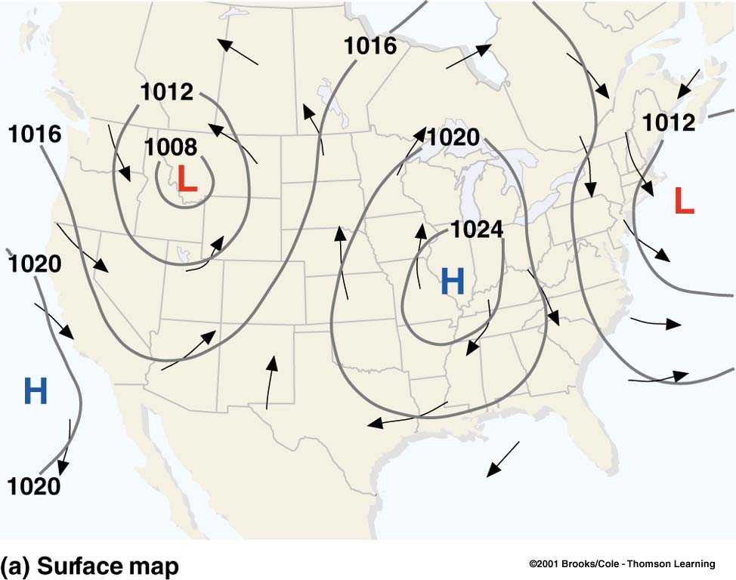
Surface Map
Surface maps describe where the centers of high & low pressures are found and winds and weather associated with these systems, solid lines are isobars at 4 hPa intervals; arrows wind direction
Isobars do not pass through each point, but with the values interpolated from the data given on the chart.
With isobars plotted, the chart is called ‘sea level pressure chart’ or simply ‘Surface Map’, and When weather data are plotted are in this map, it becomes ‘Surface Weather Map’ .
Surface winds Influenced by PGF, CF, and SF, winds blow across the isobars.
H’s: Centers of high pressure (also called anticyclones)
L’s: Centers of low pressure (also known as depressions or mid-latitude depressions or extra-tropical cyclones) – they form in the middle latitudes, outside of the tropics.

Slide 4
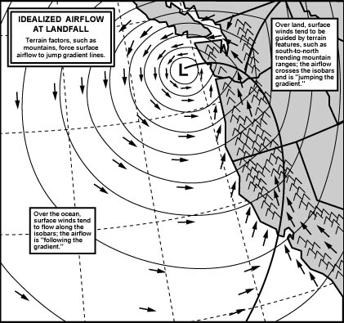
Winds
Wind speeds and directions are related to the spacing and orientation of the isobars.
There are two important relationships between isobars and winds:
• The closer the isobars, the stronger the wind.
• The wind blows almost parallel to the isobars.
Forces that act on winds: Pressure Gradient Force (PGF), Coriolis Force (CF), Surface friction (SF).
Coriolis Force (CF): is an apparent deflection of the winds due to rotation of the Earth (NH winds deflected right, SH winds deflected left), and the deflection is strongest at poles and zero at the Equator, CF acts perpendicular to the direction of motion.
Surface friction (SF):acts to slow air movement which change the direction winds is deflect by topography (mountains, elevated plateaus.

Slide 5
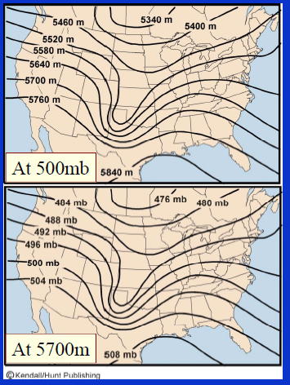
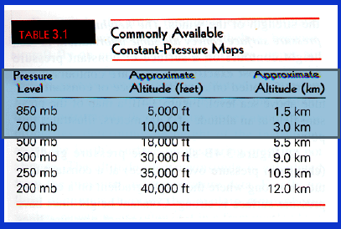
Pressure Surface
Each altitude above a point on the Earth’s surface has a unique value of pressure.
Pressure can be easily substituted for altitude as a coordinate to specify locations in the vertical.
Rawinsondes determine the height of the instrument above Earth’s surface by measuring pressure.
Fluid dynamics theories and equations that explain atmospheric motions are often in a more shortly forms when they use pressure as a vertical coordinate.
A pressure surface is a surface above the ground where the pressure has a specific value, such as 700mb.
Constant pressure surfaces slope downward from the warm to the cold side.

Slide 6
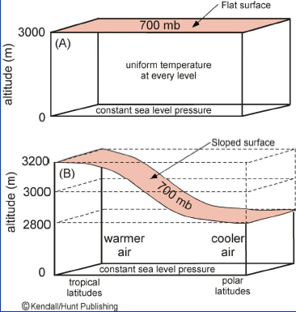
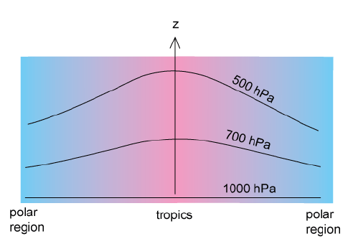
Less dense air in the south; cold air in the north; Height of the pressure surface varies; Changes in elevation of a constant pressure surface shown as a contour lines on a isobaric map
Since the atmosphere in the polar regions is cold and the tropical atmosphere is hot, all pressure surfaces in the troposphere slope downward from the tropics to the polar regions.

Slide 7
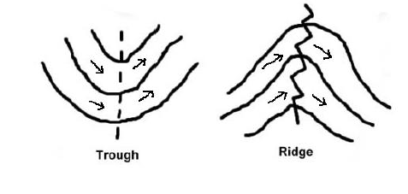
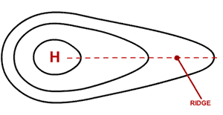
Some Features in the Weather Maps
It's also possible to have high pressure ridges and low pressure troughs.
A ridge is a region with relatively higher heights which is an extension of an anticyclone or high-pressure area shown on a synoptic chart (an elongated area of relatively high pressure extending from the center of a high-pressure region).
A broad region of sinking air or a deep warm air mass will both lead to ridging. Since air is often sinking within a ridge they tend to bring warmer and drier weather (generally associated with fine, anticyclonic-type weather).

Slide 8
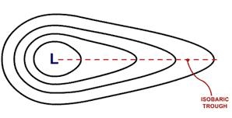
Some Features in the Weather Maps
A trough is a pressure feature of the synoptic chart; is a region with lower heights (an elongated area of relatively low pressure extending from the center of a region of low pressure), it is characterized by a system of isobars which are concave towards a depression and have maximum curvature along the axis of the trough, or ‘trough line’.
A front is necessarily marked by a trough but the converse is not true.
A Troughs tend to bring in cooler and cloudier weather as they approach

Slide 9
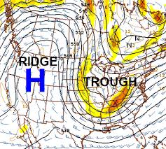
On upper-level charts, height contours often have a wave-like appearance . The part of the wave with higher heights is called a ridge, while the part with lower heights is called a trough Troughs and ridges are analyzed on pressure surfaces aloft such as 850, 700, 500 and 300 mb.

Slide 10
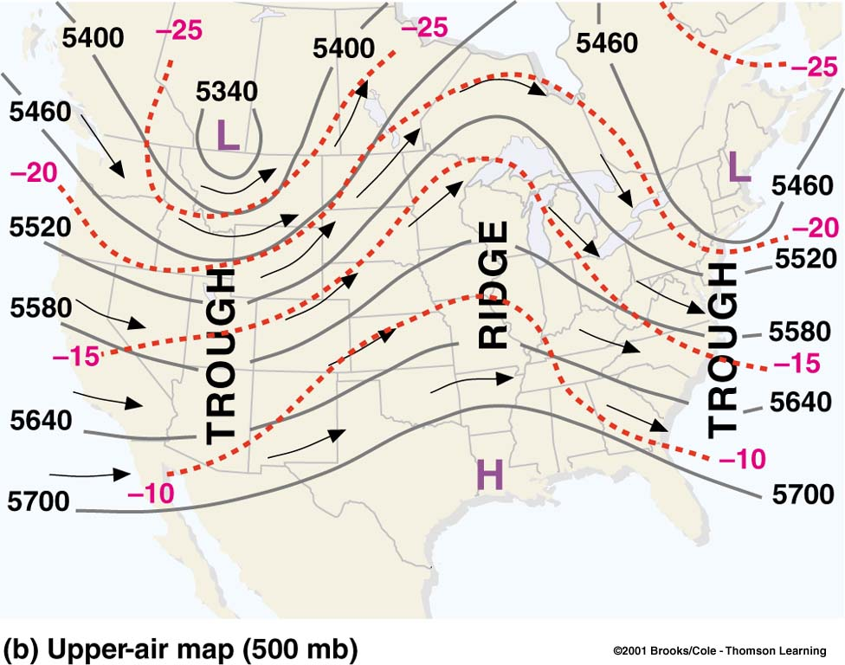
Upper Air Map
Upper-air charts are important for weather forecast; upper-level winds determine the movement of surface air pressure systems, as well as whether these surface systems will intensify or weaken.
The upper-air map is a constant pressure chart, constructed to show height variations along a constant pressure (isobaric surface)
Contour lines connect points of equal elevation above sea level.
The wind in the upper troposphere is Geostrophic and it is influenced by PGF and CF only ( no friction), and the wind flow is parallel to isobars/ geopotential heights, Geostrophic flow is westerly (west to east) in NH, these types of winds are evident on geopotential height maps.
Upper-level 500 mb map for the same day; solid lines: contour lines in meters above sea level; dashed lines:isotherms (°C); wind directions are parallel to the contour lines.

Slide 11
Upper Air Map
Contour lines of low height represent regions of lower pressure & lines of high height represent region of higher pressure; decrease from south to north.
isotherms (dotted line) shows north is colder than south in which cold air aloft is associated with low pressure.
Contour lines bend and turn indicating elongated highs (ridges, warmer air) & depressions (troughs, colder air).
The winds on the 500-mb chart tend to flow parallel to the contour lines on a wavy west-to-east direction

Slide 12
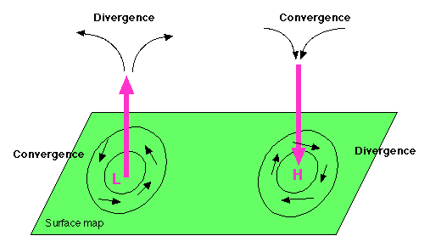
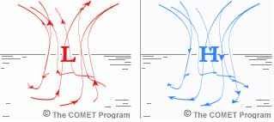
Winds and Vertical Air Motions
Convergence – The piling up of air or the atmospheric condition that exists when the wind cause a horizontal net inflow of air into a specified region
Divergence – the spreading out of air or the atmospheric condition that exists when the winds cause a horizontal net outflow of air from a specific region

Slide 13
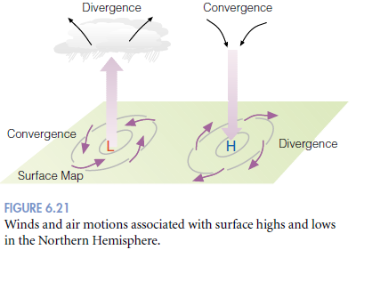
Winds and Vertical Air Motions
(Convergence and divergence of air are so important to the development or weakening of surface pressure systems.
Winds blow in toward the center of low pressure and outward away from the center of high pressure. As air moves inward toward the center of a low-pressure area, it must go somewhere. Since this converging air cannot go into the ground, it slowly rises.
Above the surface low (at about 6 km or so), the air begins to spread apart (diverge) to compensate for the converging surface air.
As long as the upper-level diverging air balances the converging surface air, the central pressure in the low does not change. However, the surface pressure will change if upper-level divergence and surface convergence are not in balance.

Slide 14
Winds and Vertical Air Motions
For example, if upper-level divergence exceeds surface convergence (that is, more air is removed at the top than is taken in at the surface), the central pressure of the low will decrease, and isobars around the low will become more tightly packed. This situation increases the pressure gradient (and, hence, the pressure gradient force), which, in turn, increases the surface winds.
Surface winds move outward (diverge), away from the center of a high-pressure area. To replace this laterally spreading air, the air aloft converges and slowly descends Again, as long as upper-level converging air balances surface diverging air, the central pressure in the high will not change.

Slide 15
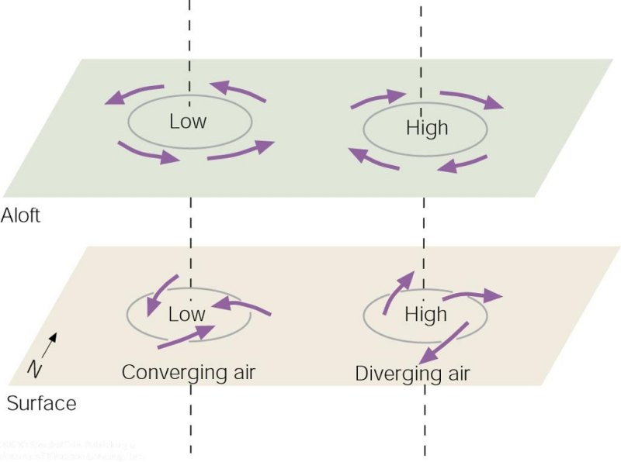
Suppose the upper-level low is directly above the surface low. Notice that only at the surface (because of friction) do the winds blow inward toward the low’s center. As these winds converge (flow together), the air “piles up.” This piling up of air, called convergence, causes air density to increase directly above the surface low. This increase in mass causes surface pressures to rise; gradually, the low fills and the surface low dissipates.
The same reasoning can be applied to surface anticyclones. Winds blow outward away from the center of a surface high. If a closed high or ridge lies directly over the surface anticyclone, divergence (the spreading out of air) at the surface will remove air from the column directly above the high. Surface pressures fall and the system weakens.

Slide 16
A low that is not supported by some divergence aloft will dissipate.
Same is true for a high pressure system; divergence at the surface needs some support from convergence aloft to survive
If lows and highs aloft were always directly above lows and highs at the surface, the surface systems would quickly dissipate.

Slide 17
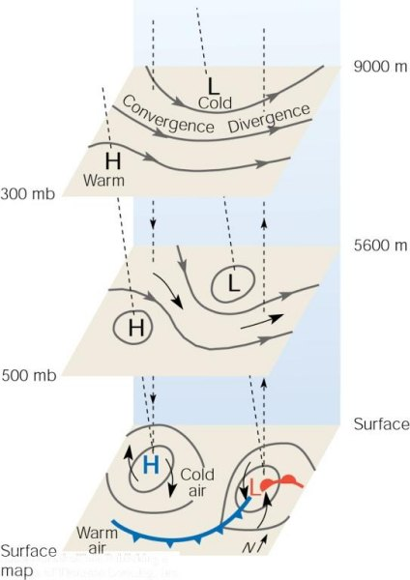
We can see from the figure that, when an upper-level trough is as sufficiently deep, a region of converging air usually forms on the west side of the trough and a region of diverging air forms on the east side.
An area of divergence MUST be directly above the surface low
If divergence aloft > convergence at surface, will the low will deepen, intensifying the storm, or will it decay?
if divergence aloft < convergence at surface, will the low will deepen, or decay?
Notes:
deepen
decay

Slide 18
An area of convergence MUST be directly above the surface high
if convergence aloft > divergence at surface, pressure at surface will increase and the high will build (intensify)
if convergence aloft < divergence at surface, pressure at surface will decrease and the high will decrease in intensity

Slide 19
Winds and Vertical Air Motions
Air moves in response to pressure differences. Because air pressure decreases rapidly with increasing height above the surface, there is always a strong pressure gradient force directed upward, much stronger than in the horizontal. Why, then, doesn’t the air rush off into space?
Air does not rush off into space because the upward-directed pressure gradient force is nearly always exactly balanced by the downward force of gravity.
When these two forces are in exact balance, the air is said to be in hydrostatic equilibrium. When air is in hydrostatic equilibrium, there is no net vertical force acting on it, and so there is no net vertical acceleration.
Most of the time, the atmosphere approximates hydrostatic balance, even when air slowly rises or descends at a constant speed. However, this balance does not exist in violent thunderstorms and tornadoes, where the air shows appreciable vertical acceleration. But these occur over relatively small vertical distances, considering the total vertical extent of the atmosphere.

Slide 20
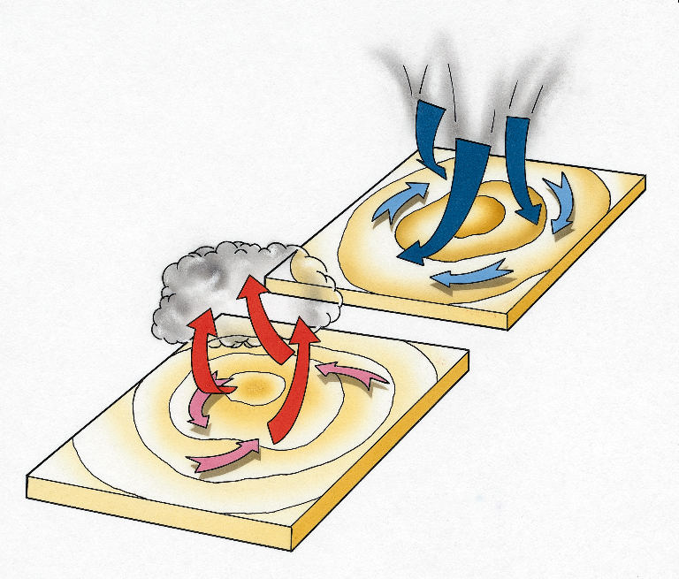
Moisture and Pressure
Moist air is less dense than dry air, and therefore has a lower air pressure.
A water molecule has less mass than other molecules that make up the air. If you replace some of the air molecules with water molecules, the water lowers the density (and lowers the air pressure).
O
N
H2O
N
H2O is lighter than Nitrogen and Oxygen
O
N
O
H2O
Q/ Air pressure in a weather system reflects the amount of water in the air, which affects the weather, how?

