Slide 1
4th lecture in Antibiotics
Sulpha drug & Quinolones

Slide 2
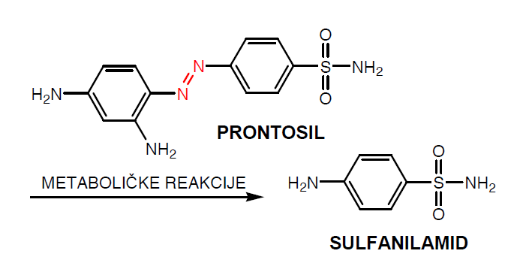
Sulfonamide (also called sulphonamide, sulfa drugs or sulpha drugs)
Sulfonamides are synthetic antimicrobial agents that contain the active antibacterial sulfonamide group which is the first synthetic antibacterial agent acting on a wide range of infections
The early used drug related to this group was Prontosil, red dye, (1933) ,used against staphylococcal septicemia and in 1935 Gerhard Domagk used it to cure streptococcal infections in mice and rabbits
By the discovery of Penicillin G (1929) by Alexander Fleming
and shown to be successful as antibacterial agent in humans (1941 ) which lead to a decline in use of sulfa drug
However, sulfa drugs are still used for
malaria, tuberculosis, leprosy, meningitis
, pneumonia, scarlet fever,
respiratory infections, and Intestinal/urinary tract infections.
Because sulfa drugs concentrate
in the urine before being excreted,
treating urinary tract infections
Is one of their most common uses.
.

Slide 3
Sulfa mode of action
Antibacterial sulfonamides affect bacteria by interfering with their metabolism targeting their metabolic pathway as competitive inhibitors of the enzyme dihydropteroate synthetase(DHPS). Dihydropteroate synthetase activity is essiantial in the synthesis of folate, and folate is required for cells to make nucleic acids, such as DNA or RNA. So if DNA molecules cannot be built, the cell cannot divide.
Sulfonamides (bacteriostatic) and trimethoprim (bactericidal) are commonly used in combination where they are bactericidal, because
(1) they inhibit two different reactions on the same metabolic pathway and thus exhibit synergistic activity and
(2) the combination reduces the likelihood that resistance will develop
humans and other higher animals do not synthesize folate, however, must obtain folic acid in the diet. Thus, sulfa drugs can inhibit the growth of invading microorganisms without harming the host.

Slide 4
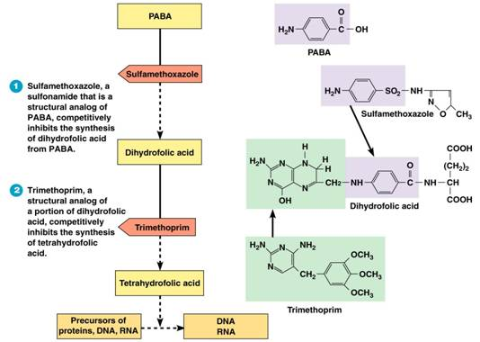

Slide 5
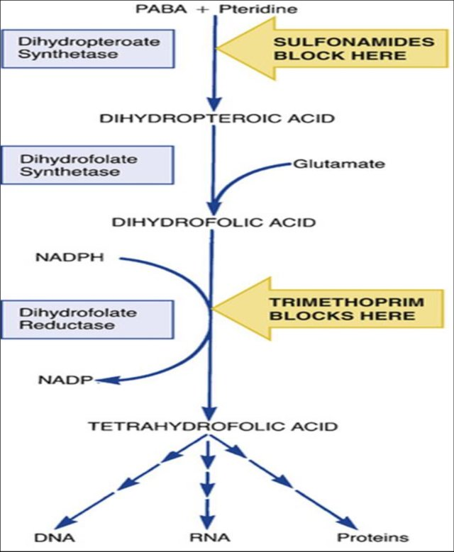

Slide 6

Examples of Sulfonamides : co –trimoxazole bactericidal
It is a combination between Trimethoprim (one part)/ sulfamethoxazole(five parts)(TMP/SMX), also known as co-trimoxazole, is an antimicrobial agent used to treat a variety of bacterial infections. It is used for urinary tract infections, MRSA, skin infections, travelers‘ diarrhea, respiratory tract infections, and cholera. It may be used to treat and prevent pneumocystis pneumonia (is a form of pneumonia, caused by the yeast-like fungus Pneumocystis jirovecii) in people with HIV/AIDS. It can be given by mouth or intravenously.
Common side effects: include nausea, vomiting, rash, and diarrhea. Severe allergic reactions and Clostridium difficile diarrhea may occasionally occur. Because sulfonamides displace bilirubin from albumin, kernicterus (brain damage due to excess bilirubin) is an important potential side effect of sulfonamide.

Slide 7
Examples of Sulfonamides
1= Sulfadoxine
Belongs to a new generation of sulfonamides
Long lasting antibacterial agent
Once weekly dosing regime
Used for the treatment of malaria
2= Succinyl sulfathiazol
Acts as a prodrug of sulfathiazole
Ionized in the alkaline conditions of the intestine
Too polar to cross the gut wall
Concentrated in the gut and Slowly hydrolysed by enzymes in the gut
Used for gut infections
3=Sulfonamides with reduced toxicity
Thiazole ring is replaced with a pyrimidine ring
Sulfadiazine and its metabolite are more water soluble
Reduced toxicity
Silver sulfadiazine is used topically to prevent infection of burns

Slide 8
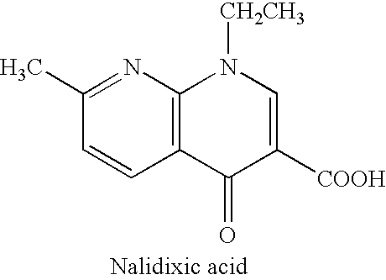
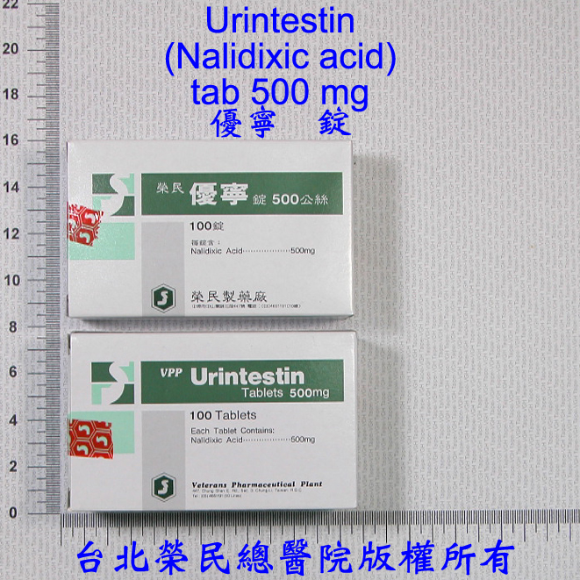
Quinolones
Quinolones were first developed in the 1960s and can be classified into generations based on antimicrobial activity.
The first quinolone used was nalidixic acid (1962). was marketed in many countries as Negram followed by many derivatives, such as flumequine, which are not marketed now. They had an antibacterial effect on Escherichia coli, Proteus, Enterobacter and because of their urinary elimination in high concentrations they were used for treatment of urinary tract infections.
it cant reach the blood stream thus it doesn't used to treat systemic infection.

Slide 9
Fluoroquinolones
Quinolones with a fluorine atom are called fluoroquinolones; Because of their very good diffusion, they act on infections with different locations. The fluoroquinolones used in the treatment of the urinary tract infections are eliminated in the urine in high concentration. The fluoroquinolones used in urogenital infections due to sensitive microorganisms are norfloxacin, enoxacin and lomefloxacin.
The microorganisms sensitive to fluoroquinolones are very numerous: Gram-negative bacilli, salmonellas, Escherichia coli, shigella, gonococci, Proteus, Enterobacter, Helicobacter, Gram-positive bacilli, staphylococci, streptococci…
The fluoroquinolones indicated in general infections (septicemia) or localized infections (meningeal, respiratory, osteoarticular, urogenital) are pefloxacin, ciprofloxacin and ofloxacin.
The majority of fluoroquinolones is active against Mycobacterium tuberculosis and can be useful for the treatment of resistant tuberculosis.

Slide 10
Generational Classification
First Generation Quinolones (1stgeneration)
-- Active against Gram-negative, but Pseudomonas spp.
  Highly protein bound
  Mostly used in UTIs
Fluoroquinolones (2nd, 3rd and 4th generation)
  Modified 1st generation quinolones
  Not highly protein bound
  Wide distribution to urine and other tissues; limited CSF penetration.
Second Generation
  Gram-negative, some gram-positive and mycobacteria.
Third and Fourth Generation
Have increased activity against gram-positive pathogens including S. pneumoniae. They are also active against many agents causing zoonotic infection and against Mycobacteria.

Slide 11
Generational Classification
Generation | Drug Names | Spectrum
1st | nalidixic acid cinoxacin | Gram ve- but not Pseudomonas species
2nd | norfloxacin ciprofloxacin enoxacin ofloxacin | Gram ve- (including Pseudomonas species), some Gram ve+ (S. aureus) and some atypicals
3rd | levofloxacin sparfloxacin moxifloxacin gemifloxacin | Same as 2nd generation with extended Gram+ and atypical coverage
4th | *trovafloxacin | Same as 3rd generation with broad anaerobic coverage
First Generation
  Cinoxacin
  Nalidixic Acid
  Oxolinic acid
Second Generation
  Ciprofloxacin
  Enoxacin
  Fleroxacin
  Lomefloxacin
  Levofloxacin
  Norfloxacin
  Ofloxacin
  rulfloxacin
Third Generation
  Gatifloxacin
  Grepafloxacin
  Pazufloxacin
  Sparfloxacin
  Tosufloxacin
Fourth Generation
  Clinafloxacin
  Gemifloxacin
  Moxifloxacin
  Trovafloxacin

Slide 12
Mechanism of Action( Bactericidal)
The quinolones act by inhibiting type 2 bacterial DNA topoisomerases, DNA gyrase and topoisomerase IV. Gyrase is involved primarily in supporting nascent chain elongation during replication of the chromosome, whereas topoisomerase IV separates the topologically linked daughter chromosomes during the terminal stage of DNA replication.
They bind to and trap the enzyme-DNA complex. This blocks DNA synthesis and cell growth and ultimately has a lethal effect on the cell.
  Inhibition of bacterial DNA Gyrase (Topoisomerase II)
    Formation of quinolone-DNA-Gyrase complex
    Induced cleavage of DNA
  Inhibition of bacterial Topoisomerase IV
    Mechanism poorly understood

Slide 13
Spectrum of activity
The fluoroquinolones are potent bactericidal against:
E.coli and various species of Salmonella, Shigella, Enterobacter, Campylobacter, and Neisseria
Ciprofloxacin is more active than norfioxacin against
P. aeruginosa
Fluoroquinolones also have good activity against staphylococci, including methicillin­-resistant strains
Several intracellular bacteria are inhibited by fluoroquinolones these include species of Chlamydia, Mycoplasma, Legionella, Brucella, and Mycobacterium (including Mycobacterium tuberculosis)

Slide 14
Ciprofloxacin (ciprodar )
Administration [Usual Dosage]: IV, tablet [500 – 750 mg each 8-12h]
Spectrum: Gram-negative aerobic rods, and Legionella pneumophila, and other atypical bacteria . Poor activity against Strep. pneumoniae.
Indications: Nosocomial pneumonia, Intra-abdominal infections (typhoid fever and dysentery) Uncomplicated / complicated UTI , Anthrax exposure.
ADRs: (American depositary receipt ) Arrhythmias, Nausea, GI upset Interstitial nephritis.
Levofloxacin Brand Name: Levaquin®, Quixin®
Administration [Usual Dosage]: IV, and ophthalmic Tablet [500-750 mg q24h]
Spectrum: Gram-negative, Gram-positive (S. aureus including MRSA & S. pneumoniae) and Legionella pneumophila, atypical respiratory . pathogens, and Mycobacterium tuberculosis
Indications: Chronic bronchitis and Nosocomial pneumonia and Intra-abdominal infections
ADRs: Blood glucose disturbances in DM patients, arrhythmias Nausea, GI upset, Interstitial nephritis.

Slide 15
Mechanism of resistance
Resistance to quinolones may develop during therapy via mutations in the bacterial chromosomal genes encoding DNA gyrase or topoisomerase IV, or by active transport of the drug out of the bacteria.
Mechanism of resistance:
  Chromosomal:
  1-Alter target enzymes: DNA gyrase and topoisomerase IV
  2- Decreased drug penetration (Efflux pump): Pseudomonas, E. coli
  Plasmid: seen in some K. pneumoniae and E. coli
  Mutations in both target enzymes are needed to produce significant resistance

Slide 16
Clinical uses of fluoroquinolones
Disease | Recommendations
RESPIRATORY TRACT INFECTIONS
Pharyngitis, otitis media | Not appropriate
Necrotizing otitis | Ciprofloxacin for Pseudomonas aeruginosa
Sinusitis | Third-generation fluoroquinolone
Community-acquired pneumonia | Third-generation fluoroquinolone
Hospital-acquired pneumonia | Ciprofloxacin, for susceptible gram-negative pathogens
URINARY TRACT INFECTIONS
Cystitis, uncomplicated | All effective (second generation most appropriate)
Pyelonephritis | All effective (second generation most appropriate)
Prostatitis | All effective
SKIN STRUCTURE INFECTIONS
Primary cellulitis | Not appropriate as first line therapy
Anaerobic soft-tissue infections | Not appropriate

Slide 17
Disease | Recommendations
OSTEOMYELITIS
Gram-negative bacterial infections | Ciprofloxacin
BACTERIAL DIARRHEAL DISEASES | Ciprofloxacin used most commonly; all considered likely to be effective
SEXUALLY TRANSMITTED DISEASES
Gonorrhea | Resistance testing required
Chlamydia | Ofloxacin, levofloxacin
Chancroid | All likely to be effective
Mycoplasma | Ofloxacin, levofloxacin
Syphilis | Not appropriate
MYCOBACTERIAL DISEASES
Disseminated M. avium complex | Ciprofloxacin, ofloxacin as fourth agent if needed
M. tuberculosis | Ofloxacin, levofloxacin for drug-resistance or intolerance to first-line agents

Slide 18
Adverse effects:
Gastrointestinal effects : Nausea, vomiting
Central nervous system CNS: Headache, dizziness, confusion, insomnia, delirium, hallucinations.
Cardiovascular: rare
Musculoskeletal: Rupture of tendon (rare) Damage to growing cartilage (not recommended for use in children)
Neurologic: Polyneuropathy (rare)
haematological disorders, leukopenia, thrombopenia, anemia
, even after a moderated exposure to light; photosensitization was particularly frequent with sparofloxacin.

