Slide 1
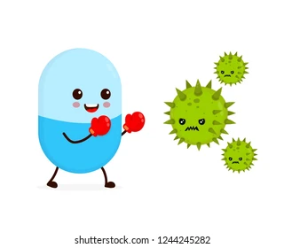
Mode of Antibiotics action

Slide 2
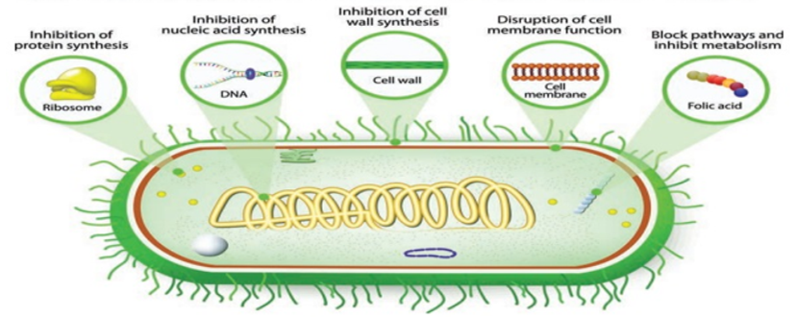
There are five main mechanisms by which antibacterial agents act.
Mechanisms of antibacterial action
  1. Inhibition of cell wall synthesis
  2. Disruption of Cell Membrane Function
  3. Inhibition of protein synthesis
  4. Interference with metabolism process
  5. Inhibition the synthesis of nucleic acids (DNA & RNA)

Slide 3
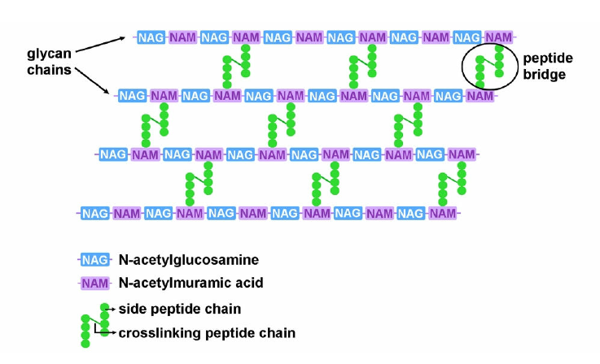
1. Inhibition of cell wall synthesis (Bactericidal agents)
Peptidoglycan (PG) is an essential macromolecular sacculus surrounding most bacteria. PG determines the bacterium cell shape and provides protection from rupture under the high cytoplasmic osmotic pressure. The PG structure consists of glycan strands made of alternating β-1,4-linked N-acetylglucosamine (GlcNAc) and N-acetylmuramic acid (MurNAc) residues cross-linked by peptides. Nascent glycan strands are first polymerized by the glycosyl transferases (GTs) using the lipid II precursor (un-decaprenyl-pyrophosphoryl-MurNAc-(pentapeptide)-GlcNAc) as a substrate, and cross-linked between them and with the pre-existing cell wall by the penicillin-binding proteins (PBPs)/transpeptidases (TPs).

Slide 4
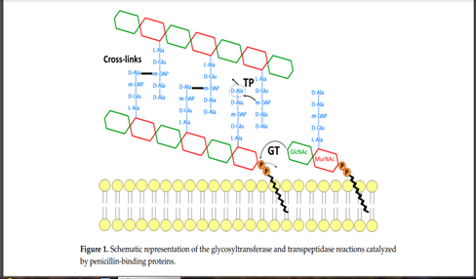

Slide 5
Penicillins and cephalosporins, as well as other beta-lactam antibiotics act by inhibiting transpeptidase enzyme (It was hypothesized that penicillin is a structural analog of the acyl D-alanyl-D-alanine terminus of the pentapeptide side chains of nascent peptidoglycan), thus the bacteria will loss the integrity of bacterial cell wall, leakage of its cellular component and destruction of the bacterial cell.
Binding of the drug to the Transpeptidase (BPB) ties up the enzyme and prevents it from reforming the peptide cross-links between the rows and layers of new peptidoglycan monomers are added during bacterial cell growth

Slide 6
Vancomycin: Inhibits cell wall synthesis by binding to the D-Ala-D-Ala terminal of the growing peptide chain during cell wall synthesis, resulting in inhibition of the transpeptidase, which prevents further elongation and cross-linking of the peptidoglycan matrix.
Cycloserine inhibits the formation of the basic peptidoglycan subunits by:
Inhibits two enzymes → D-alanine-D-alanine synthetase and alanine racemase → catalyzes cell wall synthesis.
Alanine racemase is an enzyme that catalyzes the chemical reaction of convert L-alanine to D-alanine.
Bacitracin is effective against gram-positive bacteria used topically (skin, mucous membranes, eyes) and as a feed additive, it is toxic to the kidneys.
  It disrupts the bacterial cell wall by Inhibition of the dephosphorylation of C55-isoprenyl pyrophosphate(C55-isoprenyl pyrophosphate is an essential molecule involved in construction of the bacterial peptidoglycan cell wall. It is a receptor found in the plasma membrane of bacteria that allows glycan tetrapeptide monomers synthesized in the cell cytoplasm to translocate to the periplasmic space).
  This reaction is essential for the regeneration of the lipid carrier required for the cyclic synthesis of peptidoglycan, in other words, it interferes with the mucopeptide transfer to the growing cell wall.

Slide 7
  2. Disruption of Cell Membrane Function
Cell membrane is important barrier that regulate the intra- and extracellular flow of substances. A disruption or damage to this structure could result in leakage of important solutes essential for the cell’s survival.
Polymixin B and colistin are antibiotics posses the ability to inhibit the cell membrane, and they used as an ointment or wet dressing and often they combined with neomycin and bacitracin (triple ABX ointment).
Hint…
Because of high similarity of the cell membrane structure in both eukaryotic and prokaryotic cells, the action of this class of antibiotic are often poorly selective and can be toxic for the human host, and most clinical usage is topical applications.

Slide 8
3. Inhibition of Protein synthesis
Protein synthesis is an essential process necessary for the multiplication and survival of all bacterial cells since all enzymes and most cellular structures are made of proteins.
Several types of antibacterial agents target bacterial protein synthesis by binding to either the 30s subunit or 50s subunit of the ribosomes. This will cause disruption the normal bacterial cellular metabolism, and leads to the death of the organism or the inhibition of its growth and multiplication. So the process either will be bactericidal or bacteriostatic
There are many types of antibiotics which act on inhibition of protein synthesis:
Aminoglycosides.
Tetracyclines.
Chloramphenicol.
Clindamycin.
Macrolides.
Nitrofurans.

Slide 9
Aminoglycosides
They are a specialized antibiotics group interfere with protein synthesis with a broad spectrum of activity, used for gram-negative bacteria. ex: gentamicin, neomycin, amikacin, tobramycin, and streptomycin.
The mechanism of aminoglycosides actions are:
Bounding to the prokaryotic ribosome at the 16S rRNA site located in 30S subunit of the ribosome.
After that, aminoglycosides will bind with the A site for tRNA inhibits the translation process by causing hindering the translocation step.
Attachment at the A site will lead to block transition during the peptide bond–forming translocation and stop elongation of the protein chain

Slide 10
Tetracyclines
They are bacteriostatic antibiotics with a broad spectrum of activity, including rickettsial agents ex: tetracycline, oxytetracycline, chlortetracycline, doxycycline, and minocycline.
  Tetracyclins inhibit protein synthesis at this ribosomal level due to disruption of interactions between tRNA and mRNA in which binding of tRNA to the ribosomal acceptor site is prevented.
Chloramphenicol
  Is a broad-spectrum bacteriostatic antibiotic that penetrates tissues and fluids well (including the eyes and CNS :central nerves system) Binds peptidyl transferase component of 50S ribosome, blocking peptide elongation.
Clindamycin
  Narrow spectrum antibiotic, binds with 50S ribosome, prevent, peptide bond formation and/or the translocation of tRNA from the A-site to the P-site on the ribosome.This eventually leads to interference with the elongation step and thus the inhibition of protein translation

Slide 11
Macrolides
These antibiotics reversibly bind to 50S subunit ribosome and block peptide elongation. Ex: erythromycin, clarithromycin, and azithromycin.
Macrolides are protein synthesis inhibitors. The mechanism of action of macrolides is inhibition of bacterial protein biosynthesis, and they are thought to do this by preventing peptidyltransferase from adding the growing peptide attached to tRNA to the next amino acid as well as inhibiting bacterial ribosomal translation. Another potential mechanism is premature dissociation of the peptidyl-tRNA from the ribosome.
Macrolide antibiotics do so by binding reversibly to the P site on the 50S subunit of the bacterial ribosome. This action is considered to be bacteriostatic.
Nitrofurans
  Broad-spectrum antimicrobial agents that used to treat wounds (topically) and urinary tract infections. Include: furazolidone, nitrofurazone, and nitrofurantoin.
Nitrofurans have specific interactions with ribosome sites such of the 30S subunit, by disrupts codon–anticodon interactions and prevents mRNA translation.

Slide 12
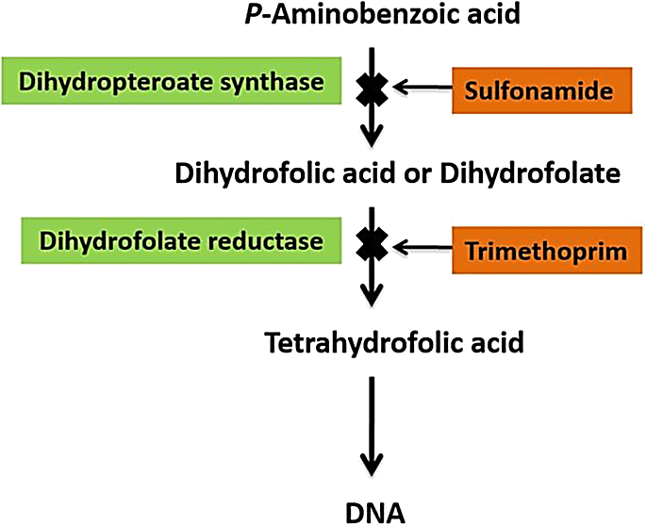
4. Interference with metabolism process.
Sulfonamides are broad spectrum bacteriostatic antibiotics that inhibit the synthesis of folic acid which is needed for the growth of many bacteria.
Some of sulfonamides are designed to stay in the GI tract (enteric forms), and some are absorbed by the GI tract and penetrate tissues (systemic forms). Ex: Sulfamethoxazole/trimethoprim.
PABA
Hint…
Bactericidal when potentiated with trimethoprim.

Slide 13
5. Inhibition the synthesis of nucleic acids.
Fluoroquinolones are antimicrobial agents with fluorine bound to the quinolone base, which increases the effects of drug, spectrum of activity, and absorption. They are broad-spectrum antibiotics. Ex: ciprofloxacin, Levofloxacin, orbifloxacin, difloxacin, marbofloxacin, and sarafloxacin.
Quinolones are types of antimicrobials act in Inhibit DNA gyrases required for supercoiling of DNA.
Rifamycins Is broad-spectrum antibiotics, disrupts RNA synthesis and used in combination with other antibiotics (usually erythromycin).
Rifampin, like other rifamycins, acts by binding to the β subunit of the RNA polymerase and blocks the extension of the nascent RNA chain.

Slide 14
Antiparasitic agents
Nitroimiazoles: Work by interacting with DNA and causing a loss of helical DNA structure and strand breakage and inhibiting the protein synthesis of the cell wall leading to cell death.
An example is metronidazole, an antibacterial and antiprotozoal agent used in the treatment of certain anaerobic bacterial and protozoal infections, such as those caused by Giardia and Trichomonas. It is often used to treat diarrhea and other intestinal problem.

Slide 15
Antifungal agents
Antifungals: are chemicals used to treat diseases caused by fungi (mold or yeast). Some fungal diseases are superficial and others are systemic.
Types of antifungals
  Nystatin and Amphotericin B: They work by binding to the fungal cell membrane.
  Ketoconazole: It works by causing leakage of the fungal cell membrane.
  Clotrimazole: its action primarily by the harmful permeability barrier in the fungal cytoplasmic membrane.
  Flucytosine: It works by interfering with the metabolism of RNA and proteins.
  Griseofulvin: They work by disrupting fungal cell division.

Slide 16
Antiviral agents
Viruses are intracellular invaders that alter the host cell’s metabolic pathways.
Antiviral drugs act by preventing viral penetration of the host cell or by inhibiting the virus’s production of RNA or DNA , like:
  Acyclovir : Interferes with the virus’s synthesis of DNA used to treat herpes virus infections (Tablets, suspension, injectable)
  Interferons (IFNs): Protect host cells from a number of different viruses. IFNs block virus replication at many levels.

