Slide 1
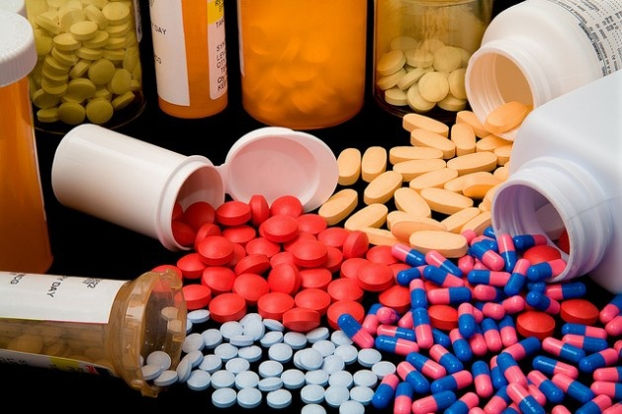
Antibiotics
First Lecture
2023

Slide 2
Antimicrobials & Antibiotics
Infections and diseases may be caused by different types of organisms (like bacteria,, parasite & viruses). The drug used to prevent the pathogenicity of microorganisms is called antimicrobial agent.
Antimicrobial agent is any natural, semisynthetic or synthetic substance has the ability to kill or inhibit growth of microorganisms with little or no damage to the host cells.
Antibiotic is a natural substance (produced by living organisms) has the ability to kill or inhibit growth of microorganisms with little or no damage to the host cells.
Hint…
All the antibiotics are antimicrobials, but not all antimicrobials are antibiotics.

Slide 3
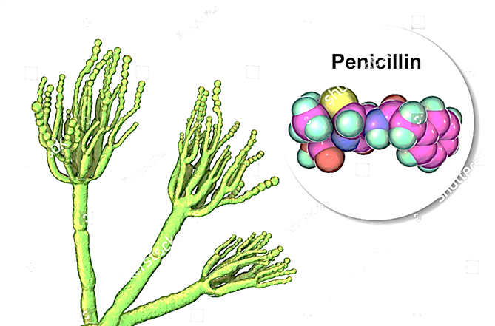
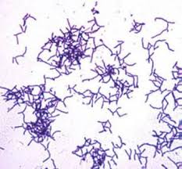
Antibiotics producing microorganisms
Actinomycetes: they produce around 60-70 % of total kinds of antibiotics ex: Streptomyces spp
Fungi: fungi produce around 20 % of antibiotics ex: Penicillium spp
Bacteria: the bacteria produce around 10 % of different antibiotics ex: Bacillus spp

Slide 4
General properties of antimicrobial agents…
Selective Toxicity: drug harms the microbe without causing significant damage to the host. When searching for ways to treat disease, scientists look for differences between the human (or animal) host and the pathogen. Ex. Penicillin interferes with cell wall synthesis. Animal cells have no cell walls, so penicillin is not toxic to animals.
Spectrum of Activity: the range of different microbes against which an antimicrobial agent acts. Example: A broad-spectrum antibiotic are an antibiotic that act on the two major bacterial groups, Gram-positive and Gram-negative vs. narrow spectrum antibiotics which are active against a selected group of bacterial types. They can act on either Gram +ve or Gram –ve but not both.

Slide 5
History of antibiotics…
In 1893, Bartolomeo Gosio discovered mycophenolic acid as a first antibiotic that was isolated from Penicillium glaucum. (Mycophenolic acid was discovered by Italian medical scientist Bartolomeo Gosio. He collected a fungus from spoiled corn and named it Penicillium glaucum (The species is now called P. brevicompactum). In 1893 he found that the fungus had antibacterial activity. In 1896 he isolated crystals of the compound, which he successfully demonstrated as the active antibacterial compound against the anthrax bacterium. This was the first antibiotic that was isolated in pure and crystalline form. But the discovery was forgotten. It was rediscovered by two American scientists C.L. Alsberg and O.M. Black in 1912, and given the name mycophenolic acid. The compound was eventually demonstrated to have antiviral, antifungal and antibacterial activities. Although it is not commercialised as antibiotic due to its adverse effects, its modified compound is an approved immunosuppressant drug in kidney, heart, and liver transplantations.)
In 1899, Pyocyanase which was prepared by Emmerich & Löw from Pseudomonas aeruginosa and was used in many hospitals.
In 1905, Paul Ehrlich, Alfred Bertheim, and Sahachiro Hata, they synthesized hundreds of organo-arsenic derivatives and tested them in syphilis-infected rabbits. In 1909, they came across the sixth compound in the 600th series tested, they named 606 or Salvarsan, which used to treat syphilis-infected rabbits (caused by Treponema pallidium) and showed significant promise for the treatment of patients with this disease in limited trials on humans.
.

Slide 6
History of antibiotics…
In 1910, Ehrlich and Hata named neosalvarsan as a new component against syphilis-infected, with more soluble and less toxic than Salvarsan
In 1928, Alexander Fleming discovered the first antibiotic, penicillin from Penicillium notatum. However, it took over a decade before penicillin was introduced as a treatment for bacterial infections
The period between 1950s and 1970s was indeed the golden era of discovery of novel antibiotics classes, with no new classes discovered since then.
Therefore, with the decreasing of the discovery rate, the main approach was dealing with modifying the existing antibiotics to control of the resistance against the discovered antibiotics.

Slide 7
Sulfa drug (Sulphanoamide)
During the earlier days of antibiotics research, a group of researchers discovered sulfa drugs, namely (Prontosil), which was synthesized by Josef Klarer and Fritz Mietzsch and tested by Gerhard Domagk (1935) for antibacterial activity in a number of diseases, which was used to treat Streptococcus pyogenes, and the active part of Prontosil is sulfanilamide.
Two other classes of synthetic antibiotics successful in clinical use are the quinolones, such as ciprofloxacin, and oxazolidinones, such as linezolid).

Slide 8
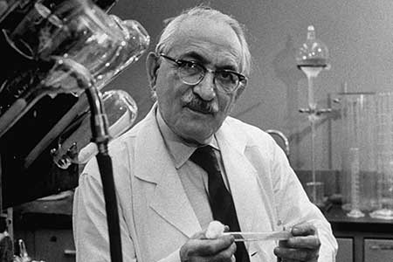
Selman Waksman: the father of antibiotic
Selman Abraham Waksman (July 22, 1888 – August 16, 1973)
The microbiologist who discovered streptomycin, He was the first to use the word "antibiotic" in the medical sense in 1943.
In 1952 he was awarded the Nobel Prize for his discovery of "streptomycin," the first antibiotic active against tuberculosis."
In 2005, Selman Waksman was granted an ACS National Historic Chemical Landmark in recognition of the significant work of his lab in isolating more than 15 antibiotics, including streptomycin, which was the first effective treatment for tuberculosis..

Slide 9
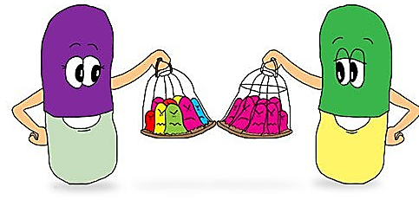
1st Classifications of Antibiotics…
Antibiotics are classified into two types depending on the spectrum of action:
Broad-spectrum antibiotics: These antibiotics are widely used to kill or inhibit both gram-positive and gram-negative bacteria, like Imipenem.
Narrow spectrum antibiotics: These antibiotics are effective against specific groups of bacteria, like Penicillin G

Slide 10
2nd Classifications of Antibiotics…
Antibiotics are classified into three types depending on the nature of antibiotics:
Natural antibiotics: These antibiotics are totally produced and derived from microorganisms, like penicillin G.
Semi-synthetic antibiotics: These antibiotics are produced and derived from microorganisms with chemical modified, like ampicillin.
Synthetic antibiotics: Made completely in a laboratory based on the structure of the natural products such as cephalosporins.

Slide 11
3rd Classifications of Antibiotics…
Antibiotics are classified into two types depending on their actions:
Bactericidal antibiotics: These antibiotics have the ability to kill microorganisms, Usually, endocarditis and meningitis are treated by bactericidal drugs, like penicillins.
Bacteriostatic antibiotics: are medications whose mechanism of action stalls bacterial cellular activity without directly causing bacterial death. The mechanisms of action of these antimicrobials are broad, and they generally require patients' to have functional immune systems to function optimally, like macrolide.
According to drug concentration, the activity may vary. For examples, if we use high concentrations of bacteriostatic agents, they may act as bactericidal, whereas low concentration of bactericidal agents may act as bacteriostatic.
The minimum concentration of a drug that is needed to inhibit bacteria is known as ‘minimum inhibitory concentration’ or MIC.
The minimum concentration of a drug that is needed to kill bacteria is called the ‘minimum bactericidal concentration’ or MBC.

Slide 12
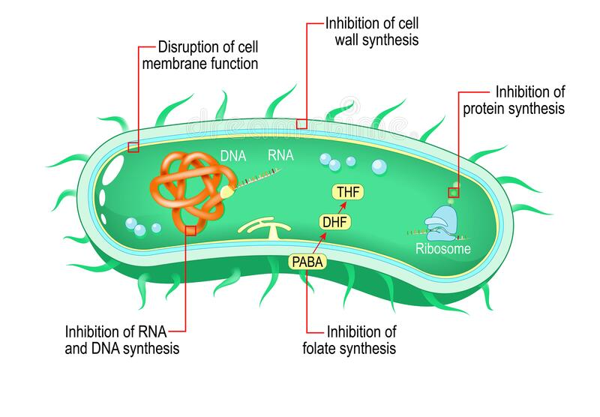
4th Classifications of Antibiotics…
Antibiotics are classified into five types depending on the mode of action of antibiotics:
Inhibit cell wall synthesis.
Disrupt cell membrane function.
Inhibit protein synthesis.
Inhibit nuclei acid synthesis.
Inhibit metabolic pathways.

Slide 13
Factors of choosing the right antibiotics…
Physicians use either one or sometimes a combination of antibiotics when treating an infection and it depends on many factors such as:
Type of infection.
Type of pathogenic agent.
Spectrum of activity.
Growth conditions.
Bacterial growth density.
Duration of infection.
Immunity state of patients.
Cost.
In some cases, one antibiotic can be bactericidal for one strain of bacteria and be bacteriostatic of a different strain. Therefore, all the aspects mentioned above should be clearly known before choosing an antibiotic.

Slide 14
Characteristics of the ideal antimicrobial agents…
Solubility in body fluids
Selective toxicity against microbes
Toxicity not easily altered (no food or drug interactions)
Non allergenic
Stability (should be degraded and excreted by the body slowly)
Resistance by microorganisms not easily acquired
Long shelf life.
Reasonable cost
Not evoke immune response
Reasonable side effects

