Slide 1
Cytokines

Slide 2
Cytokines
cytokines are a diverse group of intercellular signaling peptides and glycoproteins .
molecular weights (MW) between 6000 and 60,000, and most of them are genetically and structurally unrelated to one another.
Several hundred have been identified to date. Each is secreted by particular cell types in response to a variety of stimuli and produces characteristic effects on the growth, mobility, differentiation, or function of target cells.

Slide 3
Collectively, they regulate not only immune and inflammatory responses but also wound healing, hematopoiesis, angiogenesis, and many other biologic processes.
They are extremely potent compounds that act at concentrations of 10⁻⁹-10⁻¹⁵ M by binding to specific surface receptors on target cells. Unlike endocrine hormones, they are not produced by specialized glands and secreted into the circulation, but rather are produced locally by a variety of tissues and cells.

Slide 4
Only a few cytokines, such as transforming growth factor (TGF- β, erythropoietin (EPO), stem cell factor (SCF), and monocyte colony-stimulating factor (M-CSF), are normally present in detectable amounts in the blood and are able to influence distant target cells
Most other cytokines, unless produced in excess, act only locally over short distances, in either a paracrine manner (ie, on adjacent cells) or an autocrine manner (ie, on the producing cell itself).

Slide 5
Cytokine nomenclature
has little to do with structural relationships among molecules; some of them have been termed interleukins (IL) and been assigned a number (Table 10-1), but many others retain their descriptive and frequently misleading historical names (Table 10-2). Some can be classified into families based on their use of receptors that share a common chain or exhibit other sequence homologies. Cytokines produced by lymphocytes are also called lymphokines, whereas those produced by monocytes or macrophages are called monokines

Slide 6
A given cytokine may be secreted individually or as part of a coordinated response along with other, unrelated cytokines. Many have activities that overlap extensively, and others may be antagonistic. Furthermore, one cytokine may induce expression of other cytokines or mediators, thus producing a cascade of biologic effects.
Much of what we know about cytokine functions in vivo has come from studying humans or animals with mutations that inactivate a particular cytokine or cytokine-receptor gene. Some of these mutations occur naturally, and others have been introduced deliberately into the chromosomes of laboratory mice to create so-called knockout mouse strains with defects in specific genes

Slide 7
Interleukin | Principal Cell Source | Principal Effectsª
IL-1خ± and خ² | Macrophages, other APCs, other somatic cells | Costimulation of APCs and T cells B-cell growth and Ig production Acute-phase response Phagocyte activation Inflammation and fever Promotes hematopoiesis
IL-2 | Activated T_{H}2 cells, CTLs, NK cells | Proliferation of activated T cells Apoptosis of T cells after prolonged or repeated activation NK-cell and CTL functions B cell proliferation and IgG2 expression
IL-3 | T lymphocytes | Growth of early hematopoietic progenitors
IL-4 | T_{H}2 cells, mast cells | B-cell proliferation, IgE expression, and class II MHC expression T_{H}2-cell and CTL proliferation and functions Eosinophil and mast cell growth and function Inhibits monokine production

Slide 8
IL-5 | T_{H}2 cells, mast cells | Eosinophil growth and function
IL-6 | Activated T_{H}2 cells, APCs, other somatic cells | Synergistic effects with IL-1 or TNFخ± Fever Acute-phase response B-cell growth and Ig production Hematopoiesis
IL-7 | Thymic and marrow stromal cells | T and B lymphopoiesis CTL functions
IL-8 | Macrophages, other somatic cells | Chemoattracts neutrophils and T cells Angiogenic
IL-9 | T cells | Some

Slide 9
IL-10 | Activated T_{H}2, CD8 T, and B lymphocytes; macrophages | Inhibits cytokine production by T_{H}1 cells, NK cells, and APCs Promotes B-cell proliferation and antibody responses Suppresses cell-mediated immunity
IL-11 | Stromal cells | Synergistic effects on hematopoiesis and thrombopoiesis
IL-12 | B cells, macrophages | Proliferation and function of activated CTLs and NK cells IFNخ³ production Promotes T_{H}1-cell induction; suppresses T_{H}2-cell functions Promotes cell-mediated immunity

Slide 10
IL-13 | T_{H}2 cells | Similar, but additive, to IL-4 effects
IL-15 | Epithelial cells and monocytes, nonlymphocytic cells | Mimics IL-2 T-cell effects Mast-cell and NK activation
IL-16 | CD8 and some CD4 T lymphocytes | Chemoattracts CD4 T cells, eosinophils, and monocytes Comitogenic for CD4 T cells
IL-17 | Activated memory T cells | Promotes T-cell proliferation, neutrophil development
IL-18 | Macrophages, keratinocytes | Coinduces IFNخ³ production Coactivates T_{H}1- and NK-cell development

Slide 11
TNF alpha and beta | Activated macrophages, other somatic cells | IL-1-like effects Vascular thrombosis and tumor necrosis
LTخ± | Activated T_{H}1 cells | IL-1-like and TNFخ±-like effects
LTخ±-LTخ² complex | Activated T_{H}1 cells | Development of peripheral (secondary) lymphoid organs
IFN خ± and خ² | Macrophages, neutrophils, other somatic cells | Antiviral effects Induction of class I MHC on all somatic cells Activation of macrophages and NK cells

Slide 12
IFNخ³ | Activated T_{H}1 and NK cells | Induction of class I MHC on all somatic cells Induction of class II MHC on APCs and somatic cells Activation of macrophages, neutrophils, and NK cells Promotion of cell-mediated immunity (inhibits T_{H}2 cells) Antiviral effects
TGFخ² | Activated T lymphocytes, platelets, macrophages, other somatic cells | Antiinflammatory (suppression of cytokine production and class II MHC expression) Antiproliferative for stem cells, monomyelocytic cells and lymphocytes Promotion of fibroblast proliferation and wound healing
Abbreviations: TNF = tumor necrosis factor; LT = lymphotoxin; IFN = interferon; TGF = transforming growth factor; NK = natural killer; IL = interleukin; MHC = major histocompatibility complex. ªAll of the listed processes are enhanced unless otherwise indicated.

Slide 13
TNFخ± Its Receptors
TNFRI is the principal mediator of TNFخ± activity, with TNFRII serving an auxiliary role. Moreover, unlike TNFRII, the cytoplasmic portion of TNFRI includes an 80-amino-acid sequence known as the death domain, which is also found in the Fas protein (the receptor for FasL). The death domains of TNFRI and Fas allow these proteins to trigger apoptosis when they bind their respective ligands; they do so by activating caspase-8, which in turn activates the downstream caspase cascade. Like the IL-1 receptors, TNFخ± receptors are internalized (endocytosed) after ligand binding. IL-2 increases expression of both types of TNFخ± receptors, whereas IFNخ³ selectively induces TNFRII. Activated cells shed their TNFخ± receptors, which can bind TNFخ± and may antagonize its activity during inflammatory responses. An inherited inability to shed TNFRI results in a syndrome of recurrent localized inflammatory episodes and fevers.

Slide 14
INTERLEUKIN-2
IL-2 is an autocrine and paracrine growth factor secreted by activated T lymphocytes and is essential for clonal T-cell proliferation. The discovery of IL-2 (then called T-cell growth factor) represented a major advance in immunology, because it made it possible to propagate and study individual clones of normal T cells that maintained their immunologic properties in cell culture. Its role in promoting T-cell proliferation, cytokine production, and the functional properties of B cells, macrophages, and NK cells, make IL-2 critical for activating all types of acquired immune responses. Paradoxically, however, this cytokine appears equally important in limiting such responses and eliminating autoreactive T cells: prolonged or repeated activation in the presence of IL-2 causes T-cell apoptosis, and mutations that inactivate IL-2 or its receptor lead to excessive T-cell proliferation and autoimmunity in both humans and animal models (Table 10-6). IL-2 is thus a two-edged sword that initiates immune responses but also limits their intensity and duration

Slide 15
INTERLEUKIN-10
IL-10 is a potent inhibitor of inflammatory and immune responses, in part because it inhibits APC function by suppressing class II MHC expression on dendritic cells and macrophages. It is a product of activated T_{H}2 and CD8 T cells, B cells, monocytes, and keratinocytes and was originally identified because of its ability to inhibit cytokine production by activated T cells, often acting synergistically with TGF
خ². For example, IL-10 inhibits the production of IL-2 and IFNخ³ by T_{H}1 cells, thereby favoring T_{H}2- dependent responses. It inhibits production of cytokines by NK cells, and of cytokines, reactive oxygen species, nitric oxide, and adhesion proteins by macrophages. It is also thought to promote immune tolerance to ingested antigens in the gut (Chapter 14) and may have a more general role in anergy. Mice lacking IL-10R develop severe gastrointestinal inflammatory disease due to overexpression of proinflammatory cytokines. High-level endogenous expression of IL-10 correlates with graft survival in skin, cardiac, and islet-cell transplantation. On the other hand, IL-10 is not entirely immunosuppressive

Slide 16
INTERFERONS
In 1957, it was discovered that cells exposed to inactivated viruses produce at least one soluble factor that can â€œinterfereâ€‌ with viral replication when applied to newly infected cells. The factor was named interferon (IFN). It has since been shown that the interferons consist of a large family of secretory proteins that not only share antiviral activity, but also have the ability to inhibit proliferation of vertebrate cells and to modulate immune responses. Interferons do not exert their antiviral effects by acting on viral particles, but rather by inducing an antiviral state

Slide 17
The Antiviral IFNs
IFNs with relatively high antiviral potency are called antiviral, or type I, IFNs. They are not normally found in tissues or serum, but can be synthesized and released rapidly by most cell types in response to infection by viruses, bacteria, or protozoa, or on exposure to certain cytokines (Figure 10-2).
These IFNs can also be induced artificially by treating cells with double-stranded RNA molecules, which presumably mimic the genomes of certain RNA viruses. One commonly used inducer of type I IFN is poly(I:C)â€”a heteroduplex of polyinosine and polycytidine RNA chains.

Slide 18
There are three major forms of type I IFN: IFNخ±, IFNخ², and IFNد‰. IFNخ± is the primary IFN produced by leukocytes and consists of at least 14 glycoproteins encoded by a closely related family of genes. The amino acid sequences of these various IFNخ± proteins are approximately 73% identical to one another. Fibroblasts and most other nonleukocytes primarily express IFNخ², a protein that is only about 30% identical to IFNخ±. Small amounts of IFNخ² are also expressed by leukocytes

Slide 19
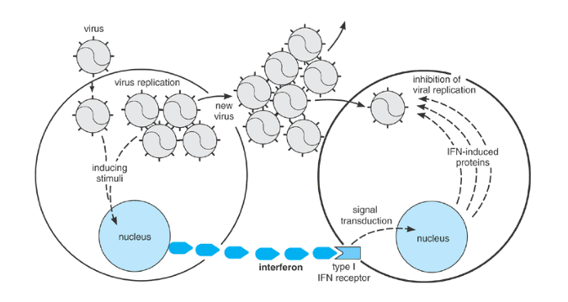

Slide 21
All type I IFNs bind to a single multichain receptor, which is expressed on nearly all cell types and is structurally related to the IL-10 receptor. Binding of type I IFN to this receptor leads to increased expression of at least 30 different proteins in the target cell. Among these are the class I MHC proteins, which enable an infected cell to present viral antigens and so to be killed by CTLs. The type I IFNs also stimulate IL-12-independent production of IFNخ³, which promotes T-cell and macrophage function. Other IFN-inducible proteins include an RNA-dependent protein kinase (PKR) and 2â€²-5â€² oligoadenylate (2-5A) synthetase, each of which requires the presence of double-stranded RNA for activity. When activated, PKR phosphorylates a component of the cellular translational machinery (called eukaryotic initiation factor 2, or eIF2

Slide 22
thereby inhibiting protein synthesis. The 2-5A synthetase produces short chains of adenylate residues joined by 2â€²-5â€² phosphodiester bonds; these bind and activate a cellular endoribonuclease that specifically degrades single-stranded RNA. These enzymes, together with other IFN-inducible proteins, combine to confer a relatively nonspecific but potent intracellular defense against viruses.
In addition to inhibiting viral replication, type I IFNs can modulate specific cellular functions. They arrest the growth of (but generally do not kill) many types of cells in culture, including transformed cell lines. They also may either inhibit or promote cellular differentiation, depending on the cell type, timing, and dosage of treatment

Slide 23
Immune IFN
IFNخ³ (also called type II IFN or immune IFN) arises from a single gene and differs in virtually all respects from the type I IFNs. There is only a single active form of IFNخ³ proteinâ€”a homodimer of polypeptides that can be glycosylated to various degrees. The receptor to which it binds is likewise unrelated to the receptor for type I IFN. Although IFNخ³ has some antiviral activity (which led to its discovery and is the source of its name), it is much less active in this regard than the type I IFNs. Moreover, IFNخ³ expression is not directly inducible by infection or by double-stranded RNA. It is involved in the regulation of nearly all phases of the immune and inflammatory responses, including the activation and differentiation of T cells, B cells, NK cells, macrophages, and others. It is therefore best regarded as a distinct immunoregulatory cytokine and has found clinical application as an immunostimulator in chronic granulomatous disease and other disorders.

Slide 24
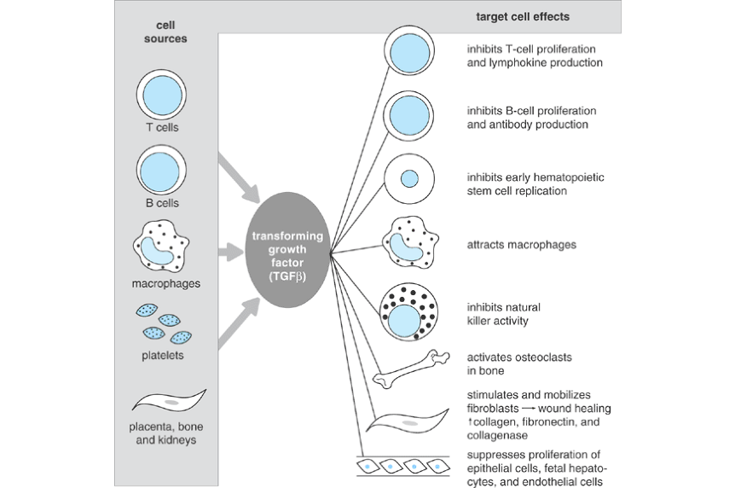

Slide 25
CYTOKINE RECEPTOR FAMILIES
The characterization of many cytokine receptors and their corresponding genes has revealed that most belong to larger multigene families (Table 10-9). The members of each family share distinctive structural features and are thought to be evolutionarily related. The divisions among families are not mutually exclusive, however, and some receptors (eg, IL-6R) can be assigned to multiple families. The receptors for IL-1, IL-6, M-CSF, G-CSF, and SCF each contain an immunoglobulin-like domain in their extracellular regions and thus belong to the immunoglobulin gene superfamily (see Chapter 7). Many of the remaining cytokines belong to the hematopoietin receptor family, whose members can be recognized by a distinctive set of four spaced cysteines in their extracellular domains as well as by a conserved sequence motif (Trp-Ser-X-Trp-Ser, where X is any amino acid) located near the external membrane surface. It has been proposed that receptor dimerization is required for signal transduction by hematopoietin receptors; the dimers can be either homodimers, as in IL-4R, or more complex heterodimers, as in IL-6R and some others.

Slide 26
Hematopoietin superfamily | Trp-Ser-X-Trp-Ser motif; 4 extracellular Cys residues | IL-2, IL-3, IL-4, IL-5, IL-6 family, IL-7, IL-9, GM-CSF, G-CSF, Epo, growth hormone, prolactin
Immunoglobulin superfamily | Ig-like extracellular domain | IL-1, IL-6, M-CSF, G-CSF, SCF
TNF family | 4 Cys-rich extracellular regions | TNFخ±, CD27, CD30, CD40, Fas, LTخ± & خ±/خ² complex, NGF

Slide 27
IL-3 family | Common خ² subunit | IL-3, IL-5, GM-CSF
IL-6 family | Common خ² subunit | IL-6, IL-11, LIF, OSM, CNTF, CT-1
IL-8 family | 7 transmembrane domains | Chemokines
Tyrosine kinase family | Intrinsic Tyr kinase activity in cytoplasmic domain | M-CSF, SCF, platelet-derived growth factor, fibroblast growth factor

Slide 28
TGFخ² family | Intrinsic Thr/Ser kinase activity in cytoplasmic domain | TGFخ², inhibins, activins, Mullerian inhibiting substance, bone morphogenetic protein
IFN family | Type I (for IFNخ±, خ², and د–[small omega with bar over]), type II (for IFNخ³) | IFNخ±, خ², د–[small omega with bar over], and خ³, IL-10
Abbreviations: TNF = tumor necrosis factor; IL = interleukin; TGF = transforming growth factor; IFN = interferon; GM-CSF = granulocyteâ€“monocyte colony-stimulating factor, G-CSF = granulocyte colony-stimulating factor; M-CSF = macrophage colony-stimulating factor; SCF = stem cell factor; LIF = leukemia inhibitory factor; OSM = oncostatin M; CNTF = ciliary neurotrophic factor; CT-1 = cardiotrophin-1.

Slide 29
HEMATOPOIETIC COLONY-STIMULATING FACTORS
CSFs are cytokines that support the production of particular mature blood cell types from pluripotent stem cells or committed progenitors in the bone marrow. Examples include G-CSF, GM-CSF, EPO, thrombopoietin (TPO), SCF, and IL-3 (also known as multi-CSF because it promotes formation of all hematopoietic cell types). The biologic properties of the CSFs and their receptors have been summarized in Chapter 1; only a few points will be highlighted here

