Slide 1
T-Cells

Slide 2
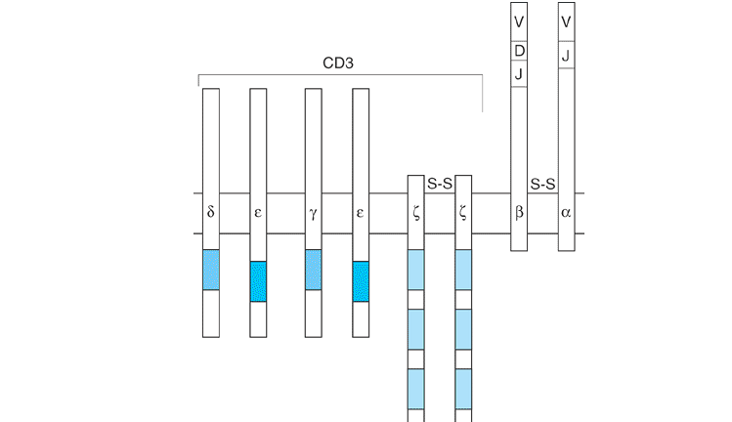
T-Cell receptor

Slide 3
T-Cell receptor
The T-cell antigen receptor (TCR). The TCR is a complex of eight transmembrane proteins. The خ± and خ² chains form a disulfide-linked (Sâ€”S) dimer that is responsible for the recognition of antigenic peptides bound to class I and class II major histocompatability class (MHC) molecules. The amino-terminal regions of the خ± and خ² chains, which are formed through rearrangements of V, D, and J segments, are highly polymorphic. The خ±خ² dimer is noncovalently associated with the CD3 complex,.

Slide 4
T-Cell receptor
which converts the recognition of antigen into transmembrane signals. The CD3 polypeptides are not polymorphic and have larger cytoplasmic domains than TCR خ± and خ². The CD3 complex consists of three sets of dimers. There are two CD3خµ chains, one paired with CD3خ³ and the other with CD3خ´. The خ¶ chain exists either as a disulfide-linked خ¶/خ¶ homodimer (as shown here) or as a heterodimer with either خ· (an alternatively spliced form of خ¶) or the خ³ chain. The functional importance of this variation in the خ¶ dimer is not understood. The cytoplasmic domains of CD3 chains contain one or more immune receptor tyrosine-based activation motifs (ITAMs), depicted here as shaded boxes

Slide 5
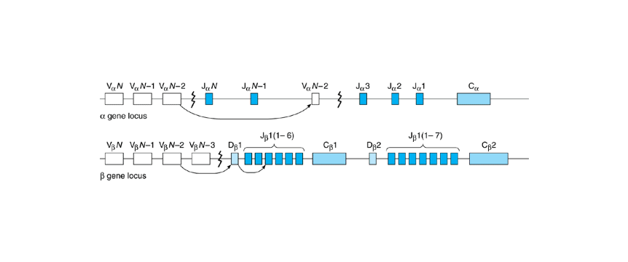
Rearrangement of t-cells receptor genes

Slide 6
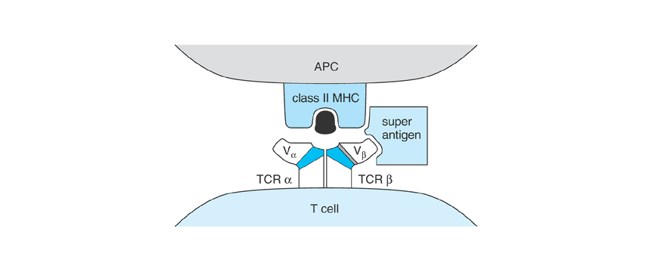
Superantigens

Slide 7
Superantigens
Figure 9-3. Model of the interactions between the TCR, class II MHC molecule, and a superantigen. The superantigen interacts with the MHC molecule outside the peptide groove and binds only to the VB segment of the TCR.

Slide 8
Because superantigens only recognize the V_{خ²} segment and not the other components of the TCR خ±خ² dimer, a superantigen has the capability of activating 10% of peripheral T cells (this is orders of magnitude more than a conventional antigen). Exposure to a superantigen, therefore, can lead to massive T-cell activation, and the ensuing release of large amounts of lymphokines accounts for many of the manifestations of acute exposure to bacterial toxins that have superantigen capabilities. This likely explains the clinical features of toxic shock syndrome, which can be induced by Staphylococcus aureus toxin TSST-1, a superantigen that activates human T cells expressing VB2In the acute phase of toxic shock syndrome there is a marked, and selective, expansion of T cells

Slide 9
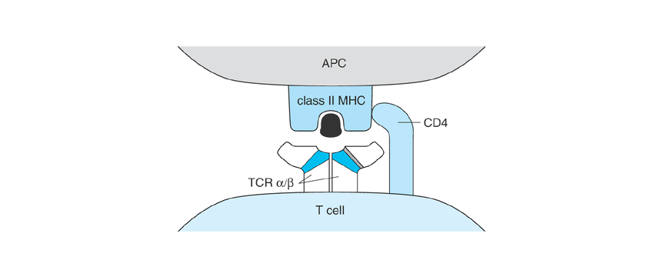
CD4 and CD8 Coreceptors

Slide 10
CD4 and CD8 Coreceptors
CD4 coreceptor. CD4 binds class II MHC molecules at a membrane-proximal region not directly involved in peptide binding. In the model depicted here, the coreceptor binds the same MHC molecule that engages the TCR. CD8 plays a similar coreceptor role on T cells that recognize antigen in association with class I MHC molecules. CD8 binds a nonpolymorphic region on MHC class I molecules. Because the cytoplasmic domains of CD4 and CD8 interact with Lck, the coreceptors can bring this Src-like protein tyrosine kinase into proximity with the TCR.

Slide 11
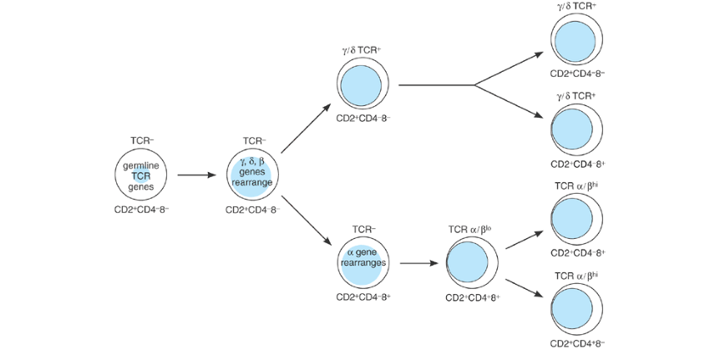
T-CELLS ONTOGENY

Slide 12
Stages in thymocyte development. Progenitor cells migrate from the bone marrow to the thymus. At the earliest stages of development, thymocytes express several T-cell surface molecules, such as CD2, but still have germline configurations of their TCR genes. Thymocytes destined to become خ±خ² T cells pass through a critical CD4⁺CD8⁺ phase during which positive and negative selection occur

Slide 13
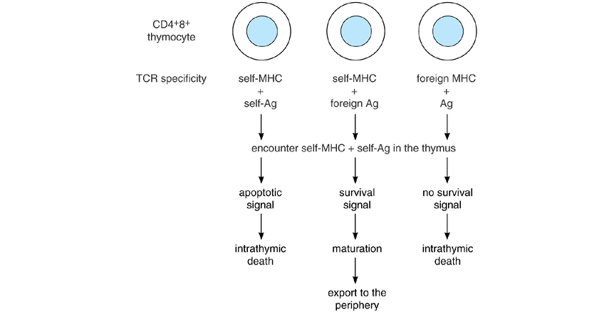
Positive and negative selection of thymocyte

Slide 14
Positive and negative selection of thymocyte
Positive and negative selection of thymocytes. CD4⁺CD8⁺TCR⁺ thymocytes encounter self-antigens bound to class I and class II major histocompatibility complex (MHC) molecules on epithelial cells in the thymic cortex and on macrophages and dendritic cells in the thymic medulla. In the resulting interactions, thymocytes whose T-cell receptors (TCRs) recognize self-MHC plus self-antigen will receive an apoptotic signal and undergo apoptosis in the thymus (negative selection).

Slide 15
Positive and negative selection of thymocyte
In contrast, thymocytes whose TCRs have specificity for self-MHC plus foreign antigens receive a survival signal that results in their positive selection. Thymocytes whose TCRs are unable to recognize antigens in association with self-MHC die of neglect (failure of positive selection). Differences in the binding affinities of TCRs for self-MHC plus self-antigen may explain these outcomes. Excessive signaling from high-affinity interactions leads to cell death, but intermediate levels of signaling from lower affinity interactions promote cell survival and rescue cells from death by neglect. The net result of thymic selections is the survival of T cells whose TCRs are restricted by self-MHC but that are not autoreactive.

Slide 16
SIGNAL TRANSDUCTION BY THE TCR
Key to the ability of the TCR to deliver intracellular signals is its interactions with protein tyrosine kinases (PTKs). In unstimulated T cells, Fyn, a member of the Src family of PTKs, associates with the cytoplasmic domains of CD3 chains (Figure 9-7).
A second Src-like PTK, called Lck, binds to the cytoplasmic domains of CD4 and CD8 and thus can be brought into proximity with the TCR through the interactions of these coreceptors with the MHC. Stimulation of the TCR by antigen-MHC triggers the phosphorylation of tyrosine residues in the cytoplasmic domains of the CD3 chains of the receptor complex. According to a widely accepted model of TCR signaling, Lck and Fyn are responsible for these initial phosphorylation events.

Slide 17
SIGNAL TRANSDUCTION BY THE TCR
The antigen-induced tyrosine phosphorylation sites lie within particular amino acid sequences, designated immune receptor tyrosine-based activation motifs (ITAMs), found in the cytoplasmic domains of CD3 molecules. ITAMs are also present in the signaling chains of the B-cell antigen receptor and of certain Fc receptors.
When tyrosine-phosphorylated, the CD3 ITAMs form a recognition unit for another PTK, called ZAP-70, and thus recruit ZAP-70 to the TCR complex. ZAP-70, either alone or together with the Src-like PTKs, appears largely responsible for the phosphorylation of a number of intracellular proteins. Mutations in ZAP-70 result in immunodeficiency in humans, underscoring the importance of ZAP-70 in TCR signaling.

Slide 18
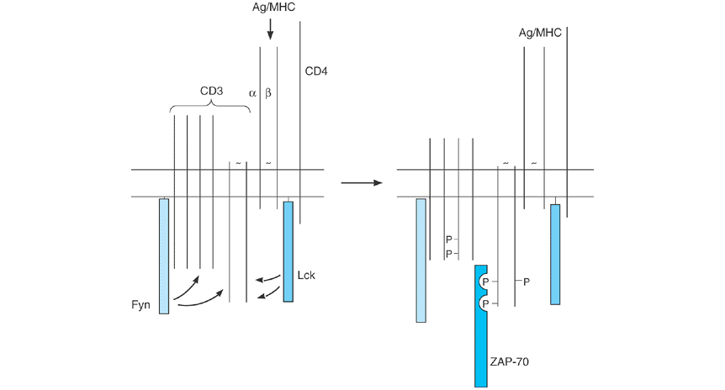
Signal transduction by TCR

Slide 19
Model for the interactions of the T-cell antigen receptor with protein tyrosine kinases.
In resting T cells, the CD3 components of the T-cell receptor (TCR) are associated with the protein tyrosine kinase Fyn, and the CD4 coreceptor is associated with Lck. On stimulation of the TCR, the CD3 chains are tyrosine phosphorylated on immunoreceptor tyrosine-based activation motifs (ITAMs), probably through the action of Fyn or Lck. The tyrosine-phosphorylated ITAMs in turn recruit a third protein tyrosine kinase, ZAP-70, to the receptor.

Slide 20
Activation of the phospholipase C (PLC) and Ras pathways by the T-cell receptor (TCR
Key signaling molecules activated by TCR stimulation include Ras and phospholipase C (PLC) -γ (3see Chapter 1). The coupling of the TCR to the Ras and PLC-γ 3pathways involves complex linker molecules such as LAT (Figure 9-8). TCR stimulation triggers the tyrosine phosphorylation of LAT, a transmembrane protein. This phosphorylation induces LAT to associate with Grb2-Sos (an initiator of Ras activation) and PLCخ³-1. The recruitment of these molecules to LAT is required for TCR-mediated activation of Ras and PLCخ³-1. Activated Ras, in turn, stimulates the MAP kinase cascade of serineâ€“threonine kinases (see Chapter 1). PLCخ³-1 hydrolyzes the membrane phospholipid called phosphatidylinositol-(4,5)-bisphosphate (PIP₂).

Slide 21
Activation of the phospholipase C (PLC) and Ras pathways by the T-cell receptor (TCR
The ensuing breakdown of PIP₂ generates two second messengers: diacylglycerol and inositol-1,4,5-tris-phosphate (IP₃). Diacylglycerol activates the protein kinase C family of serine-threonine protein kinases. IP₃ releases Ca²⁺ from internal stores into the cytoplasm, causing an increase in the concentration of cytoplasmic free calcium ([Ca²⁺]_{I}). Elevations in [Ca²⁺]_{I}, activated protein kinase C, and the Ras pathway appear to be important mediators for many of the T-cell responses, including the induction of lymphokine gene transcription and the triggering

Slide 22
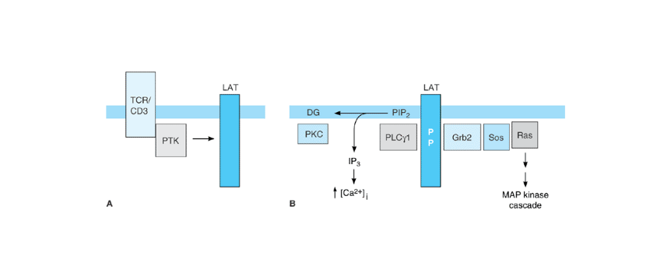
Activation of the phospholipase C (PLC) and Ras pathways by the T-cell receptor (TCR

Slide 23
Activation of the phospholipase C (PLC) and Ras pathways by the T-cell receptor (TCR
Activation of the phospholipase C (PLC) and Ras pathways by the T-cell receptor (TCR). A: Following TCR stimulation, protein tyrosine kinases (PTK) phosphorylate the linker protein LAT. B: Tyrosine-phosphorylated LAT then associates with phospholipase C خ³-1 (PLCخ³-1) and with Grb2-Sos. PLCخ³-1 hydrolyzes phosphatidylinositol-(4,5)-bisphosphate (PIP₂), producing two second messengers: diacylglycerol (DG), which activates the protein kinase C (PKC) family of serineâ€“threonine kinases, and inositol trisphosphate (IP₃), which triggers an increase in the concentration of cytosolic free calcium ions ([Ca²⁺]_{I}). Grb2-Sos recruits and activates Ras, leading to activation of the MAP kinase cascade (see Chapter 1).

Slide 24
Activation of t-cells
of cytolytic activity. One consequence of the increase in [Ca²⁺]_{I} is the activation of calcineurin, a Ca²⁺-dependent serine phosphatase that plays a key role in activating the interleukin-2 (IL-2) gene. Calcineurin is the target of cyclosporin and FK506, two immunosuppressive drugs that block TCR-mediated production of IL-2. These drugs are widely used after clinical transplantation to prevent graft rejection.

Slide 25
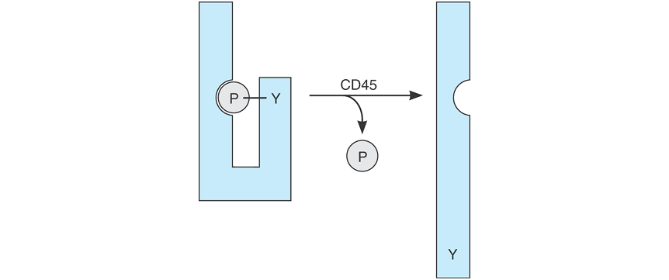
CD45: A TYROSINE PHOSPHATASE REQUIRED FOR TCR SIGNALING

Slide 26
CD45: A TYROSINE PHOSPHATASE REQUIRED FOR TCR SIGNALING
Regulation of Src-like protein tyrosine kinases by CD45. Src-like protein kinases, such as Lck and Fyn, can be phosphorylated (P) on a carboxy-terminal tyrosine (Y) by a kinase designated Csk. Phosphorylation at this site induces a conformational change in Src kinases that renders them catalytically inactive. The CD45 phosphatase removes the phosphate from this regulatory tyrosine and restores activity. An inability to activate Lck and Fyn likely explains the impaired TCR signaling observed in T cells that lack CD45.

Slide 27
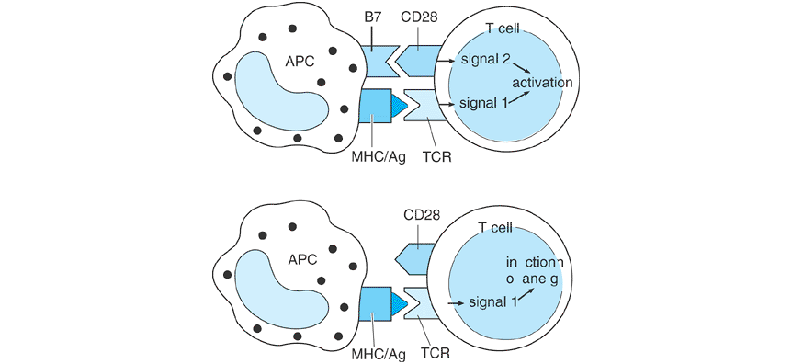
COSTIMULATION BY CD28

Slide 28
COSTIMULATION BY CD28
The role of CD28 in T-cell activation. Activation of T cells is thought to require T-cell receptor (TCR)-derived signals (signal 1) and a costimulus (signal 2). The major costimulatory molecule, CD28, binds to two cell surface molecules, B7.1 and B7.2, on antigen-presenting cells (APC). The combination of TCR signals and CD28 signals results in a substantial increase in lymphokine production over that seen with TCR stimulation alone. In the absence of the costimulus, the unopposed TCR signals can cause the T cell to enter a state of unresponsiveness known as anergy. Abbreviations: MHC = major histocompatibility complex; Ag = antigen.

Slide 29
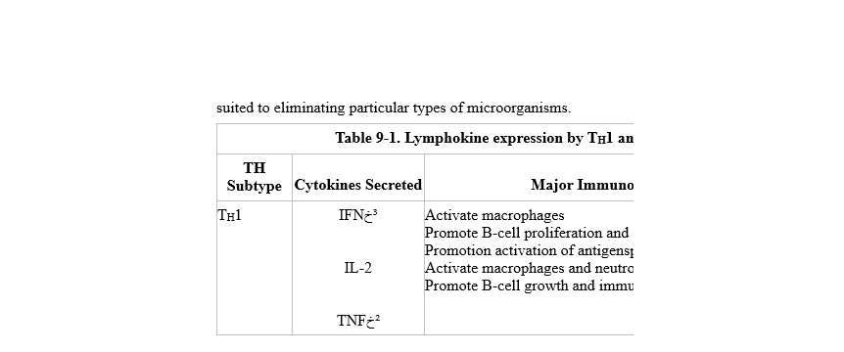
Table 9-1. Lymphokine expression by TH1 and TH2 cells

Slide 30
TH2 CYTOKINES
T_{H}2 | IL-4 IL-5 IL-6 IL-10 IL-13 | Chemoattract lymphocytes, mast cells, and basophils Enhance growth of mast cells and eosinophils Promote B-cell proliferation and class switching to IgE and IgG4 Inhibit T_{H}1-cell differentiation. Inhibit cytokine production by macrophages Enhance growth and develop ment of eosinophils Promote B-cell growth and immunoglobulin production Inhibit production of cytokines (including IFNخ³) by T_{H}1 cells, macrophages, and other APCs Inhibit T_{H}1-cell differentiation Promote B-cell growth and immunoglobulin production Same as IL-4
Abbreviations: IFNخ³ = interferon gamma, IL = interleukin, TNFخ² = tumor necrosis factor beta, APC = antigen-presenting cell. ªOnly a few pertinent effects of these cytokines are listed here; a more complete discussion can be found in Chapter 10. Each of the processes listed is enhanced by the cytokine unless otherwise stated.

Slide 31
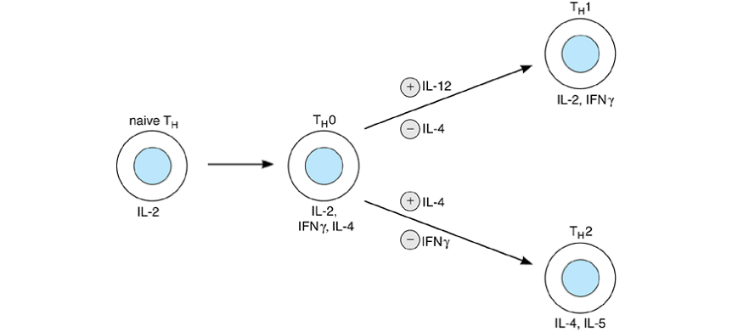
Differentiation of helper T cells into TH1 and TH2 cells.
T_{H}2 | IL-4 IL-5 IL-6 IL-10 IL-13 | Chemoattract lymphocytes, mast cells, and basophils Enhance growth of mast cells and eosinophils Promote B-cell proliferation and class switching to IgE and IgG4 Inhibit T_{H}1-cell differentiation. Inhibit cytokine production by macrophages Enhance growth and develop ment of eosinophils Promote B-cell growth and immunoglobulin production Inhibit production of cytokines (including IFNخ³) by T_{H}1 cells, macrophages, and other APCs Inhibit T_{H}1-cell differentiation Promote B-cell growth and immunoglobulin production Same as IL-4
Abbreviations: IFNخ³ = interferon gamma, IL = interleukin, TNFخ² = tumor necrosis factor beta, APC = antigen-presenting cell. ªOnly a few pertinent effects of these cytokines are listed here; a more complete discussion can be found in Chapter 10. Each of the processes listed is enhanced by the cytokine unless otherwise stated.

Slide 33
Naïve CD4+T cell differentiation. Naïve CD4+T cells differentiate into Th1, Th2,
Th17 or Treg cells depending upon the stimulating conditions. Transcription
factor, cytokine profile and functions are given for each Th subgroup

Slide 34
Cytotoxic T-cells
The CTL granules contain perforin (also known as cytolysin) and granzymes, a family of related serine proteases. During target cell recognition, the contents of these granules are directionally released toward the target. The perforin molecules, which are evolutionarily related to complement component C9, form 10- to 20-nm pores in the plasma membrane of the target.

Slide 35
Cytotoxic T-cells
These perforin pores are not sufficient to kill nucleated target cells, which have the ability to repair membranes and thereby avoid osmotic lysis. Rather, the pores appear to function as a means of delivering granzymes into the target, and it is the granzymes that induce death of the target by triggering apoptosis.
One important step in this process is carried out by granzyme B, which proteolytically cleaves and activates caspases in the target cell, which are components of the apoptotic pathway

Slide 36
Killing by Fas –ligand pathway
The release of cytolytic granules is not the only means by which CTLs can kill antigen-bearing cells. Antigen recognition stimulates CTLs to express Fas ligand, a member of the tumor necrosis factor (TNF) family. The interaction of Fas ligand with Fas (a cell surface molecule related to TNF receptors) induces apoptosis in the Fas-expressing cell.The Fas death pathway is also used by CD4 T_{H}1 cells, which do not express cytolytic granules

Slide 37
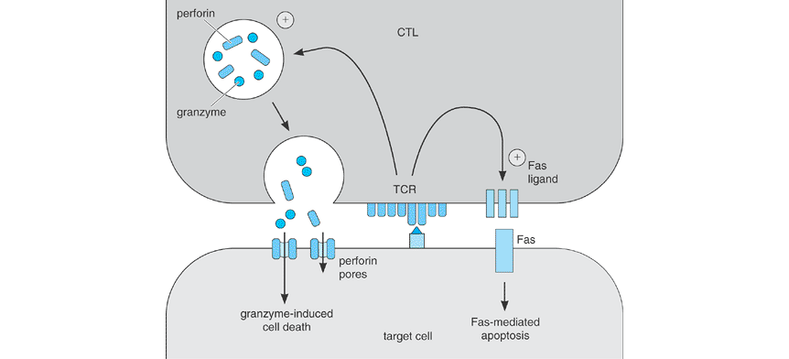
CYTOLYTIC T CELLS

