Slide 1
B-Cell Development & the Humoral Immune Response

Slide 2
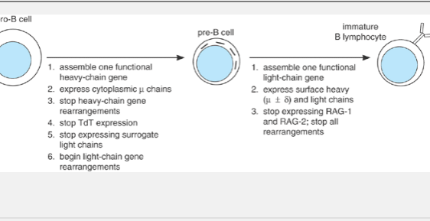
B-LYMPHOCYTE ONTOGENY

Slide 3
Mature B-cells markers
The IgM and IgD on any individual lymphocyte both incorporate the same light chains and have identical antigen specificity. Other surface markers that appear on mature B lymphocytes include complement receptors (CR1 and CR2, the latter also known as CD21);
a membrane-anchored enzyme called 5â€²-nucleotidase (CD73), whose function is unknown;

Slide 4
Mature B-cells markers
the lectin-like oligosaccharide-binding protein CD23;
and the adhesion proteins leukocyte function-associated antigen-1 (LFA-1),
intercellular adhesion molecule-1 (ICAM-1), and CD22. Individual cells also begin to express surface-homing receptors, such as L-selectin, which target them to lymph nodes or other peripheral sites.
At about the same time, the cells acquire class II major histocompatibility complex (MHC) proteins, which enable them to present antigens to helper T cells, and they also begin surface expression of CD40â€”a protein involved in receiving T-cell help With the acquisition of these various accessory molecules, the mature B lymphocytes become competent for immunologic function.

Slide 5
THE B-CELL ANTIGEN RECEPTOR
membrane immunoglobulin is retained in the endoplasmic reticulum unless it can associate with two additional proteins expressed exclusively in cells of the B-cell lineage. These proteins, called Ig-αand, ig-β associate with membrane immunoglobulin to form the B-cell antigen receptor (BCR), which can transit to the cell surface (Figure 8-3A). Ig-αand Ig-βare transmembrane glycoproteins, each of which has a moderately large cytoplasmic domain. These cytoplasmic domains each include a short region important for transmitting into the cell a signal indicating that antigen has bound. This region is called an immunoreceptor tyrosine-based activation motif (ITAM), and its key features are two precisely spaced tyrosine residues within a partially conserved surrounding sequence

Slide 7
T-CELL-INDEPENDENT ANTIGENS
the TI-1 antigen lipopolysaccharide (LPS), from gram-negative bacterial cell walls, can induce immunologic defense reactions in a number of invertebrate as well as vertebrate organisms. Mammalian cells recognize LPS with Toll-like receptor 4 (TLR4) and several other bacterial cell wall components with the closely related TLR2. Interestingly, at low concentrations TI-1 antigens often do elicit an antigen-specific antibody response. It has been postulated that this occurs because BCRs that specifically recognize the TI-1 antigen can concentrate it onto the surfaces of specific B cells, where it can then stimulate Toll-like receptors more efficiently and trigger activation

Slide 8
TI-2 antigens do not have polyclonal B-cell activator properties, nor do they activate macrophages. These antigens are generally highly repetitive polymeric antigens such as polysaccharides from bacterial cell walls, or polymeric protein structures such as bacterial flagella. It has been postulated that their B-cell-activating properties derive from their ability to cross-link numerous BCR molecules and induce either intense, or especially prolonged, intracellular-signaling reactions

Slide 9
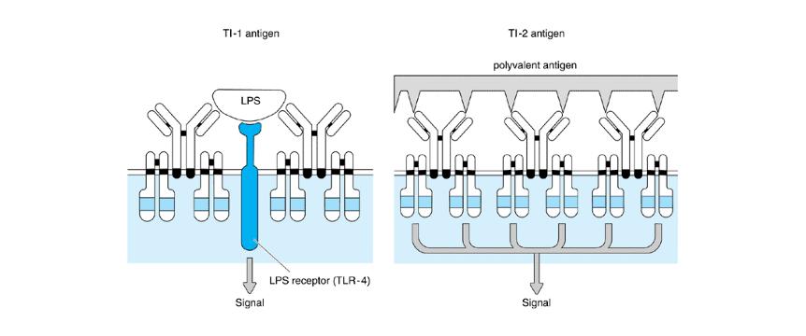

Slide 10
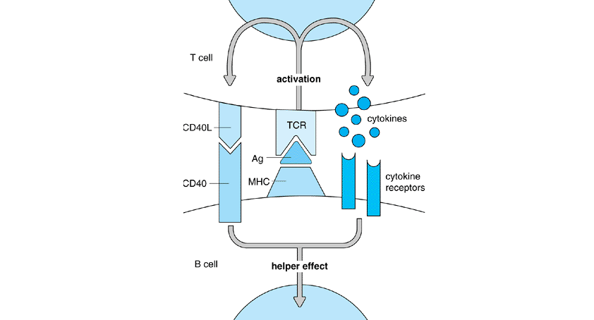

Slide 11
B-cell activation by a helper T cell. Antigen-specific B cells are stimulated by antigen contact with the B-cell receptor (BCR). They also take up the antigen (Ag) for digestion into peptides that combine with class II major histocompatibility complex (MHC) molecules and then go to the cell surface to be presented to antigen-specific helper T cells. T-cell-receptor (TCR)-based recognition of the antigen leads to T-cell activation, which stabilizes the association between the T and B cells and induces T-cell synthesis of CD40L and cytokines, which provide coactivating signals for the B cell.

Slide 12
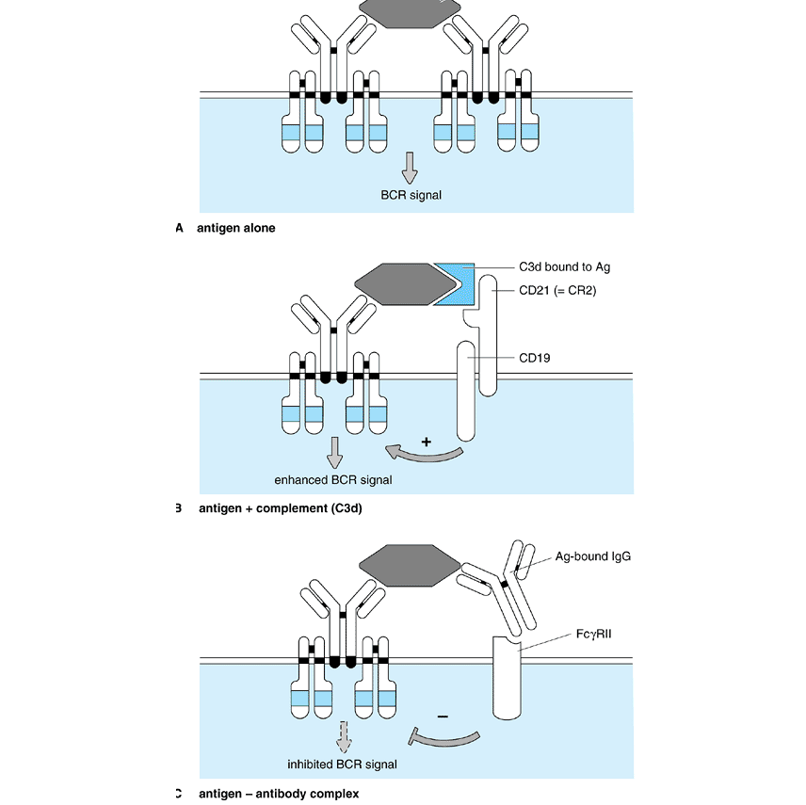

Slide 13
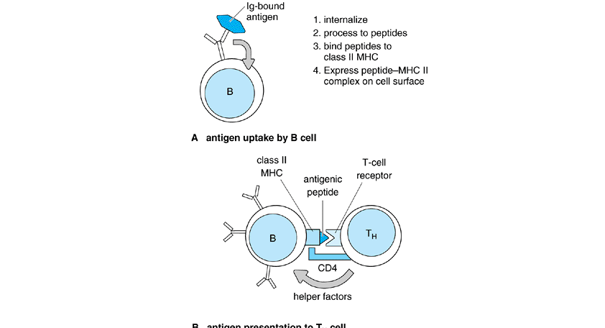

Slide 14
IMMUNOGLOBULIN SECRETION
The shift from producing membrane-bound to secreted immunoglobulin that occurs in plasma cells reflects a subtle change in the structure of the heavy-chain mRNA. The short hydrophobic tail that anchors a heavy-chain protein onto the cell membrane is encoded by the final two exons of every C_{H} region; when a B cell differentiates into a plasma cell, it produces an alternative form of heavy-chain mRNA that lacks these final exons and so encodes a heavy-chain protein that can be secreted from the cell (see Figure 3-4).

Slide 15
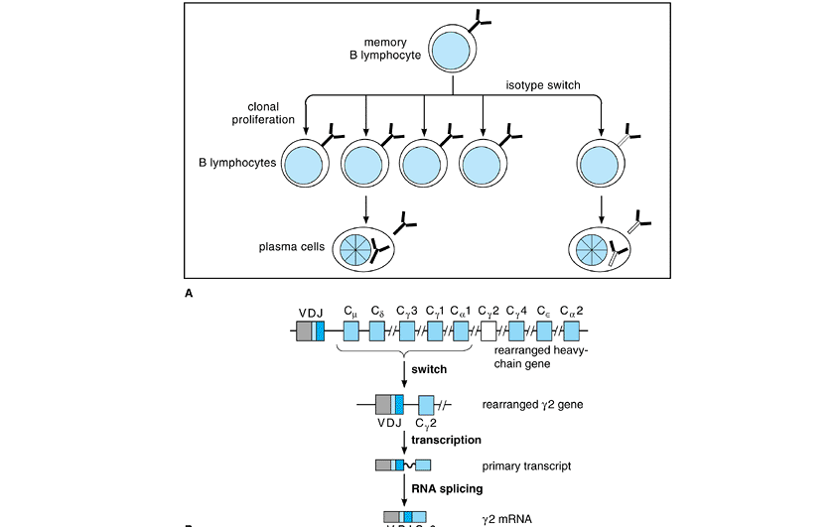

Slide 16
THE HEAVY-CHAIN CLASS SWITCH
Heavy-chain class switch. A: During clonal proliferation of an activated memory B cell, some daughter cells may arise that express a different heavy-chain isotype and pass this trait on to their progeny. B: Class switching takes place when a fully assembled heavy-chain locus undergoes an additional DNA rearrangement event that places a new C_{H} sequence adjacent to the V/D/J exon. This occurs by deletion of the intervening C_{H} exons and is carried out by an enzymatic pathway distinct from that of V/D/J rearrangement. In the example shown, the gene switches to the C_{خ³2} isotype

Slide 17
SOMATIC HYPERMUTATION
Fully assembled V/J and V/D/J exons in B cells undergo point mutation at an unusually high rate during the course of an immune response. The mechanism of this phenomenon, termed somatic hypermutation, is unknown but appears quite specific in that adjacent regions on the chromosome (including the C_{H} exon) are not affected. As the mutations are introduced into the variable region exon at random, they can have the effect of either increasing or decreasing affinity of the resulting immunoglobulin for its target antigen

Slide 18
PRIMARY & SECONDARY HUMORAL RESPONSES

Slide 19
B-CELL TOLERANCE
many autoreactive B cells initially express خ؛ light chains; in those cells, the reactivated recombinase is able to carry out a special type of DNA rearrangement in which a VKor J_{K} segment in the active خ؛-gene locus becomes fused to a site downstream of the C_{خ؛} segment, which is called the خ؛-deleting element (Figure 8-10). As a result of this rearrangement, the C_{خ؛} segment and other important regions are deleted, the gene is permanently inactivated, and the cell can then attempt to assemble a new خ؛ or خ» gene on one of its other chromosomes. This process has been called receptor editing. If the

Slide 20
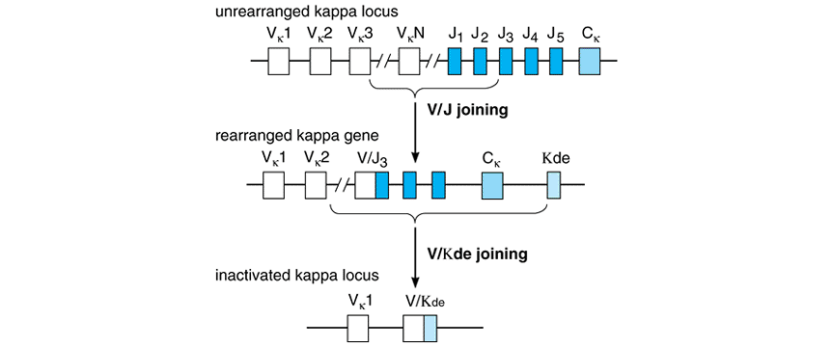
Receptor editing

Slide 21
B-CELL TOLERANCE
This mechanism acts only on B cells in peripheral tissues and relies on the fact that B-cell activation by most protein antigens requires the participation of helper T cells. When a mature B cell contacts antigen in the absence of appropriate T-cell help, the B cell either dies or loses its ability to carry out an immune response. The fate of the B cell depends on the physical nature of the antigen involved.

Slide 22
B-CELL TOLERANCE
In the case of membrane-bound or particulate antigens, the self-reactive B cell generally diesâese”a phenomenon referred to as clonal deletion. Soluble protein antigens, which presumably generate weaker signals through the BCR of a self-reactive B cell, do not cause cell death but instead make the cell unresponsive to activating stimuliâ€”a phenomenon called clonal anergy. Anergic B cells can become activated under some circumstances, so clonal anergy is thought to be a less absolute mechanism for enforcing tolerance to self

