Slide 1
The immune response

Slide 2
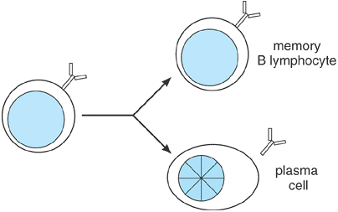
The progeny of an activated B lymphocyte can differentiate into either memory B lymphocytes or antibody-secreting plasma cells

Slide 3
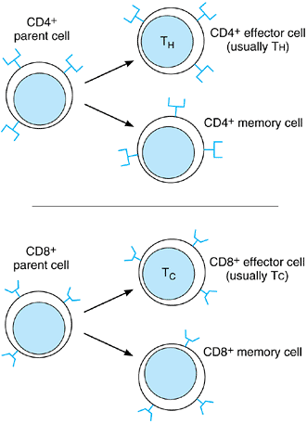
The progeny of activated T lymphocytes retain the surface phenotype (CD4⁺ or CD8⁺) of their parents.

Slide 4
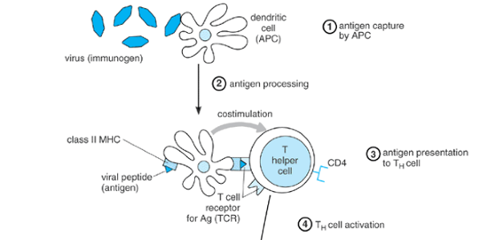

Slide 5
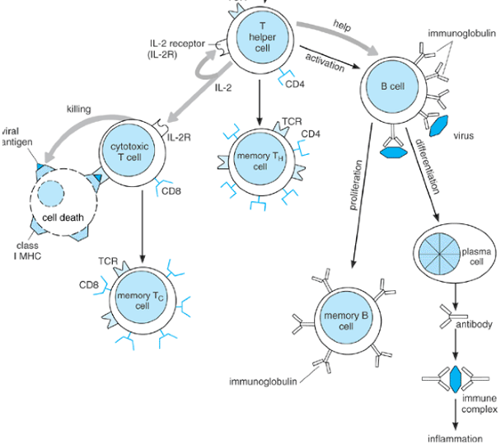

Slide 6
Capture, processing, and presentation of antigen by an antigen-presenting cell (APC). The immunogen is captured by phagocytosis, receptor-mediated endocytosis, or pinocytosis and is broken down into fragments. Some fragments (antigens) become associated with major histocompatibility (MHC) class II proteins and are transported to the cell surface, where they can be recognized by CD4 T cells. Abbreviation: TCR = T-cell receptor.

Slide 7
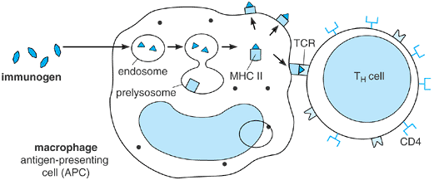

Slide 8
T_{H}-cell activation.
The antigen-presenting cell (APC) presents an antigenic peptide, bound to major histocompatibility class (MHC) II, to the T_{H} cell and also provides a costimulatory signal when a B7 protein on its surface binds CD28 on the T_{H} cell. The two signals lead to activation of the T_{H} cell. Activation leads to interleukin (IL)-2 receptor expression and IL-2 secretion by the T_{H} cell, resulting in autocrine growth stimulation.

Slide 9
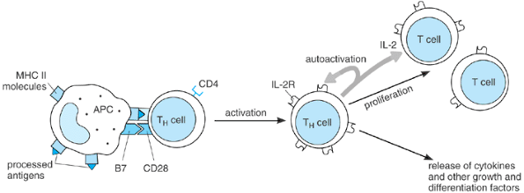

Slide 10
B-cell activation
. Antigen binding to the surface immunoglobulins, coupled with soluble or contact-mediated helper factors from an activated T_{H} cell, lead to proliferation and differentiation. Cytokines involved in T_{H}-cell help include interleukin (IL)-2, IL-4, and IL-6. Contact-mediated help generally involves binding of CD40 on the B-cell surface to CD40 ligand (CD40L) on the activated T_{H} cell.

Slide 11
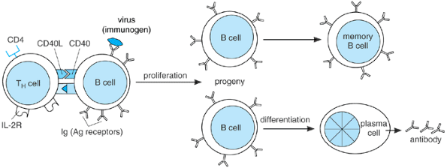

Slide 12
T_{C}-cell activation
requires contact with a specific antigen complexed with a major histocompatibility class (MHC) I molecule on the surface of a target cell. It also requires interleukin(IL)-2 from a nearby activated T_{H} cell. The activated T_{C} cell kills the target cell either by secreting cytotoxins (as shown) or by inducing it to commit suicide. Abbreviation: TCR = T-cell receptor.

Slide 13
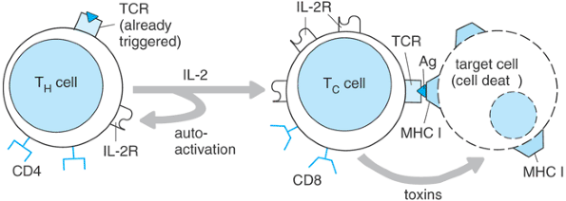

Slide 14
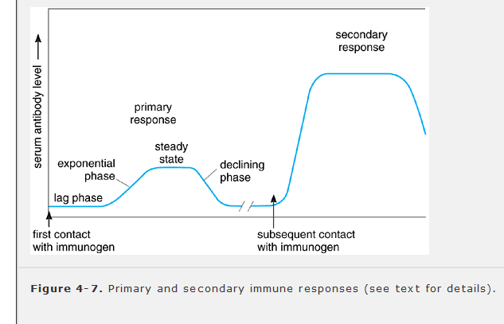

Slide 15
