Slide 1

Immunoglobulins and
Immunoglobulin Genes

Slide 2
immunoglobulins
The two hallmarks of immunoglobulins as antigen-binding proteins are the specificity of each for a particular epitope target and their diversity as a group. In addition to antigen binding, however, immunoglobulins also possess secondary biologic activities that are critical for host defense. These include, for example, the ability to function as opsonins, to activate the complement cascade, or to cross the placental barrier. Immunoglobulin proteins are heterogeneous with respect to these latter activities, which are determined by structural features independent of those that dictate antigen specificity. In this chapter, we first consider how the structures of immunoglobulins account for their specificity, diversity, and secondary biologic activities. We then examine the remarkable genetic mechanisms that give rise to these proteins.

Slide 3
IMMUNOGLOBULINS
The immunoglobulins are an enormous family of related, but nonidentical glycoproteins. It has been estimated that each person is capable of producing at least 10⁸ different antibody molecules, each with its own distinct properties.
When a serum specimen is fractionated by electrophoresis, for example, most immunoglobulins are found to migrate as a broad band (called the gamma-globulin fraction) that reflects the presence of innumerable different proteins, each with slightly different electrophoretic properties. This extreme diversity made it virtually impossible to isolate sufficient amounts of any single antibody protein from a normal donor to permit a thorough biochemical analysis.

Slide 4
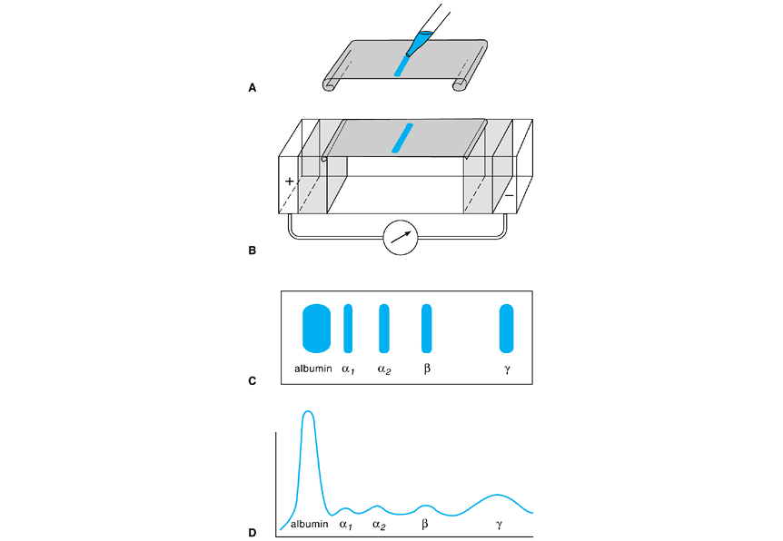
Serum electrophoresis

Slide 5
The Four-Chain Basic Unit
Every immunoglobulin molecule is made up of two different types of polypeptides. The larger, heavy (H) chains are roughly twice as large as the smaller, light (L) chains. Every immunoglobulin contains equal numbers of heavy- and light-chain polypeptides and can be represented by the general formula (H₂L₂)n. The chains are held together by noncovalent forces and also by covalent interchain disulfide bridges to form a bilaterally symmetrical structure as depicted in Figure 7-1. All normal immunoglobulins conform to this basic structure, although some, as we shall see, are composed of more than one of these four-chain units

Slide 6
Heavy chain
In both heavy and light chains, this variability is most pronounced in the N-terminal domain, whereas the sequences of the other domains remain relatively constant. For this reason, the N-terminal domain in aheavy- or light-chain polypeptide is called the variable region, abbreviated V_{H} or V_{L}, respectively. The other domains are collectively termed the constant region, abbreviated C_{H} or C_{L}. Light-chain polypeptides contain only a single C_{L} domain, but heavy chain C_{H} regions comprise three or more domains that are numbered sequentially (C_{H}1, C_{H}2, etc) beginning with the domain closest to V_{H}.

Slide 7
Hinge region
The region at the base of each arm in the T or Y, located between the C_{H}1 and C_{H}2 domains, is called the hinge region; in most immunoglobulins, it has a loose secondary structure that makes it flexible, enabling the two arms to move relatively freely with respect to each other.

Slide 8
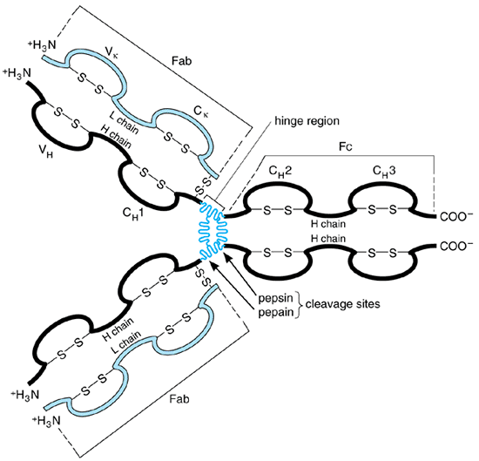

Slide 9
Enzymatic Digestion Products of Immunoglobulins
Immunoglobulins are rather resistant to proteolytic digestion but are most susceptible to cleavage near the hinge region (see Figure 7-1), which usually lies adjacent to the site of interchain disulfides linking the two heavy chains together. The enzyme papain happens to cleave this region on the N-terminal side of the inter-heavy-chain disulfides, and so splits an immunoglobulin into three fragments of roughly similar size. Two of these are identical to each other, consisting of an entire light chain along with the V_{H} and C_{H}1 domains of one heavy chain; these fragments thus contain the antigen-binding sites of the protein, and so are called Fab fragments (ie, antigen-binding fragments) The third fragment comprises the carboxy-terminal portions of both heavy chains held together by disulfides.

Slide 10
The structure of this third fragment is identical for many different immunoglobulin molecules, so that fragments of this type can often be crystallized even if they are derived from a heterogeneous antibody population. Hence, this third fragment is designated the crystallizable, or Fc, fragment.
A somewhat different pattern of cleavage occurs with the enzyme pepsin, which cleaves on the carboxy-terminal side of the inter-heavy-chain disulfides. This yields a single large fragment called an F(ab)â€²2 fragment, which roughly corresponds to two disulfide-linked Fab fragments and has divalent antigen-binding activity. The Fc region, on the other hand, is extensively degraded by pepsin, and usually does not survive as an intact fragment

Slide 11
Light-Chain Types and Subtypes
All light chains have protein molecular weights of approximately 23,000 but can be classified into two distinct types, called kappa (k and lambda on the basis of their C_{L}-region sequences. No known functional differences exist between these two types, and each can associate with any of the various classes of heavy chains. Nevertheless, expression of two distinct light-chain types is common among mammals. Indeed, the amino acid sequence similarities between human and mouse kappa chains are much greater than those between the kappa and lambda chains within each speciesâ€”indicating that the primordial kappa and lambda genes separated from one another during evolution prior to the divergence of these mammalian species. The C regions of all خ؛ light chains produced by an individual are essentially identical. In contrast, a single person may express as many as six slightly different forms of the C region. These various subtypes of differ from one another only slightly in C-region amino acid sequences and are functionally identical, though each is encoded by a separate chromosomal locus

Slide 12
Heavy-Chain Classes and Subclasses
Humans express five different classes (or isotypes) of immunoglobulin heavy chains, which differ considerably in their C_{H}-region sequences and in their physical and biologic properties. All of the heavy chains in any given immunoglobulin are identical. The five classes of heavy chains are designated آµ, خ´, خ³, خ±, and خµ, and immunoglobulins that contain these heavy chains are designated the IgM, IgD, IgG, IgA, and IgE classes, respectively. The خ³ and خ± classes are further divided into subclasses (خ³1, خ³2, خ³3, خ³4, خ±1, and خ±2) based on relatively minor differences in C_{H} sequence and function; the corresponding immunoglobulin subclasses are denoted IgG1, IgG2, and so on. Heavy chains representing the various subclasses within a class are much more similar to one another than to the other classes. Normal individuals express all nine classes and subclasses, because each is encoded by a separate genetic locus and is inherited independently

Slide 13
Membrane and Secreted Immunoglobulins
Immunoglobulins of all classes can exist in either membrane-bound or secreted forms.
Immunoglobulins of all classes can exist in either membrane-bound or secreted forms. The membrane forms always exist as individual four-chain units and have on their heavy chains an additional carboxyterminal sequence of approximately 40 amino acid residues. This sequence consists of a highly acidic region of 12â€“14 residues, followed by a strikingly hydrophobic sequence of about 26 residues. The hydrophobic portion is the transmembrane component, which anchors the heavy chain (and, hence, the entire four-chain unit) into the cell membrane

Slide 14
J Chain and Secretory Component
As noted earlier, the secreted forms of IgM and IgA generally exist as polymers of the basic four-chain unit that include a single additional polypeptide called the J chain. The J chain is a small (MW 15,000) acidic protein that is structurally unrelated to heavy and light chains but is synthesized by all plasma cells that secrete polymeric immunoglobulins. In these polymeric assemblies, the J chain is disulfide-bonded to the penultimate cysteine residue in the tail segment of the خ± or آµ chains. Its function seems to be to facilitate proper polymerization

Slide 15
Secretory component is a single glycopeptide with a peptide molecular weight of approximately 70,000 and a high carbohydrate content. It is associated only with IgA and is found almost exclusively in body secretions. Its amino acid sequence is invariant and shows no resemblance to the J chain or to any of the immunoglobulin polypeptides. Secretory component can exist either in free form or bound to dimeric or polymeric (but not monomeric) IgA molecules
Secretory component is not synthesized by lymphocytes but rather by mucosal epithelial cells that overlie Peyer's patches and other submucosal lymphoid tissues. Such epithelial cells take up IgA that is secreted from the lymphoid cells beneath them, link it with secretory component, and transport the resulting complex across the epithelial barrier into secretions. Linkage with secretory component is presumed to facilitate the transepithelial passage of IgA.

Slide 16
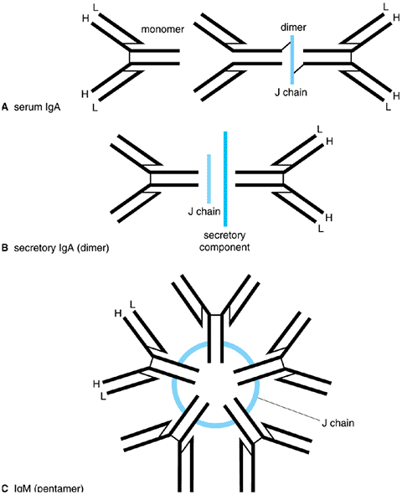

Slide 17
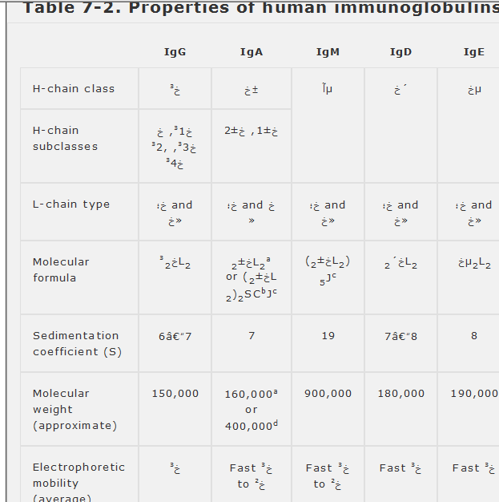

Slide 19
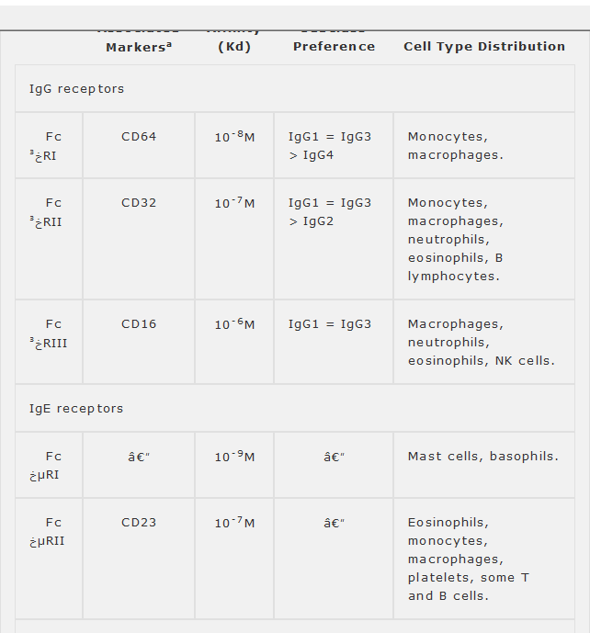

Slide 20
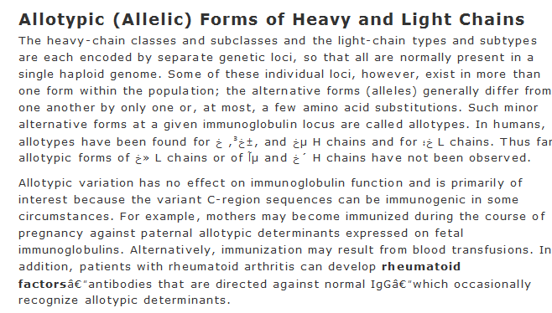

Slide 21
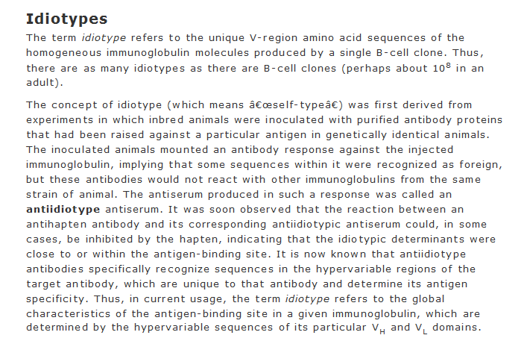

Slide 22
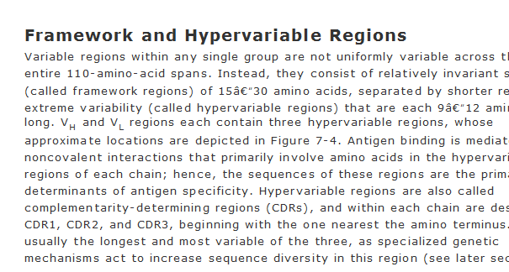

Slide 23
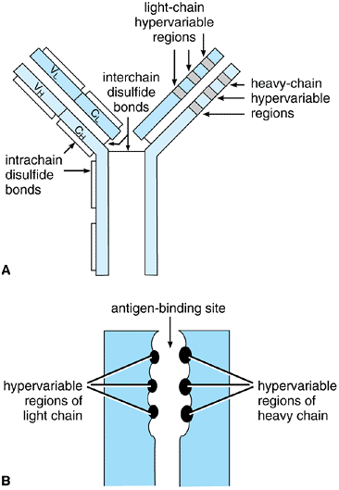

Slide 24
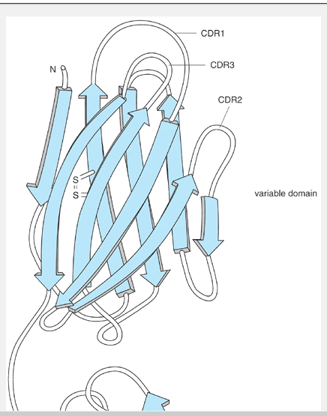
CDRS

Slide 25
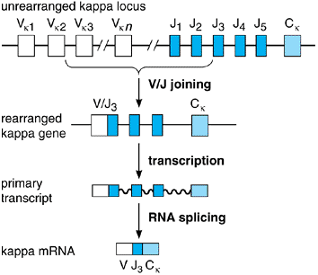

Slide 26
Figure 7-8. Assembly and expression of the K light-chain locus. A DNA rearrangement event fuses one V segment (in this example, Vk2to one J segment (J3to form a single exon. The V/J exon is then transcribed together with the unique C_{k}exon, and the transcript is spliced to form mature k mRNA. Note that any unrearranged J segments on the primary transcript are removed as part of the intron during RNA splicing.

Slide 27
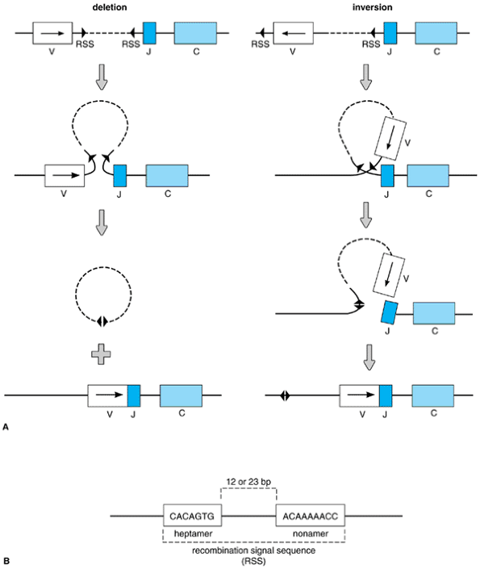

Slide 28
؛ Mechanism of immunoglobulin gene rearrangement. A: Site-specific cleavage and religation of the chromosomal DNA is guided by a pair of recombination signal sequences (RSS) flanking V and J gene segments. The chromosome segment undergoes either deletion (left) or inversion (right), depending on the original orientation of the V segment with respect to the J and C segments. If deletion occurs, the DNA that originally separated V and J is released as a covalently closed circle and subsequently is degraded. B: The RSS, consisting of a pair of short DNA sequences (heptamer and nonamer) separated by either 12 or 23 bp of DNA, marks all sites of recombinase action in both heavy- and light-chain genes.

Slide 29
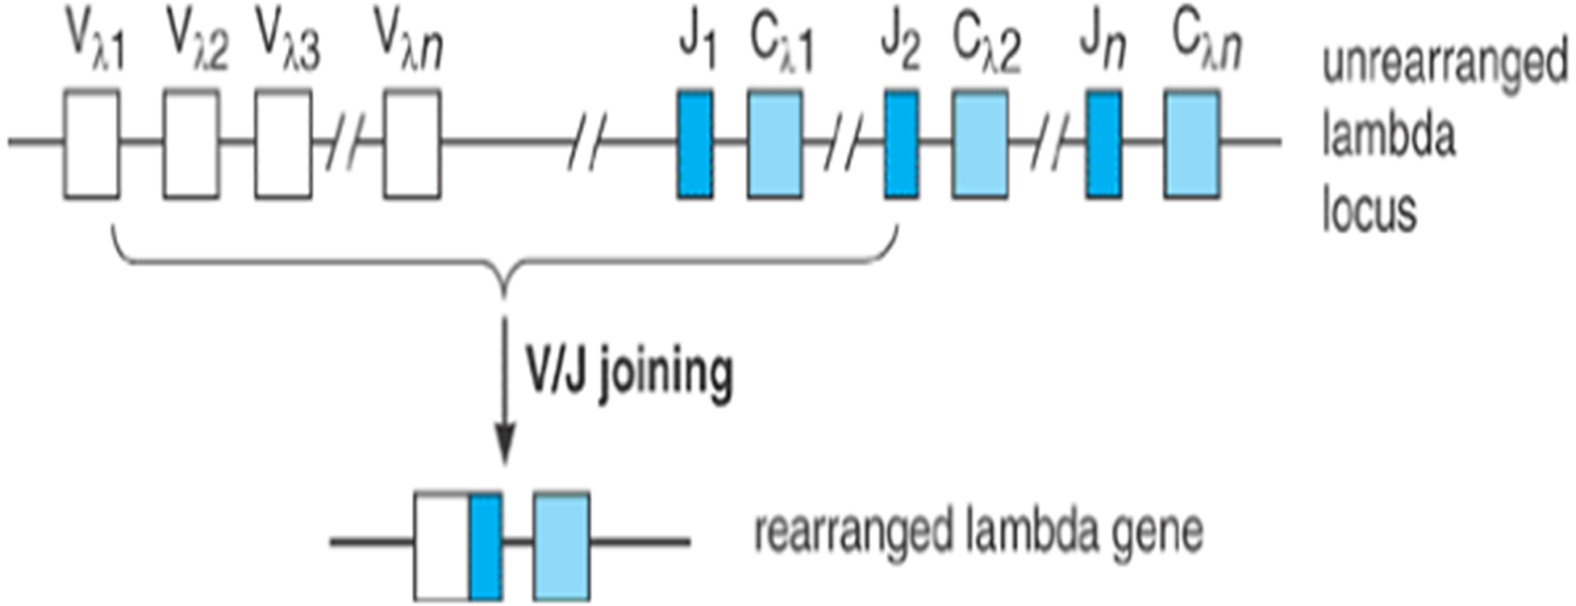

Slide 30
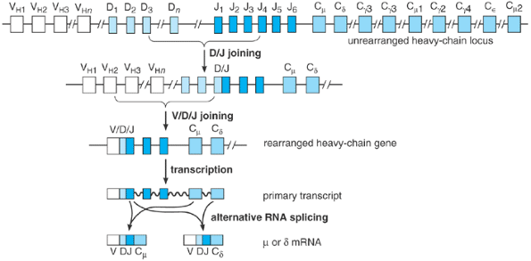

Slide 31
Rearrangement and expression of the heavy-chain locus. Unlike the light-chain genes, assembly of a heavy-chain V region exon requires two sequential DNA rearrangement events involving three different types of gene segments. The D_{H} and J_{H} segments are joined first and are then fused to a V_{H} segment. Nine alternative C-region sequences are present; of these, however, only C_{آµ} and C delta are initially transcribed. The primary transcript can be spliced in either of two ways to generate mRNAs that encode آµ or delta heavy chains with identical V domains. This diagram is highly schematic: Each C_{H} sequence is actually composed of multiple exons whose aggregate length is more than three times longer than that of the V/D/J exon.

Slide 32
The Molecular Basis of V/(D)/J Rearrangement
Active gene rearrangements of the type that produce V/(D)/J joining were first thought to be a unique property of the immunoglobulin genes. Subsequently, however, it was found that the genes encoding T-cell antigen receptors (TCRs) also are assembled from germline V, D, J, and C segments through a virtually identical series of DNA rearrangements (see Chapter 9). Among the similarities, for example, the rearrangement sites in both immunoglobulin and TCR genes always coincide with so-called recombination signal sequences (see Figure 7-9B)â€”a pair of short DNA sequences (7 and 9 bp long, respectively) that are located immediately adjacent to each unrearranged V, D, or J segment. It is now thought that rearrangement of both the immunoglobulin and TCR gene families is carried out by the same molecular machinery: a system of enzymes and other proteins known collectively as the V/(D)/J recombinase.
The most important components of the recombinase are two nuclear proteins called RAG-1 and RAG-2 (the products of recombination activating genes 1 and 2, respectively), which are expressed in immature B- and T-lineage cells. Acting together, RAG-1 and RAG-2 have the ability to recognize and cleave DNA specifically at a recombination signal sequence, making them the critical ingredients in these early steps

Slide 33
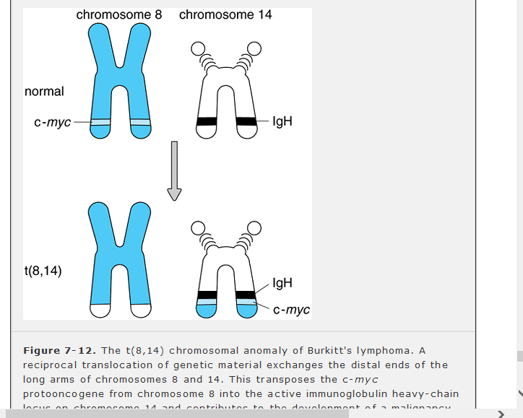

Slide 34
For example, the cells of Burkitt's lymphoma, a B-lymphocytic malignancy, usually contain a specific chromosomal abnormality called t(8,14), in which a portion of chromosome 8 has been translocated onto chromosome 14 (Figure 7-12). In this translocation, breakage of chromosome 14 occurs within the immunoglobulin heavy-chain locus, whereas the breakpoint on chromosome 8 coincides with a cellular protooncogene known as c-myc, which encodes the transcription factor c-Myc (see Chapter 1). As a result, the c-myc gene is moved to a position directly adjacent to the heavy-chain gene. It is thought that this proximity to the transcriptionally active heavy-chain locus alters the expression of the protooncogene, and that this, along with other damage to c-myc that can occur during translocation, contributes to malignant transformation. Less commonly, Burkitt's lymphoma may lack t(8,14) and instead exhibit a closely related anomaly in which the c-myc locus is translocated into the kappa or lambda light-chain gene on chromosomes 2 or 22, producing the same effects.

Slide 35
A similar type of chromosomal anomaly, designated t(14,18), is observed in at least 90% of cases of follicular lymphomathe most common human B-cell malignancy. In this translocation, the gene on chromosome 18 that encodes the cytoplasmic membrane protein Bcl-2 is moved to a position immediately adjacent to the heavy-chain locus on chromosome 14. B-cells carrying the t(14,18) anomaly express unusually high levels of structurally normal Bcl-2 protein and hence are resistant to being killed by many of the physiologic processes that normally induce apoptosis

