Slide 1
Major histocompatibility complex

Slide 2
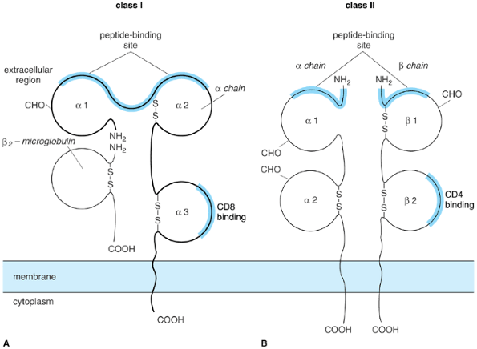

Slide 3
MHC class I and class II proteins
A: The class I molecule consists of a MW 44,000 polymorphic transmembrane polypeptide (Î± chain) noncovalently associated with a MW 12,000 nonpolymorphic polypeptide (Î²2-microglobulin) that is not anchored in the membrane. The three extracellular domains of the Î± chain are designated Î±1, Î±2, and Î±3. The binding site for antigenic peptides is formed by the cleft between the Î±1 and Î±2 domains; CD8 contacts a portion of the Î±3 domain. B: The class II molecule consists of a MW 34,000 Î± chain noncovalently associated with a MW 29,000 Î² chain, both of which are polymorphic. Antigenic peptides bind a cleft formed by the Î±1 and Î²2 domains; CD4 contacts sequences in the Î²2 domain. Locations shown for the peptide-, CD4-, and CD8-binding sites are approximations only

Slide 4
Class II proteins are instead translocated to an endosomal compartment (either directly or by way of the cell surface), where the invariant chain is degraded to the CLIP peptide and then removed entirely to be replaced by peptides from the endocytic pathway. Peptide loading onto class II is assisted by the nonclassical MHC molecule HLA-DM. Abbreviations: RER = rough endoplasmic reticulum; TAP = transporter of antigenic peptides; HLA = human leukocyte antigen; MHC = major histocompatibility complex; CLIP = corticotropin-like intermediate lobe peptide.

Slide 5
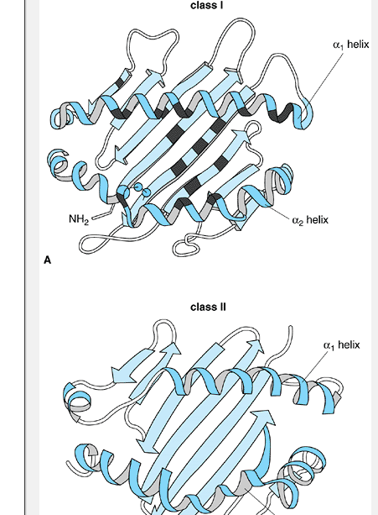

Slide 6
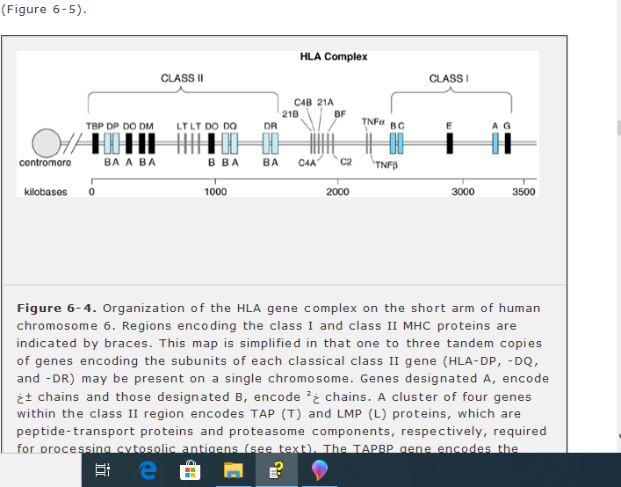

Slide 7
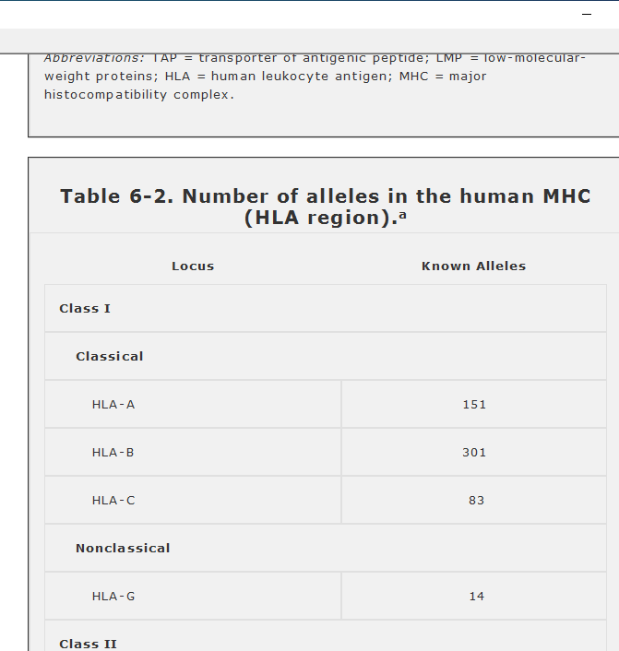

Slide 8
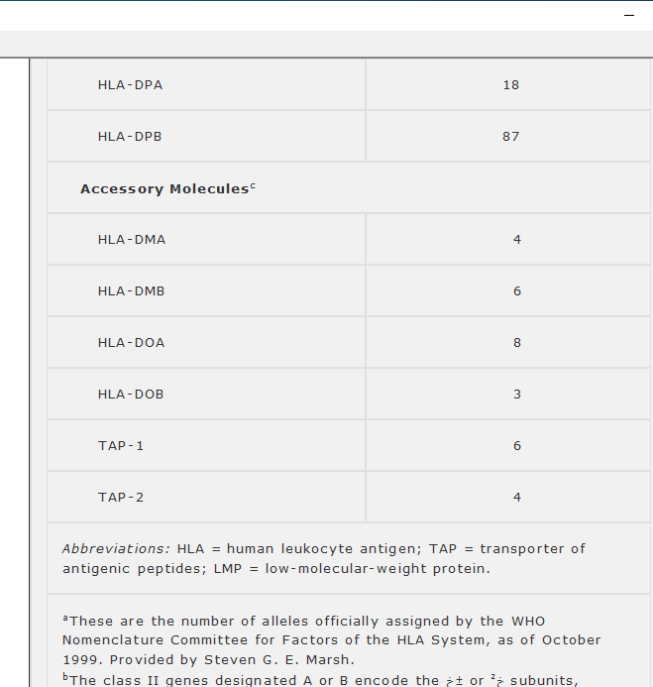

Slide 9
Antigen pathways:
Pathways of assembly and transport for antigenâ€“MHC complexes containing (top) class I and (bottom) class II HLA molecules. MHC polypeptides of both classes are initially expressed in the RER lumen. Peptides from cytosolic antigens processed by proteasomes are actively pumped into the RER by TAP transporters; they bind class I Î± chain and Î²₂-microglobulin in the RER lumen and are then transported to the cell surface. Class II proteins associate with the invariant chain in the RER and so are prevented from binding cytosolically processed peptides.

Slide 10
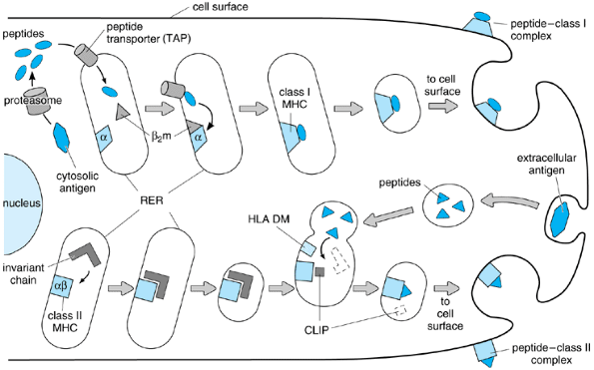

Slide 11
