Slide 1

The Course of
Renewable energy
MUSTANSIRIYAH UNIVERSITY
COLLEGE OF SCIENCES
ATMOSPHERIC SCIENCES DEPARTMENT
2019-2020
Dr. Ali Alhafiz
fourth STAGE

Slide 2
Welcome Students! ☺
To LECTURE Four

Slide 3
Describing Wind Variations: Weibull Distribution
The General Pattern of Wind Speed Variations
It is very important for the wind industry to be able to describe the variation of wind speeds. Turbine designers need the information to optimize the design of their turbines, so as to minimize generating costs. Turbine investors need the information to estimate their income from electricity generation.

Slide 4
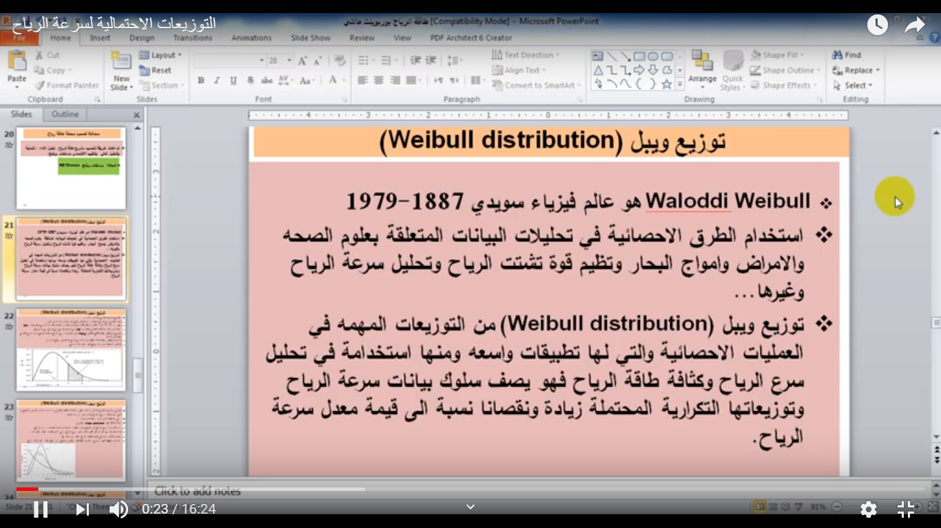

Slide 5
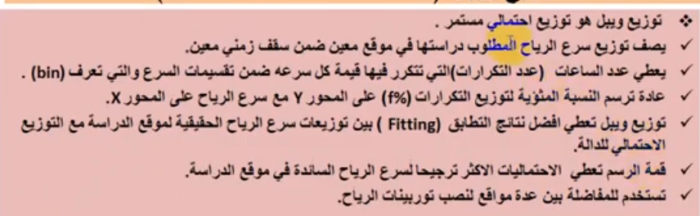
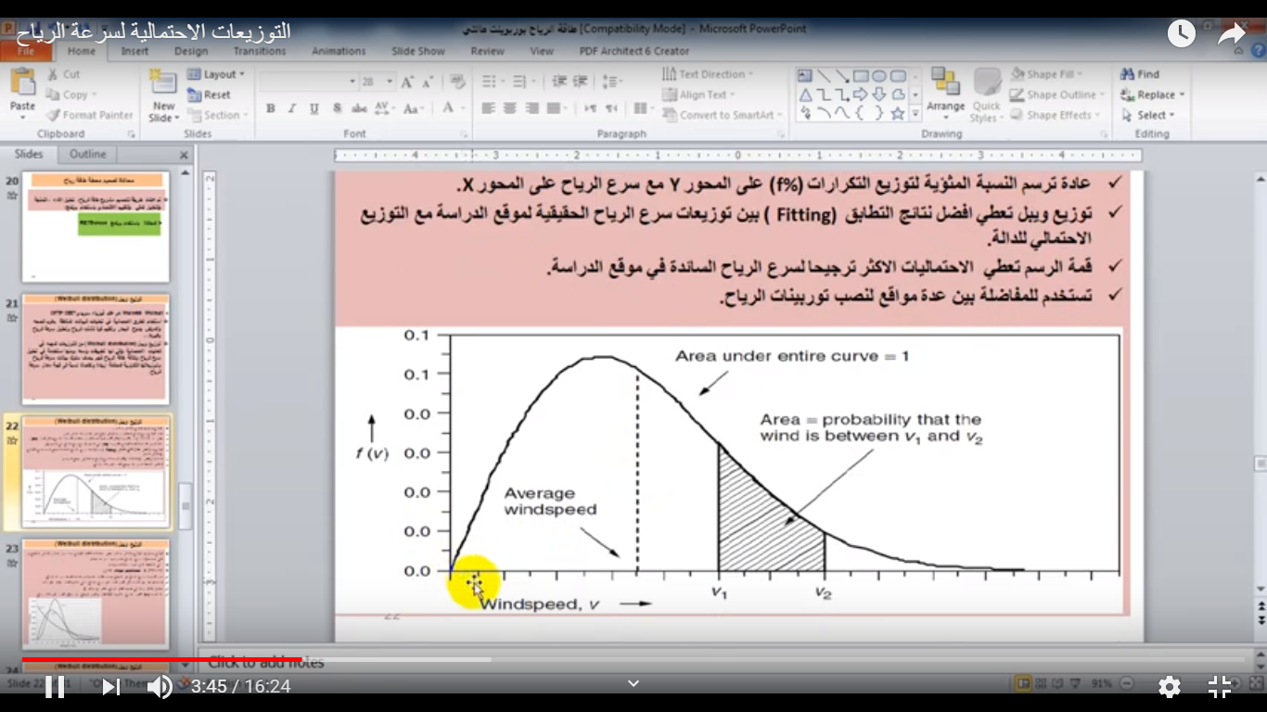

Slide 6

If you measure wind speeds throughout a year, you will notice that in most areas strong gale force winds are rare, while moderate and fresh winds are quite common.
The wind variation for a typical site is usually described using the so-called Weibull distribution,
The Weibull distribution is often used in the field of life data analysis due to its flexibility, and it can mimic the behavior of other statistical distributions such as the normal and the exponential.
The statistical distribution of wind speeds varies from place to place around the globe, depending upon local climate conditions, the landscape, and its surface. The Weibull distribution may thus vary, both in its shape, and in its mean value. As shown in the image, Weibull distribution depend on two parameter scale(C) and shape(k)

Slide 7

Estimating the Weibull Distribution Parameters
To obtain a Weibull density distribution is necessary determine shape parameter k and c scale parameter, the common methods for determining k and c are:
1. Graphical method
2. Standard deviation method
3. Moment method
4. Maximum likelihood method
5. Energy pattern factor methods

Slide 8

The most simple method to calculate the two parameters scale(A) and shape(k) is(Standard deviation method) and we can calculated them by using those equations:
As we shown the above equation depend on Standard Deviation (S.D) and the mean of wind speed) X(
C=
C
While the scale parameter depends on the mean of wind speed and Gamma function Γ.
And the figure down about ( PDF) Probability Density function to Mosul station
So, we calculate the Wind power density by Weibull distribution
C

Slide 9
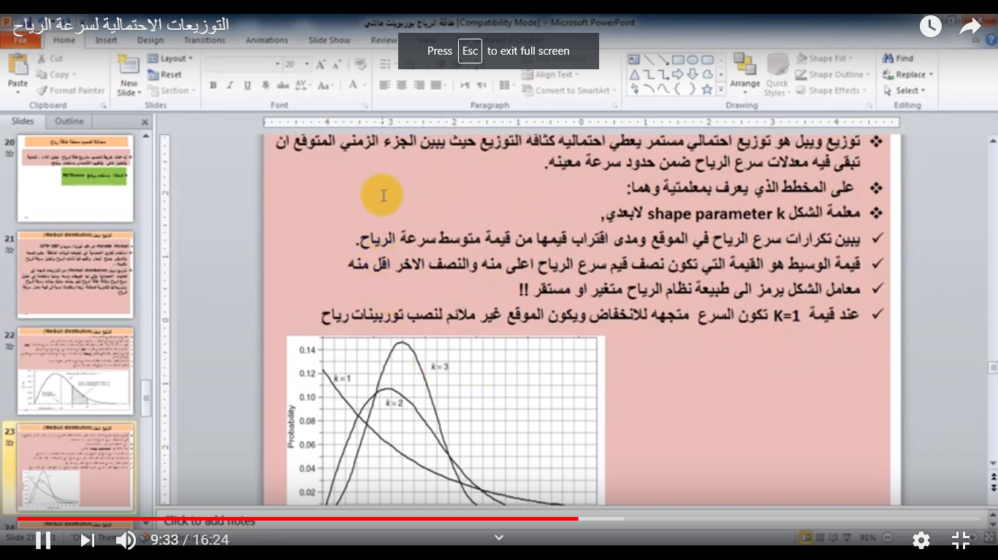

Slide 10
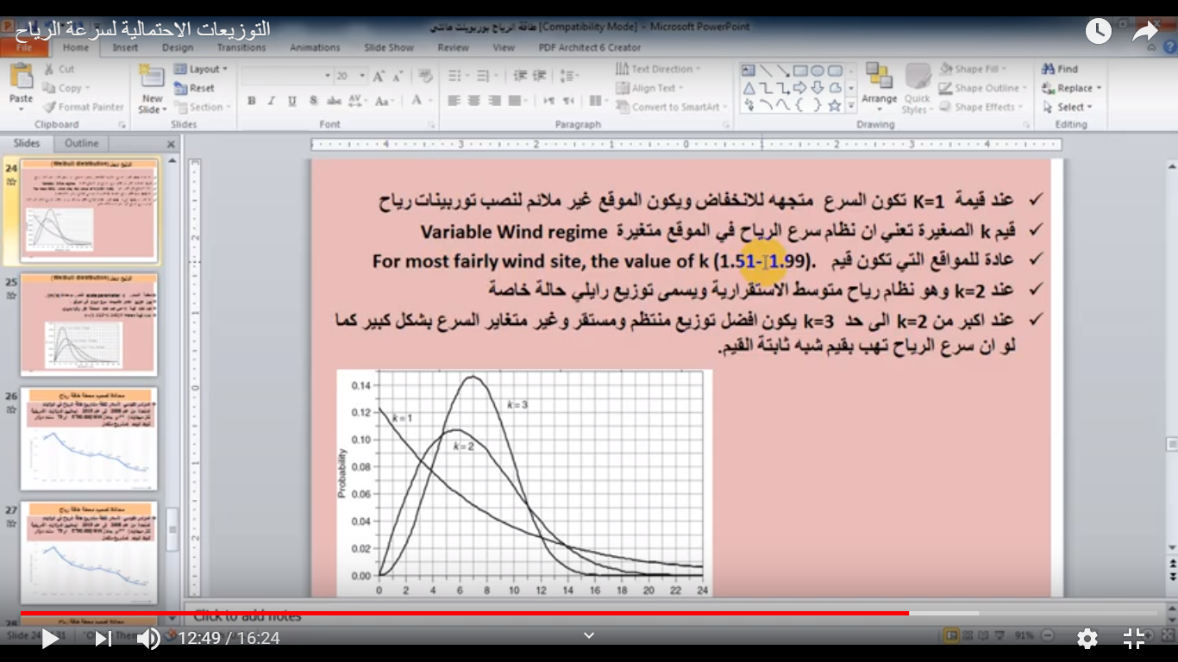

Slide 11
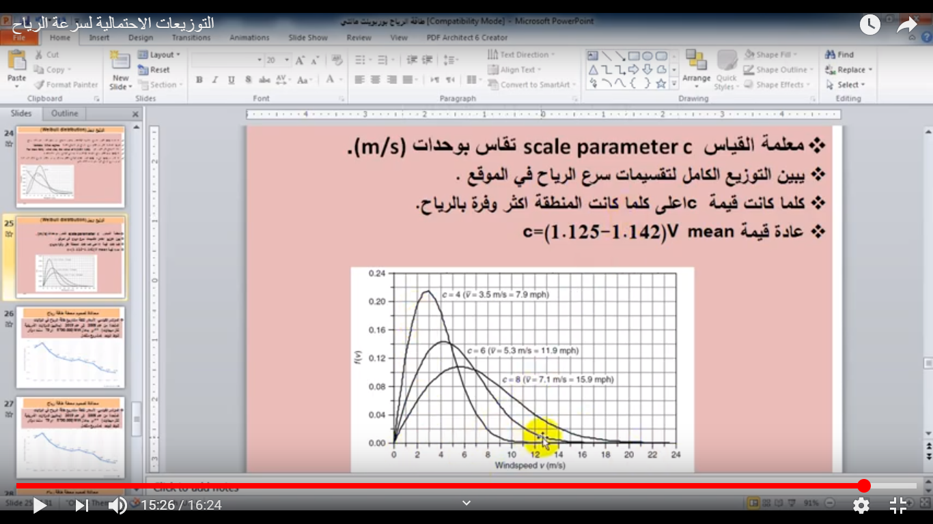

Slide 12
