Slide 1

Precipitation
Precipitation refers to any product of the condensation of atmospheric water vapor that is deposited on the Earth's surface.
Precipitation intensity can be measured by precipitation rate (R), which is normally defined as the rain water falling on ground per unit area per unit time, of unit in SI system which is the same concept of mass flux.
So, basically precipitation rate is measured by depth per unit time. m/s is too large for precipitation measurement. In real practice, we usually use unit of mm/h.

Slide 2
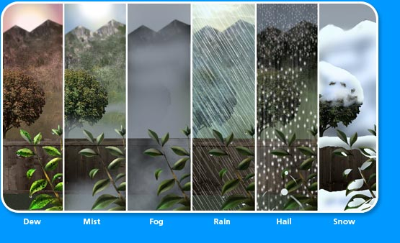
Forms of precipitation

Slide 3
Precipitation Estimation (QPE)
The term Quantitative Precipitation Estimation, or QPE, refers to the estimation of observed precipitation.
Observed precipitation is only an estimate because the tools used provide inexact approximations of the actual magnitude and distribution of precipitation.
RAIN GAUGE
Precipitation can be measured at a fixed location (point estimates) by a rain gauge, and will not necessarily provide good spatial resolution.
It measures rain as well as the liquid equivalent of frozen precipitation that has fallen over a specific time period.
Rain gauges come in a variety of styles, both manual and automated.

