Slide 1
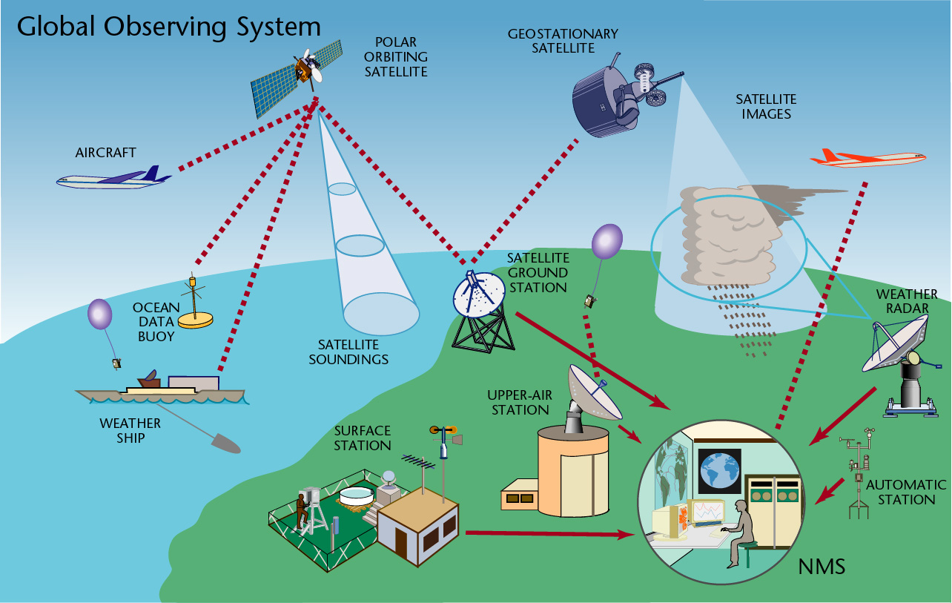
The Course of
Meteorological Instrumentation and Observations
MUSTANSIRIYAH UNIVERSITY
COLLEGE OF SCIENCES
ATMOSPHERIC SCIENCES DEPARTMENT
2022-2023
Dr. Husain A. Nema
SECOND STAGE

Slide 2

Welcome Students! ☺
To LECTURE Three
Temperature

Slide 3
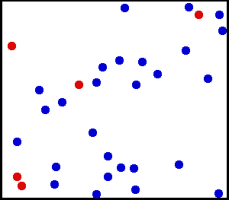
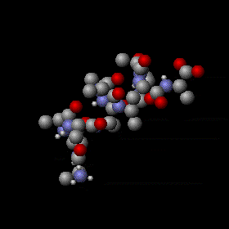
Temperature
Temperature is a measure of the average speed of the atoms and molecules, where higher temperatures correspond to faster average speeds, it is a physical property of a system that underlies the common notions of hot and cold.
Suppose we examine a volume of surface air about the size of a large flexible balloon:
If we warm the air inside, the molecules would move faster, but they also would move slightly farther apart—the air becomes less dense.
If we cool the air, the molecules would slow down, crowd closer together, and the air would become more dense.

Slide 4
Suppose we continue to slowly cool the air. Its atoms and molecules would move slower and slower until the air reaches a temperature of –273°C, which is the lowest temperature possible. At this temperature, called absolute zero, the atoms and molecules would possess a minimum amount of energy and theoretically no thermal motion. at absolute zero, we can begin a temperature scale called the absolute, or Kelvin scale.
Heat, is energy in the process of being transferred from one object to another because of the temperature difference between them. In the atmosphere, heat is transferred by conduction, convection, and radiation.
After heat is transferred, it is stored as internal energy. The atmosphere contains internal energy, which is the total energy stored in its molecules.

Slide 5
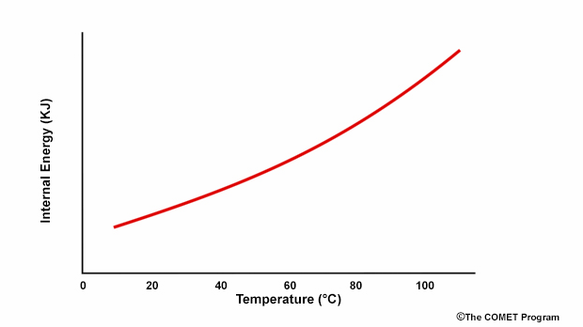
The change in temperature is equal to the specific energy that flows to or from the object divided by its heat capacity.
ΔT = Q / mc
where Q equals energy transferred, m equals mass, and c is the specific heat capacity.

Slide 6
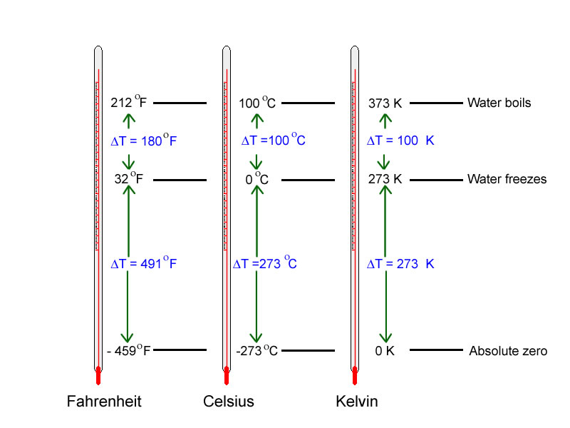
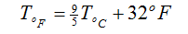
Temperature units and scales
Thermometer Calibrations
There are three reference points; Extra care must be taken, in order to get a good ice point and boiling point values…
 | Ice | Triple Point | Steam
Kelvin | 273.15 | 273.16 | 373.15
Celsius | 0.00 | 0.01 | 100.00
Notes:
For a linear
Where x is some quantity that varies with temperature
Two calibration points will give you two equations for the two unknowns a and b as
That can be solved to give the calibration coefficients.

Slide 7
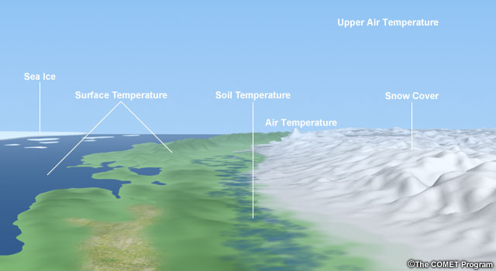
The meteorological requirements for temperature measurements primarily relate to the following:
The air near Earth’s surface
The surface of the ground
The soil at various depths
The surface of the sea and lakes
The upper air

Slide 8
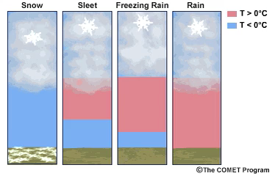
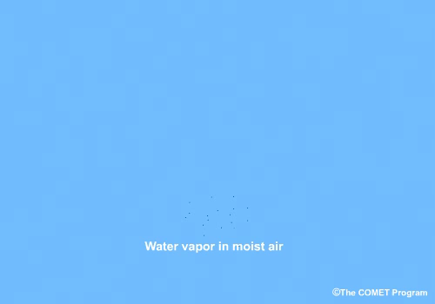
Why Measure Temperature?
Temperature is a very important property of the atmosphere. For example, temperature determines the maximum water vapor pressure that can be present in an air parcel, the value corresponding to 100% relative humidity, except in rare cases when air is supersaturated.
Temperature also determines the phase of the water in the atmosphere (liquid vs. ice), which in turn determines precipitation type and the habit of the ice crystal for a given cloud super-saturation.
Knowing the temperatures at all levels of the atmosphere, as well as the amount of water vapor present in an air parcel, is vital for understanding atmospheric processes. As air rises and cools, the latent heat release that accompanies condensation provides energy for thunderstorms, hurricanes, and many other weather events.

Slide 9
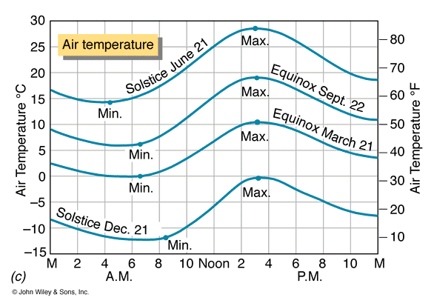
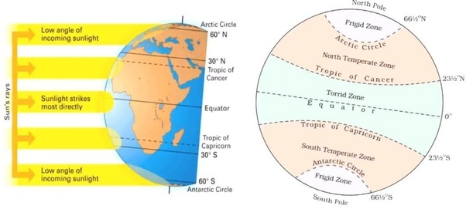
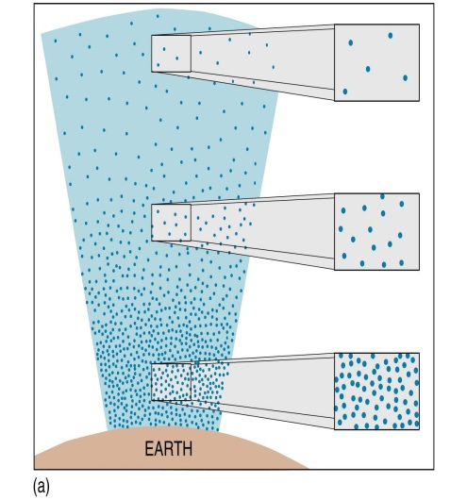
What determines the temperature of a place?
Insolation (daily and annual cycles)
Latitude
Urban/Rural Surface
Coastal vs. Interior location
Elevation

Slide 10
MEASUREMENT OF TEMPERATURE
A thermometer is an instrument that measures the temperature of a system in a quantitative way. The easiest way to do this is to find a substance having a property that change in a regular way with its temperature. The most direct 'regular' way is a linear one:
t(x) = ax + b,
where t is the temperature of the substance and changes as the property x of the substance changes. The constants a and b depend on the substance used and may be evaluated by specifying two temperature points on the scale, such as 32° for the freezing point of water and 212° for its boiling point.
Notes:
For a linear
Where x is some quantity that varies with temperature
Two calibration points will give you two equations for the two unknowns a and b as
That can be solved to give the calibration coefficients.

Slide 11
Temperature Sensors
A variety of sensors can be used to measure temperature. The chosen instrument depends on factors such as:
measurement uncertainty and resolution,
the type of environment being measured,
cost,
design,
height, and
need for protective housing.

Slide 12
Liquid-in-Glass Thermometer
The most familiar instrument for measuring temperature, most commonly used for surface-based measurements. These thermometers are based on the principle that substances expand when temperatures increase and contract when temperatures decrease.
This expansion and contraction is true for almost all substances; solid, liquid, or gas. Liquid water is an exception in that between 0°C and 4°C it contracts with increasing temperature and expands with decreasing temperature.
Liquid has the advantage of being visible (compared with gases) and it expands and contracts much more than a solid substance over a relatively small temperature range.
The calibration needed depends on the liquid, size of the capillary bore and reservoir, and the type of glass. Most liquid-in-glass thermometers use alcohol or mercury, but these liquids have various benefits and drawbacks.

Slide 13
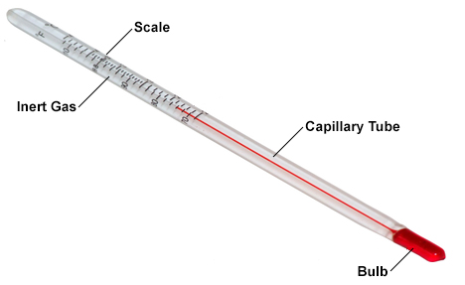
A typical liquid-in-glass thermometer
has four main parts
The bulb holds the highest volume of liquid and, therefore, has the most response to a change in temperature. the liquid also fills part of the capillary tube or stem
The stem is made from glass that does not expand or contract significantly with temperature in the range of operation.
In the part of the capillary not filled with liquid is an inert gas such as nitrogen, which prevents separation of the liquid column.
The scale on the thermometer allows the expansion and contraction of the liquid to be converted into a temperature measurement. It is based on the volume and thermal expansion coefficient of the liquid. The scale also indicates the highest and lowest temperatures that can be measured with the thermometer (referred to as the range, usually from about -90°C to 60°C) .

Slide 14
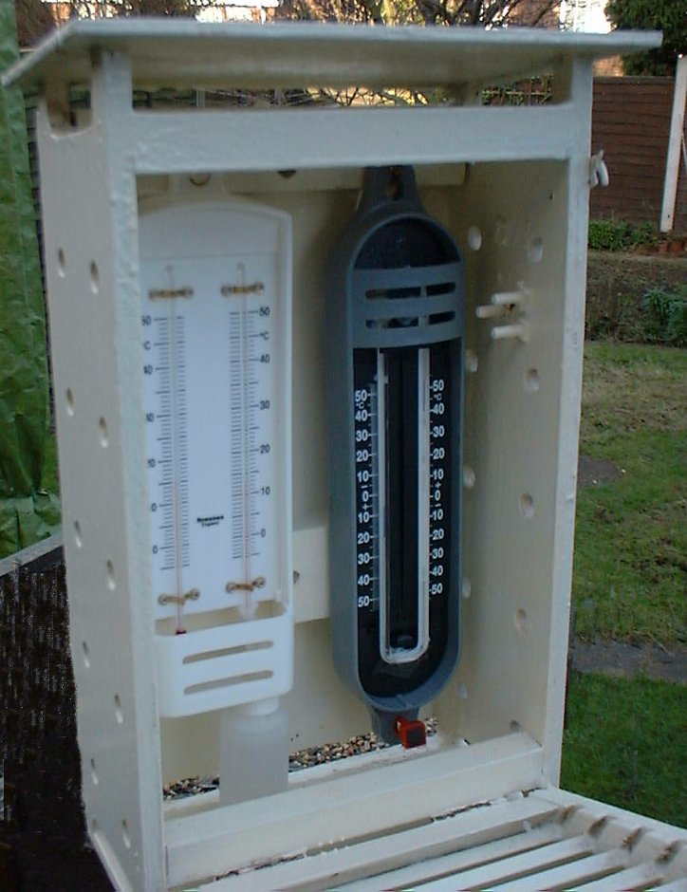
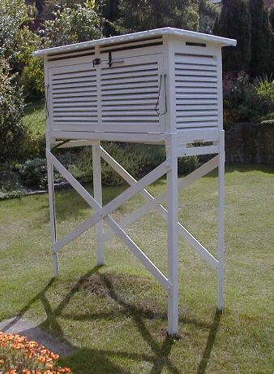

Slide 15

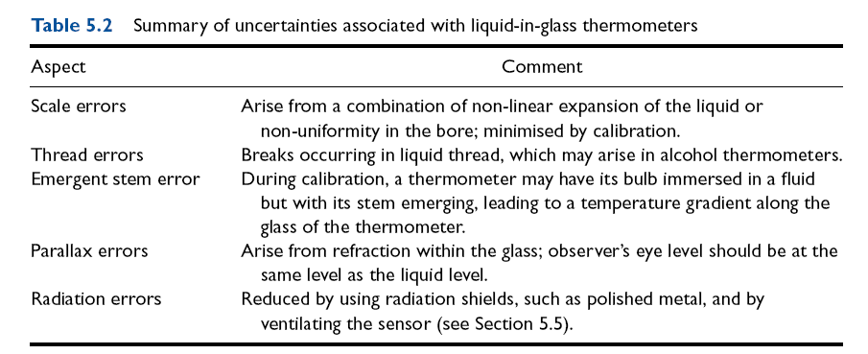

Slide 16
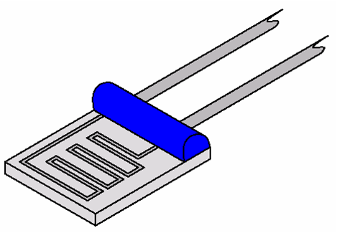
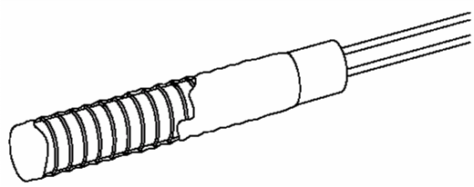
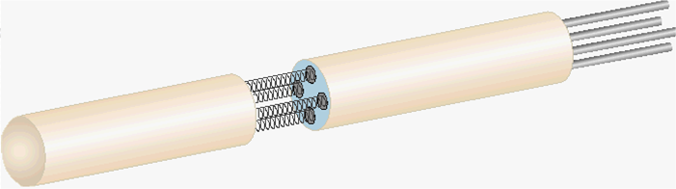
Resistance Thermometer
Electrical resistance of some materials changes with changing Temperature have known resistance-temperature (R-T) relationships. Resistance thermal sensor can be made with small wires such as platinum wire to give fast response
film
Wire-wound

Slide 17
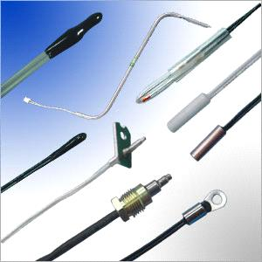
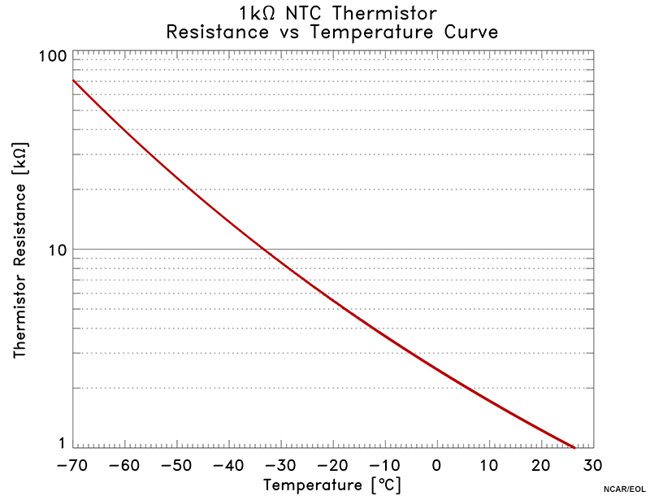
Thermistors
A thermistor is a type of resistor whose resistance varies with temperature. Thermistors differ from resistance temperature sensors in that the material used in a thermistor is generally semi-conductor, such as ceramic or polymer, while the latter uses pure metals. The temperature response is also different; the resistance temperature sensors are used for larger temperature ranges, while thermistors typically achieve a higher precision within a limited temperature range

Slide 18
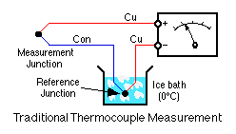
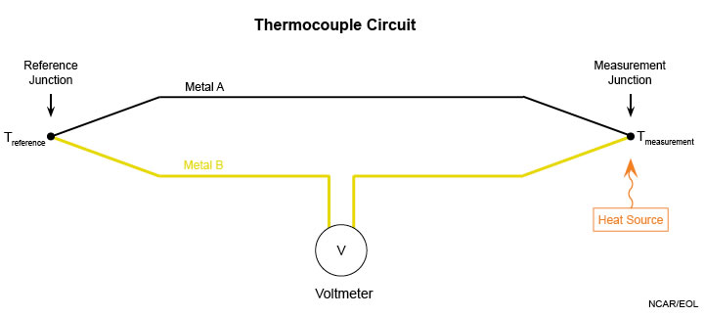
A Thermocouple consists of two wires of dissimilar metals connected together (usually by welding) to create two junctions. At each junction, there will be a voltage difference across the junction (arising from the thermoelectric effect, also called the Peltier-Seebeck effect) that depends on the temperature at that junction. When the wires are connected as shown in the diagram below, the voltmeter reading will depend on the difference in temperature at the two junctions and so can be used to measure that difference. The temperature sensitivity of a thermocouple depends on the metals used. A common combination is copper and constantan, which has a sensitivity of 43 µV/°C.

Slide 19
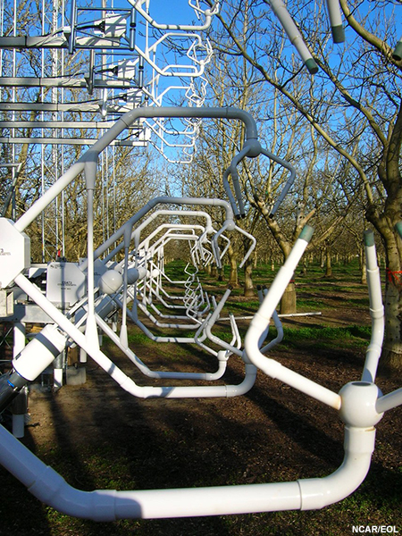
Sonic thermometers A thermometer based on the principle that the velocity of a sound wave is a function of the virtual temperature of the medium through which it passes.
By transmitting acoustic pulses in opposite directions between two transducers, the travel time difference can be used to infer the virtual temperature, provided that the wind speed across the acoustic path is known.
The virtual temperature depends on the amount of water vapor in the air, so to convert to a measurement of temperature the moisture content must also be measured.
Sonic thermometers possess very short time constants and eliminate radiation error.
Notes:
The virtual temperature is the temperature that a sample of dry air (no moisture) needs in order to match the density of air with moisture.

Slide 20
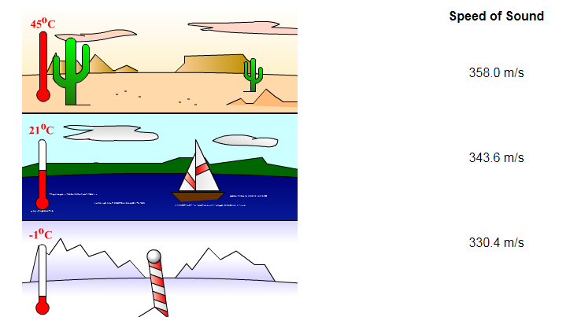
Temperature is also a condition that affects the speed of sound. Heat, like sound, is a form of kinetic energy. Molecules at higher temperatures have more energy, thus they can vibrate faster. Since the molecules vibrate faster, sound waves can travel more quickly.

Slide 21
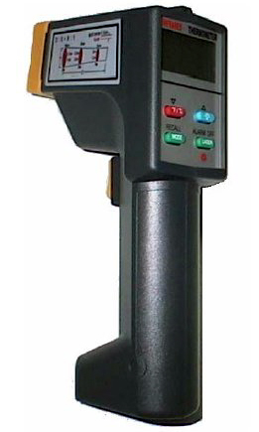
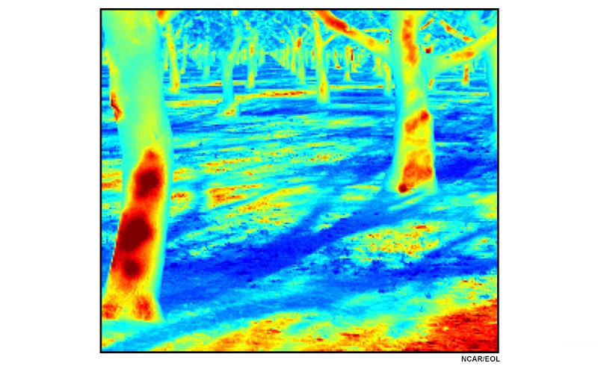
Radiation thermometers
Based on the principle that the radiation emitted from an object depends on its temperature. By knowing the amount of infrared energy emitted by the object and its emissivity, the object's temperature can be determined. They are, sometimes, called laser thermometers if a laser is used to help aim the thermometer to enhance the device’s ability to measure temperature from a distance.
Radiometric temperature measurements can also be made from instrumentation aboard research aircraft.

Slide 22
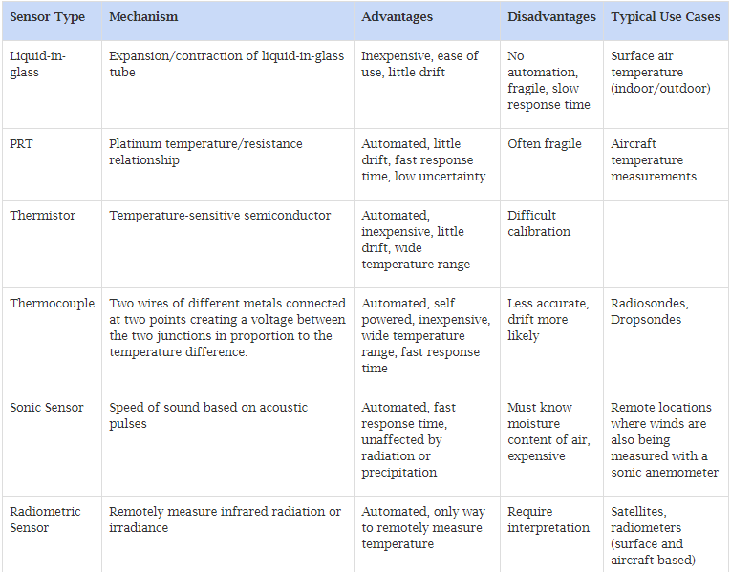
Advantages and Disadvantages of Sensor Types

Slide 23
Thermometer Response Time
Is the time a system or sensor takes to react to a given input Factors that control the time constant
The constant τ is proportional to the heat capacity
and inversely proportional to heat transfer rate.
In air, the rate of energy loss from the sensor due to convective processes will be proportional to the area of the sensor A and the convective heat flux Hconv that depends on the ventilation of the sensor and sensor geometry.
in a liquid or solid, the relevant energy transfer will be associated with conductive properties of the medium. The total heat transfer from the sensor can then be written as AHconv.
This expression shows that the smaller the sensor the higher the convective heat transfer rate, then the smaller the time constant.

Slide 24
Sensor exposure
Exposure standards are necessary to define what is meant by adequate exposure for certain applications. For example,
What is meant by surface temperature on synoptic scales?
Is it acceptable to mount the temperature sensor besides a building?
How about on the roof of a building?
For synoptic observations, we want the measurement to be representative of a large area. At what height above the ground should measurements be made?
Sitting Surface Sensors
Radiation can cause measurement errors by heating the sensor. Temperatures are much higher in direct sunlight than in the shade or in a shelter. Another source of error is wetting. When a sensor gets wet evaporation can cool the sensor and a wet sensor is slower to respond to changing ambient temperatures. Steps must be taken to shield the thermometer from direct sunlight and precipitation, while also allowing air to flow around the sensor.

Slide 25
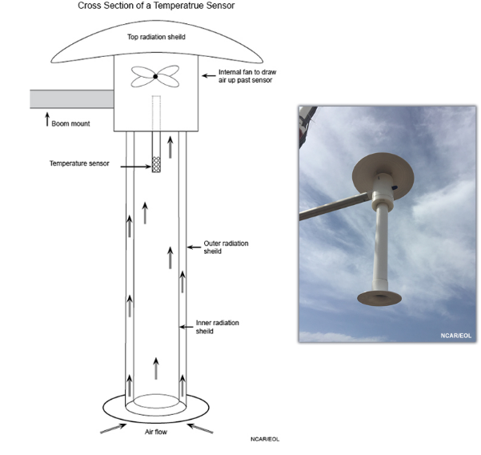
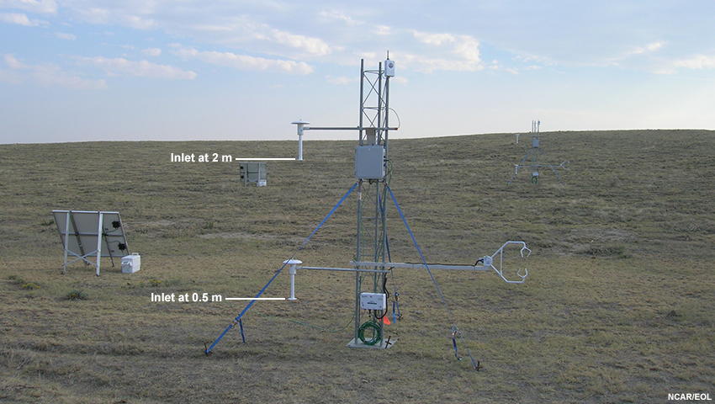
This is an instrument called the TR/H for Temperature, and Relative Humidity. It uses a fan to draw ambient air up and over the sensor. The radiation shield prevents direct and diffuse solar radiation from heating the sensor and introducing error in the temperature measurement. TR/H sensors are hung at discrete points on a tower to make measurements at specific heights above the ground. Images from NCAR/EOL.

