Slide 1
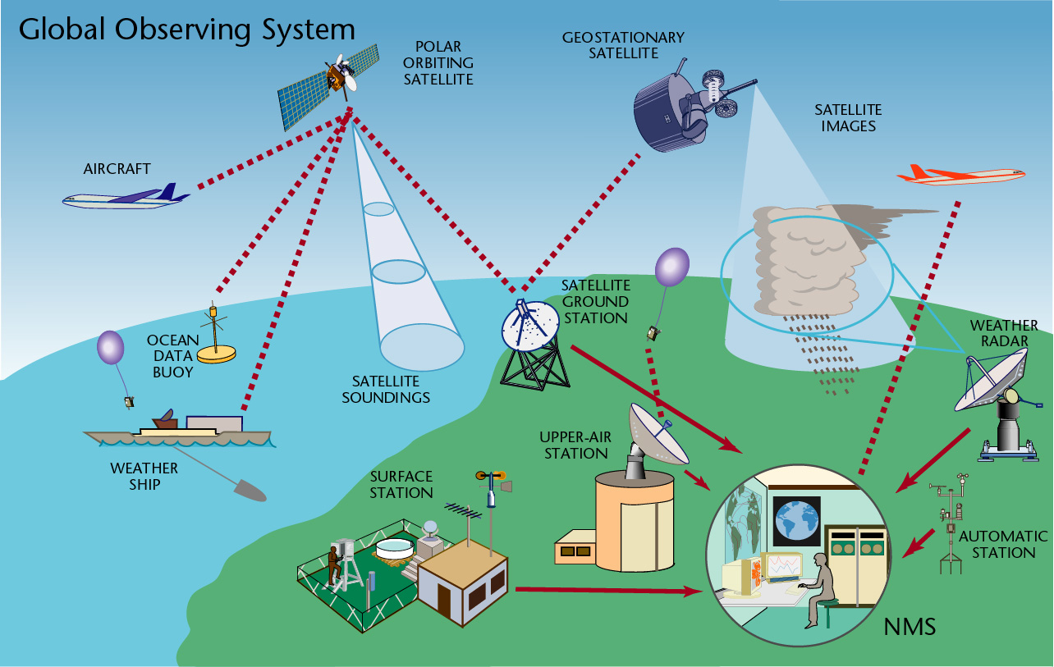
The Course of
Meteorological Instrumentation and Observations
MUSTANSIRIYAH UNIVERSITY
COLLEGE OF SCIENCES
ATMOSPHERIC SCIENCES DEPARTMENT
2022-2023
Dr. Husain A. Nema
SECOND STAGE

Slide 2
Welcome Students!
To LECTURE 2
Observing System

Slide 3
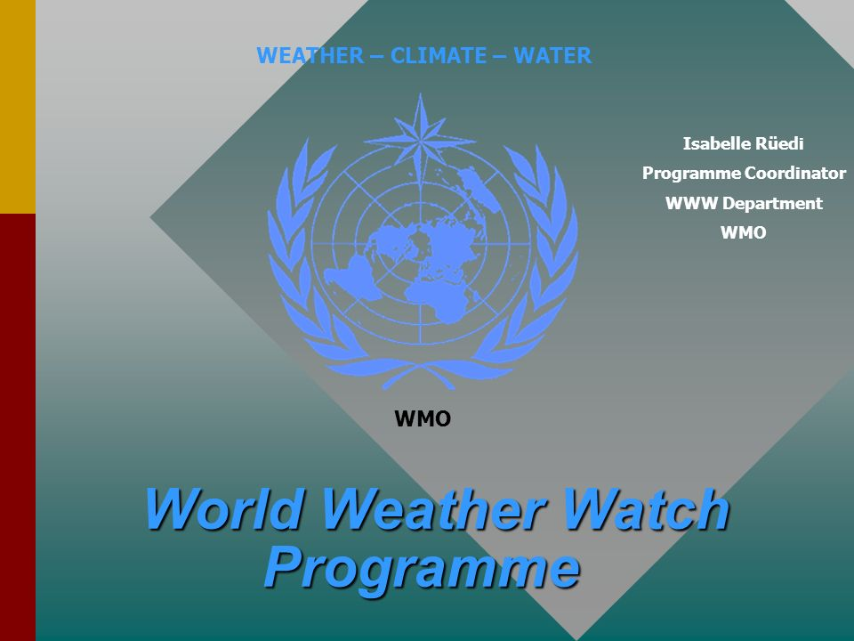
World Weather Watch Program
To predict the weather, modern meteorology depends upon near- instantaneous exchange of weather information across the entire globe. Thus , the World Weather Watch Program - the core of the WMO Programs - comprises the design, implementation, operation and further development of the three interconnected, and increasingly integrated, core components to make available meteorological and related environmental information needed to provide efficient services in all countries.

Slide 4
Global Observing System (GOS)
Global Telecommunication System (GTS)
Global Data-processing and Forecasting System (GDPFS)
Consisting of facilities and arrangements for making meteorological observations (including climatological observations) and other related environmental observations at stations on land and at sea, and from aircraft, meteorological environmental satellites and other platforms.
Consisting of integrated networks of telecommunications facilities and services for the rapid, reliable collection and distribution of observational data and processed information.
Consisting of World, Regional Specialized, and National Meteorological Centres that provide quality-assured, processed data, analyses, and forecast products on a wide range of temporal and spatial scales.

Slide 5
Global Observing System (GOS) and its components
The WMO (GOS) comprised of operationally reliable surface- and space-based subsystems.
Its components are :
Surface observations
Upper-air observations
Marine observations
Aircraft-based observations
Satellite observations
Weather Radar observations
Other observation platforms
For more information, visit this website http://www.wmo.int/pages/prog/www/OSY/Gos-components.html

Slide 6
OBSERVING SYSTEMS
There are two main types of the observations:
Surface observations
Conventional (un-automated) observing systems.
Upper air observations
Radiosondes
Remote surface-based instruments, e.g. wind profiler radars, SODAR, etc.
Modern (automated) observing systems.
Upward-looking ground-based instruments using microwave radiometers, ex. SODAR-RASS.

Slide 7
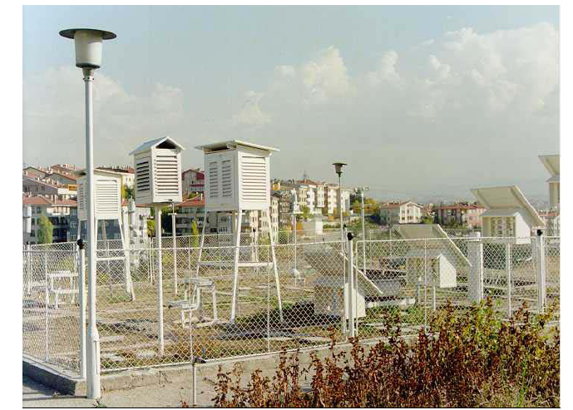
CONVENTIONAL OBSERVING SYSTEMS
نظم المراقبة التقليدية
It consist of observer and some instruments for some essential parameters. Those systems can be described in general as follows:
Observation of certain parameters such as wind, temperature, relative humidity, air pressure, precipitation, clouds and visibility
Conventional instruments with dependency on observer for reading with subjectivity in observations
Limited observation frequency due to the number of the observers at the station and limited observation parameters.
Mechanical instruments recording on charts

Slide 8
MODERN OBSERVING SYSTEMS AWOS
نظم المراقبة الحديثة AWOS
Automated Weather Observing Systems (AWOS) is defined as:
  any system which creates and archives a digital (computer-readable) record of one or more weather ‘elements’, such as air temperature, precipitation, sunshine, wind speed or other parameters.
It can only observe the atmosphere continuously by recording all significant changes and phenomena.
It is able to collect and maintain a greater volume of continuous data, report or log data at much higher resolution rates.
AWOSs can take samples and report messages every second indefinitely if required, as compared with manual observations, which are restricted to a set observation program, which may not include observations at weekends or overnight.
Q: what is the differences between the COS and AWOS ?

Slide 9
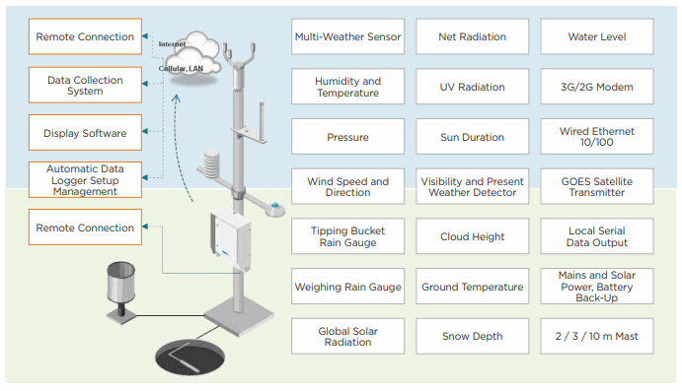
MODERN OBSERVING SYSTEMS AWOS
In its simplest form, an AWS can be a single sensor integrated with a small, inexpensive electronic data recorder (a ‘data logger’ or simply ‘logger’). Loggers that can record only one input signal, or ‘channel’, are therefore ‘single-channel loggers’; those that can handle two or more are ‘multi-channel’.

Slide 10
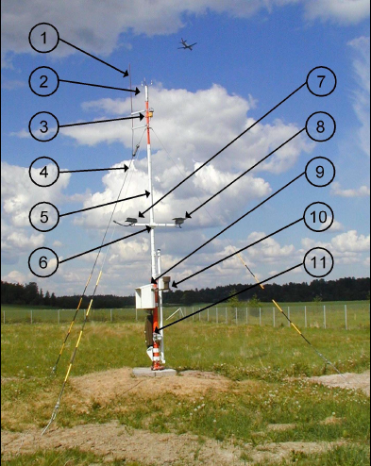
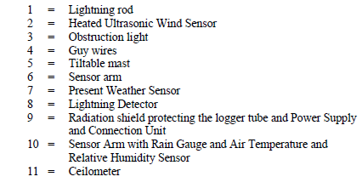
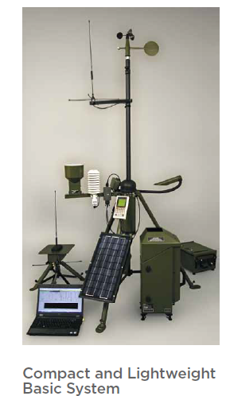

Slide 11
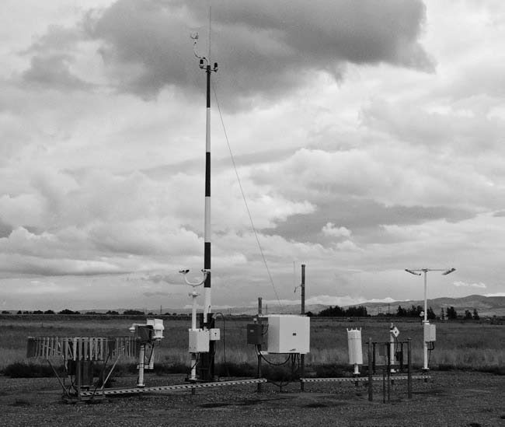
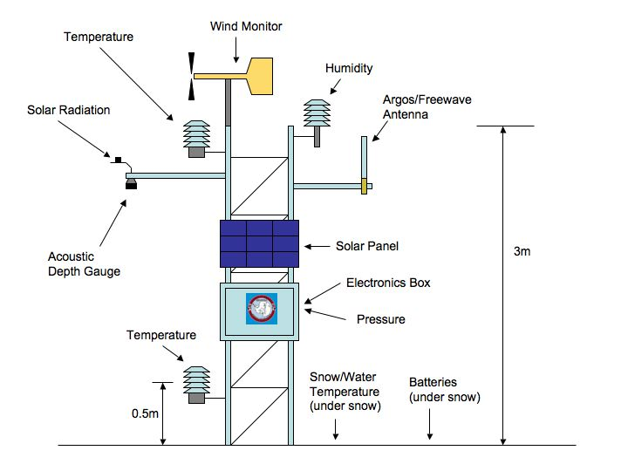
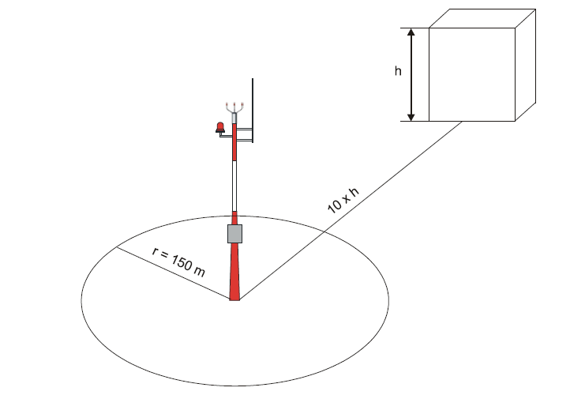
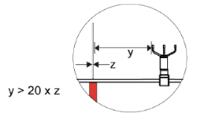
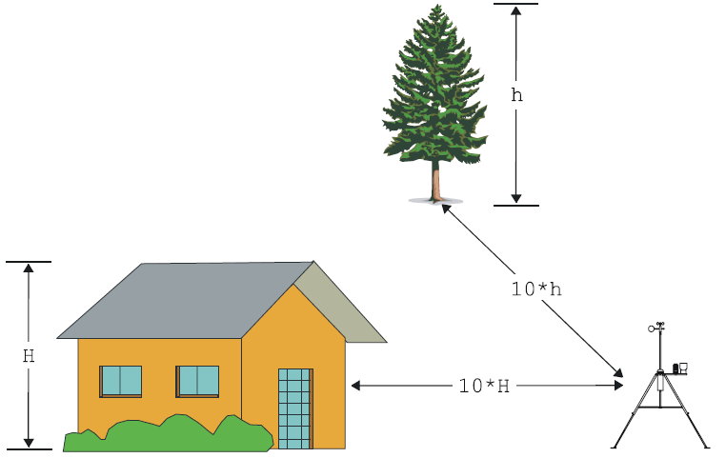

Slide 12
Although the main components are almost same, AWOS can be classified as follows by considering the purpose of their use:
AWOS for Synoptic Meteorology: observes and calculates the parameters and generates the reports for weather forecast analysis
AWOS for Climatological Meteorology: observes and calculates the parameters and generates the reports for climate and research studies
AWOS for Agricultural Meteorology (Agrometeorology): observes and calculates the parameters including soil and plants to support agricultural activities
AWOS for Aviation Meteorology: observes and calculates the parameters required for supporting flight security and aviation
AWOS for Marine Meteorology: observes and calculates the parameters required for supporting navigation and maritime
AWOS for Road Meteorology: observes and calculates the parameters required for supporting road administration and security
AWOS for Hydrology: observes and calculates the parameters required for hydrology and irrigation

Slide 13
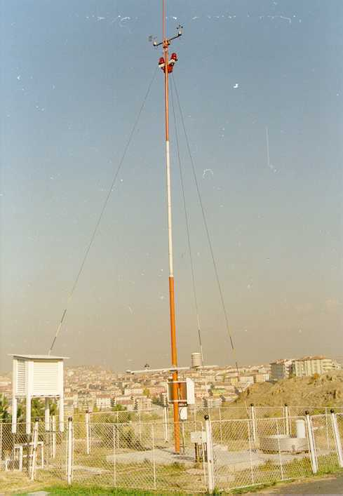
Types of Automated Weather Observing Systems (AWOS)
AWOS for Synoptic Meteorology
AWOS for Climatological Meteorology
AWOS for Agrometeorology

Slide 14
Advantages of automated weather observeing systems
As it is expected, automated observations have a great advantages over manual ones. Advantages of automated systems can be summarised as follows:
Standardisation of observations (both time and quality)
Real-time continuous measuring of parameters daytime and night-time
More accurate
More reliable
Automatic data archiving
Higher resolution
Collection of data in a greater volume
Adjustable sampling interval for different parameters
Free from reading errors
Free from subjectivity
Automatic QC(quality Control) in both collection and reporting stages
Automatic message generation and transmission
Monitoring of meteorological data
Access of archived data locally or remotely
Data collection from harsh environments

Slide 15
Disadvantages of automated observations
Limited represented area of 3-5 km of sensor site
It is not possible to observe all parameters automatically, e.g. Cloud coverage and types
Ongoing periodic maintenance
Periodic test and calibration
Well trained technicians and specialists
Well trained operators
High cost of instrumentation and operation
Even with today’s most sophisticated technology and sensors, human observers are still required for many weather observing tasks; for example, AWSs are still very poor at telling the difference between rain and wet snow, nor can they report shallow fog just starting to form across the low lying parts of an airfield or see distant lightning flashes on the horizon which warn of an approaching thunderstorm. Human weather observers will continue to be required for a long while to come!

Slide 16
Universal Time
To ensure that the observations are taken and reported at the correct times, and to ensure that the radiosondes are launched simultaneously, a common time system is required. This provides a view of atmospheric conditions for broad areas of the world.
To work within a common time system, weather communities use a 24-hour clock based on the 0° longitude meridian, known as the Greenwich Meridian.
On this clock, 00:00 UTC is 12:00 a.m. local Greenwich time and the hours and minutes increment through the course of the day so that 23:59 UTC is 11:59 p.m. local Greenwich time.
Before 1972, this universal clock was referred to as Greenwich Mean Time (GMT), but is now known as Universal Time Coordinated (UTC) or Coordinated Universal Time. It is also sometimes referred to as Zulu Time or Z time.

Slide 17
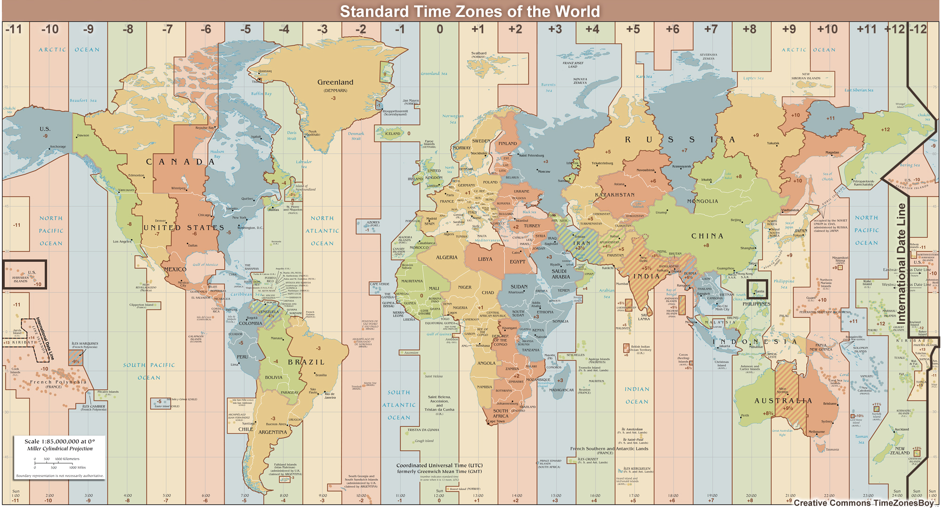

Slide 18
UTC is used to specify the set times that observations are taken and reported worldwide:
METARs: hourly, with SPECIs as conditions change
Balloon-borne radiosondes: 00:00 UTC and 12:00 UTC
Synoptic observations: 00:00 UTC, 06:00 UTC, 12:00 UTC, 18:00 UTC
Working with UTC takes some practice. You can determine your local time by adding or subtracting a set number of hours from UTC. The number of hours you add or subtract corresponds to the number of time zones you would cross if you were to travel from Greenwich, England to your local location. You will need to consider if you cross the international date line (shown in black toward the right edge of the image) or if your location has special time considerations such as daylight saving time, which might require that you add or subtract an additional hour depending on the time of year. How and when these special circumstances affect your local time will be specific to your location.
Let's look at an example.

Slide 19
If you are located in Manila in the Philippines, what local time would correspond to 09:00 UTC? The Philippines are located in the South China Sea, directly north of Indonesia. From the map, Manila is +8 hours from UTC, so eight hours ahead of UTC or Greenwich Mean Time. To find the local time, add the UTC conversion to the current time:
Local time = UTC + offset
PHT (Philippine Standard Time) = UTC + 8
PHT = 09:00 UTC + 8 hours (UTC conversion) = 17:00 hours
The local time is 17:00, or 5:00 p.m.

