Slide 1
Immune response to virus infections
Lec. 3

Slide 2
The relationship between viruses and the immune system is much more intimate than it is for most bacteria: viruses often modify the cells within which they replicate, thereby rendering them ‘foreign’ and susceptible to attack by sensitized lymphocytes; furthermore, some viruses can multiply within lymphocytes and mononuclear phagocytes that are important components of the immunological defenses. A good example is HIV, which attaches to and destroys the CD4+ ‘helper’ lymphocytes that are so important to the integrity of the immune system.

Slide 3
However, the animal world has developed efficient and highly complex mechanisms for combating infection by parasites, which can be considered under the headings of innate (‘general’ or ‘non-specific’) immunity and adaptive (or ‘specific’) immunity.
By ‘innate’ we mean those defence mechanisms with which we are born and form the first line of protection against microbial invasion. They can be regarded as ‘built-in’ defenses, and fall into two categories: those that protect the individual and others, genetically mediated, that determine the resistance or susceptibility of populations. Innate resistance mechanisms differ from adaptive mechanisms in having no immunological ‘memory’.

Slide 4
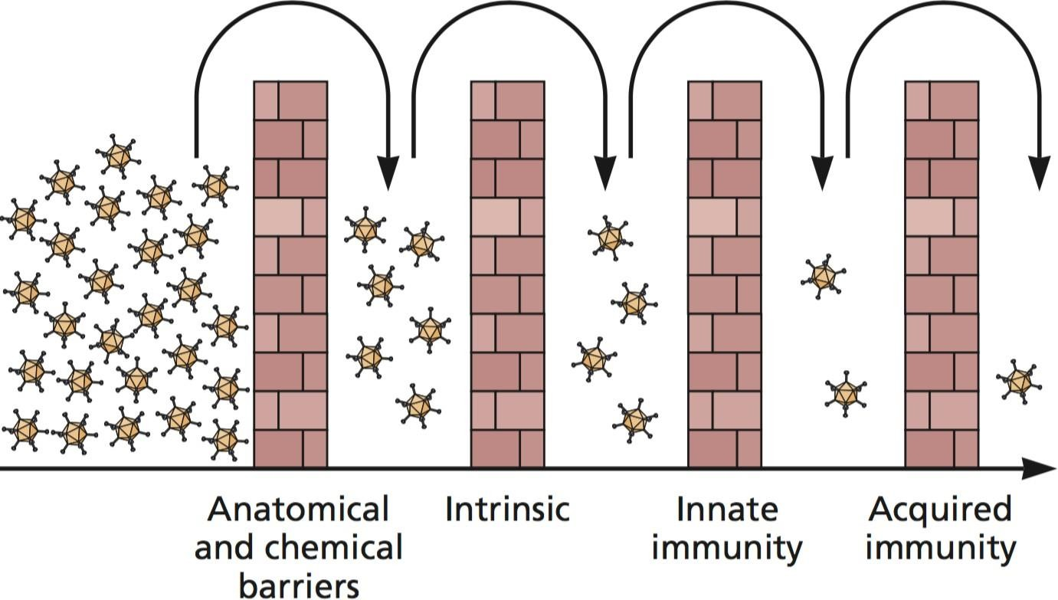
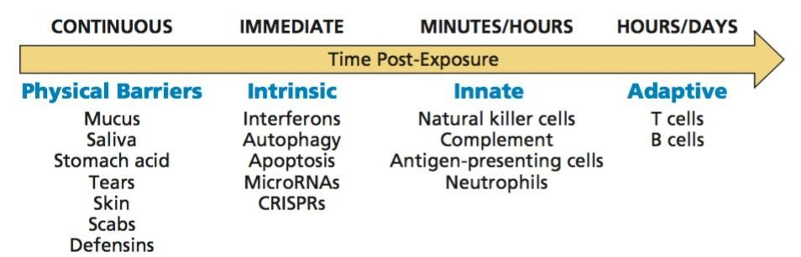

Slide 5
General factors in resistance:
  Mechanical and chemical barriers
The skin is the first barrier to infection.
The retrograde movement of epithelial cilia acts to prevent infection of the respiratory tract, and damage to these cells by influenza and paramyxoviruses may open the way to secondary bacterial infection.
The gastrointestinal tract is to some extent protected against ingested viruses by the low pH in the stomach; although viruses that regularly infect by this route are resistant to acidity; this applies to most enteroviruses, but it is interesting that the rhinoviruses, a sub- group causing the common cold, do not have to survive passage through the stomach and are not acid resistant.

Slide 6
The secretions from mucous membranes, e.g. eyes, mouth, respiratory, genital, and gastrointestinal
tracts, offer a means of transporting various elements of the immune systems (cytokines,
antibodies, lysozyme, etc.) to where they are needed.
  Fever
A high temperature is naturally regarded by patients as an unpleasant effect of a virus infection; but a body temperature much above 37°C is inimical to the replication of a number of viruses and is thus a defence mechanism.

Slide 7
  Age
This factor is an example of the way in which the general overlaps with the particular, as age-related resistance is, in part at least, mediated by immune responses. An infant is sent into the world with a useful leaving present from its mother in the form of a package of IgG antibodies directed against infections from which she has suffered. IgG antibodies to these predominantly viral infections, supplemented by IgA antibodies in colostrum and breast milk, helps to tide the baby over the first 6 months or so, after which its susceptibility to viral infections increases.

Slide 8
  Nutritional status
Poor nutrition may trigger the severity of some virus infections, an often-quoted example being measles in African children, which has a much higher mortality rate than in developed countries.
  Hormones
It is well known that treatment with steroids trigger the severity of herpes simplex and varicella-zoster infections but their precise role in natural resistance or susceptibility is unknown. The severity of hepatitis E may be trigger by pregnancy, presumably because of hormonal influences, but again, the mechanism is not yet understood.

Slide 9
  Genetic factors
In experimental animals there is clear evidence that genetic factors influence resistance, or conversely, susceptibility to virus infections. Thus some highly inbred lines of mice are killed by very small inoculate of HSV, whereas others withstand enormous doses with no sign of illness. In this case, resistance is dominant, and is mediated by only four genes: with other viruses, susceptibility may be the dominant genetic factor.

Slide 10
  Species resistance
The host range of many viruses is restricted, probably because the cells of resistant species do not possess appropriate receptors. The best understood example is poliovirus, the receptors for which are present only in humans and other primates. Others, notably the human immunodeficiency viruses and some hepatitis agents, are equally selective; by contrast, others again, such as rabies, are capable of infecting most or all warm- blooded animals

Slide 11
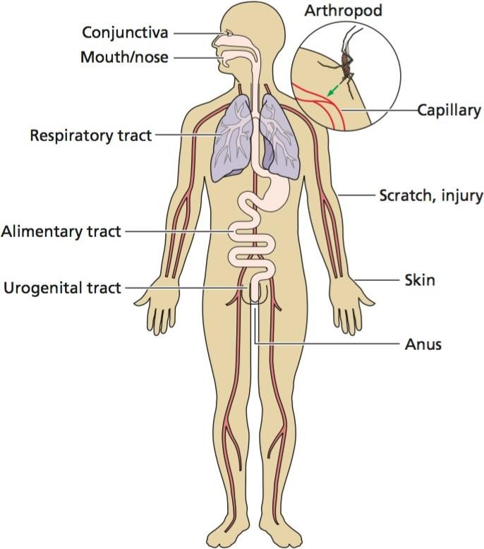
Intrinsic:
Always present in the uninfected
Cell: Apoptosis, autophagy,
RNA silencing, antiviral proteins
Innate immune system: Induced by infection
Adaptive immune system: Tailored to pathogen

Slide 12
Apoptosis, also known as programmed cell death, is a ubiquitous mode of cell death known to be responsible for clearance of unwanted, injured, or virus-infected cells. Cells undergoing apoptosis are accompanied by characteristic morphological changes, including cell shrinkage and deformation, chromatin condensation, nuclear fragmentation, and plasma membrane bledding, which forms the apoptotic body containing the fragments of nucleus or cytoplasm.

Slide 13
In contrast to necrosis, apoptotic cells form apoptotic bodies that are phagocytized by neighboring cells, without the release of cellular contents. Apoptosis plays important roles in physiology and pathology, and can be triggered by numerous stimuli, including ischemia, hypoxia, exposure to certain drugs and chemicals, immune reactions, infectious agents, high temperature, radiation, and various disease states.

Slide 14
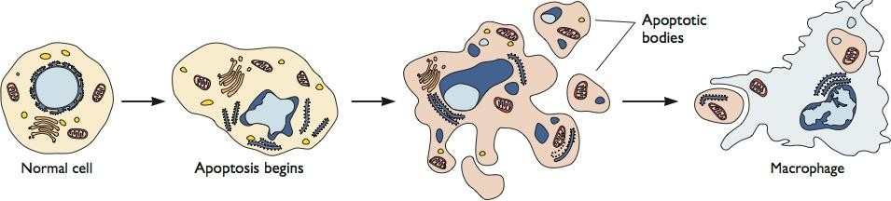
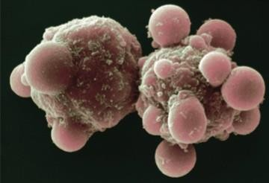
Apoptosis is monitored by sentinel cells

Slide 15
Local non-specific defences
Soluble factors such as the IFNs, complement and C-reactive protein, and phagocytic cells, particularly natural killer (NK) cells, all of which are important components of the innate immune system. The various elements of these responses can be mobilized very quickly—within a matter of hours.
When the pathogen enter the skin confronted with macrophages and other phagocytic cells possessing (microbial sensors) like TLRs (Toll-like receptors ) a family of evolutionary conserved Pattern recognition systems, that among other activities, enhance the expression of MHC molecules and are thus important in the innate immune response.

Slide 16
These interactions between cells of the immune system are mediated by a substantial variety of small (about 20 kDa) glycoproteins referred to collectively as cytokines. This is an umbrella term that encompasses a wide range of molecules. The cytokines act as chemical messengers, stimulating or inhibiting the activities of the various cellular components of the immune system. As such, they form an important component of innate immunity and can provide links between this and certain of the adaptive components. They contain several subgroups include IFNs. Other categories include the chemokines, which act as chemical attractants of leucocytes to sites of inflammation.

Slide 17
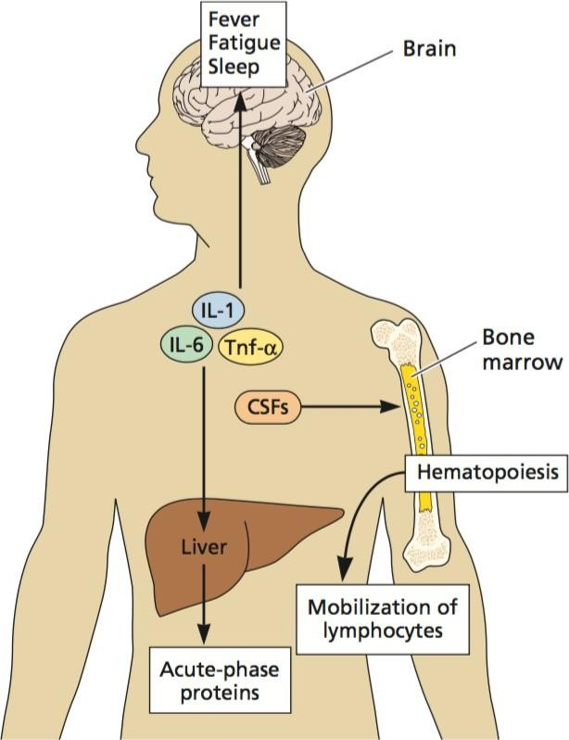
Three classes of cytokines
Group | Some members | Activity
Proinflammatory | IL-1, Tnf, IL-6, IL-12 | Promote leukocyte activation
Antiinflammatory | IL-10, IL-4, Tgf-β | Suppress PICs
Chemokines | IL-8 | Recruit immune cells
Initially function locally in antiviral defense
In larger quantities, enter circulation,
have global eﬀects (sleepiness, lethargy,
muscle pain, no appetite, nausea)
A localized viral infection produces global eﬀects

Slide 18
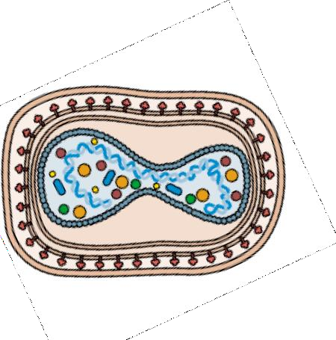
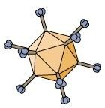
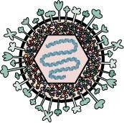
Inflammation usually stimulates potent immune responses
Cytopathic viruses cause inflammation because they promote cell and tissue damage Activate the innate response
Consequently cytopathic viral genomes encode proteins that modulate this immune response
Adenoviruses, herpesviruses, poxviruses

Slide 19
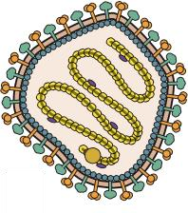

Some viruses do not stimulate inflammation
Typically non-cytopathic viruses
  - Cells are not damaged, no apoptosis/necrosis
  - Low or ineﬀective innate immune response
  - Do not eﬀectively activate adaptive immune response
Non-cytopathic viruses have dramatically diﬀerent interactions with the host immune system
  - Persistent infections: rarely or ineﬃciently cleared

Slide 20
Interferons
Interferons are member of a large group of proteins called cytokines which affect a wide range of target cells and tissue by binding to specific receptors present on the surface of target cells.
Interferons play an important role in first line of defense against viral infections. They are part of the non-specific immune system and are induced at an early stage of viral infection before the specific immune system has had time to respond.
Interferons are not expressed in normal cells but virus infection of a cell causes interferons to produce and release from the cell and that cell will often eventually die as a result of infection. The interferons then bind to target cell and initiate an antiviral state.

Slide 21
There are several IFNs, which differ in the way they are produced, in chemical composition, and in mode of action. They are proteins with molecular weights of about 20 kDa, manufactured by leucocytes or fibroblasts in response not only to viral infection, but also to stimulation by natural or synthetic dsRNA and some bacteria (e.g. chlamydia). These molecules are not virus-specific, so that IFN induced by one virus is effective against others; on the other hand, they are species-specific, so that IFN produced by, a guinea-pig, is ineffective in mouse or human cells. IFN-g differs in a major way from the a and b varieties as it is produced by a subset of T memory cells in response to stimulation by an antigen previously encountered. IFNs do not kill viruses, nor do they act like antibodies.

Slide 22
Production of IFNα/β is rapid: within hours of infection, declines by 10 h
IFN binding to IFN receptors leads to synthesis of >1000 cell proteins (ISGs, IFN stimulated genes)
Mechanisms of most ISGs not known

Slide 23
Mode of action of interferons
Both DNA and RNA viruses can induce interferon.
production Viruses are target specific and then DNA or RNA virus binds to specific receptors on a target cell, it induce transcription of 20-30 genes ultimately forming mRNA. This induces formation of 20-30 proteins; interferons.

Slide 24
Among these proteins 3 proteins appears to paly important role in induction of antiviral state:First protein called 2,5-oligo A synthase results in activation of second protein called ribonuclease which can breakdown mRNA and causes expression of third protein; a protein kinase. The kinase inhibits the initiation step of protein synthesis.
These activities of proteins target not only viral protein synthesis but also of host protein synthesis. Activation of these proteins results in death of cell but at least the progression of virus infection is prevented.

Slide 25
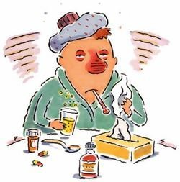
The IFN system is dangerous
IFN induces the expression of many deleterious gene products – most of our cells have IFN receptors.
IFNs have dramatic physiological consequences:
fever, chills, nausea, malaise.
Every viral infection results in IFN production, one reason why ‘flu- like’ symptoms are so common

Slide 26
The complement
The complement system functions as an immune surveillance system that rapidly responds to infection. Activation of the complement system typically occurs via three distinct target recognition pathways (the classical, lectin, and alternative). The complement system has been shown to exhibit numerous antiviral mechanisms via direct neutralization of both enveloped and non-enveloped viruses, and/or the promotion of other immune responses. However, when dysregulated, these powerful functions can become destructive and the complement system has been implicated as a pathogenic effector in numerous diseases, including infectious diseases.

Slide 27
The adaptive immune system
The adaptive defense consists of antibodies and lymphocytes, often called the humoral response(the synthesis of virus-specific antibodies by B lymphocytes) and the cell-mediated response (the synthesis of specific cytotoxic T lymphocytes that kill infected cells). Both of these components of the adaptive immune response result also in the production of long-lived "memory cells" that allow for a much more rapid response (i.e., immunity) to a subsequent infection with the same virus.

Slide 28
The term ‘adaptive’ refers to the differentiation of self from non-self (microbes) which called antigens (molecules, or groups of molecules, capable of eliciting an immune response)

Slide 29
The B-cell response to viral infection
Immunoglobulins (Igs)The five classes of immunoglobulin, IgA, IgM, IgG, IgD, and IgE, are each produced by particular clones of plasma cells; only the first three seem to be important in virus infections.
The IgA secreted at mucous surfaces( produced by lymphoid tissue underlying the mucous membranes) they are found in secretions of the oropharynx, gastrointestinal and respiratory tracts, and are thus important in defending against viruses that enter by these routes. IgA is also produced during lactation, particularly in the colostrum that help to protect against infections in early infancy.

Slide 30
IgM antibodies
IgM antibodies are the first to be produced in systemic infections, Production of IgM antibody is a fairly short-term process, lasting for a few weeks or months. The finding of a specific IgM is thus evidence of a recent or current infection and is used widely for diagnosis.
IgG antibodies
IgG antibodies continue to be produced for very long periods—often during the entire life span—and thus afford long-term protection against subsequent encounters with the same virus.

Slide 31
Mode of action of antibodies
Mode of action of antibodies
There are several possible ways in which a specific immunoglobulin can act against a virus, the exact mechanism depending on the virus concerned.
It can neutralize by agglutinating the virions and thus stop them attaching to susceptible cells
or by blocking the receptor binding site.
Some antibodies can block the functioning of an internal viral protein when it is expressed on the cell surface like the influenza M2 protein. Antibody may act as an opsonin, combining with virions and increasing the ability of macrophages to phagocytose and destroy them.

Slide 32
Macrophages coated with specific antibody are activated or ‘armed’ to destroy infected cells expressing on their surfaces viral antigens with the same specificity.
Antibody plus complement can combine with viral antigen expressed on the surface of an infected cell, which they lyse. This effect is known as antibody-dependent-cellular cytotoxicity (ADCC).

Slide 33
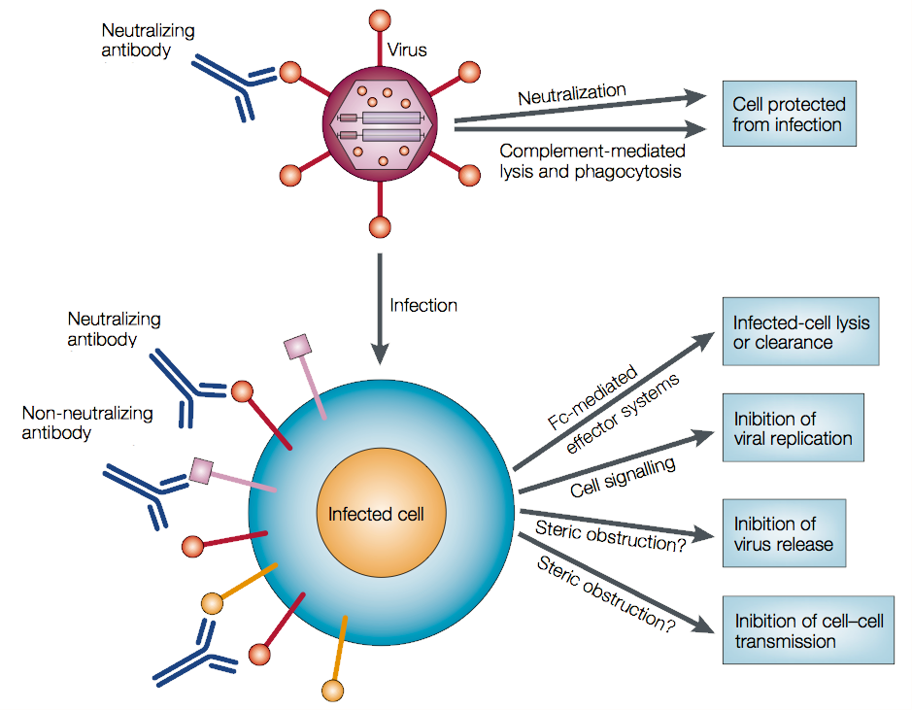

Slide 34
B cells and antibody-mediated immunity
Virus and/or virus-infected cells can stimulate B lymphocytes to produce antibody (specific for viral antigens) Antibody neutralization is most effective when virus is present in large fluid spaces (e.g., serum) or on moist surfaces (e.g., the gastrointestinal and respiratory tracts).
IgG, IgM, and IgA have all been shown to exert antiviral activity. Antibody can neutralize virus by:
1) blocking virus-host cell interactions
2) recognizing viral antigens on virus-infected cells which can lead to antibody-dependent cytotoxic cells (ADCC) or complement-mediated lysis. IgG antibodies are responsible for most antiviral activity in serum, while IgA is the most important antibody when viruses infect mucosal surfaces.

Slide 35
T cells and cell-mediated immunity
The term cell-mediated immunity refers to
recognition and/or killing of virus and virus-infected cells by leukocytes
production of different soluble factors (cytokines) by these cells when stimulated by virus or virus-infected cells. Cytotoxic T lymphocytes, natural killer (NK) cells and antiviral macrophages can recognize and kill virus-infected cells.
T lymphocytes originate from stem cells in the bone marrow, These cells are responsible for CMI
Cytotoxic cells
These cells (Tc) ,they are particularly important in virus infections, as they recognize virus-specified antigens on the surface of infected cells, which they attack and lyse.

