Slide 1
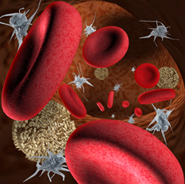
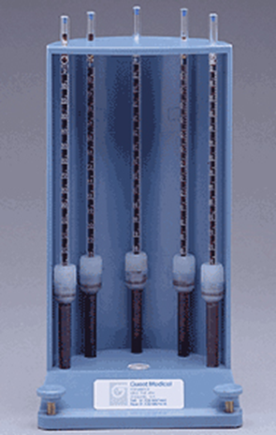
Erythrocyte sedimentation rate (Westergren technique)
Value of test:
Non-specific test.
It is raised in a wide range of infectious, inflammatory , and malignant conditions associated with changes in plasma proteins.
The ESR is also affected by many other factors including anemia, pregnancy, and treatment with anti-inflammatory drugs.

Slide 2
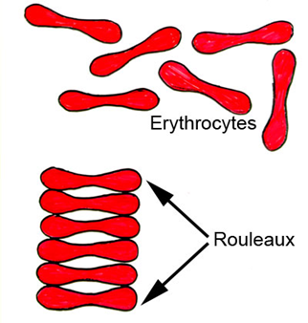
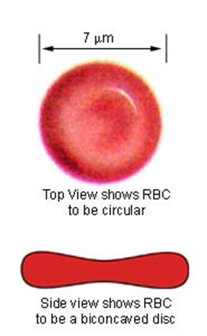
Mechanism
ESR is determined by the interaction between factors that promote (fibrinogen) and resist (negative charge of RBCs - that repel each other) sedimentation.
Normal RBCs settle slowly as they do not form rouleaux or aggragate together. Instead, they gently repel each other due to the negative charge on their surfaces.
Increased rouleaux formation contributes to high ESR.
Rouleaux are stacks of many RBCs that become heavier and sediment faster.

Slide 3
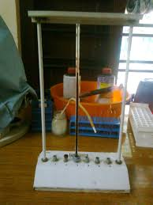
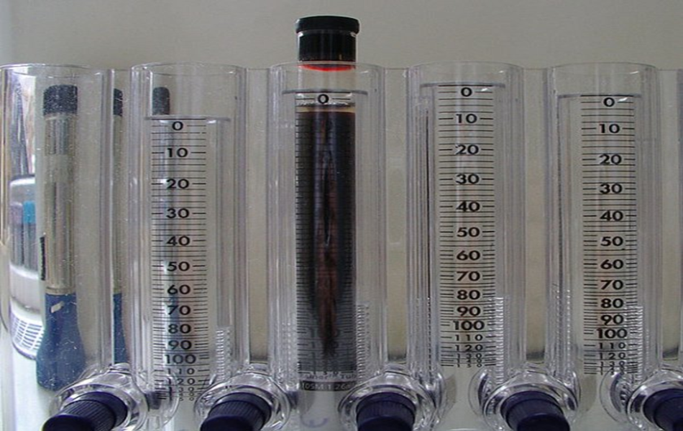
Factors effecting an ESR
1. The settling tube must be kept upright, straight, and standardized.
2. Counter should be level.
3. Temperature should be kept constant.
4. Blood sample should be used within 2 hours of collection and well mixed
5. Test must be timed correctly

Slide 4
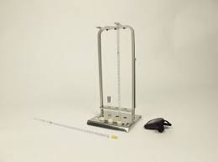
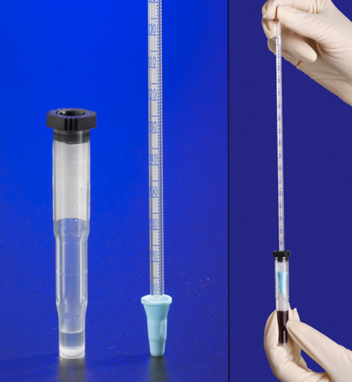
Equipments
● Westergren ESR pipette
1. Glass Westergren pipettes or when available, disposable plastic Westergren pipettes can be used.
2. Westergren pipettes measure 300 mm in length
(plastic pipettes are often shorter) and are graduatedfrom 0–200 mm.
3. The diameter should not be less than 2.55 mm.
4. When reusing pipettes,care must be taken to ensure the pipettes are completely clean and dry.

Slide 5
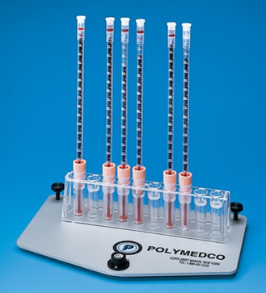
Equipments
Test tube.
ESR rack.
Disposable syringe & cotton & alcohol.
Timer capable of timing accurately 1 hour.
Reagent
Tri-Sodium citrate, Store the reagent at 4–8 C. Renew if it becomes cloudy. (0.4 ml of tri-sodium citrate.)
Specimen
Blood sample.( 1.6 ml of blood).

Slide 6
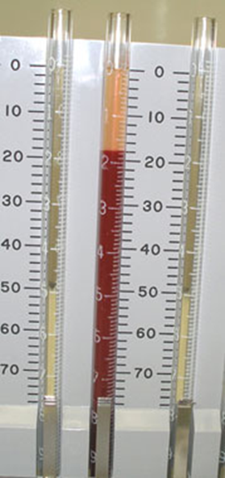
Procedure
Patient must fasting at least 4 hours before testing.
The blood sample must be mixed with anticoagulant agent in this test.
Put 0.4 ml sodium citrate + 1.6 ml blood . OR put 0.2 ml sodium citrate + 0.8 ml blood .
Mix gently with out shaking then put in the graded tube and leave it stand vertically on the stand for 1 hour.
Read the amount of plasma that appeared without moving it.

Slide 7
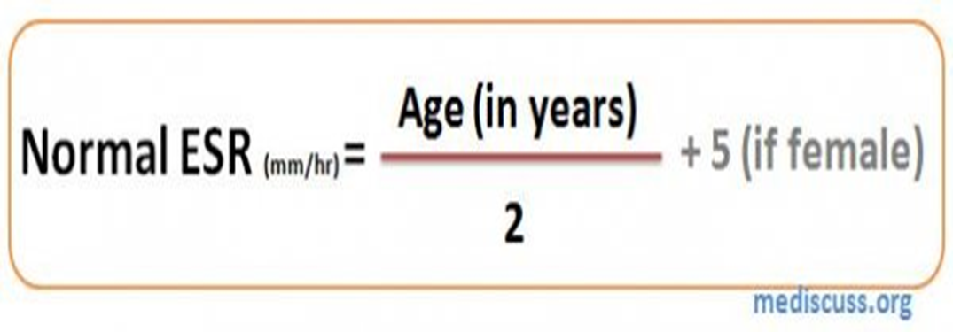
Sedimentation Phases
The initial lag phase .(10m)
The phase of rapid RBC falling(40m)
The packing phase (10m).
Normal value
ESR values tend to rise with age and are generally higher in women. ESR is also elevated in the black population and those with anemia.
Adult females 0-20 mm/h Adult males 0-15 mm/h Children(<10) 0-10 mm/h

