Slide 1
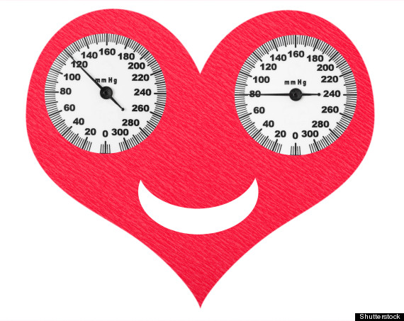
Blood Pressure

Slide 2
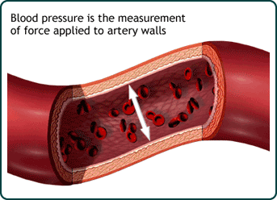
Blood pressure (BP) is the pressure exerted by circulating blood upon the walls of blood vessels.
When used without further specification, "blood pressure" usually refers to the arterial pressure of the systemic circulation.
usually measured at a person's upper arm.

Slide 3
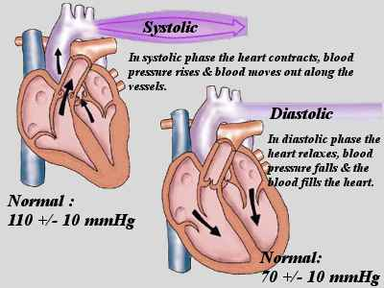
Systolic pressure
the blood pressure during the contraction of the left ventricle of the heart.
Diastolic pressure
the blood pressure after the contraction of the heart while the chambers of the heart refill with blood

Slide 4
The mean arterial pressure (MAP)
is the average over a cardiac cycle. MAP can be approximately determined from measurements of the systolic pressure and the diastolic pressure while there is a normal resting heart rate.

Slide 5
Blood pressure varies depending on situation, activity, and disease states, and is regulated by the nervous and endocrine systems.
Blood pressure that is pathologically low is called hypotension, while pressure that is pathologically high is hypertension.
Both have many causes and can range from mild to severe, with both acute and chronic forms.
Chronic hypertension is a risk factor for many diseases, including kidney failure, heart attack, and stroke. Chronic hypertension is more common than chronic hypotension in Western countries.

Slide 6
Hypotension may be caused by:
Sepsis
Hemorrhage – blood loss.
Toxins including toxic doses of blood pressure medicine.
Hormonal abnormalities, such as Addison's disease.
Eating disorders.
Sometimes the arterial pressure drops significantly when a patient stands up from sitting. This is known as orthostatic hypotension due to gravity.

Slide 8
Awareness, Treatment and Control of High Blood Pressure
16%
42%
23%
19%
Patients unaware of their high blood pressure 42%
Aware but not treated and not controlled 19%
Treated but not controlled 23%
Treated and controlled 16%
Notes:
Slide 6
Despite the advances that have been made in the treatment of hypertension over the last 50 years, it is clear that there is still room for improvement in the management of this condition. Less than 40% of of Canadians with hypertension are treated for their condition. Only 16% those receiving treatment have their blood pressure controlled (BP < 140/90).
Joffres MR, et al. Awareness, Treatment, and Control of Hypertension in Canada. Am J Hypertens 1997; 10:1097-1102.

Slide 9
Blood Pressure Measurement
Normal resting blood pressure for an adult is approximately 120/80 mm Hg (Systolic/Diastolic).
To take a blood pressure reading, you need to be relaxed and comfortably seated, with your arm well supported. Alternatively, you can lie on an examination couch.

Slide 10
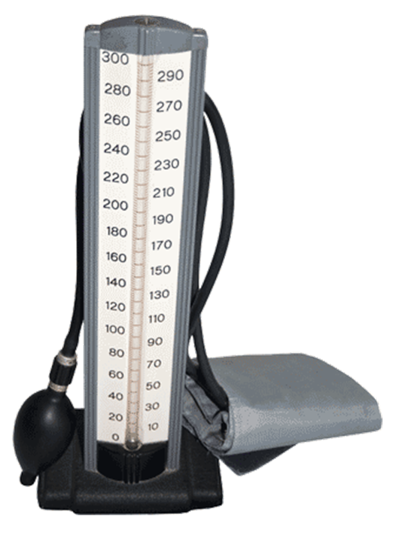
Sounds can be heard because the blood flows violently causing audible sounds.
When the artery is fully open, the blood flows freely and the sounds disappear.
The first sounds that are heard indicate systolic pressure (top number).
When the sounds stop, diastolic pressure has been reached (bottom number).
Average blood pressure is:
120/80

Slide 11
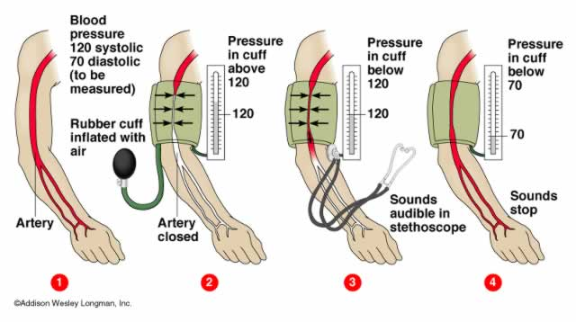

Slide 12
