Slide 1
Microhematocrit {Hct}= {Packed cell Voulum PCV}
Hematocrit is the ratio of the total volume of RBC’s to that of whole blood expressed as percentage(%) (whole blood = total volume of cells + plasma).
The second synonym for hematocrit is PCV (Packed Cell Volume).

Slide 2
Principle
The procedure is easy to perform, whole blood is centrifuged in a narrow tube (capillary tube directly from a finger prick, to a heparin coated capillary tube.)
cellular elements will be separated from the plasma, after centrifugation blood will be separated into 3 layers :

Slide 3
Principle

Slide 4
Apparatus and Materials:
1- Microhematocrit centrifuge.
2- Modeling clay (seal material).
3- Capillary tubes (7 cm long, 1mm diameter)
4- Hematocrit measuring device reader or a conventional ruler.

Slide 5
Procedure:
1- Fill the capillary tube with blood by capillary attraction. Either from freeflowing finger punctured by a sterile lancet/ or from a well mixed anticoagulated
whole venous blood (this requires only few microliters of blood).
2- Seal with the modeling clay the empty end of the capillary tube.

Slide 6
Procedure:
3- Place and position the capillary tube in the radial grooves of the
microhematocrit centrifuge with the sealed end away from the center (pointed toward the outside).
4- Centrifuge for 5 minutes at 10000 rpm .

Slide 7
Procedure:
5- The height of the RBC column, and the total column should be measured with the aid of a ruler in cm and mm, then divide the RBC column height over the
total column height
(total height = RBC column + buffy coat + plasma column).
6- Express the results in percentage (%).

Slide 8
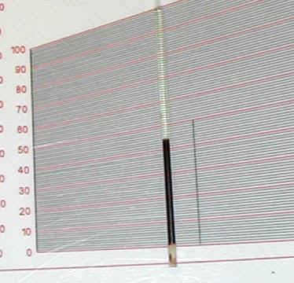
Buffy coat is the layer where WBC’s and Platelets are collected to, after centrifuging a whole blood sample, this is the middle whitish-tan colored layer.

Slide 9
Reference intervals:
-Males : 40 - 53%
Females : 37 - 47%
Newborns: 51 - 60%
Children : 34 - 49%

Slide 10
Reference intervals:
Nowadays, Hct is supplied by the widely used automated hematology analyzers. But this Hct is calculated rather than measured, these analyzers are not equipped with centrifuges,

Slide 11
PCV
RBCs =---------------- *10⁶
6
PCV
Hb =--------------- gm/100 cc
3

Slide 12
NOTE
↑ PCV with normal condition in pregnancy due to {↑body fluid in pregnant woman lead to ↑ plasma volume }.
↑ PCV in case of polycythemia and loosing fluid such as diarrhea ,barns ,vomiting.
↓PCV in Anemia and bleeding.

