Slide 1

Richardson Number
Basim ALknani

Slide 2
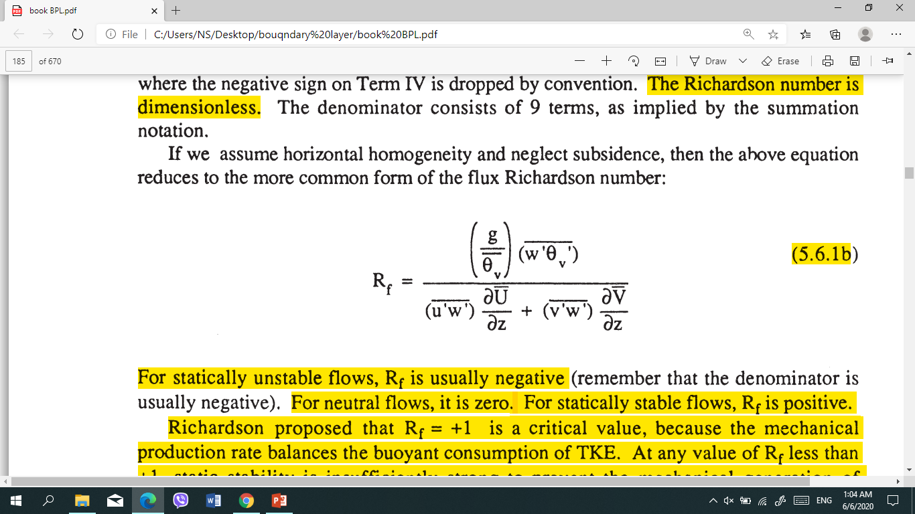
Flux Richardson Number
In a statically stable environment, turbulent vertical motions are acting against the restoring force of gravity. Thus, buoyancy tends to suppress turbulence, while wind shears tend to generate turbulence mechanically. The buoyant production term of the TKE budget equation is negative in this situation, while the mechanical production term is positive. the ratio of The buoyant production term to the mechanical production term . This ratio, called the flux
Richardson number, Rf, is given by
The Richardson number is dimensionless.
For statically unstable flows, Rf is usually negative . For neutral flows, it is zero. For statically stable flows, Rf is positive. Richardson proposed that Rf = + 1 is a critical value, because the mechanical production rate balances the buoyant consumption of TKE.
flow is turbulent (dynamically unstable) when Rf < +1
Flow become laminar (dynamically stable) when Rf > +1

Slide 3
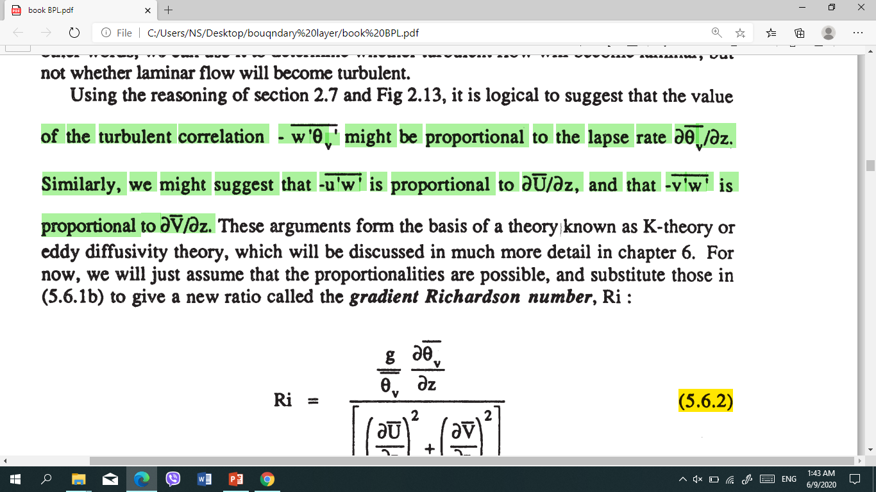

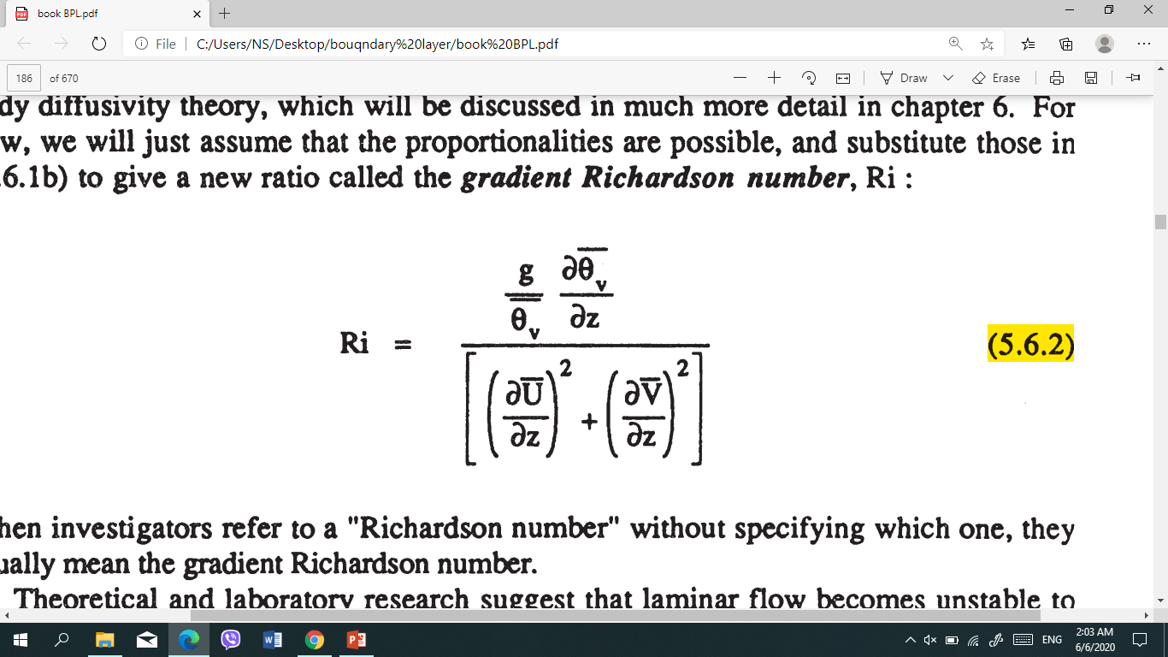
Gradient Richardson Number
we can use it to determine whether turbulent flow will become laminar. but not whether laminar flow will become turbulent. suggest that the value
When investigators refer to a "Richardson number" without specifying which one. They usually mean the gradient Richardson number.
critical Richardson number Rc and RT indicates the termination of turbulence.
The dynamic stability criteria can be stated as follows:
Laminar flow becomes turbulent when Ri < Rc.
Turbulent flow becomes laminar when Ri > RT
the correct values of Rc and RT it appears that Rc =0.21 to 0.25 and RT = 1.0
KH wave formation is Ri < Rc
wave begins to "roll up" or "break". This "breaking" wave is called a Kelvin-Helmholtz (KH) wave ,

Slide 4
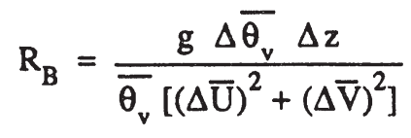
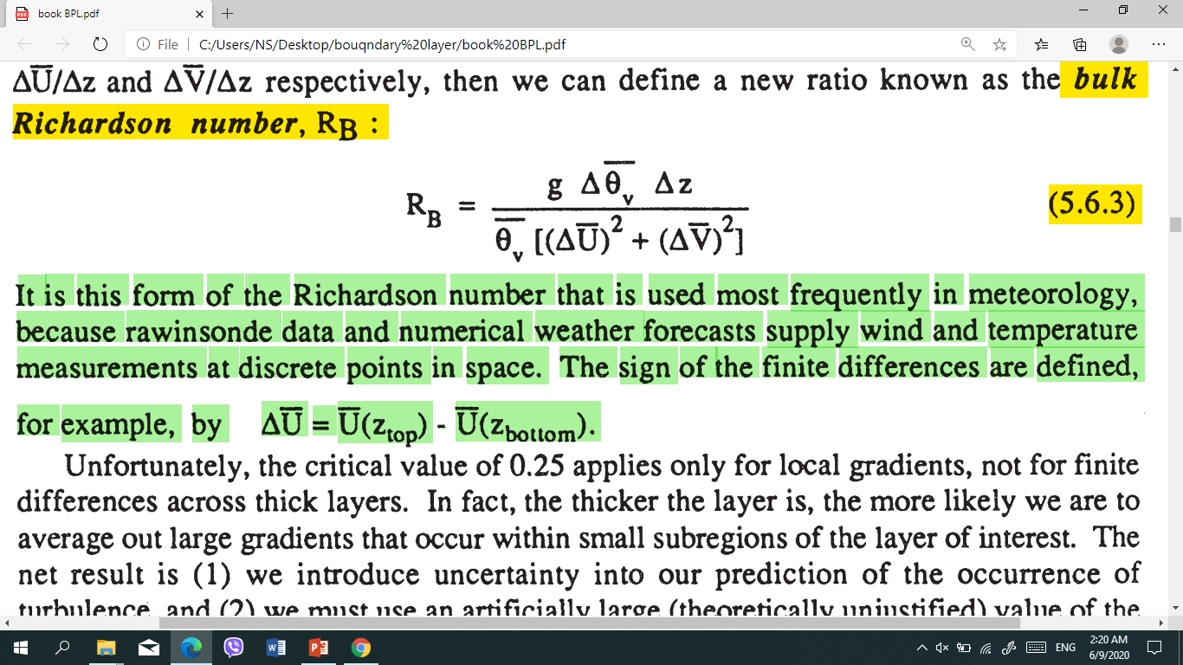
Bulk Richardson number, RB
the Richardson number itself says nothing about the intensity of turbulence, only about the yes/no presence of turbulence.

Slide 5
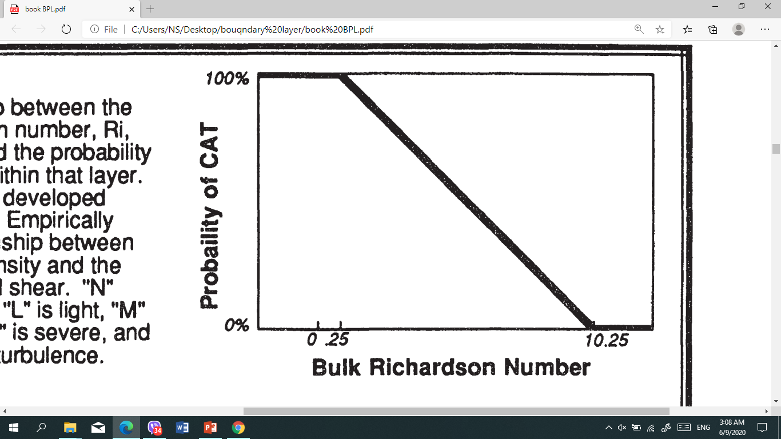
Relationship between the bulk Richardson number, Ri, over a layer and the probability of turbulence within that layer.

Slide 6
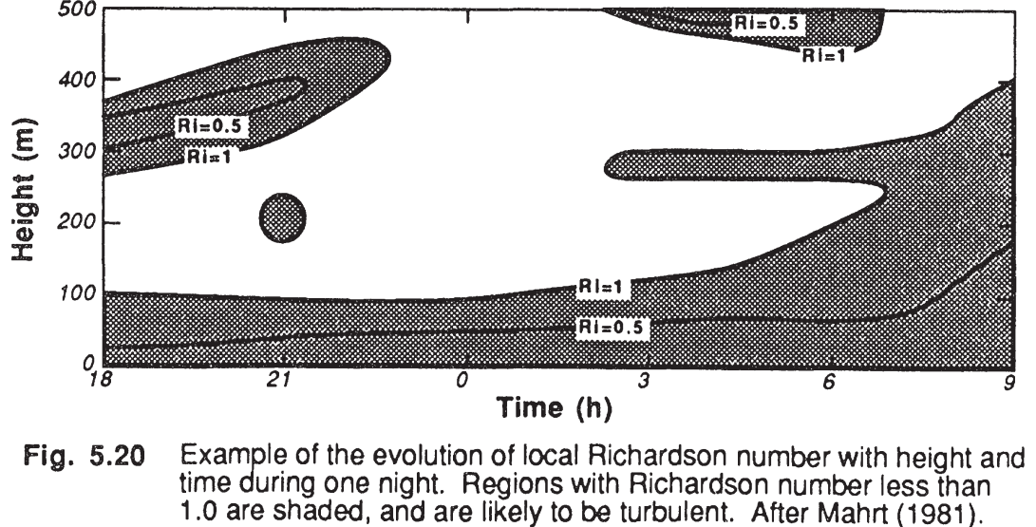

Slide 7
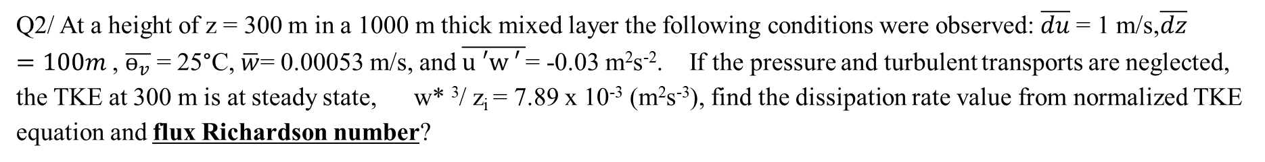
Q1)
Calculate the bulk Richardson number for the measured wind speed at 0.1 Km height is equal to 6 m/s, while the measured wind speed at 0.2 Km height is equal to 7.5 m/s and the average decreases temperature with height at the constant rate of 27 ℃/km.
Q) How many methods to measure stability? Explain with equations.
Q2/ At a height of z = 300 m in a 1000 m thick mixed layer the following conditions were observed: $\overline{du}$ = 1 m/s,$\overline{dz}=100m$ , $\overline{ɵ_{v}}$ = 25°C, $\overline{w}$= 0.00053 m/s, and $\overline{u ′w ′ }$= -0.03 m²s⁻². If the pressure and turbulent transports are neglected, the TKE at 300 m is at steady state, w* ³/ z_{i} = 7.89 x 10⁻³ (m²s⁻³), find the dissipation rate value from normalized TKE equation and flux Richardson number?

Slide 8
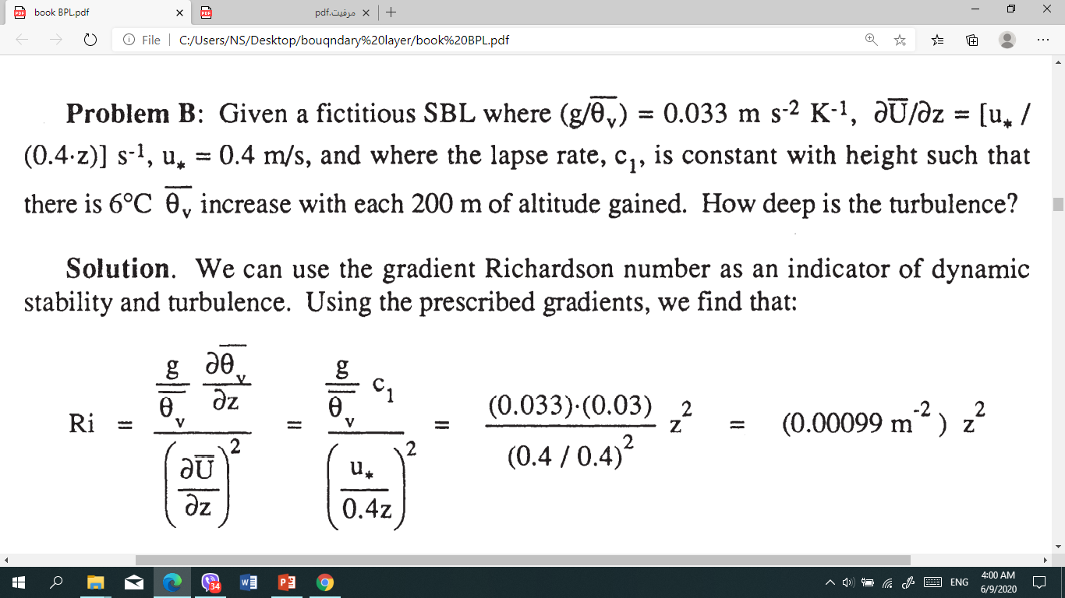
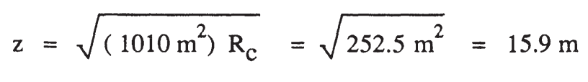
Thus, below 15.9 m we expect turbulence, while above 31.8 m we expect laminar flow

