Slide 1

Turbulence kinetic energy (TKE) budget equation
Basim ALknani

Slide 2
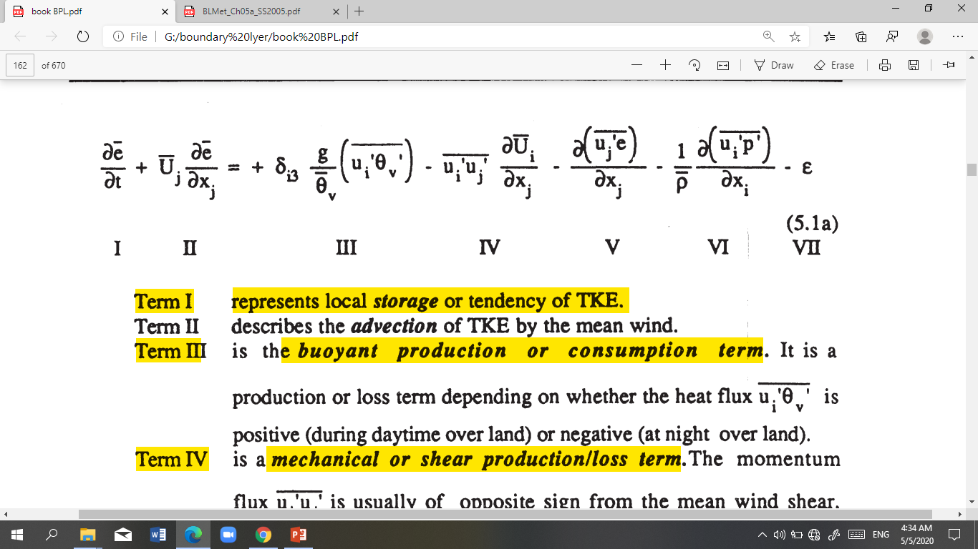
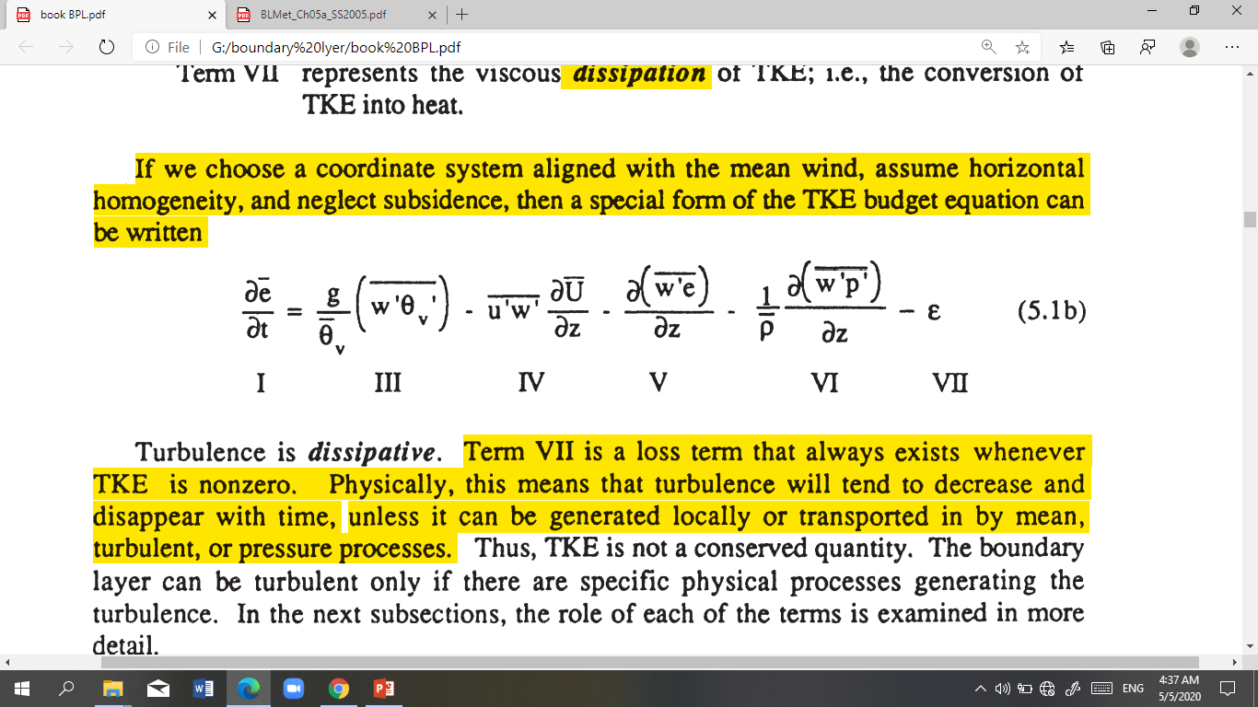
Turbulence kinetic energy (TKE) budget equation
The individual terms in the TKE budget equation describe physical processes that generate turbulence. The relative balance of these processes determines the ability of the flow to maintain turbulence or become turbulent and thus indicates flow stability.
If we choose a coordinate system aligned with the mean wind, assume horizontal homogeneity, and neglect subsidence, then a special form of the TKE budget equation can be written

Slide 3

Term I represents the rate-of-change of TKE or represents local storage
Term III is the buoyant production or consumption term, It is a production or loss term depending on whether the heat flux is positive (during daytime over land) or negative (at night over land).
Term IV is a mechanical or shear production/loss term. The momentum flux is usually of opposite sign from the mean wind shear, because the momentum of the wind is usually lost downward to the ground.
Term V is the turbulent transport of TKE. It describes how TKE is moved around by the turbulent eddies
Term VI is the pressure correlation term that describes how TKE is redistributed by pressure perturbations.
Term VII represents the viscous dissipation of TKE. Term VII is a loss term that always exists whenever TKE is nonzero.

Slide 4
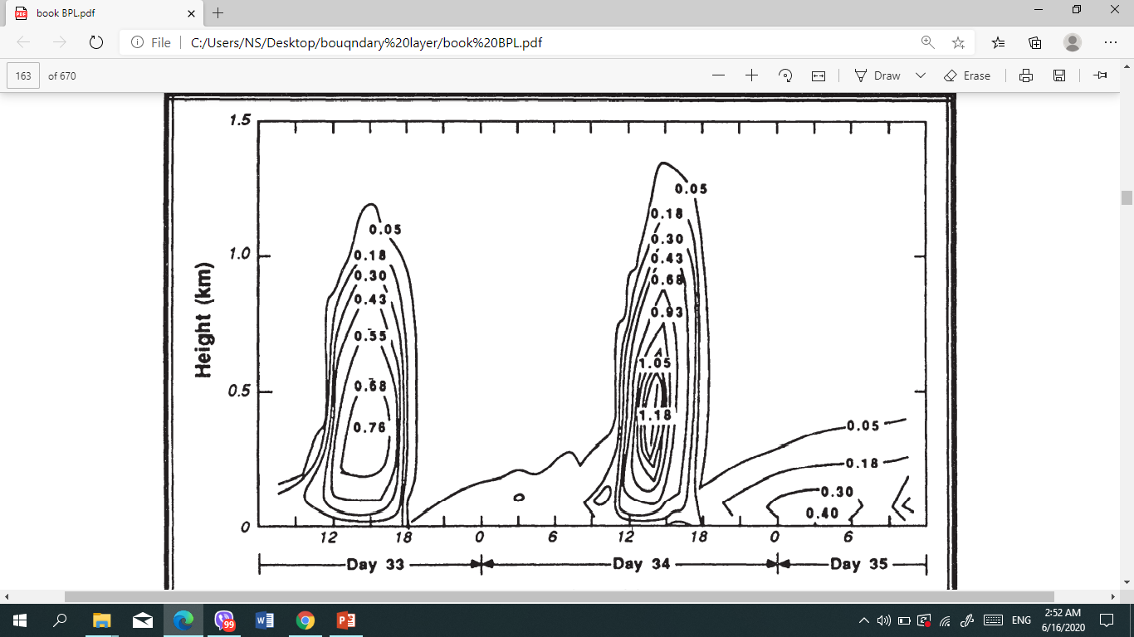
Contributions to the TKE
1- Term Storage
Fig 5.1 shows a simulation of TKE over a two day period, where a dramatic increase and decrease of TKE occur within each diurnal cycle. An increase in TKE from a small early morning value to a larger early afternoon value represents net storage of TKE in the air. In particular, nonturbulent FA air just above the ML top must be spun up.
The storage term is thus negative during this transition phase.

Slide 5
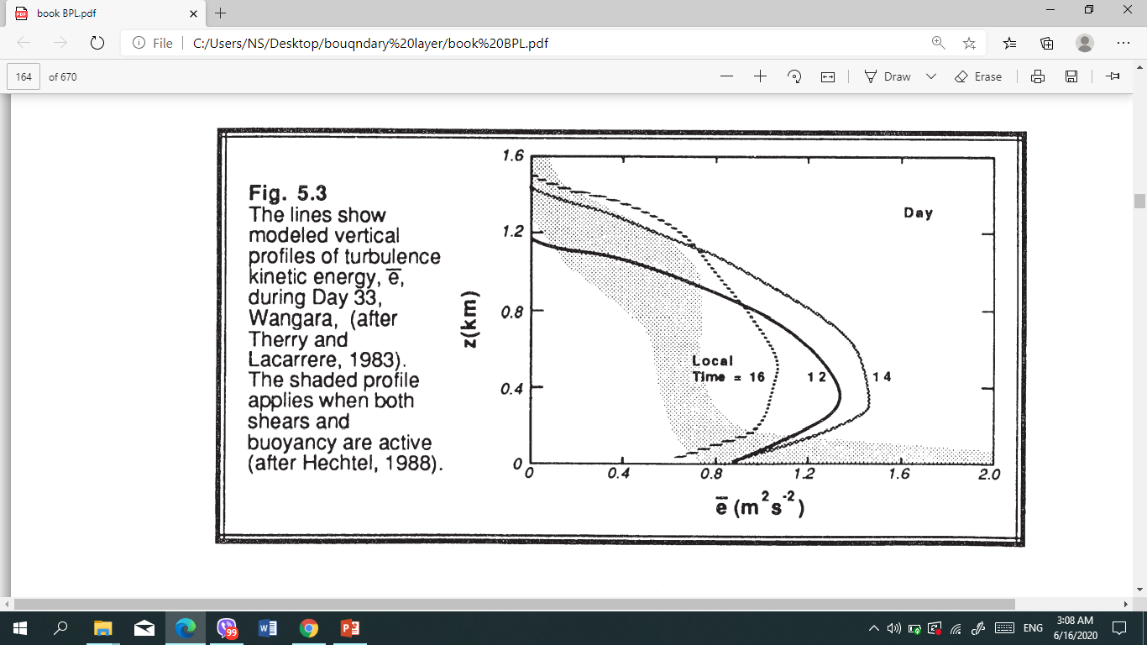
TKE can sometimes increase to a maximum with a height when free convection dominates.
At night, the TKE often decreases very rapidly with height.
Over surfaces such as oceans, the storage term is often so small that it can be neglected (i.e., steady state can be assumed). This is not to say that there is no turbulence, just that the intensity of turbulence is not changing significantly with time.
Fig. The lines show modeled vertical profiles of turbulence kinetic energy, e, during Day 33, The shaded profile applies when both shears and buoyancy are active .

Slide 6
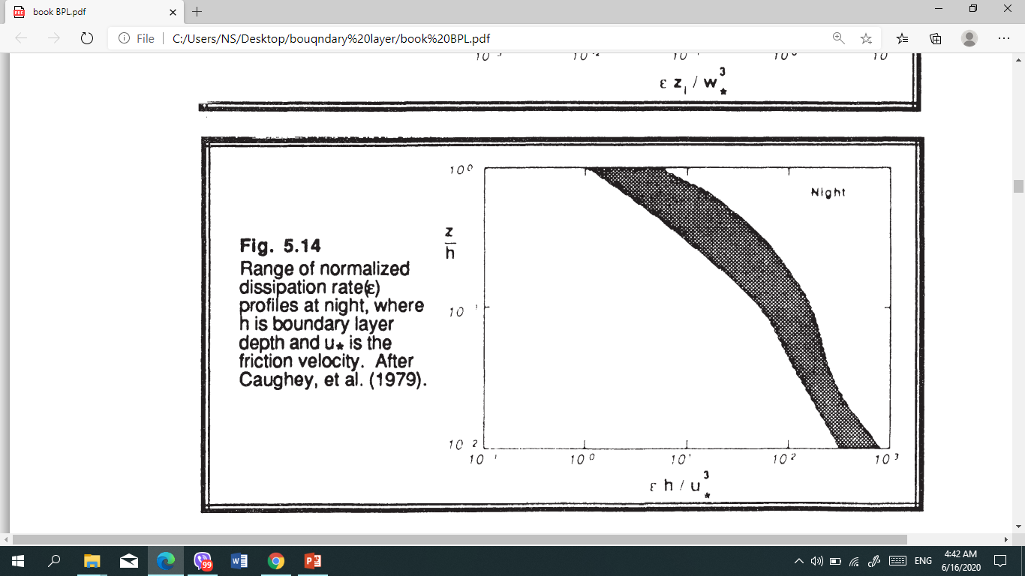
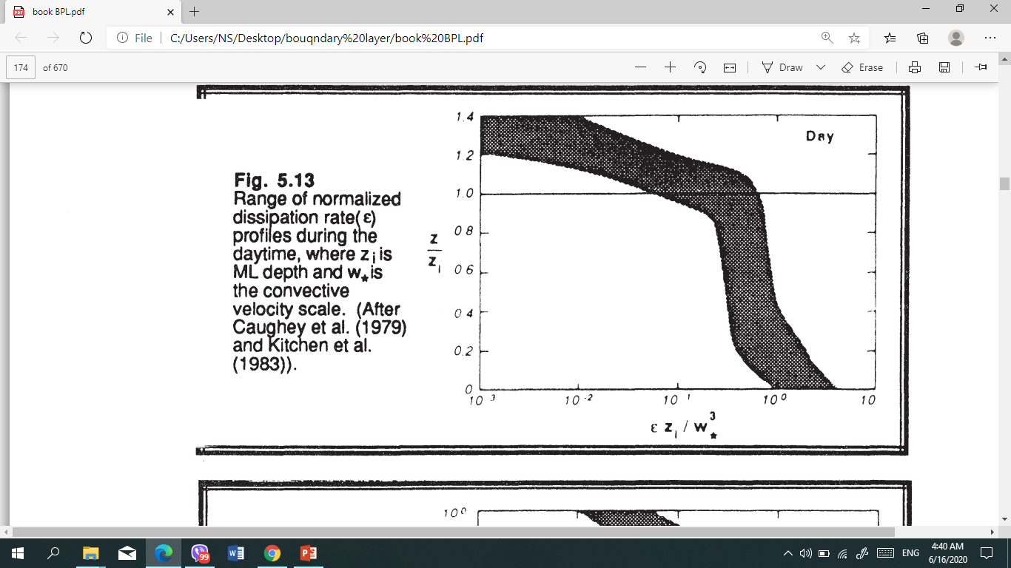
2- Term VII: Dissipation
Molecular destruction of turbulent motions is greatest for the smallest size eddies (when small-scale turbulence, the rate of dissipation is greater). Daytime dissipation rates (Fig 5.13) are often largest near the surface, and then become relatively constant with height in the ML. Above the ML top, the dissipation rate rapidly decreases to near zero. At night (Fig 5.14), both TKE and dissipation rate decrease very rapidly with height.
the TKEs and dissipation rate are the largest - near the surface.
Fig. 5.13 Range of normalized dissipation rate profiles at night. where h is boundary layer depth and u* is the friction velocity
Fig. 5.14 Range of normalized dissipation rate profiles during the daytime. where zi is ML depth and w*is the convective

Slide 7
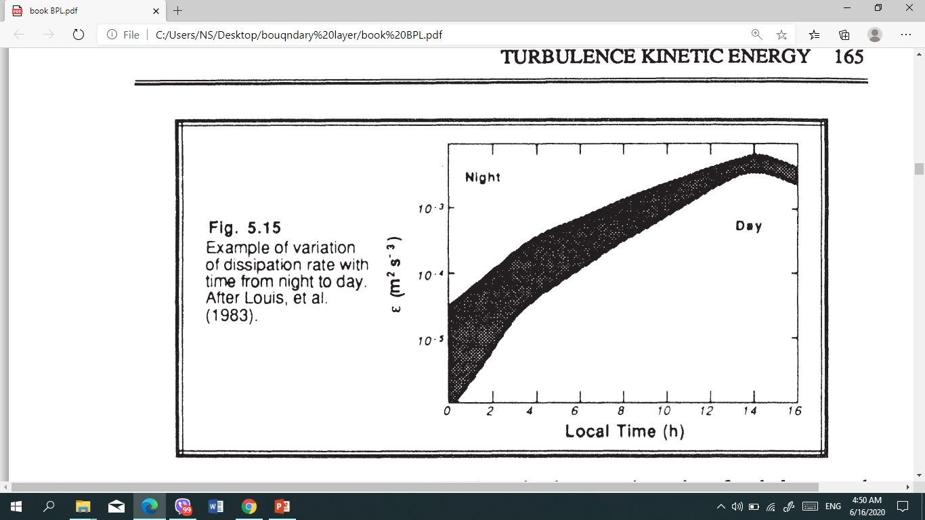
Fig 5.15. At night where only shear can produce turbulence, the dissipation rate is small because the associated TKE is small After sunrise, buoyant production greatly increases the turbulence intensity, resulting in the associated increase in dissipation

Slide 8
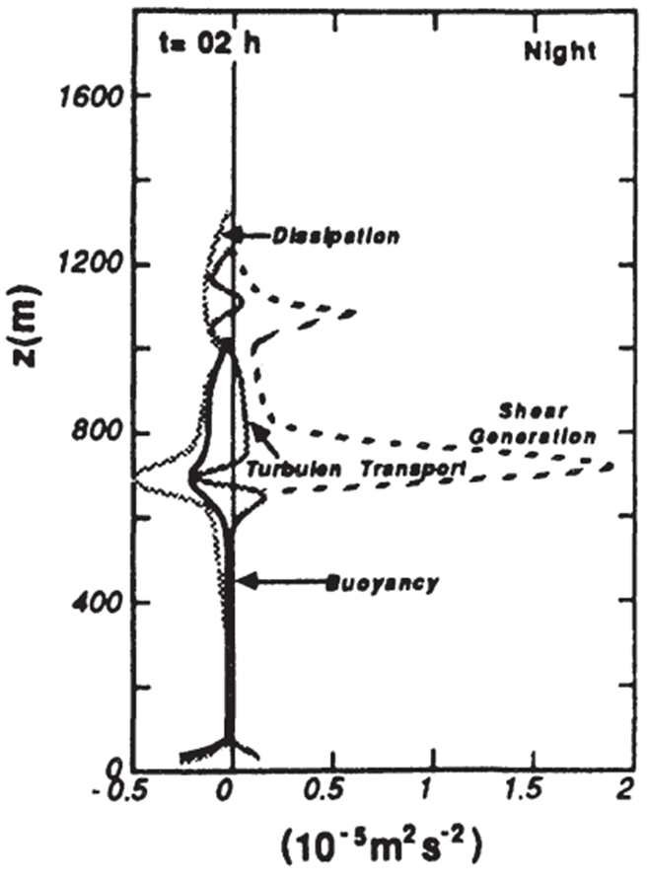
3- Buoyant Production/Consumption
Near the ground, term III is large and positive, corresponding to a large generation rate of turbulence whenever the underlying surface is warmer than the air. this term represents the effects of thermals in the ML. It's with sunny days overland, or cold air advection over a warmer underlying surface, it can be larger. For cloudy days over land, it can be much smaller.
The buoyancy term acts only on the vertical component of TKE. Hence. this production term is anisotropic (not isotropic).
Static stability thereby tends to suppress or consume TKE, (negative values of term III), Such conditions are present in the SBL at night over land. or anytime the surface is colder than the overlying air. An example of the decay of turbulence in negatively buoyant conditions just after sunset is shown in the figure.

Slide 9
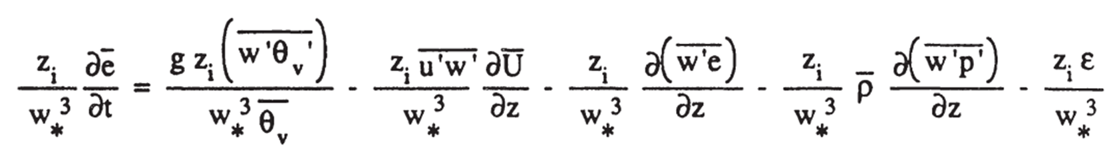
Equations that are made dimensionless by dividing by scaling parameters are said to be normdized.

Slide 10
4- Mechanical (Shear) Production
A negative sign precedes Term IV. the momentum flux is usually of opposite sign from the mean shear. resulting in production not loss of turbulence.
The greatest wind shear magnitude occurs at the surface (the maximum shear production rate also occurs there).
the wind speed frequently varies little with height in the ML above the surface layer. resulting in near zero shear and near zero shear production of turbulence.
A smaller maximum of shear production sometimes occurs at the top of the ML because of the wind shear across the entrainment zone.
The relative contributions of the buoyancy and shear terms can be used to classify the nature of convection .
Free convection scaling is valid when the buoyancy term is much larger than the mechanical term,
forced convection scaling is valid when the opposite is true.
Magnitudes of the shear production term in the surface layer are obviously greatest on a windy day, and are small on a calm day. In synoptic-scale cyclones the strong winds and overcast skies suggest that forced convection is applicable. At night over land, or anytime the ground is colder than the air, the shear term is often the only term that generates turbulence.
Both the buoyant and shear production terms can generate anisotropic turbulence. The difference is that shear generation produces turbulence primarily in the horizontal directions (V and U) components, while buoyant generation produces it primarily in the vertical direction.

Slide 11
5-Turbulent Transport
)w'e( represents the vertical turbulent flux of TKE. depending on whether there is a flux convergence or divergence.
(Term V) neither creates nor destroys TKE, it just moves or redistributes TKE from one location in the BL to another.
Stability Concepts
Unstable flows become or remain turbulent. Stable flows become or remain laminar.
There are many factors that can cause laminar flow to become turbulent, and other factors that tend to stabilize flows.
The static stability is determined by the local lapse rate

Slide 12

Static Stability and Convection
Static stability is a measure of the capability for buoyant convection. The word "static" means "having no motion"; hence this type of stability does not depend on wind. Air is statically unstable when less-dense air (warmer and/or moister) underlies more dense air.
It is better to examine the stability of the whole layer, and make a layer determination of stability ,For example,
If at the earth's surface is positive, or if displaced air parcels will rise from the ground y or sink from cloud top as thermals traveling across a BL, then the whole BL is said to be unStable or Convective.
If is negative at the surface, or if displaced air parcels y return to their starting point, then the BL is said to be Stable if the buoyancy term is near zero, then the boundary layer is said to be Neutral. In overcast conditions with strong winds but little temperature difference between the air and the surface, the BL is often close to neutral stability.
In some of the older literature, the boundary layer of this latter case is also sometimes referred to as an Ekman boundary layer. During fair weather conditions over land, the BL touching the ground is rarely neutral. Neutral conditions are frequently found in the RL aloft. In overcast conditions with strong winds but little temperature difference between the air and the surface, the BL is often close to neutral stability.
dynamic Stability The word "dynamic" refers to motion; hence, dynamic stability depends in part on the winds. Even if the air is statically stable, Wind shears may be able to generate turbulence dynamically.

Slide 13
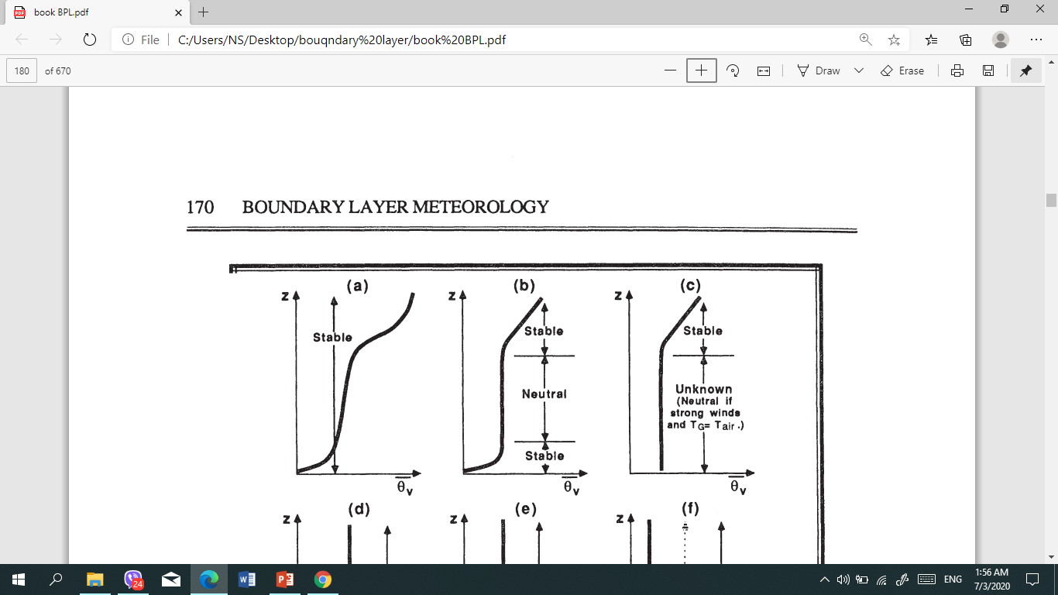
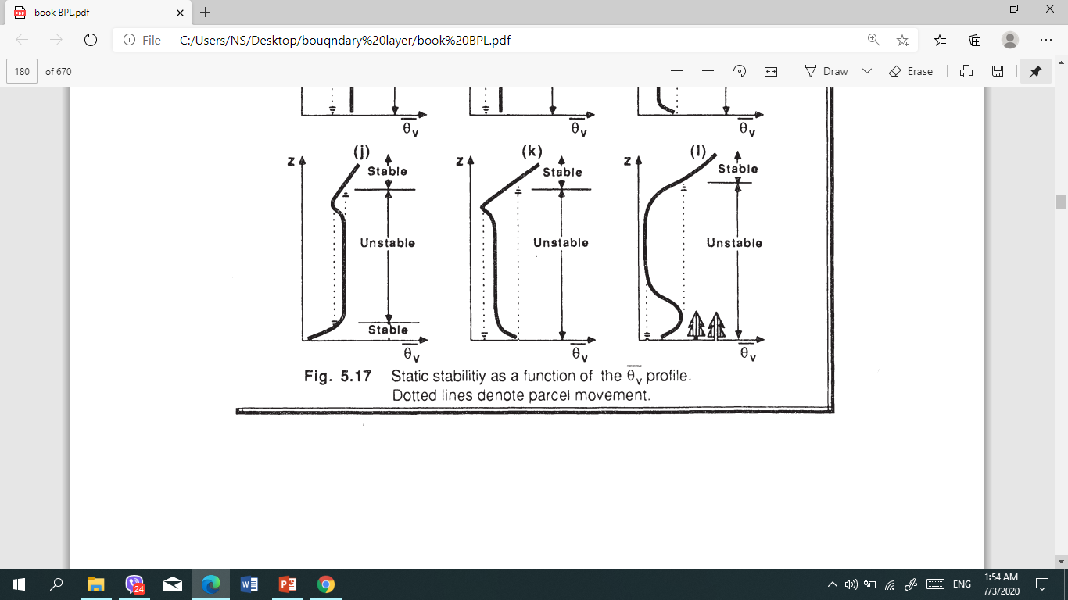
As an example, in the middle 50% of the convective ML the lapse rate is nearly adiabatic, causing an incorrect classification of neutral stability

Slide 14
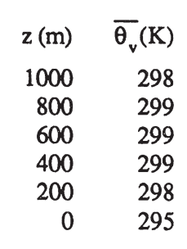
Kelvin-Helmholtz (KH) wave is wave begins to "roll up" or "break". This "breaking" wave is called a Kelvin- Helmholtz (KH) wave , These waves are frequent occurrence within statically stable shear layers
Clear - Air Turbulence (CAT) These often occur above and below strong wind jets, such as the nocturnal jet and the planetary-scale jet stream. In these situations, continued dynamic forcing's can allow turbulence to continue for hours to days. These regions of CAT have large horizontal extent (hundreds of kilometers in some cases), but usually limited vertical extent (tens to hundred of meters).
Home work
Q1) From data radio sound, identify the static stability of the air at z = 200 m , 400 m and 1000 m ?

Slide 15
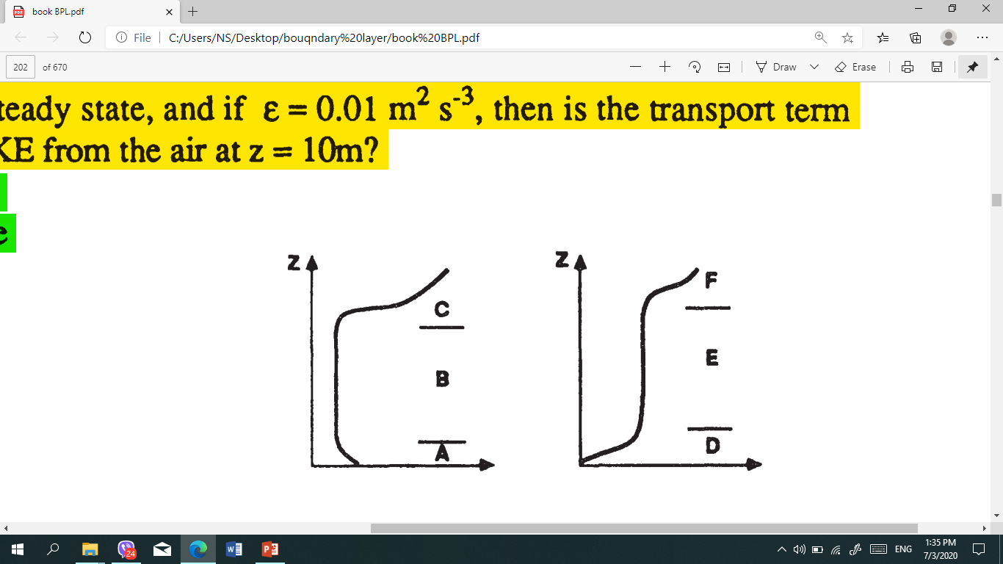
Q2) What is the static stability of each of the layers in the diagram at right?

