Slide 1
Advanced Agro-Hydro- Meteorology A MSc course for students of Atmospheric Sciences Dr. Thaer Obaid Roomi 2021-2022 Lecture 3: Precipitation (Part 2)

Slide 2
3.1 Precipitation systems
 | Precipitation system | Description | Horizontal scale (km) | Vertical velocity (cm s⁻¹)
1 | Localized convection | Precipitation from single clouds or from convective cells within larger scale systems. They may occupy a large depth of the atmosphere, in which case they are referred to as thunderstorms | 10^{0.5} | 10²
2 | Mesoscale precipitation area (MPA) | Cluster of convective cells | 10^{1.5} | 10
3 | Mesoscale rain band | Convective cells occurring in lines, sometimes almost two‐dimensional | Width 10^{1.5} Length 10² | 10
4 | Synoptic scale precipitation systems | Mid‐latitude depressions | Width 10² Length 10³ | 1
5 | Tropical storms | Known as hurricanes in the southern part of the North Atlantic, cyclones in the northern part of the Indian Ocean, typhoons in the southwestern part of the North Pacific, and willy-willies in the north‐east of Australia | Radius 10^{1.5} | 10²

Slide 3
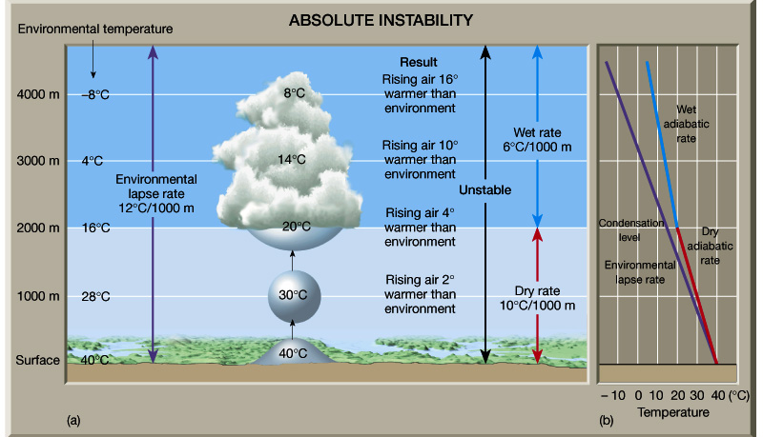
3.1.1 Localized Convection
If the atmosphere is unstable → vertical motion will occur→ condensation of water vapor →formation of cloud.

Slide 4
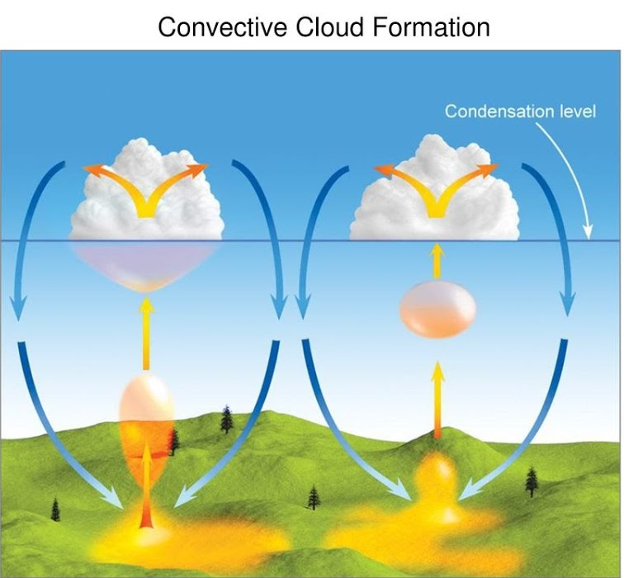
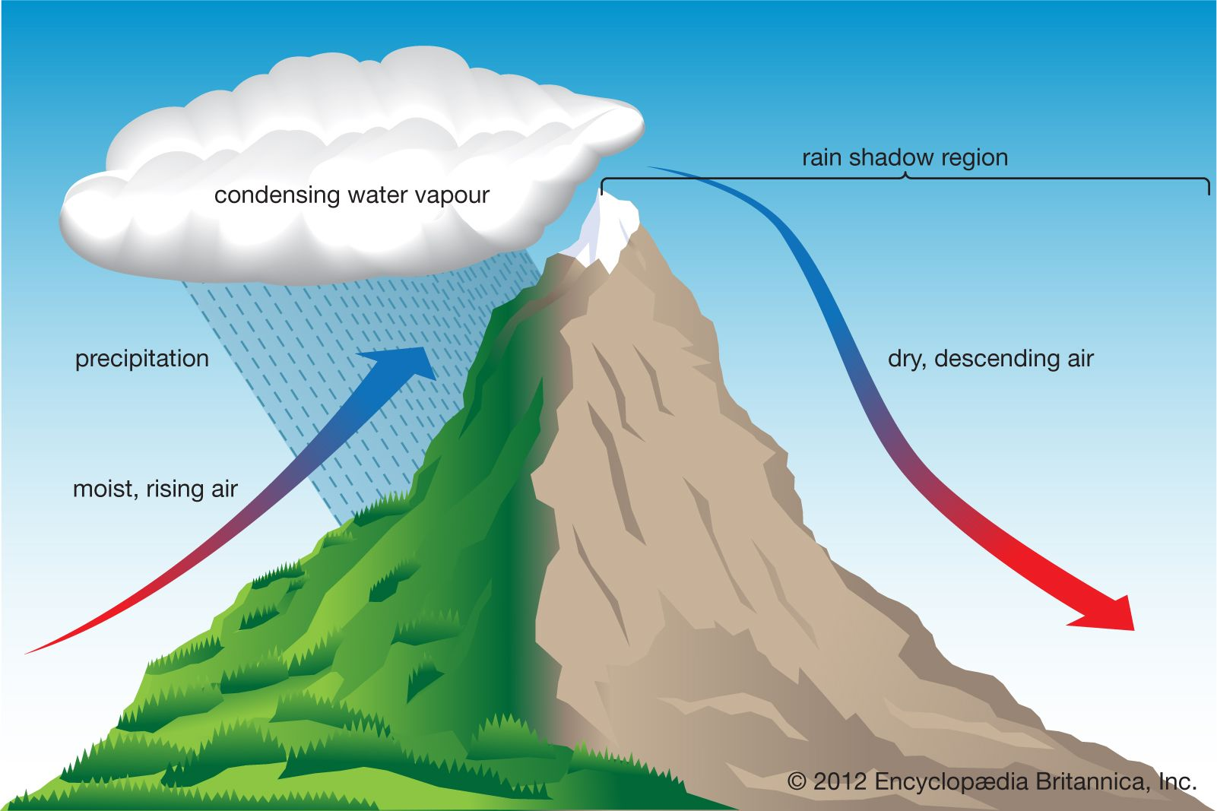
The development of convection may be controlled either by boundary layer characteristics (microscale) or by atmospheric synoptic situations.
The same effect may be produced by air forced to rise over hills.
Such clouds grow to a height of several kilometers in 20–40 minutes, producing rain of intensity dependent upon the depth of the cloud.

Slide 5
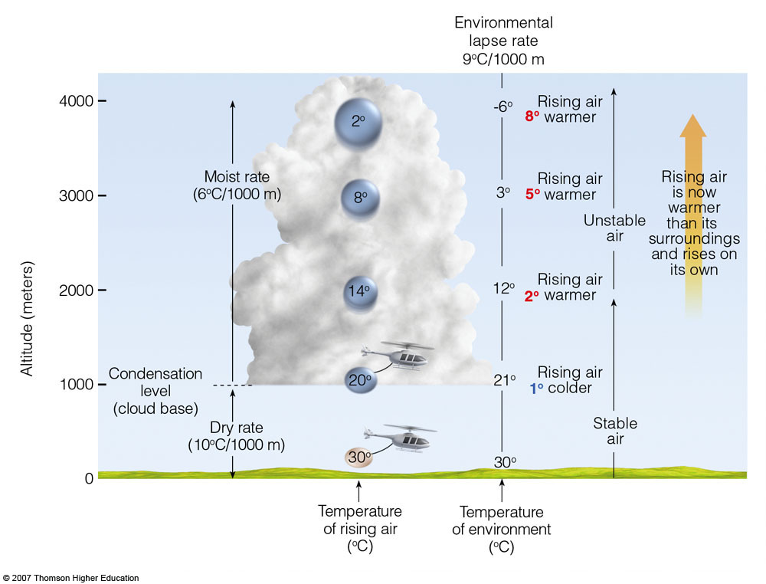
The vertical velocity will be dependent upon the difference between the environmental lapse rate and the SALR. If this difference is large, then the vertical motion will be large, and a small shower cloud may develop rapidly to a height of around 10 km, becoming a thunderstorm (mostly with lightning).

Slide 6
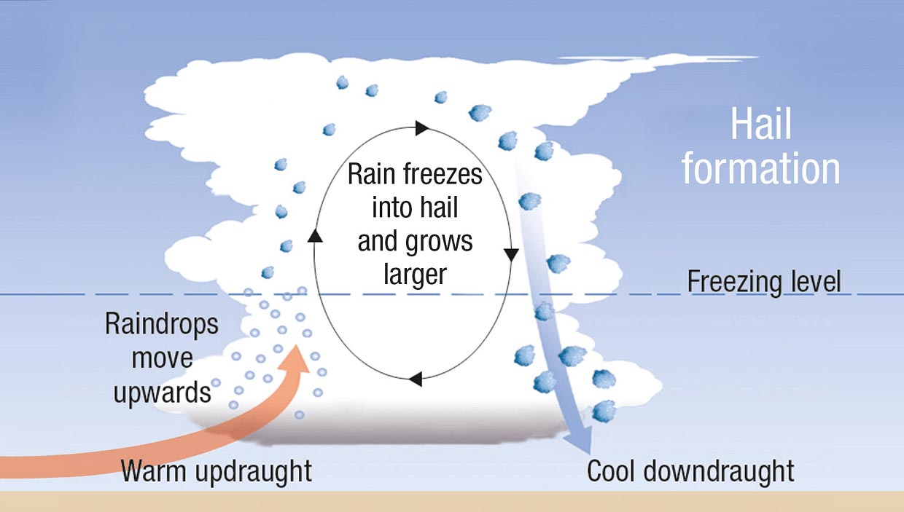
Within thunderstorms, hail may be produced by precipitation particles sweeping up supercooled droplets in an updraught until they are of such a size that they fall out of the updraught.

Slide 7
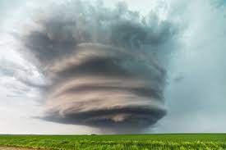
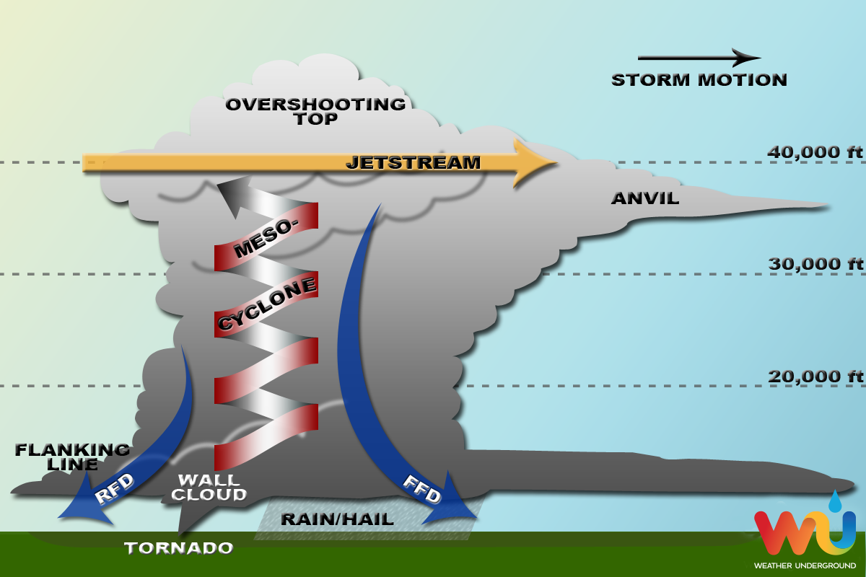
Main types of thunderstorms
multi‐cell storms : several cells (clouds) at different stages of development at any one time
New cells may form where the outflow regions from other cells intersect. The air of the downdraught spreads out laterally.
2. Supercell storms. single storm‐scale circulation comprising one giant updraught–downdraught pair.
Either of these types of storm may produce a tornado (a region a few kilometers wide, high rotation (about 300 km/h) and low pressure visualized as a funnel cloud.

Slide 8
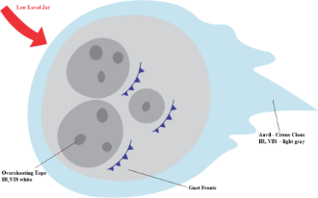
3.1.2 Mesoscale precipitation systems
Several thunderstorms may be grouped together within a mesoscale convective complex (MCC).
The timescale of individual cumulonimbi > 1hour.
A typical timescale of an MCC in mid‐latitudes is around three hours.
The precipitation area is continuous and larger than precipitation from any individual storm.
In the early stages of development the MCC is very convective, and the rainfall is dominated by that produced by the individual cells.

Slide 9
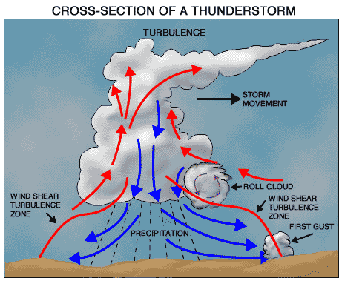
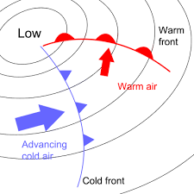
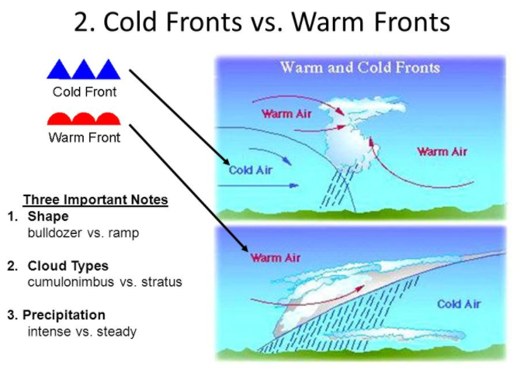
3.1.3 Mid‐latitude depressions
Although thunderstorms produce large amounts of rainfall in mid‐latitudes at any one place, they are quite rare.
Most of the rainfall originates from low pressure systems termed depressions.
Rain from stratiform (layered) cloud is associated with the warm front, and rain from convective cloud and thunderstorms is associated with the cold front.

Slide 10
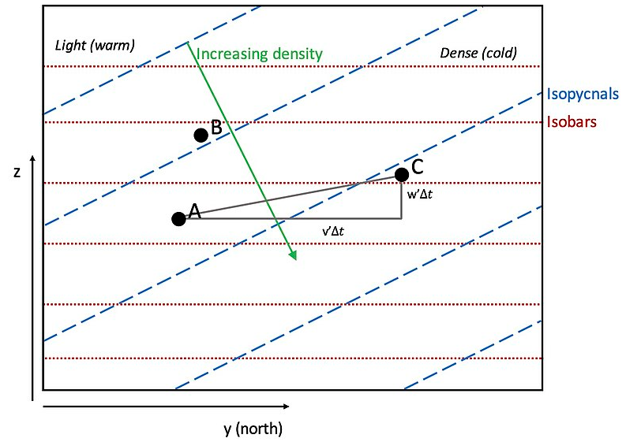
The basis of a dynamical description of the depression is the release of energy in sloping (baroclinic) convection.

Slide 11
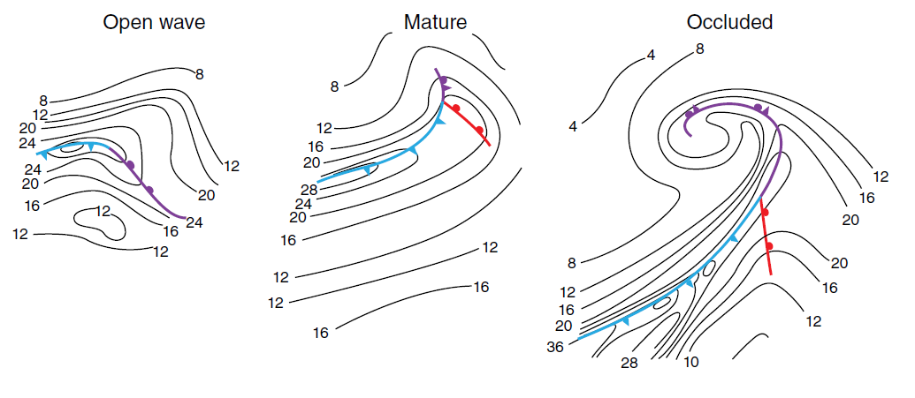
Figure 3.2 shows the lifetime of a depression based upon microwave radiometer data from an open wave through a mature stage to an occluded stage.

Slide 12
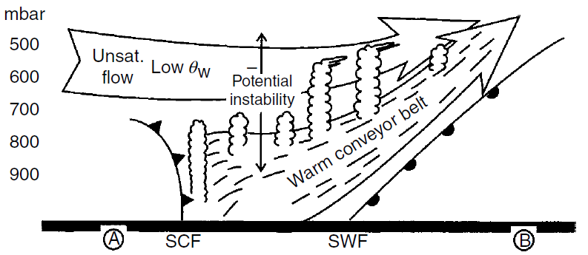
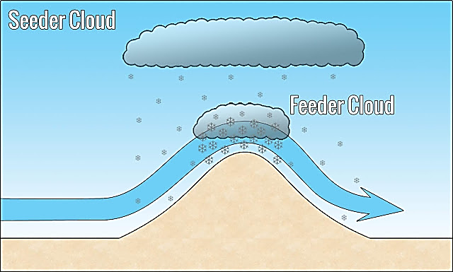
The dry air behind the cold front often overrides the warm conveyor belt (WCB) in the region. This causes the air to become unstable if it is ascending, with the result that convection is released in small cells at mid‐levels known as generating cells.
These cells tend to occur in clusters and give rise to mesoscale precipitation areas (MPAs) The rainfall is produced by what is known as a seeder–feeder mechanism. Ice particles from the generating cells fall into lower level frontal cloud and act as natural seeding particles, causing a rapid growth of precipitation particles.

Slide 13
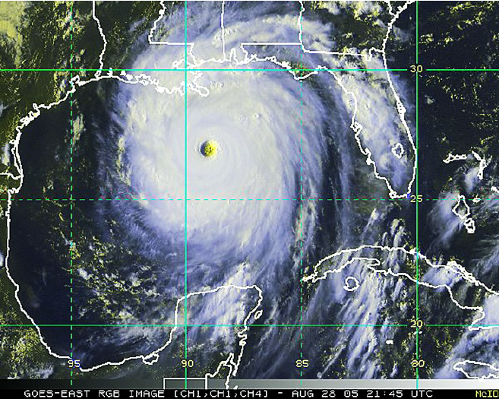
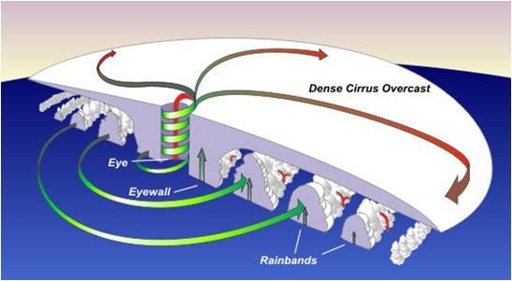
Tropical storms
One favoured area for the formation of tropical cloud clusters is the Inter‐Tropical Convergence Zone (ITCZ) located close to the equator. Here the north‐east trade winds of the northern hemisphere converge with the south‐east trade winds of the southern hemisphere.
A small fraction of clusters develop into hurricanes (cyclones or typhoons). Heavy precipitation occurs in the main cloud band known as the eye wall band and other bands, although lighter precipitation does occur between them.

Slide 14
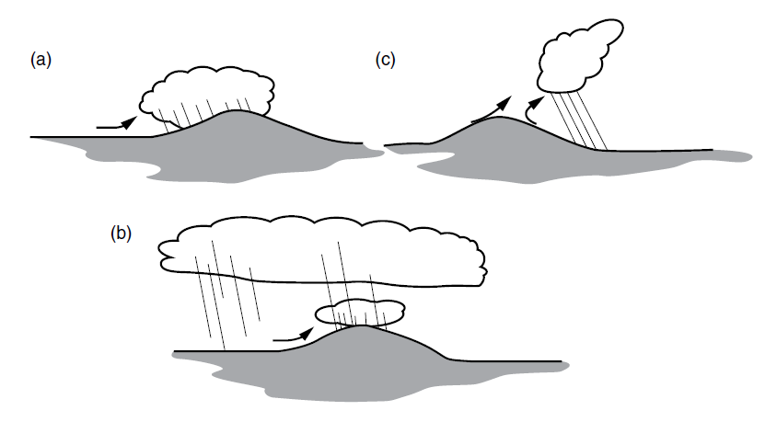
3.2 Orographic effects on precipitation distribution
Orography can affect the distribution of rainfall by forcing air to ascend. The ascent may lead to condensation and rainfall (Figure 3.6a),
or may result in convection leading to rainfall (Figure 3.6b). A third process is the enhancement of rain over hills from pre‐existing clouds as a result of a natural seeding process (Figure 3.6c). Mechanisms (a) and (c) in Figure 3.6 occur in frontal rainfall situations.

Slide 15
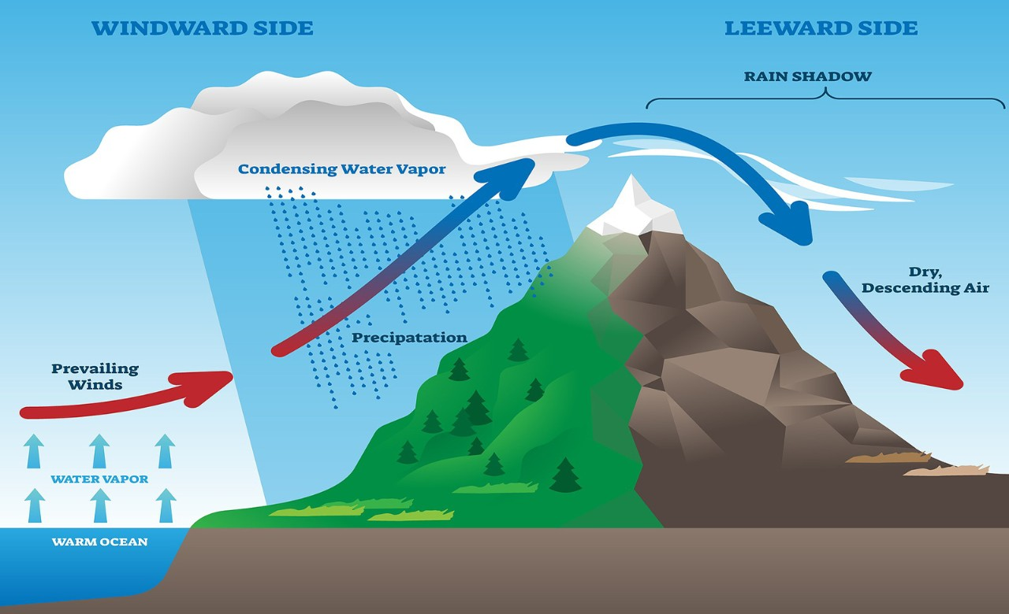
The increase in rainfall over hilly areas is very evident on average annual rainfall maps in mid‐latitudes for areas exposed to moist air moving from the sea. Indeed there is almost a relationship between elevation and average annual rainfall amount, although this relationship does vary spatially. In the lee of ranges of hills, descending air (or subsidence) may lead to reduced rainfall in areas known as rain shadows.

Slide 16
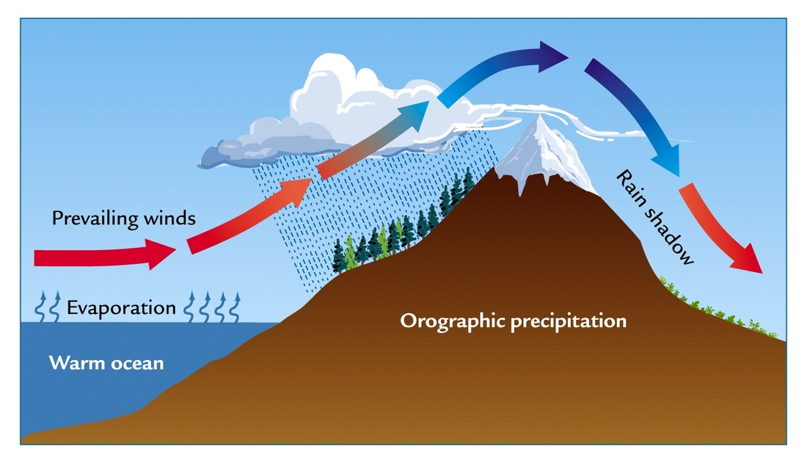
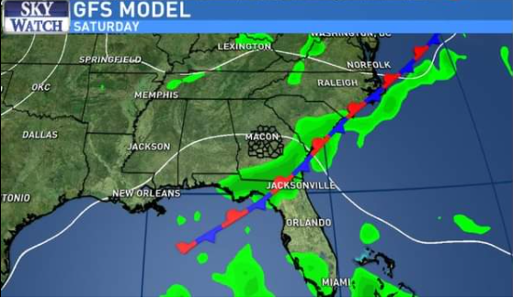
Topographical effects on precipitation distribution
Precipitation amount may be increased in coastal areas by the difference in the convergence of air caused by increased friction over the land compared to that experienced over the sea.
Differences between land and sea can cause fronts associated with mid‐latitude depressions to become stationary just off‐shore, which can lead to very large falls of precipitation in coastal regions, particularly if the land is hilly.

Slide 17
The sea or land breezes (associated with air circulation caused by temperature differences between the land and the sea) may organize convection such that precipitation amounts can be very much enhanced.

Slide 18
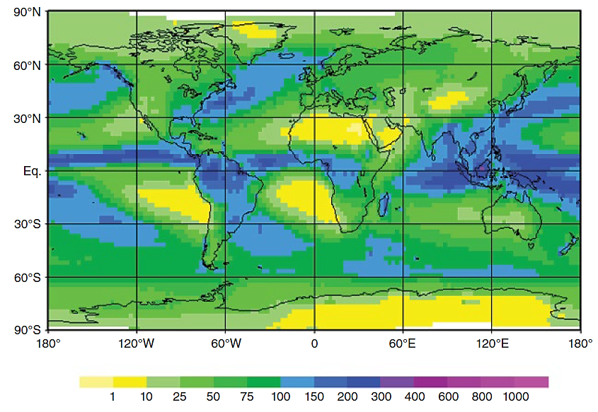
Global atmospheric circulation
The average time that a molecule of water is resident in the atmosphere as vapor or within a cloud is 10-12 days. During this period, the molecule may travel a considerable distance within the atmospheric circulation before being returned to the surface of the Earth as precipitation.
The climatological distribution of annual rainfall can be visualized as in the figure.

Slide 19
The precipitation maxima in mid‐latitudes are associated with depressions, showers and thunderstorms.
In the tropics, the rainfall maximum is associated with cloud clusters and tropical storms.

