Slide 1
Advanced Agro-Hydro- Meteorology
A MSc course for students of Atmospheric Sciences
Dr. Thaer Obaid Roomi
2022-2023
Lecture 2: Precipitation (Part 1)

Slide 2
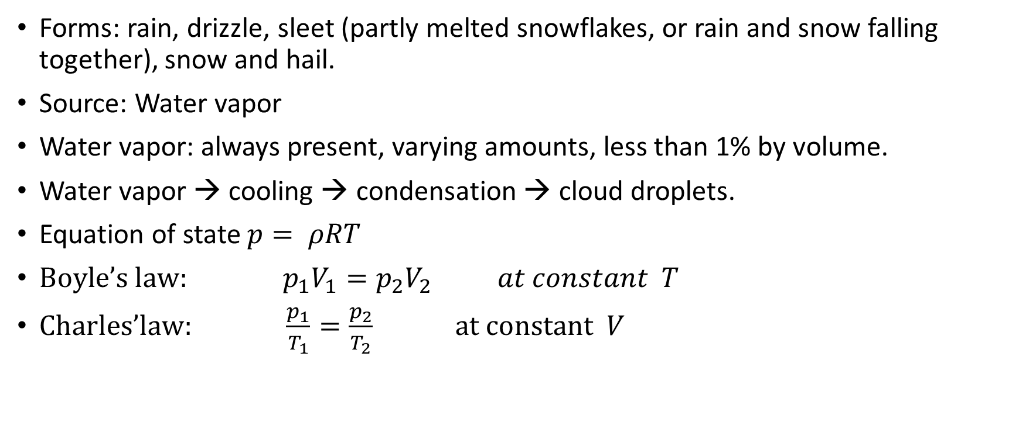
precipitation
Forms: rain, drizzle, sleet (partly melted snowflakes, or rain and snow falling together), snow and hail.
Source: Water vapor
Water vapor: always present, varying amounts, less than 1% by volume.
Water vapor → cooling → condensation → cloud droplets.
Equation of state $p= ρRT$
${Boyle’s law: p}_{1}V_{1}=p_{2}V_{2} at constant T$
$Charles’law: \frac{p_{1}}{T_{1}}=\frac{p_{2}}{T_{2}} at constant V$

Slide 3
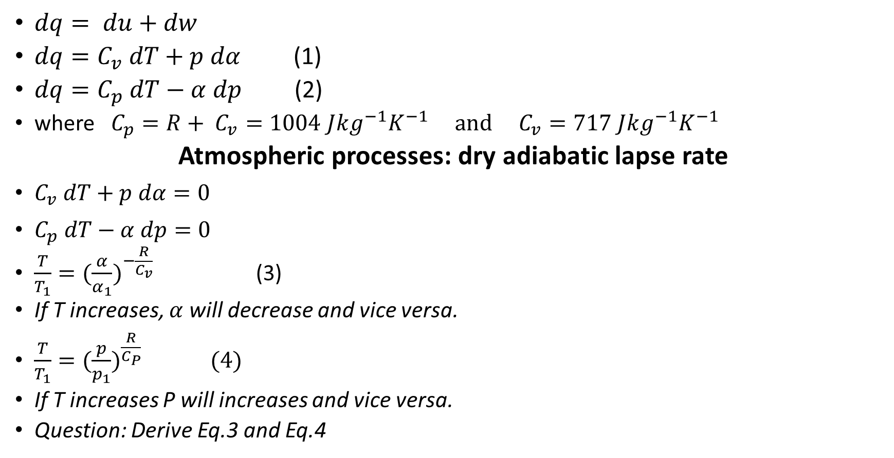
First law of thermodynamics
$dq= du+dw$
$dq=C_{v} dT+p dα$ (1)
$dq=C_{p} dT−α dp$ (2)
where $C_{p}=R+ C_{v}=1004 Jkg^{−1}K^{−1} and C_{v}=717 Jkg^{−1}K^{−1}$
Atmospheric processes: dry adiabatic lapse rate
$C_{v} dT+p dα=0$
$C_{p} dT−α dp=0$
$\frac{T}{T_{1}}=(\frac{α}{α_{1}})^{−\frac{R}{C_{v}}}$ (3)
If T increases, $α$ will decrease and vice versa.
$\frac{T}{T_{1}}=(\frac{p}{p_{1}})^{\frac{R}{C_{P}}} (4)$
If T increases P will increases and vice versa.
Question: Derive Eq.3 and Eq.4

Slide 4
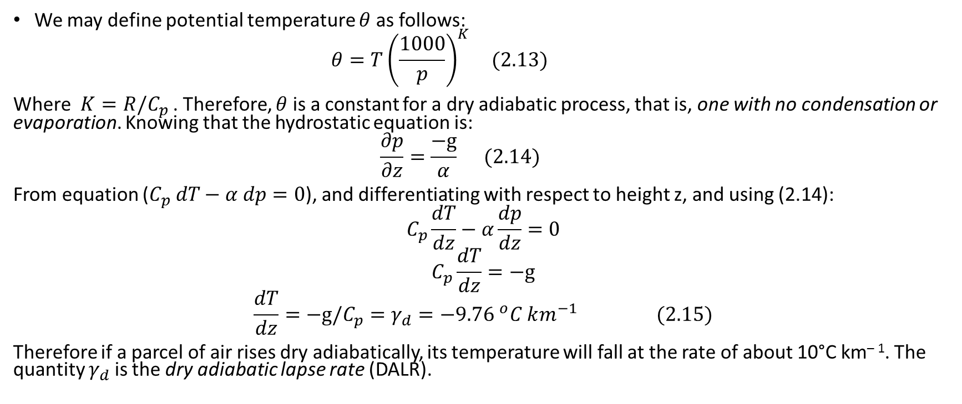
Potential temperature and DALR
We may define potential temperature $θ$ as follows:
$$θ=T{\left(\frac{1000}{p}\right)}^{K} (2.13)$$
Where $K=R/C_{p}$ . Therefore, $θ$ is a constant for a dry adiabatic process, that is, one with no condensation or evaporation. Knowing that the hydrostatic equation is:
$$\frac{∂p}{∂z}=\frac{−g}{α} (2.14)$$
From equation ($C_{p} dT−α dp=0$), and differentiating with respect to height z, and using (2.14):
$$C_{p}\frac{dT}{dz}−α\frac{dp}{dz}=0$$
$$C_{p}\frac{dT}{dz}=−g$$
$$\frac{dT}{dz}=−g/C_{p}=γ_{d}=−9.7{6 }^{o}C km^{−1} (2.15)$$
Therefore if a parcel of air rises dry adiabatically, its temperature will fall at the rate of about 10°C km^{– 1}. The quantity $γ_{d}$ is the dry adiabatic lapse rate (DALR).

Slide 5
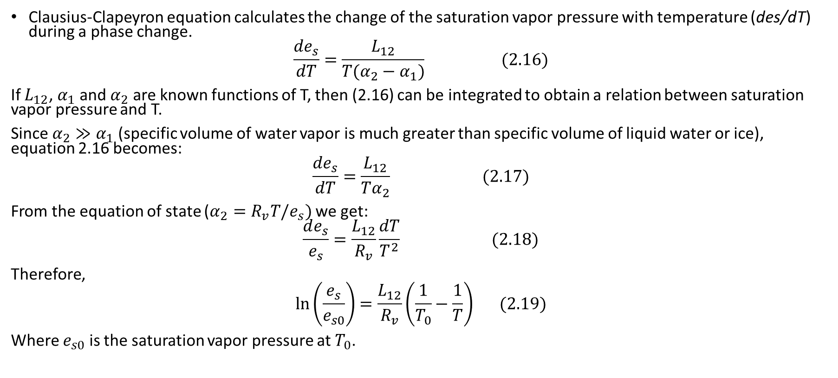
The Clausius-Clapeyron Equation
Clausius-Clapeyron equation calculates the change of the saturation vapor pressure with temperature (des/dT) during a phase change.
$$\frac{de_{s}}{dT}=\frac{L_{12}}{T(α_{2}−α_{1})} (2.16)$$
If $L_{12}$, $α_{1}$ and $α_{2}$ are known functions of T, then (2.16) can be integrated to obtain a relation between saturation vapor pressure and T.
Since $α_{2}≫α_{1}$ (specific volume of water vapor is much greater than specific volume of liquid water or ice), equation 2.16 becomes:
$$\frac{de_{s}}{dT}=\frac{L_{12}}{Tα_{2}} (2.17)$$
From the equation of state ($α_{2}=R_{v}T/e_{s})$ we get:
$$\frac{de_{s}}{e_{s}}=\frac{L_{12}}{R_{v}}\frac{dT}{T^{2}} (2.18)$$
Therefore,
$$\ln\left(\frac{e_{s}}{e_{s0}}\right)=\frac{L_{12}}{R_{v}}\left(\frac{1}{T_{0}}−\frac{1}{T}\right) (2.19)$$
Where $e_{s0}$ is the saturation vapor pressure at $T_{0}$.

Slide 6
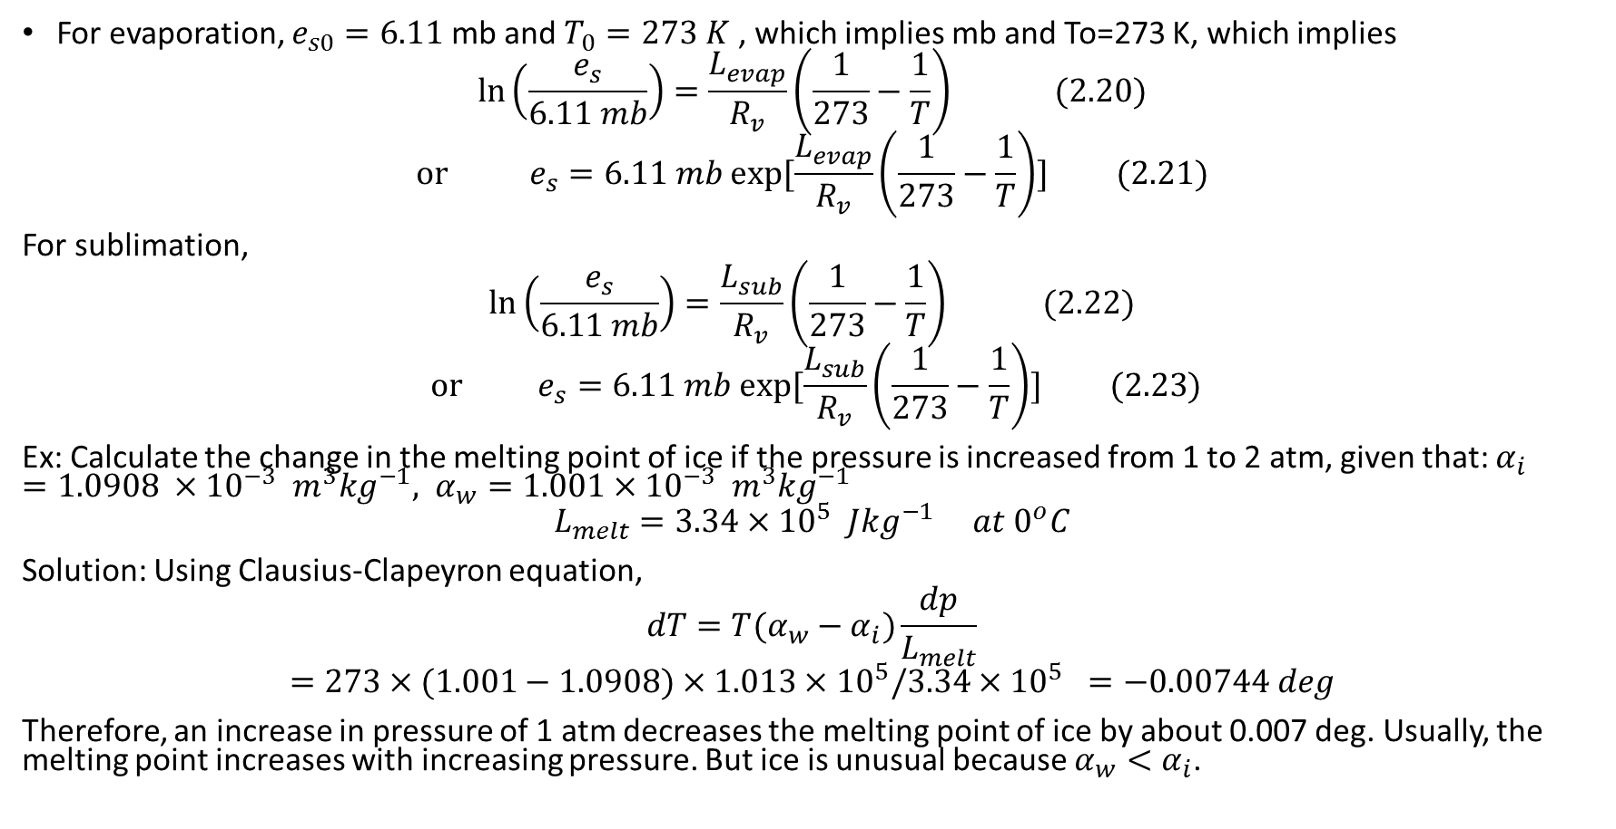
For evaporation, $e_{s0}=6.11$ mb and $T_{0}=273 K$ , which implies mb and To=273 K, which implies
$$\ln\left(\frac{e_{s}}{6.11 mb}\right)=\frac{L_{evap}}{R_{v}}\left(\frac{1}{273}−\frac{1}{T}\right) (2.20)$$
$$or e_{s}{=6.11 mb exp⁡[\frac{L_{evap}}{R_{v}}\left(\frac{1}{273}−\frac{1}{T}\right)] (2.21)}$$
For sublimation,
$$\ln\left(\frac{e_{s}}{6.11 mb}\right)=\frac{L_{sub}}{R_{v}}\left(\frac{1}{273}−\frac{1}{T}\right) (2.22)$$
$${ or e}_{s}{=6.11 mb exp⁡[\frac{L_{sub}}{R_{v}}\left(\frac{1}{273}−\frac{1}{T}\right)] (2.23)}$$
Ex: Calculate the change in the melting point of ice if the pressure is increased from 1 to 2 atm, given that: $α_{i}=1.0908 ×{10}^{−3} m^{3}{kg}^{−1}, α_{w}=1.001×{10}^{−3} m^{3}{kg}^{−1}$
$$L_{melt}=3.34×{10}^{5} J{kg}^{−1} at 0^{o}C$$
Solution: Using Clausius-Clapeyron equation,
$$dT=T(α_{w}−α_{i})\frac{dp}{L_{melt}}$$
$$=273×(1.001−1.0908)×1.013×{10}^{5}/3.34×{10}^{5} =−0.00744 deg$$
Therefore, an increase in pressure of 1 atm decreases the melting point of ice by about 0.007 deg. Usually, the melting point increases with increasing pressure. But ice is unusual because $α_{w}<α_{i}$.

Slide 7
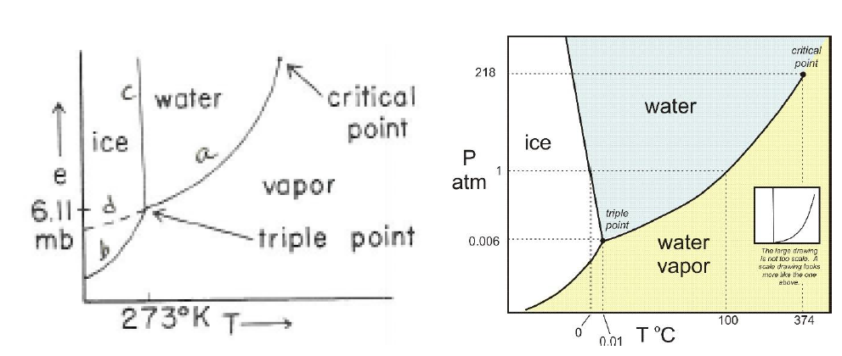
Equations (2.20) and (2.22) plus a similar equation for melting allow us to plot the curves of saturation pressure versus temperature. These curves describe the T-e relations during phase changes (e=e_{s}).

Slide 8
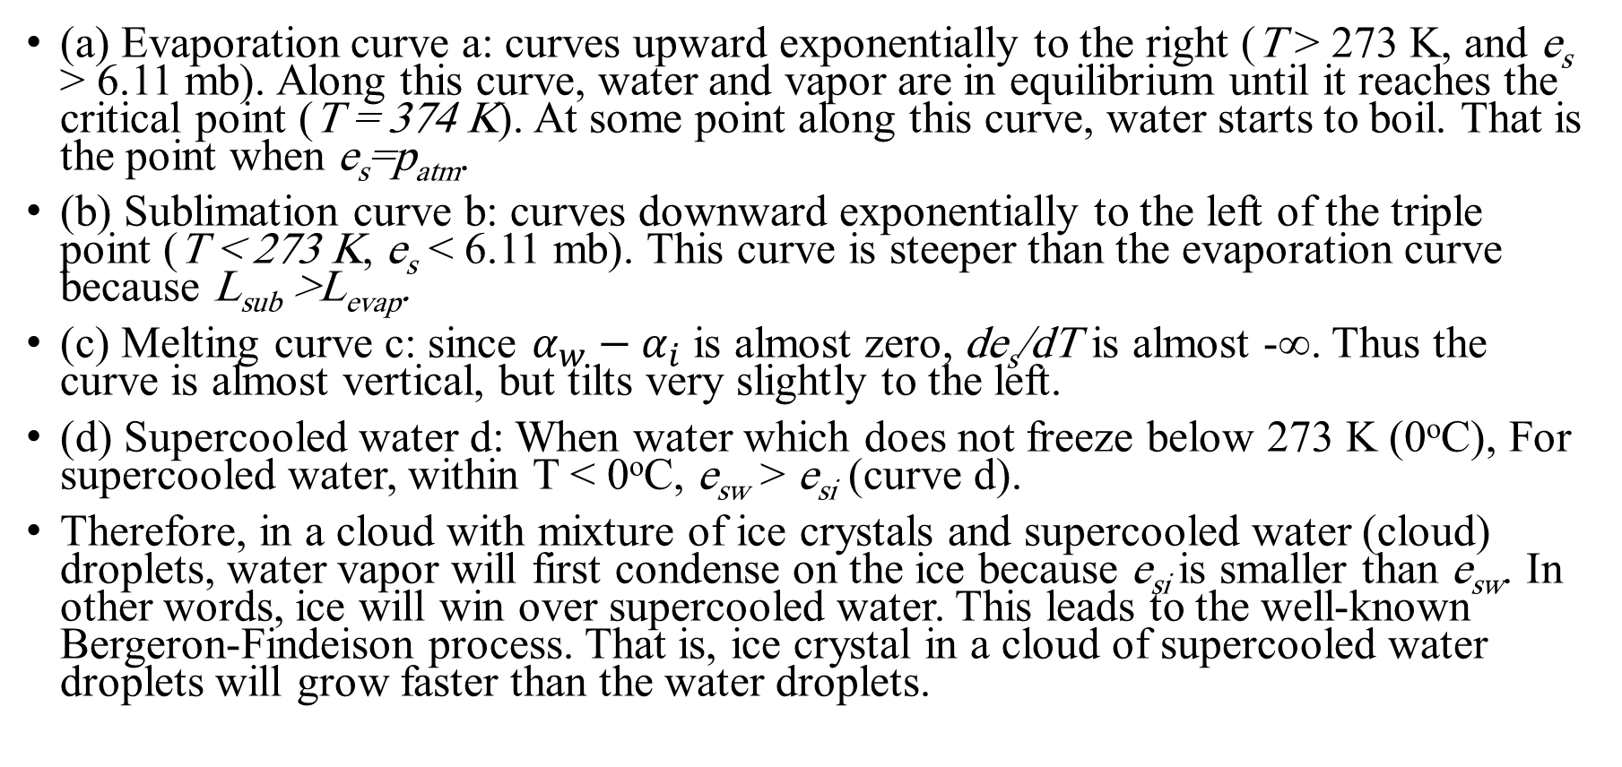
All curves begin at the triple point.
(a) Evaporation curve a: curves upward exponentially to the right (T > 273 K, and e_{s} > 6.11 mb). Along this curve, water and vapor are in equilibrium until it reaches the critical point (T = 374 K). At some point along this curve, water starts to boil. That is the point when e_{s}=p_{atm}.
(b) Sublimation curve b: curves downward exponentially to the left of the triple point (T < 273 K, e_{s} < 6.11 mb). This curve is steeper than the evaporation curve because L_{sub} >L_{evap}.
(c) Melting curve c: since $α_{w}−α_{i}$ is almost zero, de_{s}/dT is almost -∞. Thus the curve is almost vertical, but tilts very slightly to the left.
(d) Supercooled water d: When water which does not freeze below 273 K (0ºC), For supercooled water, within T < 0ºC, e_{sw} > e_{si} (curve d).
Therefore, in a cloud with mixture of ice crystals and supercooled water (cloud) droplets, water vapor will first condense on the ice because e_{si} is smaller than e_{sw}. In other words, ice will win over supercooled water. This leads to the well-known Bergeron-Findeison process. That is, ice crystal in a cloud of supercooled water droplets will grow faster than the water droplets.

Slide 9
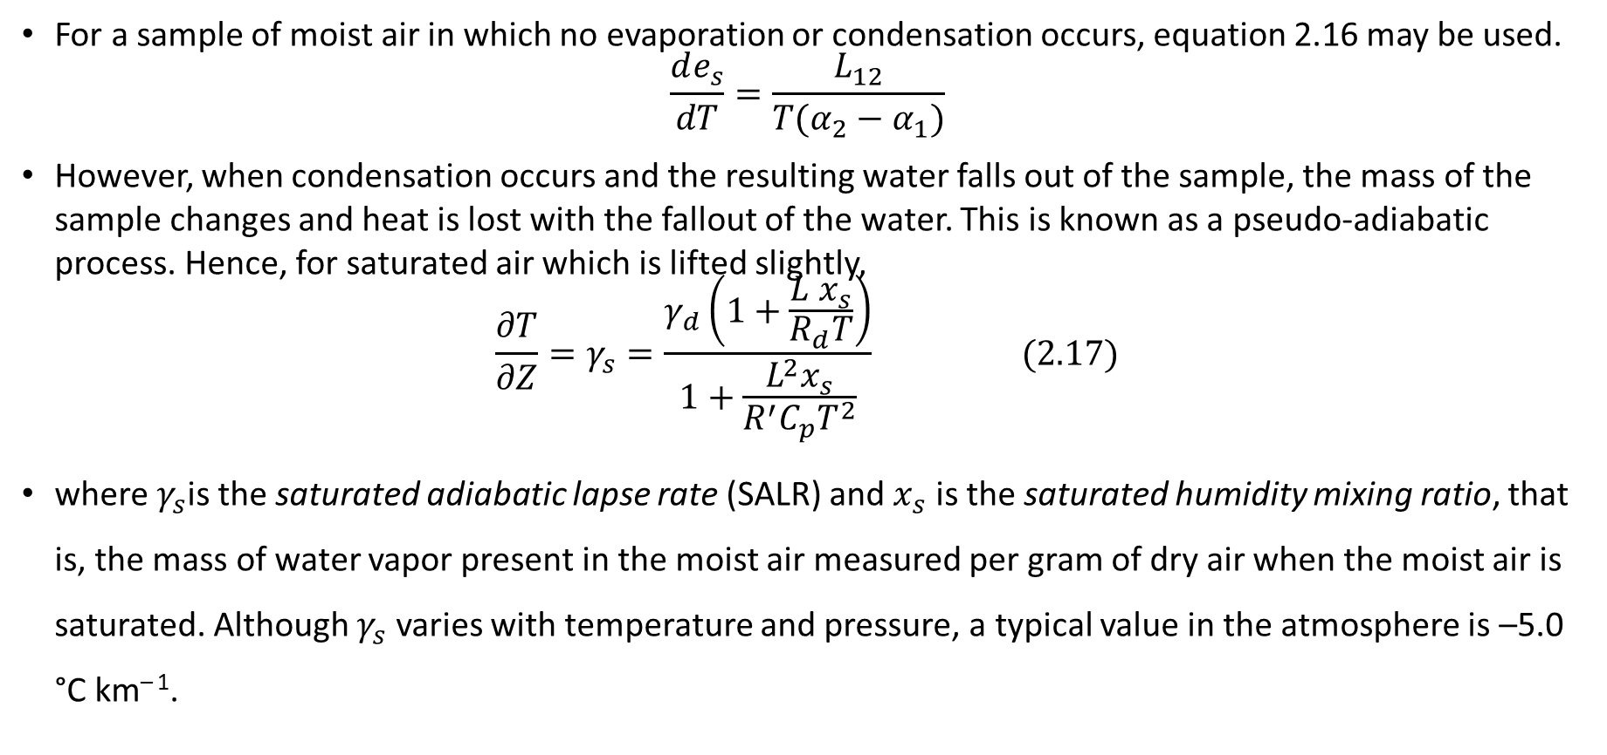
Atmospheric processes: saturated adiabatic lapse rate
For a sample of moist air in which no evaporation or condensation occurs, equation 2.16 may be used.
$$\frac{de_{s}}{dT}=\frac{L_{12}}{T(α_{2}−α_{1})}$$
However, when condensation occurs and the resulting water falls out of the sample, the mass of the sample changes and heat is lost with the fallout of the water. This is known as a pseudo‐adiabatic process. Hence, for saturated air which is lifted slightly,
$$\frac{∂T}{∂Z}=γ_{s}=\frac{γ_{d}\left(1+\frac{L x_{s}}{R_{d}T}\right)}{1+\frac{L^{2}x_{s}}{R^{′}C_{p}T^{2}}} (2.17)$$
where $γ_{s}$is the saturated adiabatic lapse rate (SALR) and $x_{s}$ is the saturated humidity mixing ratio, that is, the mass of water vapor present in the moist air measured per gram of dry air when the moist air is saturated. Although $γ_{s}$ varies with temperature and pressure, a typical value in the atmosphere is –5.0 °C km^{– 1}.

Slide 10
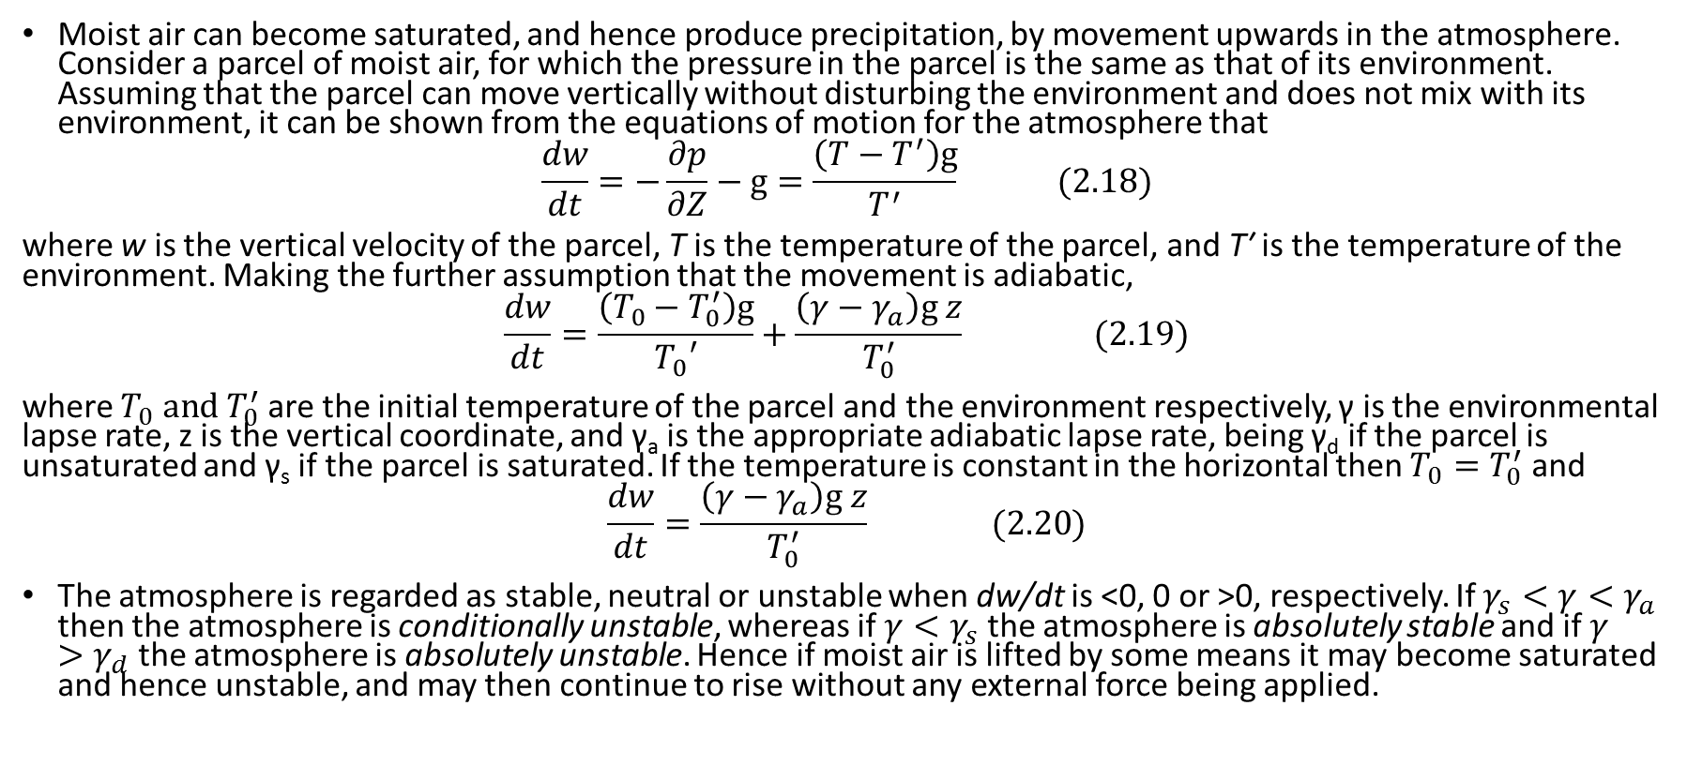
Stability and convection in the atmosphere
Moist air can become saturated, and hence produce precipitation, by movement upwards in the atmosphere. Consider a parcel of moist air, for which the pressure in the parcel is the same as that of its environment. Assuming that the parcel can move vertically without disturbing the environment and does not mix with its environment, it can be shown from the equations of motion for the atmosphere that
$$\frac{dw}{dt}=−\frac{∂p}{∂Z}−g=\frac{\left(T−T^{′}\right)g}{T^{′}} (2.18)$$
where w is the vertical velocity of the parcel, T is the temperature of the parcel, and T′ is the temperature of the environment. Making the further assumption that the movement is adiabatic,
$$\frac{dw}{dt}=\frac{\left(T_{0}−T_{0}^{′}\right)g}{T_{0}′}+\frac{\left(γ−γ_{a}\right)g z}{T_{0}^{′}} (2.19)$$
where $T_{0} and{ T}_{0}^{′}$ are the initial temperature of the parcel and the environment respectively, γ is the environmental lapse rate, z is the vertical coordinate, and γ_{a} is the appropriate adiabatic lapse rate, being γ_{d} if the parcel is unsaturated and γ_{s} if the parcel is saturated. If the temperature is constant in the horizontal then $T_{0}=T_{0}^{′}$ and
$$\frac{dw}{dt}=\frac{\left(γ−γ_{a}\right)g z}{T_{0}^{′}} (2.20)$$
The atmosphere is regarded as stable, neutral or unstable when dw/dt is <0, 0 or >0, respectively. If $γ_{s}<γ<γ_{a}$ then the atmosphere is conditionally unstable, whereas if $γ<γ_{s}$ the atmosphere is absolutely stable and if $γ>γ_{d}$ the atmosphere is absolutely unstable. Hence if moist air is lifted by some means it may become saturated and hence unstable, and may then continue to rise without any external force being applied.

Slide 11
The growth of precipitation particles and Bergeron Process
The movement of air upwards → condensation of water vapor → water droplets or ice crystals. Precipitation particles are denser than the air surrounding them → begin to fall. These particles will either evaporate in unsaturated air below the cloud, or be held suspended by vertical currents within the cloud. These will reach the ground as precipitation if they become large enough.
In order for cloud droplets to become rain drops, they have to increase in size almost a million times. Indeed, even the cloud droplet to form, complicated processes must take place.

Slide 12
Often times this process would be impossible without the presence of aerosols. Let us first examine the case without them, known as homogeneous nucleation.
Condensation will occur when the relative humidity reaches 100%, or when the vapor pressure equals the saturation vapor pressure.
In the microphysics of clouds condensation, however, pure water will condense only when levels of saturation reach upwards of 120% (20% supersaturation). The reason being that the spherical shape a water droplet forms is a very unstable structure, hence resisting formation of the droplet. It is not until these high levels of saturation are reached that the forcing will overcome this resistance known as surface tension.
The process known as heterogeneous nucleation involves "polluting" the pure water with aerosols, or CCN. By adding CCN, water is allowed to condense with much lower values of supersaturation.

Slide 13
How the cloud droplets can grow to the size of a raindrop?
One such way is through collision and coalescence. Cloud droplets will be carried by air currents within the cloud, and collide with each other.
If they collide then stick together → coalescence. Although this process is important, especially in the tropics and in increasing the size of raindrops, it is not the primary mechanism for the formation of raindrops. The process needed was the Bergeron process relies primarily on the fact that the saturation vapor pressure with respect to ice is less than the saturation vapor pressure with respect to water.

Slide 14
Because of surface tension and the structure of water, to get a pure water droplet to freeze requires a temperature of -40°C.
The freezing nuclei, in contrast to CCN, are not plentiful in the atmosphere because there structure must be similar to the structure of an ice crystal. Most of the naturally occurring freezing nuclei "activate" at about -10°C. These freezing nuclei allow for the cloud droplets to freeze around them.
Because of the relative sparseness of the freezing nuclei, ice crystals and supercooled water droplets can coexist at the same time.

Slide 15
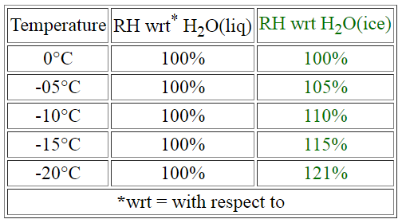
The following chart illustrates the differences in saturation vapor pressures of water.
Note that since RH= e/e_{s}, if e_{s} is made smaller, RH increases.

Slide 16
The Bergeron process can be summarized as such: The air reaches saturation and some of the resulting droplets will come in contact with freezing nuclei.
There have a combination of ice crystals and supercooled water droplets. From the perspective of the supercooled droplets, the air is in equilibrium at saturation, but from the perspective of the ice crystals, the air is supersaturated.
Therefore, water vapor will sublimate on the ice crystals. Since the amount of water vapor in the air has decreased, and from the perspective of the supercooled water droplet, the air is subsaturated, the supercooled water will evaporate until the air once again reaches saturation. The process then continues.
In short summary, the ice crystal grows through sublimation at the expense of the supercooled water droplet.

