Slide 1
Exercises

Slide 2
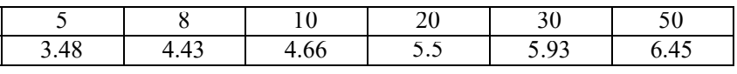
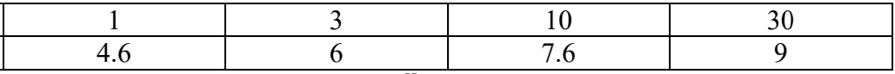
Q1)
If an orchard is planted with 1000 trees per square kilometer, where each tree is 4m tall and has a vertical cross-section area of 5 $m^{2}$ , what is the aerodynamic roughness length ?
Q2) Given the following wind speed data for a neutral surface layer , find the roughness length ( z0 ) , displacement distance (d) , friction velocity ( u* ), and the shear stress at the ground ( 𝜏) ,air density ρ=1.2 𝑘𝑔 $m^{−3}$, k= 0.4.
Z m
U m/s
Q3) if the displacement distance is zero , find z0 and u* , given the following data in Statically Neutral conditions at sunset :
Z m
U m/s

Slide 3
Q4) when we putting anemometers to measured wind speed over surface coated with grass and at two level 4m and 12m, the mean record wind speed is u(4m) =5.5m/s, u(12m) =8.5m/s. find Drag coefficient and shear stress at the level 4m. (used k= 0.4, z₀=0.065m, 𝜌 = 1.2 𝑘𝑔 𝑚3, assumed neutral condition).
Q5)
through the field measurement in the rural area and at neutral condition, wind speed at the height 5m and 10m was u (5m) =9m/s and u(10m) = 15m/s, find the roughness length of surface in (mm), at wind speed 5m, taken the eddy height l=0.5m.
Q6) through the logarithmic equation to change wind speed with height, at two level z₁ and z₂ state that:
𝑙𝑛𝑧₀ = 𝑢₂𝑙𝑛𝑧₁ −𝑢₁ ln𝑧₂ / 𝑢₂ −𝑢₁
Q7) state that when the friction velocity is constant at two levels , the friction velocity can putting in :
𝑢∗ = 𝑘 ( 𝑢(𝑧₂) − 𝑢(𝑧₁)) / ln( 𝑧₂ /𝑧₁)
Q13) through the use of logarithms wind speed at two level 𝑧₁, 𝑧₂, state that roughness length is equal to:
𝑧₀ = 𝑧₁ /( 𝑧₂ / 𝑧₁ )^{𝑥}
𝑤ℎ𝑒𝑟𝑒 𝑥 = 𝑢(𝑧₁) / 𝑢(𝑧₂) − 𝑢(𝑧₁)

Slide 4
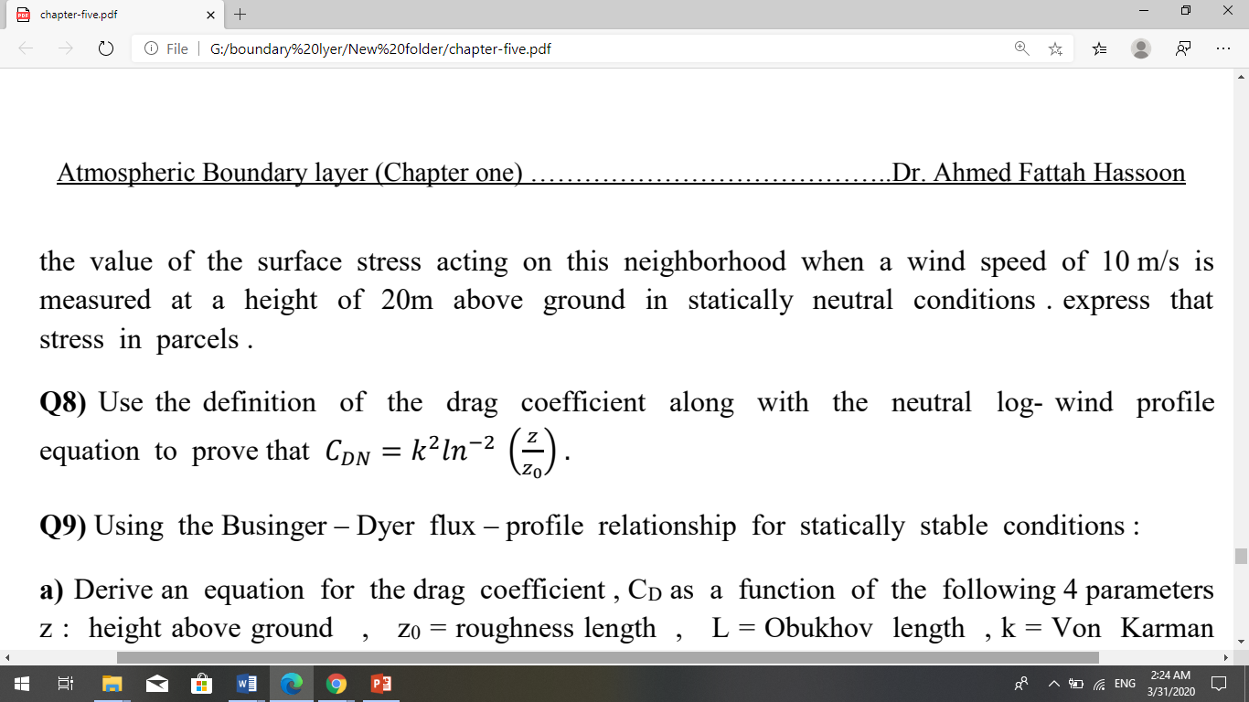
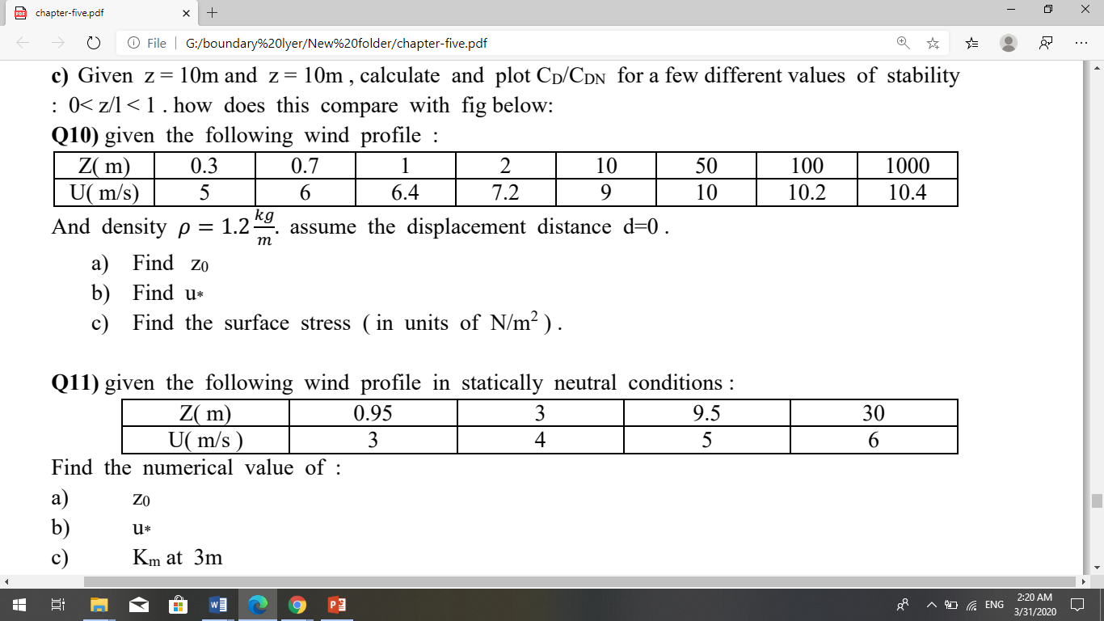
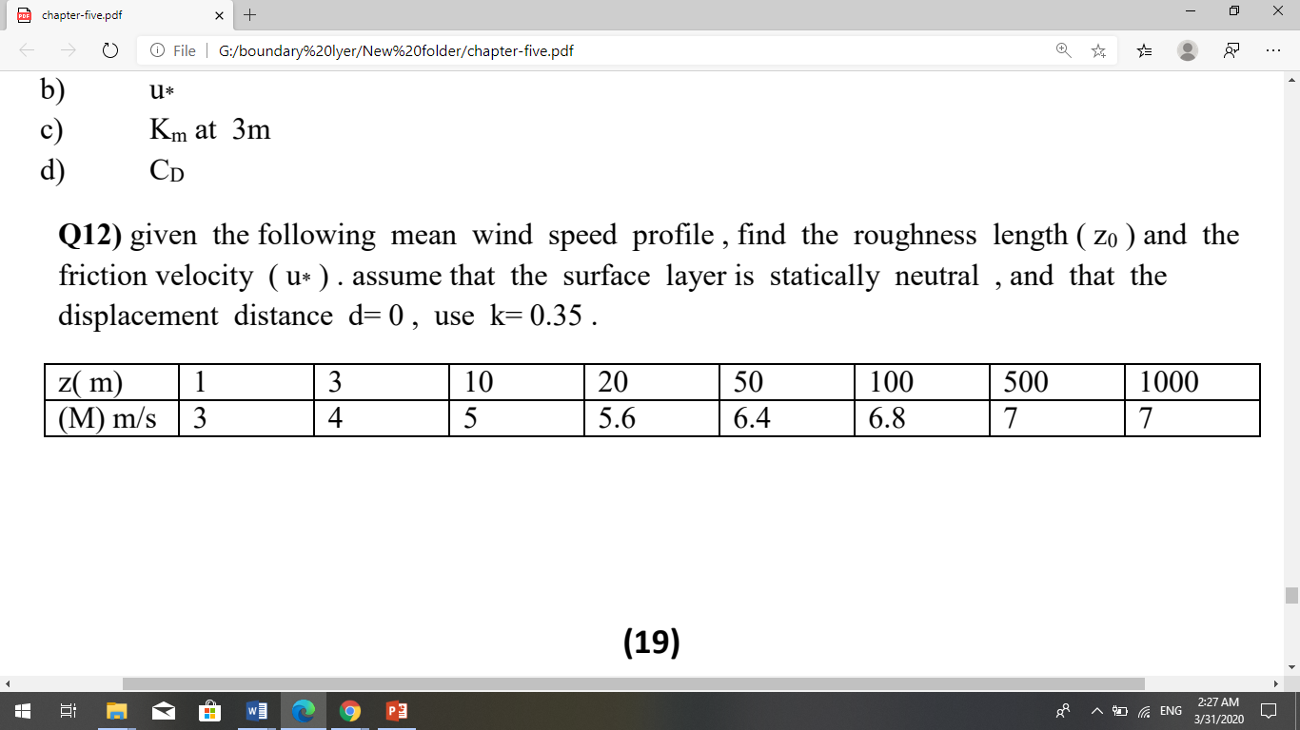

Slide 5
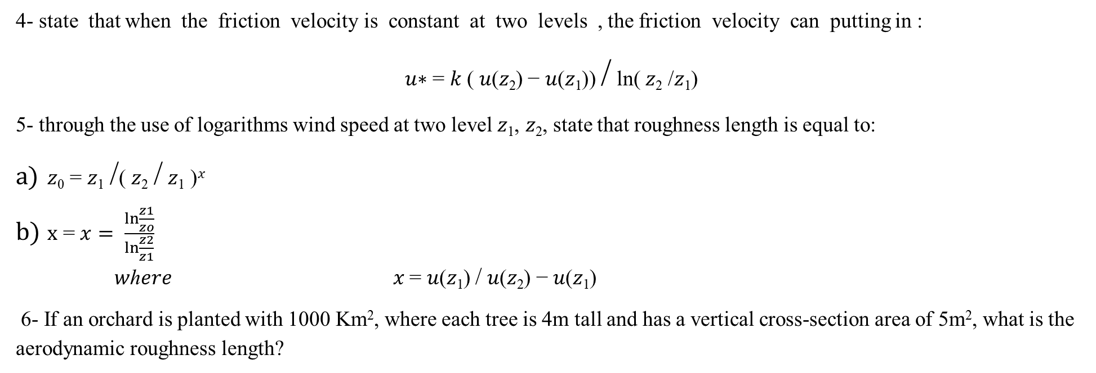
4- state that when the friction velocity is constant at two levels , the friction velocity can putting in :
𝑢∗ = 𝑘 ( 𝑢(𝑧₂) − 𝑢(𝑧₁)) / ln( 𝑧₂ /𝑧₁)
5- through the use of logarithms wind speed at two level 𝑧₁, 𝑧₂, state that roughness length is equal to:
𝑧₀ = 𝑧₁ /( 𝑧₂ / 𝑧₁ )^{𝑥}
x = $x= \frac{\ln{\frac{z1}{zo}}}{\ln{\frac{z2}{z1}}}$
𝑤ℎ𝑒𝑟𝑒 𝑥 = 𝑢(𝑧₁) / 𝑢(𝑧₂) − 𝑢(𝑧₁)
6- If an orchard is planted with 1000 Km², where each tree is 4m tall and has a vertical cross-section area of 5m², what is the aerodynamic roughness length?

Slide 7
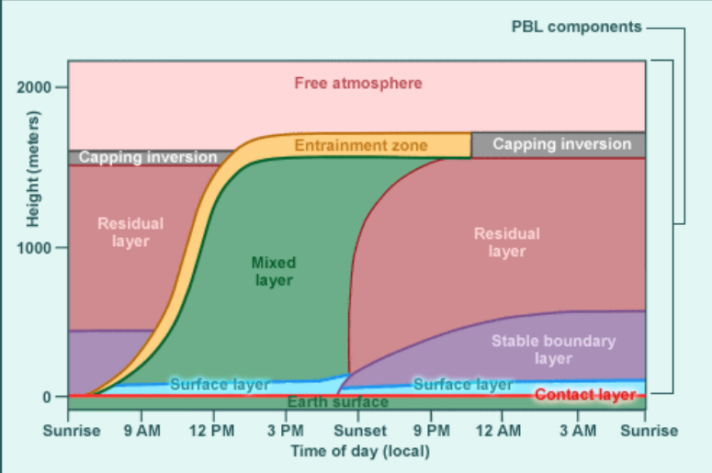

Slide 8
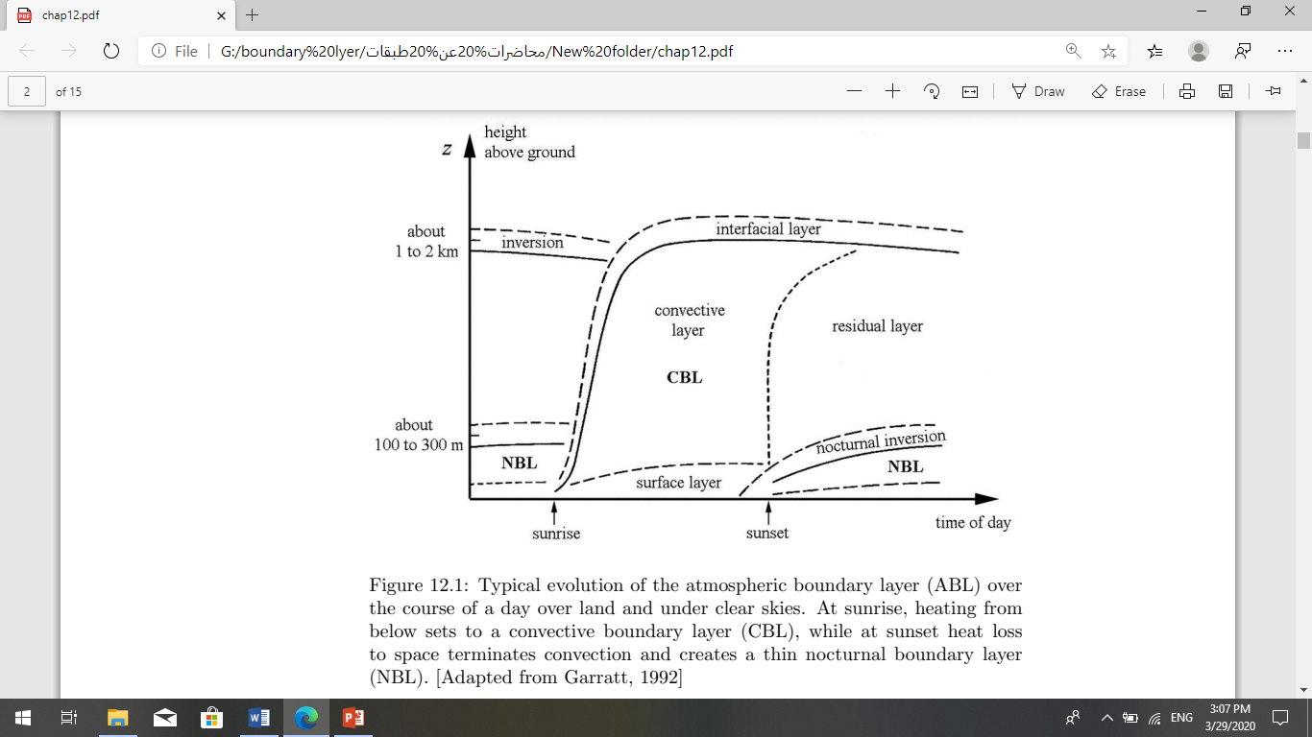

Slide 9
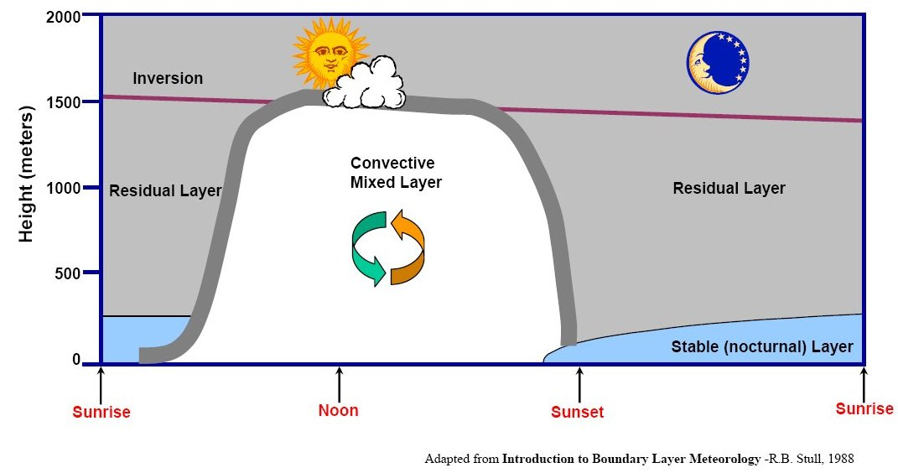

Slide 10
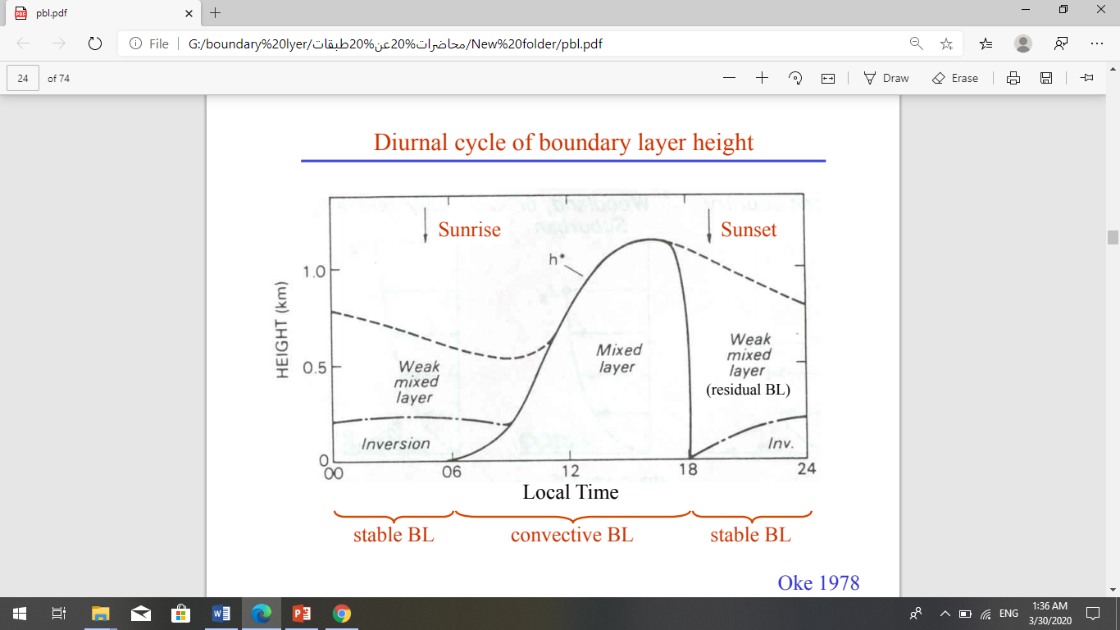

Slide 11
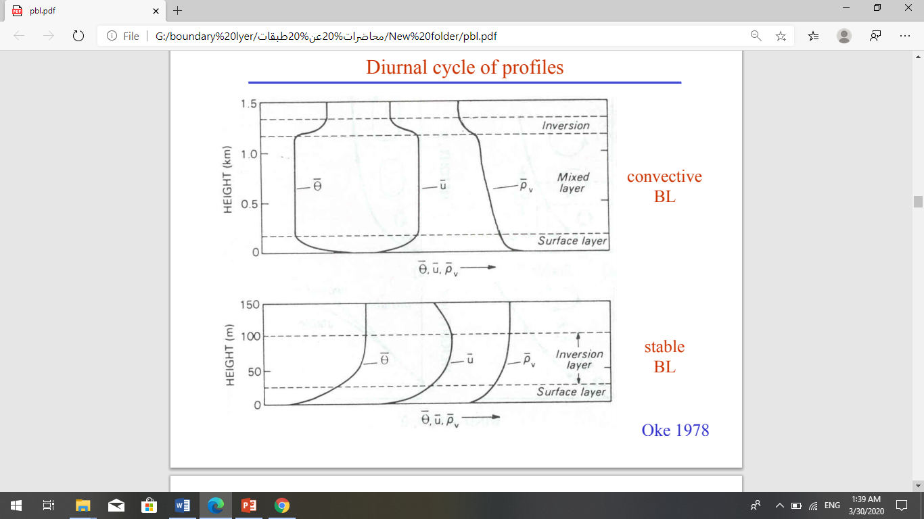

Slide 12
