Slide 1

Wind logarithm and Power law profiles
Basim Alknani

Slide 2
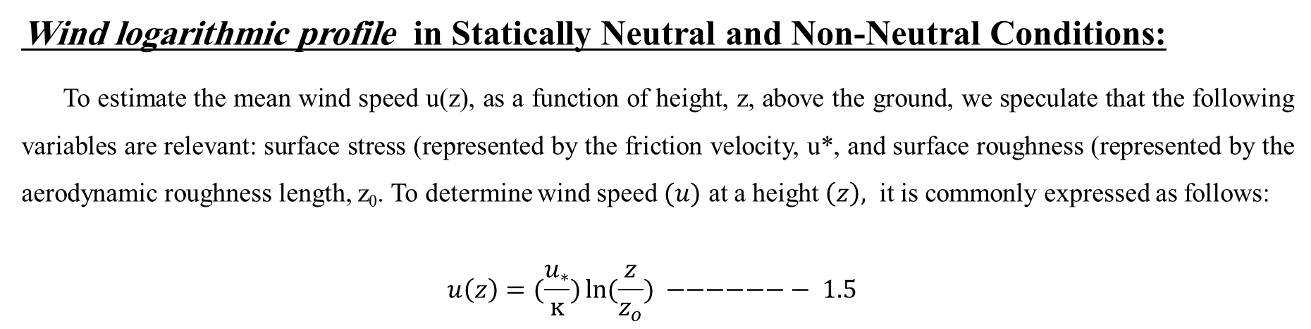
There are two mathematical models that are widely used to model the vertical profile of wind speed over regions of homogeneous and flat terrain, which are :
a- Logarithmic Law profile.
b- Power Law profile.
Wind logarithmic profile in Statically Neutral and Non-Neutral Conditions:
To estimate the mean wind speed u(z), as a function of height, z, above the ground, we speculate that the following variables are relevant: surface stress (represented by the friction velocity, u*, and surface roughness (represented by the aerodynamic roughness length, z₀. To determine wind speed $(u)$ at a height $\left(z\right),$ it is commonly expressed as follows:
$$u\left(z\right)=(\frac{u_{∗}}{ĸ})\ln{(\frac{z}{z_{o}}}) −−−−−−− 1.5$$

Slide 3
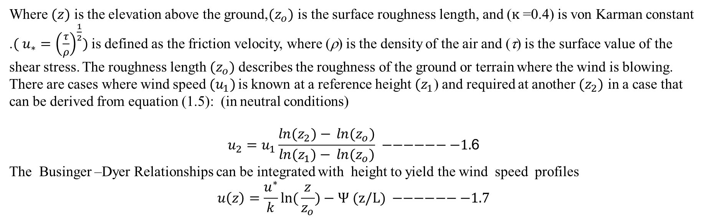
Where $(z)$ is the elevation above the ground,${(z}_{o})$ is the surface roughness length, and ($ĸ$ =0.4) is von Karman constant .$( u_{∗}={\left(\left.\frac{τ}{ρ}\right)\right.}^{\frac{1}{2}})$ is defined as the friction velocity, where (ρ) is the density of the air and (τ) is the surface value of the shear stress. The roughness length${(z}_{o})$ describes the roughness of the ground or terrain where the wind is blowing. There are cases where wind speed $(u_{1})$ is known at a reference height${(z}_{1}$) and required at another ${(z}_{2})$ in a case that can be derived from equation (1.5): (in neutral conditions)
$$u_{2}=u_{1}\frac{\ln{{(z}_{2})−} \ln{{(z}_{o})}}{\ln{{(z}_{1})−} \ln{{(z}_{o})}} −−−−−−−1.\text{6}$$
The Businger –Dyer Relationships can be integrated with height to yield the wind speed profiles
$$u\left(z\right)=\frac{u^{∗}}{k}ln({\frac{z}{z_{o}}})−Ψ (z/L) −−−−−−−1.7$$
Where (L) is the Obukhov length and the function Ψ (𝑧/𝐿) is given for stable conditions (z/L > 0) by :
Ψ (𝑧/𝐿) = 4.7 (𝑧/ 𝐿) …………………….…………… 1.8
And for unstable (z/L < 0) by:
Ψ (𝑧/𝐿) = −2ln[(1+𝑥)/ 2] −ln[(1+𝑥²)/ 2] +2𝑡𝑎𝑛⁻¹(𝑥)-𝜋 /2………………. 1.9
Where 𝑥 = [1− (15 𝑧/𝐿)]^{1/4}.

Slide 4
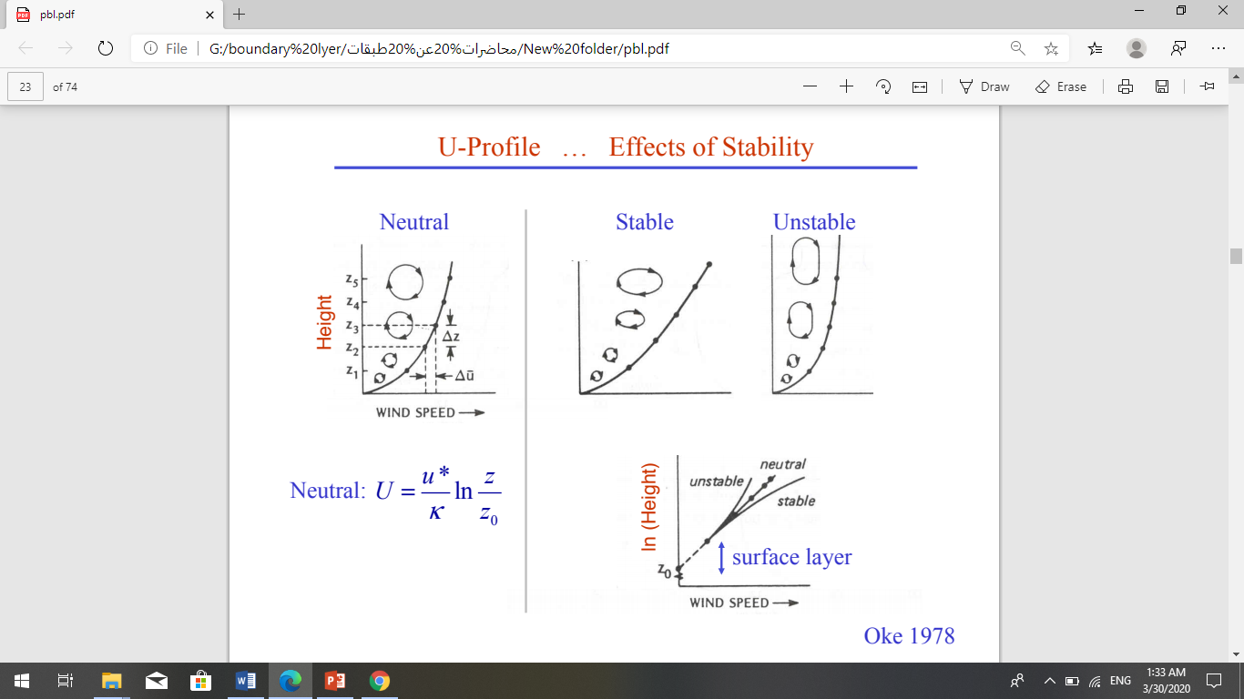

Slide 5
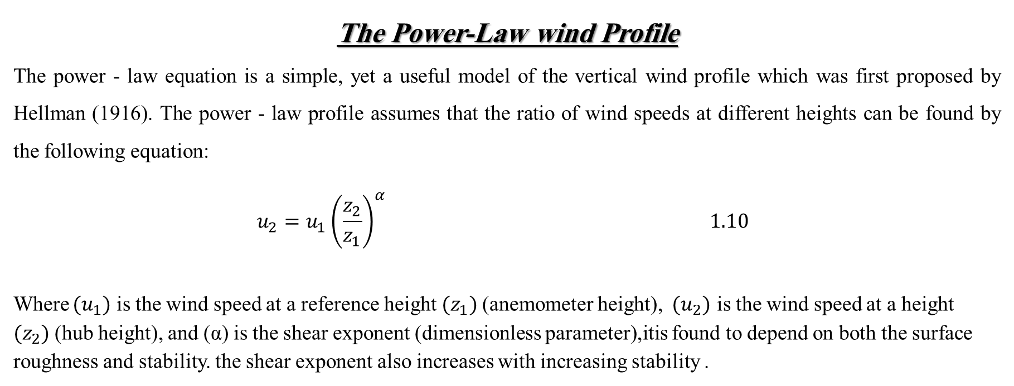
The Power-Law wind Profile
The power - law equation is a simple, yet a useful model of the vertical wind profile which was first proposed by Hellman (1916). The power - law profile assumes that the ratio of wind speeds at different heights can be found by the following equation:
$$u_{2}=u_{1}{\left(\left.\frac{z_{2}}{z_{1}}\right)\right.}^{α} 1.10$$
Where ${(u}_{1})$ is the wind speed at a reference height ${(z}_{1})$(anemometer height), ${(u}_{2})$ is the wind speed at a height ${(z}_{2})$(hub height), and (α) is the shear exponent (dimensionless parameter),itis found to depend on both the surface roughness and stability. the shear exponent also increases with increasing stability .

Slide 6
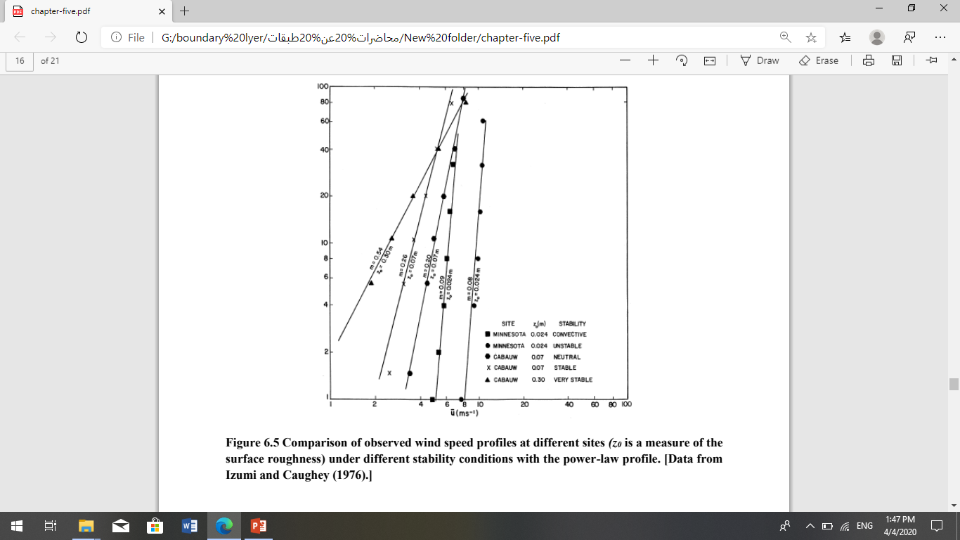

Slide 8
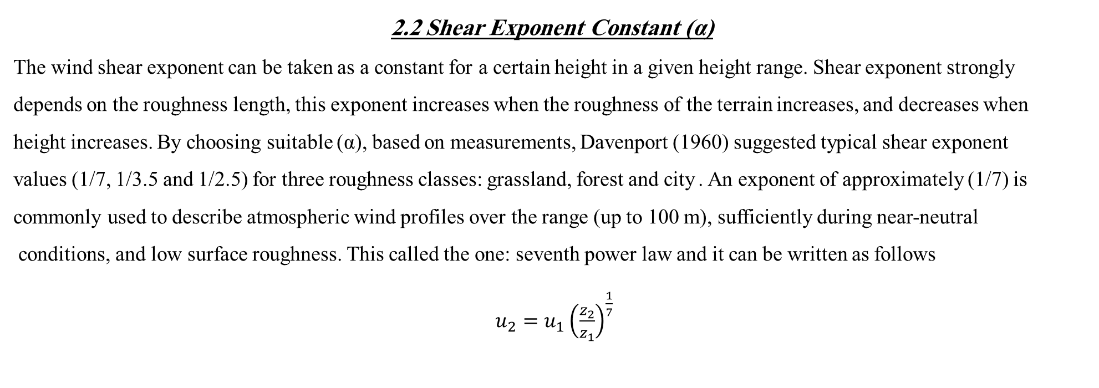
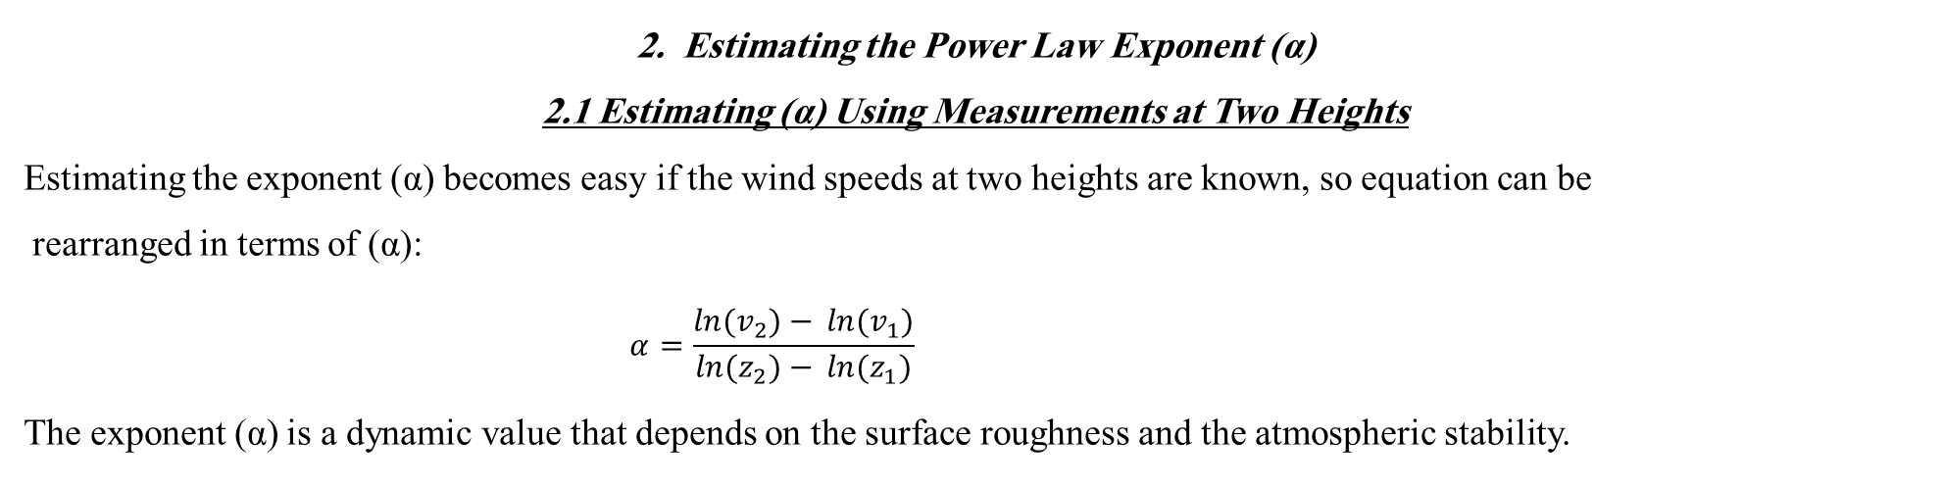
2. Estimating the Power Law Exponent (α)
2.1 Estimating (α) Using Measurements at Two Heights
Estimating the exponent (α) becomes easy if the wind speeds at two heights are known, so equation can be
rearranged in terms of (α):
$$α=\frac{\ln{{(v}_{2})−} \ln{{(v}_{1})}}{\ln{{(z}_{2})−} \ln{{(z}_{1})}}$$
The exponent (α) is a dynamic value that depends on the surface roughness and the atmospheric stability.
2.2 Shear Exponent Constant (α)
The wind shear exponent can be taken as a constant for a certain height in a given height range. Shear exponent strongly
depends on the roughness length, this exponent increases when the roughness of the terrain increases, and decreases when
height increases. By choosing suitable (α), based on measurements, Davenport (1960) suggested typical shear exponent
values (1/7, 1/3.5 and 1/2.5) for three roughness classes: grassland, forest and city . An exponent of approximately (1/7) is
commonly used to describe atmospheric wind profiles over the range (up to 100 m), sufficiently during near-neutral
conditions, and low surface roughness. This called the one: seventh power law and it can be written as follows
$u_{2}=u_{1}{\left(\left.\frac{z_{2}}{z_{1}}\right)\right.}^{\frac{1}{7}}$

Slide 9
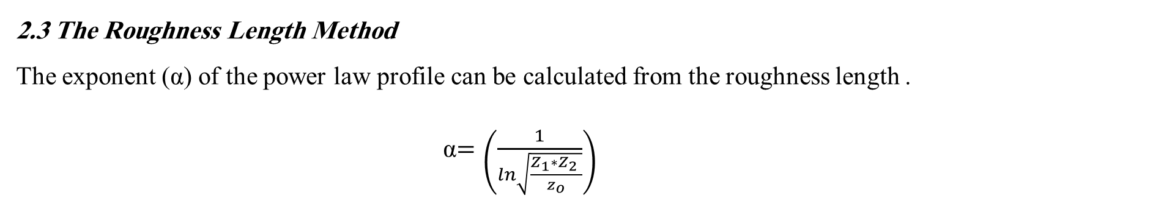
2.3 The Roughness Length Method
The exponent (α) of the power law profile can be calculated from the roughness length .
α$=\left(\frac{1}{ln\sqrt{\frac{Z_{1}∗{Z_{2}}_{ }}{z_{o}}}}\right)$
There is another method used to estimate the shear exponent, which is:

Slide 10
HOMEWORK 1
Q1 ) write a mathematical expression of the following:
1- Wind speed logarithmic equation in stable conditions.
2- Wind speed logarithmic equation in unstable conditions.
3- Wind speed logarithmic equation in neutral conditions.
4- power-law equation for wind profile

Slide 11
HOMEWORK 2
Q2 ) write a mathematical expression of the following:
1- The aerodynamic roughness length equation when the roughness elements are evenly spaced.
2- The aerodynamic roughness length equation which uses in an urban city
3- Displacement distance equation .
4- Friction velocity equation .
5- 𝑑𝑟𝑎𝑔 𝑐𝑜𝑒𝑓𝑓𝑖𝑐𝑖𝑒𝑛𝑡 equation .

